Slide 1
Chapter 4
Area Filling Techniques
&
Character Generation

Slide 2
Topics to be covered
Area Filling Techniques
Character Generation

Slide 3
Area Filling Techniques
Area or Region filling is the process of “Colouring in” a definite / enclosed area or region defined by a closed polygon.
A region may be described at various levels
  Pixel Level
    Boundary Defined Region
    Interior Defined Region
  Geometric Level
30 January 2013
Computer Graphics

Slide 4
Region/Area Specification
1. Pixel Level
  A region is defined in terms of pixels that are stored in the display memory.
  Two type of descriptions
      Boundary Defined Region
      Interior Defined Region
30 January 2013
Computer Graphics

Slide 5
Region/Area Specification
  Boundary Defined Region: A region is defined in terms of bounding pixels that outline it.
  Interior Defined Region: A region is defined in terms of totality of pixels that comprise it.
Boundary Defined
Interior Defined
30 January 2013
Computer Graphics

Slide 6
Region/Area Specification
  To fill the area defined by pixels we use seed fill algorithms
  We start from a given interior position (called seed) and paint outward from this point until the specified closed region is completely coloured.
30 January 2013
Computer Graphics

Slide 7
Region/Area Specification
2. Geometric Level
  A region is defined in terms of objects such as lines, polygons, circles etc.
  To fill the area we use Scan fill algorithms i.e. we determine overlap Intervals for scan lines that cross that area.
30 January 2013
Computer Graphics

Slide 8
Area Filling Techniques
Various area filling techniques are
Area Filling
Techniques
Seed Fill Algorithms
(Pixel Level)
Scan Fill Algorithms
(Geometric Level)
Boundary Fill Algorithm
(Bounding Pixel)
Flood Fill Algorithm
(Interior Pixel)
Horizontal Pixel-Span Algo
(Bounding Pixel)
30 January 2013
Computer Graphics

Slide 9
Area Filling Algorithms
Seed Fill Algorithm
  Flood Fill Algorithm
  Boundary Fill Algorithm
  Horizontal Pixel Span Algorithm
Scan Fill Algorithms
30 January 2013
Computer Graphics

Slide 10
Seed Fill Algorithms
Basic idea
  Start at a pixel interior to a polygon
  Fill the others using connectivity
  Used in interactive packages where interior point can be selected easily with a click and color to be filled from menu.
seed
30 January 2013
Computer Graphics

Slide 11
Seed Fill Algorithms
OR
4-connected
8-connected
Why?
Develop recursive algorithms
Need a stack.
30 January 2013
Computer Graphics

Slide 12
Seed Fill Algorithms
Start Position
30 January 2013
Computer Graphics

Slide 13
Seed Fill Algorithms
7
7
6
6
5
5
4
4
3
Hole
3
2
2
1
1
0 1 2 3 4 5 6 7 8 9
0 1 2 3 4 5 6 7 8 9
Boundary pixel
Interior pixel
Seed pixel
The stack may contain duplicated or unnecessary information !!!
30 January 2013
Computer Graphics

Slide 14
Seed Fill Algorithms
8
8
6
6
4
4
2
2
0 2 4 6 8 10
0 2 4 6 8 10
Interior-defined
boundary-defined
flood fill algorithm
boundary fill algorithm
hori pixel span algorithm
30 January 2013
Computer Graphics

Slide 15
Area Filling Algorithms
Seed Fill Algorithm
  Flood Fill Algorithm
  Boundary Fill Algorithm
  Horizontal Pixel Span Algorithm
Scan Fill Algorithms
30 January 2013
Computer Graphics

Slide 16
Flood Fill Algorithm
1. Basic Concept
  Region defined in terms of totality of pixels that comprise it and have same color.
  Start with seed, paint outwards until all the pixels belonging to the object (having same color) are painted
  Used in interactive graphic packages
  Input: Seed, fill color and object color
  Uses 4 or 8-point connectivity
  Object color should be unique
30 January 2013
Computer Graphics

Slide 17
Flood Fill Algorithm
2. Algorithm using 4-point connectivity
Void flood_fill4(x,y,oldcolor, newcolor)
{
if (getpixel(x,y) = = oldcolor)
{
setpixel(x,y,newcolor);
flood_fill4(x+1,y,oldcolor, newcolor);
flood_fill4(x-1,y, oldcolor, newcolor);
flood_fill4(x,y+1, oldcolor, newcolor);
flood_fill4(x,y-1, oldcolor, newcolor);
}
}
30 January 2013
Computer Graphics

Slide 18
Flood Fill Algorithm
3. Algorithm using 8-point connectivity
Void flood_fill8(x,y,oldcolor, newcolor)
{
if (getpixel(x,y) = = oldcolor)
{ setpixel(x,y,newcolor);
boundary_fill8(x,y+1, oldcolor, newcolor);
boundary_fill8(x,y-1, oldcolor, newcolor);
boundary_fill8(x+1,y, oldcolor, newcolor);
boundary_fill8(x-1,y, oldcolor, newcolor);
boundary_fill8(x+1,y+1, oldcolor, newcolor);
boundary_fill8(x+1,y-1, oldcolor, newcolor);
boundary_fill8(x-1,y+1, oldcolor, newcolor);
boundary_fill8(x-1,y-1, oldcolor, newcolor);
}
}
30 January 2013
Computer Graphics

Slide 19
Area Filling Algorithms
Seed Fill Algorithm
  Flood Fill Algorithm
  Boundary Fill Algorithm
  Horizontal Pixel Span Algorithm
Scan Fill Algorithms
30 January 2013
Computer Graphics

Slide 20
Boundary Fill Algorithm
1. Basic Concept
  Region defined in terms of bounding pixels having unique color
  Start with seed, paint outwards until boundary color is encountered
  Used in interactive graphic packages
  Input: Seed, fill color and boundary color
  Uses 4 or 8-point connectivity
  Boundary Color should be unique
30 January 2013
Computer Graphics

Slide 21
Boundary Fill Algorithm
2. Algorithm using 4-point connectivity
Void boundary_fill4(x,y,fill,boundary)
{
int current;
current = getpixel(x,y);
if (current != boundary) and (current != fill)
{
setpixel(x,y,fill);
boundary_fill4(x+1,y,fill,boundary);
boundary_fill4(x-1,y,fill,boundary);
boundary_fill4(x,y+1,fill,boundary);
boundary_fill4(x,y-1,fill,boundary);
}
}
30 January 2013
Computer Graphics

Slide 22
Boundary Fill Algorithm
3. Algorithm using 8-point connectivity
Void boundary_fill8(x,y,fill,boundary)
{
int current;
current = getpixel(x,y);
if (current != boundary) and (current != fill)
{ setpixel(x,y,fill);
boundary_fill8(x,y+1, fill, boundary);
boundary_fill8(x,y-1, fill, boundary);
boundary_fill8(x+1,y, fill, boundary);
boundary_fill8(x-1,y, fill, boundary);
boundary_fill8(x+1,y+1, fill, boundary);
boundary_fill8(x+1,y-1, fill, boundary);
boundary_fill8(x-1,y+1, fill, boundary);
boundary_fill8(x-1,y-1, fill, boundary);
}
}
Too much overlapping
30 January 2013
Computer Graphics

Slide 23
Area Filling Algorithms
Seed Fill Algorithm
  Flood Fill Algorithm
  Boundary Fill Algorithm
  Horizontal Pixel Span Algorithm
Scan Fill Algorithms
30 January 2013
Computer Graphics

Slide 24
Horizontal Pixel Span Algorithm
1. Basic Concept
  Recursion using connectedness use stack that may contain duplicated or unnecessary information !!!
  Instead of stacking all unprocessed neighbors, stack only beginning position for each horizontal pixel span.
  Start from seed span horizontally, stacking upper and lower scan positions.
  At each step un-stack the next start position and repeat the process.
  Also called scan line seed fill algorithm
30 January 2013
Computer Graphics

Slide 25
Horizontal Pixel Span Algorithm
2. Example:
5
6
3
4
2
1
6
5
2
3
4
1
30 January 2013
Computer Graphics

Slide 26
Horizontal Pixel Span Algorithm
10
10
8
1
8
1
Boundary pixel
6
2
3
6
2
3
Filled pixel
4
4
2
2
Original seed pixel
0 2 4 6 8 10 12
0 2 4 6 8 10 12
10
10
10
8
1
8
1
8
1
6
2
6
2
6
2
4
3
4
4
3
3
2
2
2
4
5
0 2 4 6 8 10 12
0 2 4 6 8 10 12
0 2 4 6 8 10 12
30 January 2013
Computer Graphics

Slide 27
Horizontal Pixel Span Algorithm
3. Implementation Notes
30 January 2013
Computer Graphics

Slide 28
Horizontal Pixel Span Algorithm
Scan Line
conversion
Seed
filling
+
Shani, U., “Filling Regions in Binary Raster Images:
A Graph-Theoretic Approach”, Computer Graphics,
14, (1981), 321-327
Can you apply it to interior defined regions?
30 January 2013
Computer Graphics

Slide 29
Area Filling Algorithms
Seed Fill Algorithm
  Flood Fill Algorithm
  Boundary Fill Algorithm
  Horizontal Pixel Span Algorithm
Scan Fill Algorithms
30 January 2013
Computer Graphics

Slide 30
Scan Line Polygon Fill Algorithm
1. Basic Concept
For each scan line crossing a polygon are then sorted from left to right, and the corresponding frame buffer positions between each intersection pair are set to the specified color.
10 14 18 24
Interior pixels along a scan line passing through a polygon area
30 January 2013
Computer Graphics

Slide 31
Scan Line Polygon Fill Algorithm
These intersection points are then sorted from left to right , and the corresponding frame buffer positions between each intersection pair are set to specified color
In the given example, four pixel intersections define stretches from x=10 to x=14 and x=18 to x=24
10 14 18 24
Interior pixels along a scan line passing through a polygon area
30 January 2013
Computer Graphics

Slide 32
Scan Line Polygon Fill Algorithm
  For convex polygons.
    Determine the intersection positions of the boundaries of the fill region with the screen scan lines.
A
B
y
F
C
E
D
30 January 2013
Computer Graphics

Slide 33
Scan Line Polygon Fill Algorithm
  For convex polygons.
    Pixel positions between pairs of intersections between scan line and edges are filled with color, including the intersection pixels.
A
B
y
F
C
E
D
30 January 2013
Computer Graphics

Slide 34
Scan Line Polygon Fill Algorithm
  For concave polygons.
    Scan line may intersect more than once:
      Intersects an even number of edges
      Even number of intersection vertices yields to pairs of intersections, which can be filled as previously
A
C
B
y
D
G
F
E
30 January 2013
Computer Graphics

Slide 35
Scan Line Polygon Fill Algorithm
  For concave polygons.
    Scan line may intersect more than once:
      Intersects an even number of edges
      Even number of intersection vertices yields to pairs of intersections, which can be filled as previously
A
C
B
D
y
G
F
E
30 January 2013
Computer Graphics

Slide 36
Scan Line Polygon Fill Algorithm
  For concave polygons.
    Scan line may intersect more than once:
      Intersects an odd number of edges
      Not all pairs are interior: (3,4) is not interior.
A
C
B
y
1
2
3
4
5
G
D
F
E
30 January 2013
Computer Graphics

Slide 37
Scan Line Polygon Fill Algorithm
  For concave polygons.
    Generate 2 intersections when at a local minimum, else generate only one intersection.
    Algorithm to determine whether to generate one intersection or 2 intersections.
      If the y-coordinate is monotonically increasing or decreasing, decrease the number of vertices by shortening the edge.
      If it is not monotonically increasing or decreasing, leave the number of vertices as it is.
30 January 2013
Computer Graphics

Slide 38
Scan Line Polygon Fill Algorithm
scan line
y+1
y
y-1
y decreasing:
decrease by 1
y increasing:
decrease by 1
The y-coordinate of the upper
endpoint of the current edge
is decreased by 1.
The y-coordinate of the upper
endpoint of the next edge
is decreased by 1.
30 January 2013
Computer Graphics

Slide 39
Scan Line Polygon Fill Algorithm
  Some scan-Line intersections at polygon vertices require special handling:
    A scan Line passing through a vertex intersects two polygon edges at that position, adding two points to the list of intersections for the scan Line
    In the given example , scan Line y intersects five polygon edges and the scan Line y’ intersects 4 edges although it also passes through a vertex
    y’ correctly identifies internal pixel spans ,but need some extra processing
30 January 2013
Computer Graphics

Slide 40
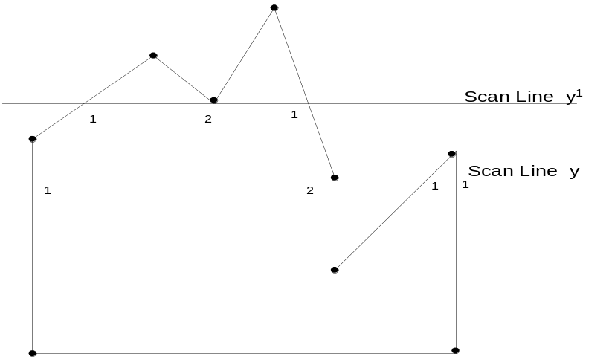
Scan Line Polygon Fill Algorithm
Figure 3-36
Intersection points along the scan lines that intersect polygon vertices. Scan line y generates an odd number of intersections, but scan line y generates an even number of intersections that can be paired to identify correctly the interior pixel spans.
30 January 2013
Computer Graphics

Slide 41
Scan line Polygon Fill Algorithm
  One way to resolve this is also to shorten some polygon edges to split those vertices that should be counted as one intersection
  When the end point y coordinates of the two edges are increasing , the y value of the upper endpoint for the current edge is decreased by 1
  When the endpoint y values are monotonically decreasing, we decrease the y coordinate of the upper endpoint of the edge following the current edge
30 January 2013
Computer Graphics

Slide 42
Scan Line Polygon Fill Algorithm
(a)
(b)
Adjusting endpoint values for a polygon, as we process edges in order around the polygon perimeter. The edge currently being processed is indicated as a solid like. In (a), the y coordinate of the upper endpoint of the current edge is decreased by 1. In (b), the y coordinate of the upper end point of the next edge is decreased by 1
30 January 2013
Computer Graphics

Slide 43
Scan Line Polygon Fill Algorithm
The topological difference between scan Line y and y’
  For Scan line y, the two intersecting edges sharing a vertex are on opposite sides of the scan line …!
  But for scan line y’, the two intersecting edges are both above the scan line
  Thus, the vertices that require additional processing are those that have connecting edges on opposite sides of scan line.
  We can identify these vertices by tracing around the polygon boundary either in clock-wise or anti-clockwise order and observing the relative changes in vertex y coordinates as we move from one edge to the next.
  If the endpoint y values of two consecutive edges monotonically increase or decrease, we need to count the middle vertex as a single intersection point for any scan line passing through that vertex.
30 January 2013
Computer Graphics

Slide 44
Scan Line Polygon Fill Algorithm
Otherwise, the shared vertex represents a local extreme (min. or max.) on the polygon boundary, and the two edge intersections with the scan line passing through that vertex can be added to the intersection list
Figure 3-36
Intersection points along the scan lines that intersect polygon vertices. Scan line y’ generates an odd number of intersections, but scan line y generates an even number of intersections that can be paired to identify correctly the interior pixel spans.
30 January 2013
Computer Graphics

Slide 45
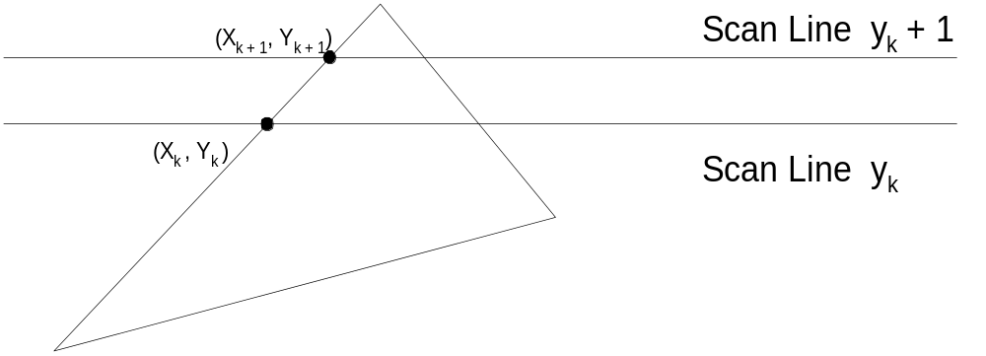
Scan Line Polygon Fill Algorithm
  Coherence between scan lines tells us that
    Edges that intersect scan line y are likely to intersect y + 1
    X changes predictably from scan line y to y + 1
30 January 2013
Computer Graphics

Slide 46
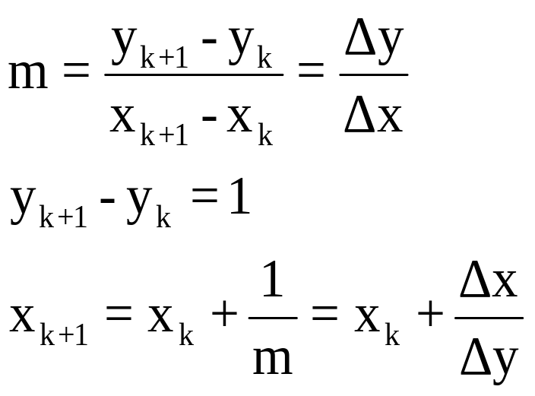
Scan Line Polygon Fill Algorithm
  Sequential fill algorithm with incremental coordinate calculations using DDA approach
  We can also have an integer solution !!!
30 January 2013
Computer Graphics

Slide 47
Scan Line Polygon Fill Algorithm
Integer Solution:
  counter = 0; y = y_{start}; x = x_{start}
  while(y<=y_{start} )
  {
  y = y+1;
  counter = counter + Δx;
  if (counter> =Δy)
  {
  x = x+1;
  counter = counter – Δy;
  }//end if
  }//end while
30 January 2013
Computer Graphics

Slide 48
Scan Line Polygon Fill Algorithm
  The scan conversion algorithm works as follows
    Intersect each scan line with all edges
    Sort intersections in x
    Calculate parity of intersections to determine in/out
    Fill the “in” pixels
  Special cases to be handled:
    Horizontal edges should be excluded
    For vertices lying on scan lines,
        count twice for a change in slope.
        Shorten edge by one scan line for no change in slope
30 January 2013
Computer Graphics

Slide 49
Scan Line Polygon Fill Algorithm
2. Data Structures
We need two data structures:
  Edge Table and
  Active Edge List
30 January 2013
Computer Graphics

Slide 50
Scan Line Polygon Fill Algorithm
(a) Edge Table The polygon is stored using Edge list which is an array of pointers, pointing to a linked-list for the scan line corresponding to the lower vertex and store the following:
    y_upper: last scan line to consider
    x_lower: starting x coordinate for edge
    1/m: for incrementing x ; compute
    All Horizontal edges are eliminated !!!!
30 January 2013
Computer Graphics

Slide 51
Scan Line Polygon Fill Algorithm
(b) Active Edge List is constructed during scan conversion. AEL is a linked list of active edges on the current scan line, y. Each active edge line has the following information :
    y_upper: last scan line to consider
    x_updated: starting with x coordinate for edge the value is updated at each scan line
    1/m: for incrementing x ; compute
The active edges are kept sorted by x!!!
30 January 2013
Computer Graphics

Slide 52
Scan Line Polygon Fill Algorithm
3. Example:
ET
AEL Progression
empty
4
4
3,4
3
5
3,5
6
3,5,6
3,5,6,7
2
7
2,7
2,7
2,7
8
1
1,8
1,8
empty
Each edge in ET: ymax, xmin, 1/m
Each edge in AEL: ymax, x, 1/m
30 January 2013
Computer Graphics

Slide 53
Scan Line Polygon Fill Algorithm
4. Algorithm
Set y to the smallest y coordinate that has an entry in the ET; i.e, y for the first nonempty bucket.
Initialize the AEL to be empty.
Repeat until the AEL and ET are empty:
  3.1 Move from ET bucket y to the AEL those edges whose y_min = y (entering edges).
  3.2 Remove from the AEL those entries for which y = y_max (edges not involved in the next scanline), the sort the AET on x (made easier because ET is presorted).
30 January 2013
Computer Graphics

Slide 54
Scan Line Polygon Fill Algorithm
  3.3 Fill in desired pixel values on scanline y by using pairs of x coordinates from AEL.
  3.4 Increment y by 1 (to the coordinate of the next scanline).
  3.5 For each nonvertical edge remaining in the AEL, update x for the new y.
Extensions:
Multiple overlapping polygons – priorities
Color, patterns Z for visibility
30 January 2013
Computer Graphics

Slide 55
Scan Line Polygon Fill Algorithm
8
5. Exercise:
P₅
P₃
6
P₄
4
2
P₁
P₂
0 2 4 6 8 10
Whitted, T., “A Software Test-Bed for the Development of 3D Raster Graphics Systems”, Computer Graphics, 14, 1981, pp 271-277
30 January 2013
Computer Graphics

Slide 56
Topics to be covered
Area Filling Techniques
Character Generation

Slide 57
Character Generation
  Character Generation often abbreviated as CG, is a technique that produces static or animated text (such as crawls and rolls) for keying into a video stream. Modern character generators are computer-based, and can generate graphics as well as text.
  Various Character generation techniques depending upon the type of display system.
    Raster Character Generation
    Outline Character Generation
30 January 2013
Computer Graphics

Slide 58
Character Generation
Raster Character Generation
Outline Character Generation
Types of Fonts

Slide 59
Character Generation
1. Raster Character Generation:
  Bit Mapped Fonts
  Several bitmap patterns are combined into one using a "raster operator".
  Rectangular grid patterns are typically used to define and plot characters.
  When the pattern is copied to some area of frame buffer, non zero bit value designate the pixel ON on the monitor.
  The size of rectangular grid can be 5x7, 9x14 or more
30 January 2013
Computer Graphics

Slide 60
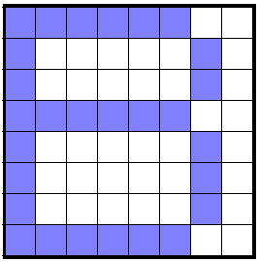
Character Generation
  Standard character patterns for numbers, letters and other symbols are predefined and stored in read only memory.
  Following figure illustrate pattern for letter B on a 8x8 matrix to be used with a bi-level raster system.
1
2
3
4
5
6
7
8
Location | BCD | Hex
01 H 02 H 03 H 04 H 05 H 06 H 07 H 08 H | 1111 1100 1000 0010 1000 0010 1111 1100 1000 0010 1000 0010 1000 0010 1111 1100 | FC 83 83 FC 83 83 83 FC
30 January 2013
Computer Graphics

Slide 61
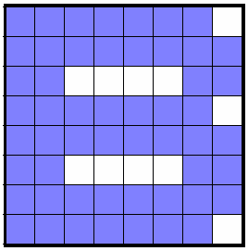
Character Generation
ADVANTAGES/DISADVANTAGES:
  + Fast, Good for animation
  + No need of scan conversion
  – Smallest area for manipulation is 8 pixels ( 1 byte)
  – Every Font facet need redefinition
Location | BCD | Hex
01 H 02 H 03 H 04 H 05 H 06 H 07 H 08 H | 1111 1110 1111 1111 1100 0011 1111 1110 1111 1111 1100 0011 1111 1111 1111 1100 | FE FF C3 FE FF C3 FF FE
30 January 2013
Computer Graphics

Slide 62
Character Generation
Raster Character Generation
Outline Character Generation
Types of Fonts

Slide 63
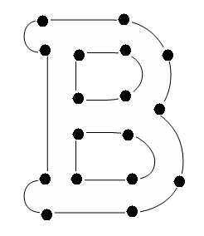
Character Generation
2. Outline Character Generation
  Used with Random Scan System
  Fonts are described using straight lines and curved sections as in postscript fonts.
B
30 January 2013
Computer Graphics

Slide 64
Character Generation
  + More Flexible scheme: as there is no need to store each variation such as boldness, italicize or fonts sizes in font cache.
  + Different shapes can be produced by manipulating curves.
  + require less memory for storage
  – Take more time to process as each time font has to be scan converted.
30 January 2013
Computer Graphics

Slide 65
Character Generation
Raster Character Generation
Outline Character Generation
Types of Fonts

Slide 66
Character Generation
3. Types of Fonts
Classification
Type Faces
Storage
Serif Fonts
Have small lines or
accents at the end of
main character strokes
like ‘For’. They are
more readable
Sans Serif Fonts
Do not have accent
They are more legible
Bit Mapped Fonts
Pixel Level Definition
(TTF Fonts)
Outline Fonts
Geo Level Definition
(Post Script Fonts)
30 January 2013
Computer Graphics

Slide 67
Polygon Scan Conversion
There are a large number of algorithms for displaying polygons on raster displays.
Each exploits some aspect of the types of polygons to be displayed:
  some algorithms allow triangular polygons only
  others require that the polygons are convex and non self-intersecting and have no holes
  triangular convex non-convex self-intersecting regions
23 January 2013
Computer Graphics

Slide 68
Simple scan conversion
May need to fill the polygon with colour.
Incorporate in a scan conversion algorithm.
Find intersection points for scan-line, updating in a top to bottom scan.
We may not be drawing actual pixels due to antialiasing, so we say we tile the polygon with pixel ‘fragments’.
Start
Finish
Scan line
23 January 2013
Computer Graphics

Slide 69
Types of polygons
Types
• Triangles
• Trapezoids
• Quadrilaterals
• Convex
• Concave
• Self-intersecting
Multiple loops
Holes
Convex
Concave
Self –
intersecting
Hole
Two approaches :
Generalise scan conversion
Split into triangles.
23 January 2013
Computer Graphics
Notes:
Only convex and concave polygons important.

Slide 70
Definitions.
A polygon is convex if: for all edges, all other vertices lie on the same side of the edge.
Otherwise it is concave.
Concave polygons can be difficult to process.
Convex
Concave
23 January 2013
Computer Graphics

Slide 71
Triangles are Always Convex
Mathematically very simple – involving simple linear equations.
Three points guaranteed coplaner.
Any polygon can be decomposed into triangles.
Triangles can approximate arbitrary shapes.
For any orientation on screen, a scan line will intersect only a single segment (scan).
23 January 2013
Computer Graphics

Slide 72
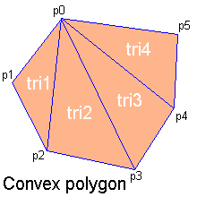
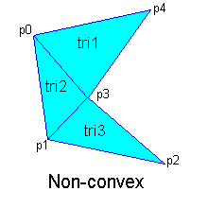
Any polygon decomposes
Convex polygons trivially decompose but non-convex polygons are non-trivial and in some overlapping or intersecting cases, new vertices have to be introduced.
23 January 2013
Computer Graphics

Slide 73
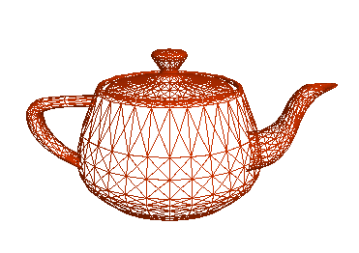
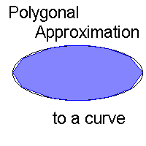
Arbitrary shapes with triangles
Any 2D shape (or 3D surface) can be approximated with locally linear polygons. To improve, need only increase no. of edges
23 January 2013
Computer Graphics

Slide 74
How do we represent polygons?
Polygonal Geometry.
Store all polygon vertices explicitly.
Inefficient
Cannot manipulate vertex positions.
E3
V1
P2
E1
P1
E2
V2
V3
23 January 2013
Computer Graphics
Notes:
Quite important storing polygonal geometry.

Slide 75
Representing Shapes.
Polygonal Geometry.
Store all polygon vertices explicitly.
Inefficient
Cannot manipulate vertex positions.
V1
E3
P1
E1
P2
Use pointer into vertex list.
Need to search to find adjacent polygons.
Edges are drawn twice.
Use pointer to edge list that points to vertex list.
E2
V2
V3
23 January 2013
Computer Graphics

Slide 76
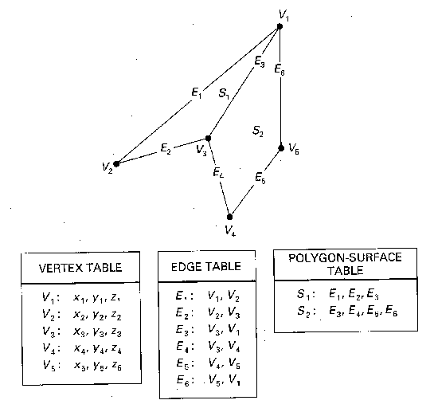
Standard Polygonal data structure
23 January 2013
Computer Graphics

Slide 77
Limitations of scan conversion

Slide 78
Limitations of Scan Conversion
Aliasing we do not get the actual pixel position but an alias. It cause staircase effects. Various anti-aliasing techniques are there.
Unequal Intensity along the diagonal lines
  Ignore it if speed is important
  Increase no. of pixels along diagonals
  Draw with more intensity
Over striking Inefficient, reduce speed pixels.
Picket Fencing while trying to fit an object in smaller space
  Local Aliasing
  Global Aliasing
3√2
3
23 January 2013
Computer Graphics

Slide 79
Antialiasing

Slide 80
Aliasing
  Distortion of information due to low-frequency sampling
  In raster images – leads to jagged edges with staircase effect. Commonly occurs when a pattern has details that are smaller than a pixel in width
  We can reduce effects by antialiasing methods to compensate for undersampling
sampling frequency
What we “see”
23 January 2013
Computer Graphics

Slide 81


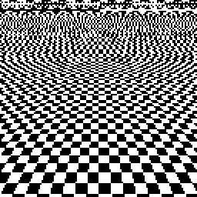
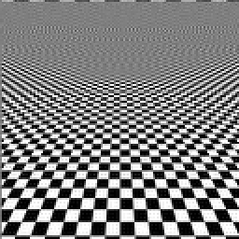
Antialiasing
Simple perspective projected texture
With some antialiasing
23 January 2013
Computer Graphics

Slide 82

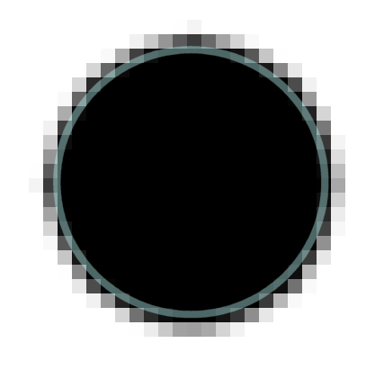
Antialiasing by Blurring
Effectively: BLUR edges to make them look smooth
23 January 2013
Computer Graphics

Slide 83
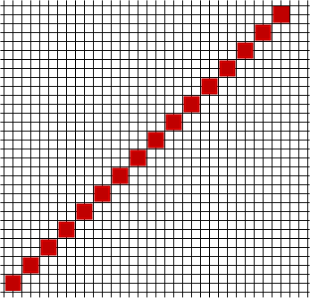
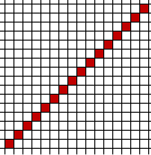
Antialiasing by Supersampling
Use twice the available resolution
4 pixels (2x2 square) for every 1 in the original
23 January 2013
Computer Graphics

Slide 84
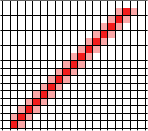
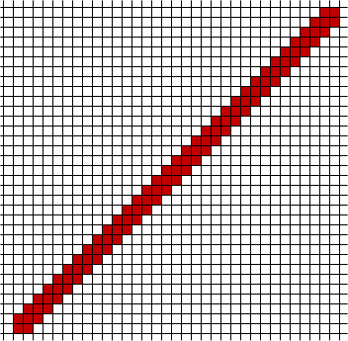

But we don’t actually render this hi-res line. Instead we downsample it using a “trick”
Avarage out the colours in the 4 pixel squares
23 January 2013
Computer Graphics

Slide 85
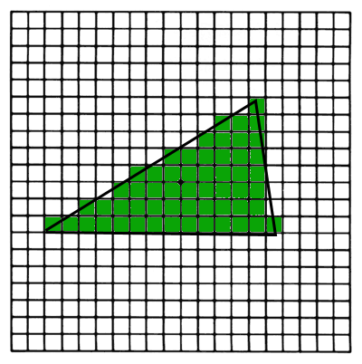
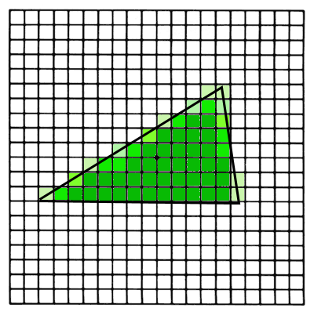
Antialiasing by Polygon Boundary
23 January 2013
Computer Graphics

Slide 86
Anti- Aliasing
Super Sampling
Area Sampling
3. Weighting

Slide 87
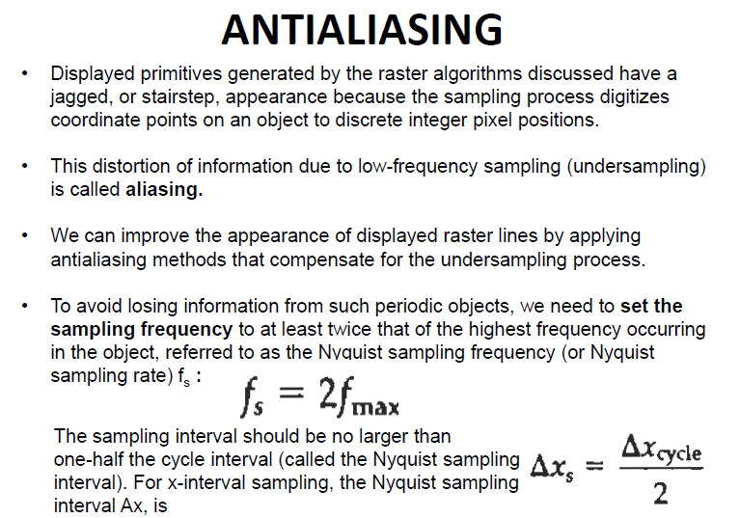
30 January 2013

Slide 88
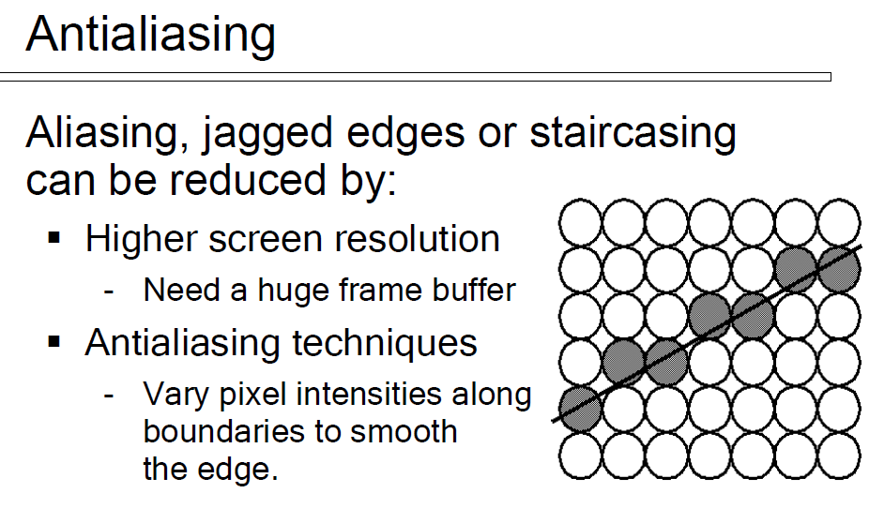
30 January 2013

Slide 89
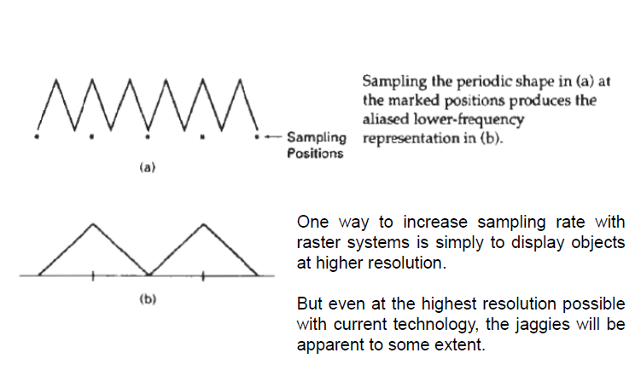
Sampling
30 January 2013

Slide 90
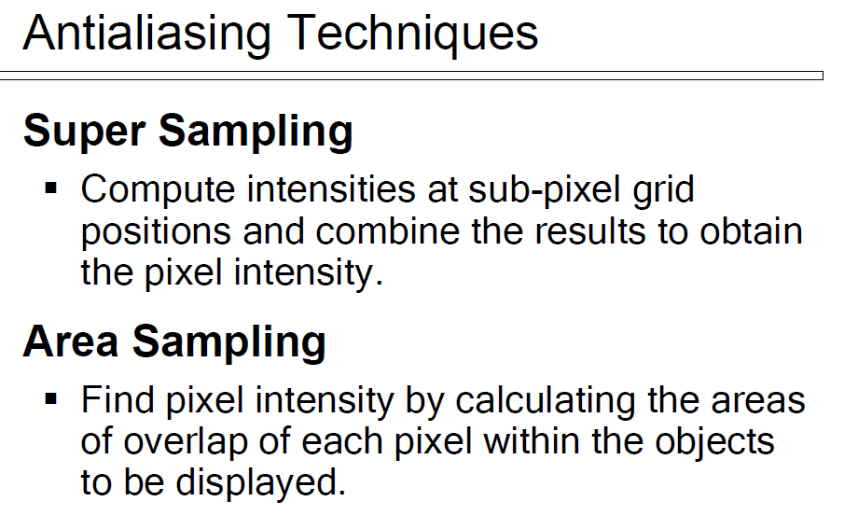
30 January 2013

Slide 91
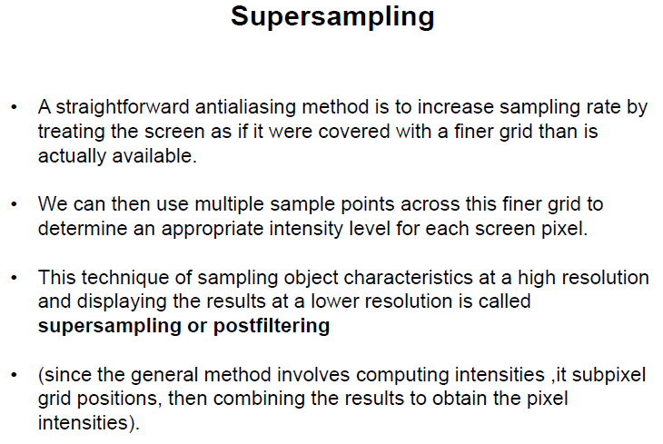
30 January 2013

Slide 92
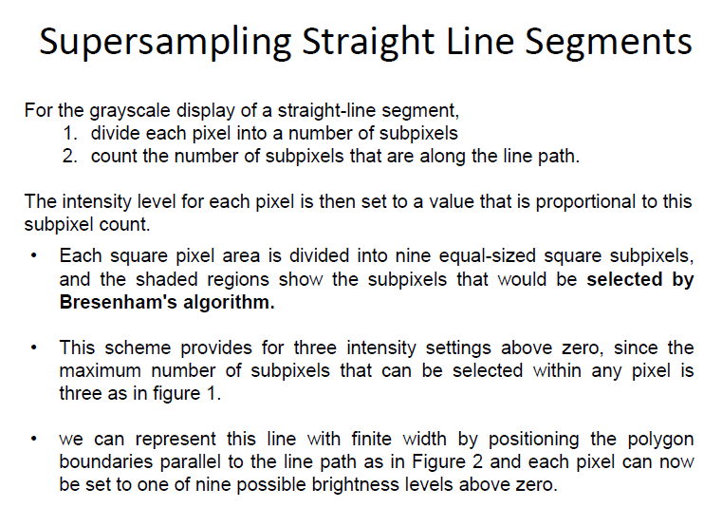
30 January 2013

Slide 93
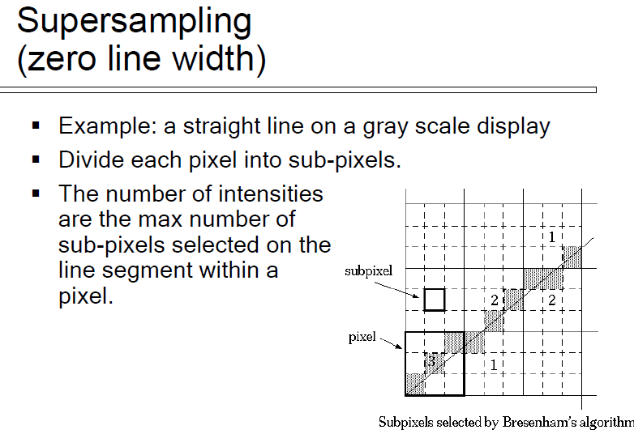
30 January 2013

Slide 94
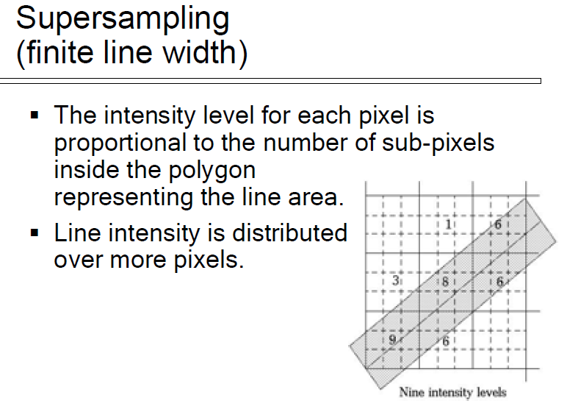
30 January 2013

Slide 95
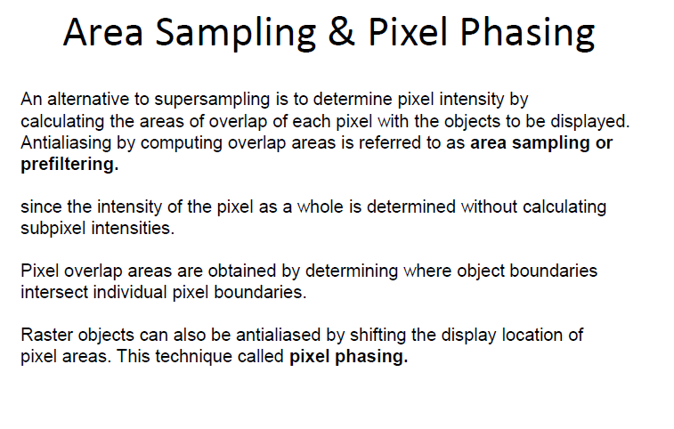
30 January 2013

Slide 96
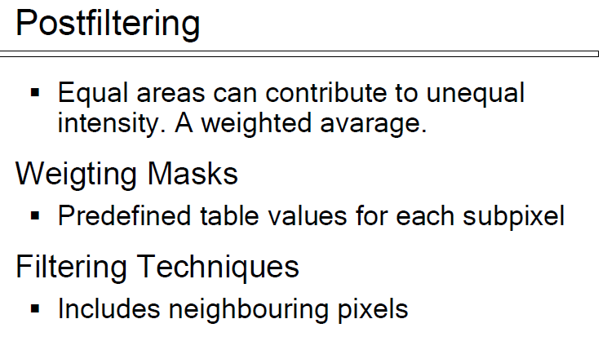
30 January 2013

Slide 97
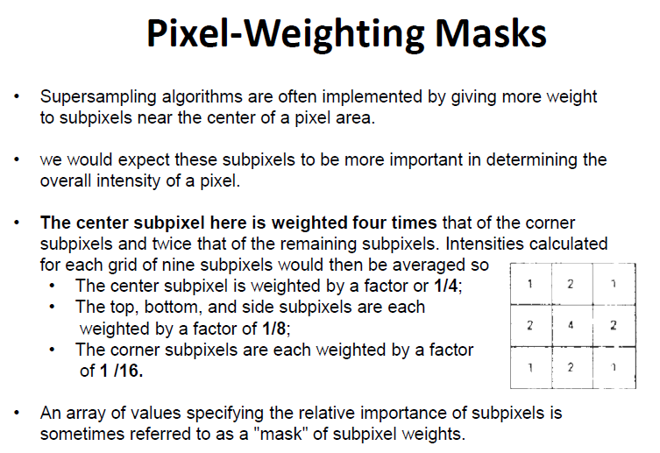
30 January 2013

Slide 98
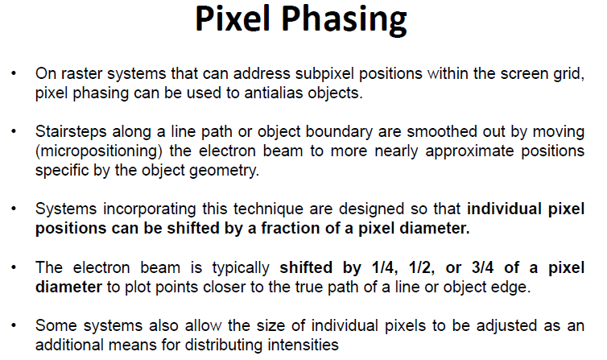
30 January 2013

Slide 99
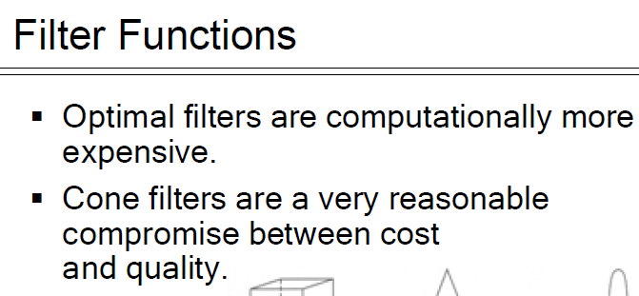
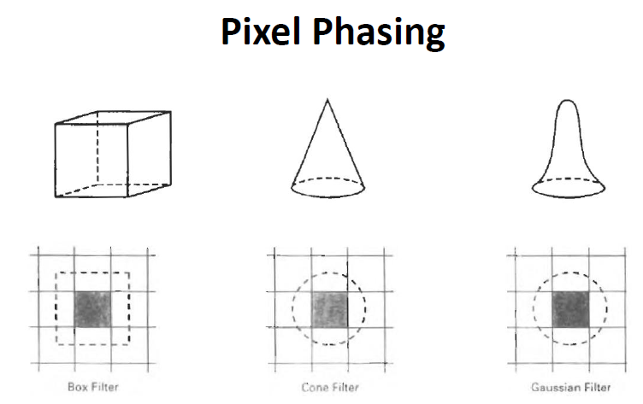
30 January 2013

Slide 100
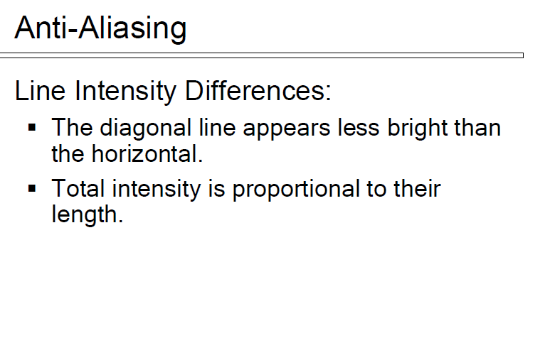
30 January 2013

Slide 101
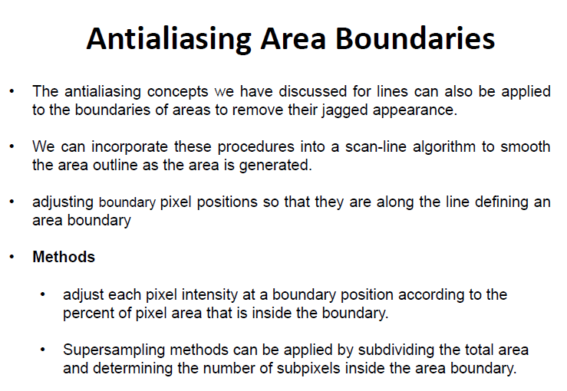
30 January 2013

Slide 102
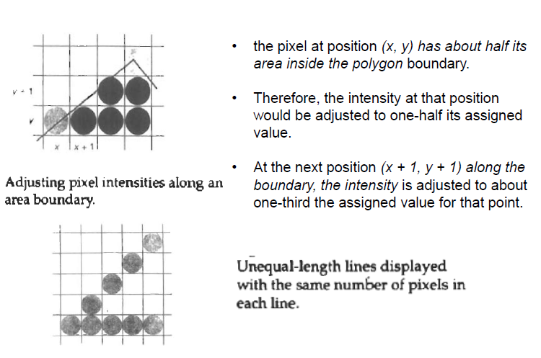
30 January 2013

Slide 103
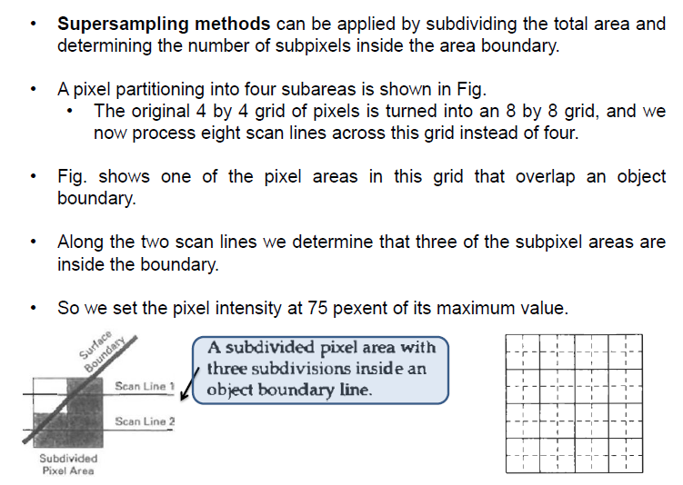
30 January 2013

Slide 104
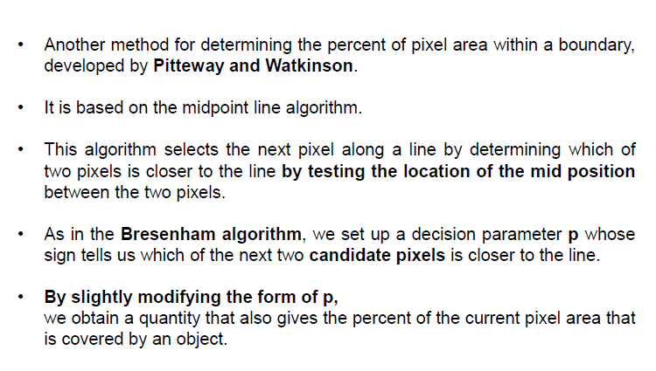
30 January 2013

Slide 105
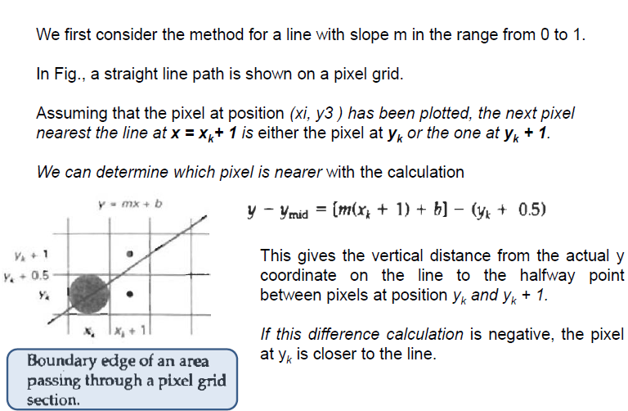
30 January 2013

Slide 106
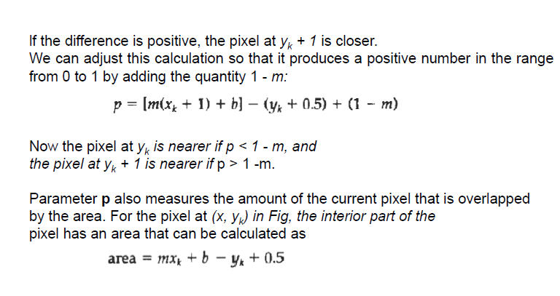
30 January 2013

Slide 107
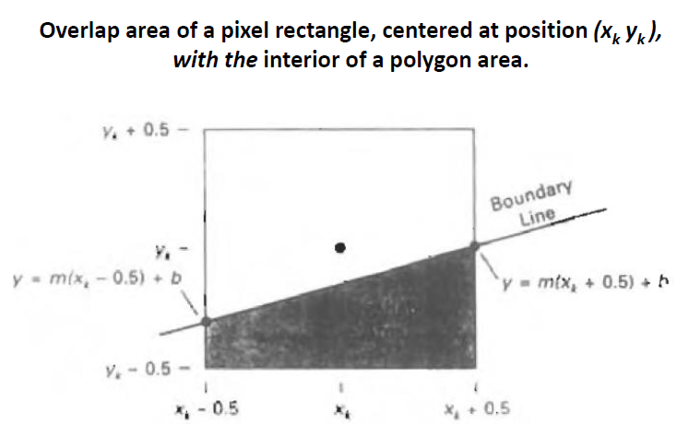
30 January 2013

