Slide 1
Chapter 6
2D Clipping
&
Viewing Transformation
Computer Graphics

Slide 2
2D Clipping
Introduction
Point Clipping
Line Clipping
Polygon/Area Clipping
Text Clipping
Computer Graphics

Slide 3
2D Clipping
1. Introduction:
A scene is made up of a collection of objects specified in world coordinates
World Coordinates
Computer Graphics

Slide 4
2D Clipping
When we display a scene only those objects within a particular window are displayed
Window
wy_{max}
wy_{min}
wx_{min}
World Coordinates
wx_{max}
Computer Graphics

Slide 5
2D Clipping
Because drawing things to a display takes time we clip everything outside the window
Window
wy_{max}
wy_{min}
wx_{min}
wx_{max}
Computer Graphics
World Coordinates

Slide 6
2D Clipping
1.1 Definitions:
  Clipping is the process of determining which elements of the picture lie inside the window and are visible.
  Shielding is the reverse operation of clipping where window act as the block used to abstract the view.
  By default, the “clip window” is the entire canvas
    not necessary to draw outside the canvas
    for some devices, it is damaging (plotters)
  Sometimes it is convenient to restrict the “clip window” to a smaller portion of the canvas
    partial canvas redraw for menus, dialog boxes, other obscuration
Computer Graphics

Slide 7
2D Clipping
Window
wy_{max}
wy_{min}
wx_{min}
World Coordinates
wx_{max}
Computer Graphics

Slide 8
2D Clipping
1.2 Example:
For the image below consider which lines and points should be kept and which ones should be clipped against the clipping window
P₄
Window
P₂
wy_{max}
P₃
P₆
P₁
P₇
P₅
P₉
P₈
wy_{min}
P₁₀
Computer Graphics
wx_{min}
wx_{max}

Slide 9
2D Clipping
1.3 Applications:
  Extract part of a defined scene for viewing.
  Drawing operations such as erase, copy, move etc.
  Displaying multi view windows.
  Creating objects using solid modeling techniques.
  Anti-aliasing line segments or object boundaries.
  Identify visible surfaces in 3D views.
Computer Graphics

Slide 10
2D Clipping
1.4 Types of clipping:
  Three types of clipping techniques are used depending upon when the clipping operation is performed
a. Analytical clipping
  Clip it before you scan convert it
  used mostly for lines, rectangles, and polygons, where clipping algorithms are simple and efficient
Computer Graphics

Slide 11
2D Clipping
b. Scissoring
  Clip it during scan conversion
  a brute force technique
    scan convert the primitive, only write pixels if inside the clipping region
    easy for thick and filled primitives as part of scan line fill
    if primitive is not much larger than clip region, most pixels will fall inside
    can be more efficient than analytical clipping.
Computer Graphics

Slide 12
2D Clipping
c. Raster Clipping
  Clip it after scan conversion
  render everything onto a temporary canvas and copy the clipping region
    wasteful, but simple and easy,
    often used for text
Computer Graphics

Slide 13
2D Clipping
Foley and van Dam suggest the following:
  for floating point graphics libraries, try to use analytical clipping
  for integer graphics libraries
    analytical clipping for lines and polygons
    others, do during scan conversion
  sometimes both analytical and raster clipping performed
Computer Graphics

Slide 14
2D Clipping
1.5 Levels of clipping:
  Point Clipping
  Line Clipping
  Polygon Clipping
  Area Clipping
  Text Clipping
  Curve Clipping
Computer Graphics

Slide 15
2D Clipping
Introduction
Point Clipping
Line Clipping
Polygon/Area Clipping
Text Clipping
Computer Graphics

Slide 16
Point Clipping
  Simple and Easy
  a point (x,y) is not clipped if:
wx_{min} ≤ x ≤ wx_{max}
&
wy_{min} ≤ y ≤ wy_{max}
  otherwise it is clipped
P₄
Clipped
Clipped
Window
P₂
wy_{max}
Clipped
P₅
P₇
P₁
Points Within the Window are Not Clipped
P₉
P₈
wy_{min}
Clipped
P₁₀
wx_{min}
wx_{max}
Computer Graphics

Slide 17
2D Clipping
Introduction
Point Clipping
Line Clipping
Polygon/Area Clipping
Text Clipping
Computer Graphics

Slide 18
Line Clipping
  It is Harder than point clipping
  We first examine the end-points of each line to see if they are in the window or not
    Both endpoints inside, line trivially accepted
    One in and one out, line is partially inside
    Both outside, might be partially inside
    What about trivial cases?
ymax
ymin
xmin
xmax
Computer Graphics

Slide 19
Line Clipping
Situation | Solution | Example
Both end-points inside the window | Don’t clip
One end-point inside the window, one outside | Must clip
Both end-points outside the window | Don’t know!
Computer Graphics

Slide 20
2D Line Clipping Algorithms
Analytical Line Clipping
Cohen Sutherland Line Clipping
Liang Barsky Line Clipping
Computer Graphics

Slide 21
Analytical Line Clipping
Also called Brute force line clipping can be performed as follows:
  1. Don’t clip lines with both
  end-points within the
  window
Computer Graphics

Slide 22
Analytical Line Clipping
  2. For lines with one end-point inside the window and one end-point outside, calculate the intersection point (using the equation of the line) and clip from this point out
  Use parametric equations
    x=x0+t(x1-x0)
    y=y0+t(y1-y0)
  Intersection if 0 ≤t ≤ 1
Computer Graphics

Slide 23
Analytical Line Clipping
  3. For lines with both end-points outside the window test the line for intersection with all of the window boundaries, and clip appropriately
  + Very Simple method
  However, calculating line intersections is computationally expensive
  Because a scene can contain so many lines, the brute force approach to clipping is much too slow
Computer Graphics

Slide 24
2D Line Clipping Algorithms
Analytical Line Clipping
Cohen Sutherland Line Clipping
Liang Barsky Line Clipping
Computer Graphics

Slide 25
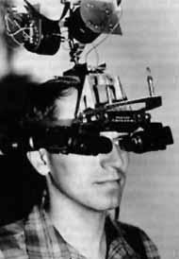

Cohen-Sutherland Line Clipping
  An efficient line clipping algorithm
  The key advantage of the algorithm is that it vastly reduces the number of line intersections that must be calculated.
Dr. Ivan E. Sutherland co-developed the Cohen-Sutherland clipping algorithm. Sutherland is a graphics giant and includes amongst his achievements the invention of the head mounted display.
Cohen is something of a mystery – can anybody find out who he was?
Computer Graphics

Slide 26
Cohen-Sutherland Line Clipping
  Two phases Algorithm
Phase I: Identification Phase
  All line segments fall into one of the following categories
  Visible: Both endpoints lies inside
  Invisible: Line completely lies outside
  Clipping Candidate: A line neither in category 1 or 2
Phase II: Perform Clipping
Compute intersection for all lines that are candidate for clipping.
Computer Graphics

Slide 27
Cohen-Sutherland Line Clipping
Phase I: Identification Phase: World space is divided into regions based on the window boundaries
  Each region has a unique four bit region code
  Region codes indicate the position of the regions with respect to the window
1001 | 1000 | 1010
0001 | 0000 Window | 0010
0101 | 0100 | 0110
3
2
1
0
above
below
right
left
Region Code Legend
Computer Graphics

Slide 28
Cohen-Sutherland Line Clipping
Every end-point is labelled with the appropriate region code
P₁₁ [1010]
P₄ [1000]
Window
wy_{max}
P₆ [0000]
P₃ [0001]
P₅ [0000]
P₁₂ [0010]
P₇ [0001]
P₉ [0000]
P₈ [0010]
wy_{min}
P₁₀ [0100]
P₁₃ [0101]
P₁₄ [0110]
wx_{min}
wx_{max}
Computer Graphics

Slide 29
Cohen-Sutherland Line Clipping
Visible Lines: Lines completely contained within the window boundaries have region code [0000] for both end-points so are not clipped
P₁₁ [1010]
P₄ [1000]
Window
wy_{max}
P₆ [0000]
P₃ [0001]
P₅ [0000]
P₁₂ [0010]
P₇ [0001]
P₉ [0000]
P₈ [0010]
wy_{min}
P₁₀ [0100]
P₁₃ [0101]
P₁₄ [0110]
Computer Graphics
wx_{min}
wx_{max}

Slide 30
Cohen-Sutherland Line Clipping
Invisible Lines: Any line with a common set bit in the region codes of both end-points can be clipped completely
  The AND operation can efficiently check this
  Non Zero means Invisible
P₁₁ [1010]
P₄ [1000]
Window
wy_{max}
P₆ [0000]
P₃ [0001]
P₅ [0000]
P₁₂ [0010]
P₇ [0001]
P₉ [0000]
P₈ [0010]
wy_{min}
P₁₀ [0100]
P₁₃ [0101]
P₁₄ [0110]
Computer Graphics
wx_{min}
wx_{max}

Slide 31
Cohen-Sutherland Line Clipping
Clipping Candidates: Lines that cannot be identified as completely inside or outside the window may or may not cross the window interior. These lines are processed in Phase II.
  If AND operation result in 0 the line is candidate for clipping
P₁₁ [1010]
P₄ [1000]
Window
wy_{max}
P₆ [0000]
P₃ [0001]
P₅ [0000]
P₁₂ [0010]
P₇ [0001]
P₉ [0000]
P₈ [0010]
wy_{min}
P₁₀ [0100]
P₁₃ [0101]
P₁₄ [0110]
Computer Graphics
wx_{min}
wx_{max}

Slide 32
Cohen-Sutherland Line Clipping
Assigning Codes
  Let point (x,y) is be given code b₃b₂b₁b₀:
bit 3 = 1 if wy_{max} - y ≤0
bit 2 = 1 if y - wy_{min} ≤ 0
bit 1 = 1 if wx_{max} - x ≤0
bit 0 = 1 if x - wx_{min} ≤ 0
P₄ [1000]
P₁₁ [1010]
Window
wy_{max}
P₃ [0001]
P₆ [0000]
P₅ [0000]
P₁₂ [0010]
P₇ [0001]
P₉ [0000]
P₈ [0010]
wy_{min}
P₁₃ [0101]
P₁₀ [0100]
P₁₄ [0110]
wx_{min}
wx_{max}
Computer Graphics

Slide 33
Cohen-Sutherland Clipping Algorithm
Phase II: Clipping Phase: Lines that are in category 3 are now processed as follows:
  Compare an end-point outside the window to a boundary (choose any order in which to consider boundaries e.g. left, right, bottom, top) and determine how much can be discarded
  If the remainder of the line is entirely inside or outside the window, retain it or clip it respectively
  Otherwise, compare the remainder of the line against the other window boundaries
  Continue until the line is either discarded or a segment inside the window is found
Computer Graphics

Slide 34
Cohen-Sutherland Line Clipping
Intersection points with the window boundaries are calculated using the line-equation parameters
  Consider a line with the end-points (x₁, y₁) and (x₂, y₂)
  The y-coordinate of an intersection with a vertical window boundary can be calculated using:
  y = y₁ + m (x_{boundary} - x₁)
  where x_{boundary} can be set to either wx_{min} or wx_{max}
  The x-coordinate of an intersection with a horizontal window boundary can be calculated using:
  x = x₁ + (y_{boundary} - y₁) / m
  where y_{boundary} can be set to either wy_{min} or wy_{max}
Computer Graphics

Slide 35
Cohen-Sutherland Line Clipping
We can use the region codes to determine which window boundaries should be considered for intersection
  To check if a line crosses a particular boundary we compare the appropriate bits in the region codes of its end-points
  If one of these is a 1 and the other is a 0 then the line crosses the boundary.
Computer Graphics

Slide 36
Cohen-Sutherland Line Clipping
Example1: Consider the line P₉ to P₁₀ below
  Start at P₁₀
  From the region codes
  of the two end-points we
  know the line doesn’t
  cross the left or right
  boundary
  Calculate the intersection
  of the line with the bottom boundary
  to generate point P₁₀’
  The line P₉ to P₁₀’ is completely inside the window so is retained
Window
wy_{max}
P₉ [0000]
P₉ [0000]
wy_{min}
P₁₀’ [0000]
P₁₀ [0100]
wx_{min}
wx_{max}
Computer Graphics

Slide 37
Cohen-Sutherland Line Clipping
Example 2: Consider the line P₃ to P₄ below
  Start at P₄
  From the region codes
  of the two end-points
  we know the line
  crosses the left
  boundary so calculate
  the intersection point to
  generate P₄’
  The line P₃ to P₄’ is completely outside the window so is clipped
P₄’ [1001]
P₄ [1000]
Window
wy_{max}
P₃ [0001]
P₃ [0001]
wy_{min}
wx_{min}
wx_{max}
Computer Graphics

Slide 38
Cohen-Sutherland Line Clipping
Example 3: Consider the line P₇ to P₈ below
  Start at P₇
  From the two region
  codes of the two
  end-points we know
  the line crosses the
  left boundary so
  calculate the
  intersection point to
  generate P₇’
Window
wy_{max}
P₇’ [0000]
P₇ [0001]
P₈ [0010]
P₈’ [0000]
wy_{min}
wx_{min}
wx_{max}
Computer Graphics

Slide 39
Cohen-Sutherland Line Clipping
Example 4: Consider the line P₇’ to P₈
  Start at P₈
  Calculate the
  intersection with the
  right boundary to
  generate P₈’
  P₇’ to P₈’ is inside
  the window so is
  retained
Window
wy_{max}
P₇’ [0000]
P₇ [0001]
P₈ [0010]
P₈’ [0000]
wy_{min}
wx_{min}
wx_{max}
Computer Graphics

Slide 40
Cohen-Sutherland Line Clipping
Mid-Point Subdivision Method
  Algorithm
    Initialise the list of lines to all lines
    Classify lines as in Phase I
      Assign 4 point bit codes to both end points a₃a₂a₁a₀ and b₃b₂b₁b₀
      If (a₃a₂a₁a₀ = b₃b₂b₁b₀ = 0 )Line in category 1
      If (a₃a₂a₁a₀)AND (b₃b₂b₁b₀ ) # 0 ) Line in category 2
      If (a₃a₂a₁a₀)AND (b₃b₂b₁b₀ ) = 0 ) Line in category 3
    Display all lines from the list in category 1 and remove;
    Delete all lines from the list in category 2 as they are invisible;
    Divide all lines of category 3 are into two smaller segments at mid-point (x_{m},y_{m}) where x_{m} = (x₁ +x₂)/2 and y_{m} = (y₁ +y₂)/2
    Remove the original line from list and enter its two newly created segments.
    Repeat step 2-5 until list is null.
Computer Graphics

Slide 41
Cohen-Sutherland Line Clipping
Window
wy_{max}
wy_{min}
wx_{min}
wx_{max}
Computer Graphics

Slide 42
Cohen-Sutherland Line Clipping
Window
wy_{max}
wy_{min}
wx_{min}
wx_{max}
Computer Graphics

Slide 43
Cohen-Sutherland Line Clipping
Mid-Point Subdivision Method
  Integer Version
  Fast as Division by 2 can be performed by simple shift right operation
  For NxN max dimension of line number of subdivisions required log₂ N.
  Thus a 1024x1024 raster display require just 10 subdivisions………
Computer Graphics

Slide 44
2D Line Clipping Algorithms
Analytical Line Clipping
Cohen Sutherland Line Clipping
Liang Barsky Line Clipping
Computer Graphics

Slide 45
Liang-Barsky Line Clipping
Introduction:
  Cohen-Sutherland sometimes performs a lot of fruitless clipping due to external intersections, but oldest, widely published, most common
  Cyrus-Beck (1978) and Liang-Barsky (1984) are more efficient
  C-B is a parametric line-clipping algorithm
  L-B is based on C-B algorithm. It adds efficient trivial rejection tests
    can be used for 2D line clipping against arbitrary convex polygons
Computer Graphics

Slide 46
Liang-Barsky Line Clipping
  Using parametric equations, compute line segment intersections (actually, just values of u) with clipping region edges
  Determine if the four values of u actually correspond to real intersections
  Then calculate x and y values of the intersections
  L-B examines values of u for earlier reject
Computer Graphics

Slide 47
Liang-Barsky Line Clipping
  Parametric definition of a line:
    x = x₁ + uΔx
    y = y₁ + uΔy
    Δx = (x₂-x₁), Δy = (y₂-y₁), 0<=u<=1
  Goal: find range of u for which x and y both inside the viewing window
Computer Graphics

Slide 48
Liang-Barsky Line Clipping
  Mathematically:
    x_{min} <= x₁ + uΔx <= x_{max}
    y_{min} <= y₁ + uΔy <= y_{max}
  Rearranged
    1: u*(-Δx) <= (x₁ – x_{min})
    2: u*(Δx) <= (x_{max} – x₁)
    3: u*(-Δy) <= (y₁ – y_{min})
    4: u*(Δy) <= (y_{max} – y₁)
– In general
u*(p_{k}) <= (q_{k}) k = 1,2,3,4
where p₁ = -Δx q₁ = x₁ - x_{min} (left)
p₂ = Δx q₂ = x_{max} – x₁ (right)
p₃ = -Δy q₃ = y₁ - y_{min} (bottom)
p₄ = Δy q₄ = y_{max} – y₁ (top)
Computer Graphics

Slide 49
Liang-Barsky Line Clipping
  Rules:
    p_{k} = 0: the line is parallel to boundaries
      If for that same k, q_{k} < 0, it’s outside
      Otherwise it’s inside
    p_{k} < 0: the line starts outside this boundary
      r_{k} = q_{k}/p_{k}
      u₁ = max(0, r_{k}, u₁)
    3) p_{k} > 0: the line starts inside the boundary
      r_{k} = q_{k}/p_{k}
      u₂ = min(1, r_{k}, u₂)
    4) If u₁ > u₂, the line is completely outside
Computer Graphics

Slide 50
Liang-Barsky Line Clipping
A line parallel to a clipping window edge has p_{k} = 0 for that boundary.
If for that k, q_{k} < 0, the line is completely outside and can be eliminated.
When p_{k} < 0 the line proceeds outside to inside the clip window and when p_{k} > 0, the line proceeds inside to outside.
For nonzero p_{k}, u = q_{k} / p_{k} gives the intersection point.
For each line, calculate u1 and u2. For u1, look at boundaries for which p_{k} < 0 (outside→ in). Take u1 to be the largest among (0, q_{k} / p_{k}). For u2, look at boundaries for which p_{k} k > 0 (inside → out). Take u2 to be the minimum of (1, q_{k} / p_{k}). If u1 > u2, the line is outside and therefore rejected.
Computer Graphics

Slide 51
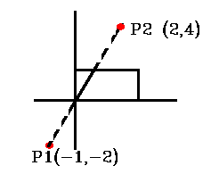
Liang-Barsky Line Clipping
Example of Liang-Barsky Line Clipping
u*(p_{k}) <= (q_{k}) k = 1,2,3,4
where p₁ = -Δx q₁ = x₁ - x_{min} (left)
p₂ = Δx q₂ = x_{max} – x₁ (right)
p₃ = -Δy q₃ = y₁ - y_{min} (bottom)
p₄ = Δy q₄ = y_{max} – y₁ (top)
_{(4,2)}
_{(0,0)}
Computer Graphics

Slide 52
Liang-Barsky Line Clipping
p₁ = -Δx = -3 q₁ = x₁ - X_{min} = -1 - 0 = -1 q₁ / p₁ = 1/3
p₂ = Δx = 3 q₂ = X_{max} - x₁ = 4 - (-1) = 5 q₂ / p₂ = 5/3
p₃ = -Δy = -6 q₃ = y₁ - Y_{min} = -2 q₃ / p₃ = 1/3
p₄ = Δy = 6 q₄ = Y_{max} - y₁ = 4 q₄ / p₄ = 4/6
for (p_{k} < 0) u₁=MAX (0,1 / 3, 1 / 3)=1 / 3
for (p_{k} > 0) u₂ = MIN (1 ,5 / 3, 4 / 6, ) = 2 / 3
Since u₁ < u₂ there is a visible section
Compute new endpoints:
u₁ = 1 / 3 x₁' = x₁ + Δx . u₁ = -1 + (3 . 1 / 3) = 0
y₁' = y₁ + Δy . u₁ = -2 + (6 . 1 / 3) = 0
u₂ = 2 / 3 x₂' = x₁ + Δx . u₂ = -1 + (3 . 2 / 3) = 1
y₂' = y₁ + Δy . u₂ = -1 + (6 . 2 / 3) = 2
Computer Graphics

Slide 53
Liang-Barsky Line Clipping
  Faster than Cohen-Sutherland, does not need to iterate
  can be used for 2D line clipping against arbitrary convex polygons
  Also extends to 3D
    Add z = z₁ + uΔz
    Add 2 more p’s and q’s
    Still only 2 u’s
Computer Graphics

Slide 54
Nicholl-Lee-Nicholl Line Clipping
T
Overview: Divide the region based on p₁
  Case 1: p₁ inside
  Case 2: p₁ across edge
  Case 3: p₁ across corner
L
R
B
LT
L
L
LR
T
L
TR
LB
L
T
LB
TB
Nicholl, Lee, and Nicholl (1987) algorithm subdivides plane into more regions.
Computer Graphics

Slide 55
Nicholl-Lee-Nicholl Line Clipping
  Symmetry handles other cases
  Find slopes of the line and 4 region bounding lines
  Find which region P₂ is in
    If not in any labeled, the line is discarded
  Subtractions, multiplies and divisions can be carefully used to minimum
  It avoids the complicated test of L-B algorithm
  Also the fastest
  Only works well for 2D
Computer Graphics

Slide 56
2D Clipping
Introduction
Point Clipping
Line Clipping
Polygon / Area Clipping
Text Clipping
Computer Graphics

Slide 57
Polygon Clipping
Polygons have a distinct inside and outside…
Decided by
  Even/Odd
  Winding Number
Computer Graphics
Notes:
Note that even/odd makes the inside of the star empty. Winding number does not. The winding number is counted by noting the number of line segments crossed and the direction of the crossing. The direction is created by walking around the edges in clockwise (or ccw) fashion. Each line segment is given a direction by this walk. Then, when deciding if a point is inside or out, you count the number of right→left crossings and left→right crossings. If they are equal, you are outside. Otherwise, you are inside.

Slide 58
Polygon Clipping
Note the difference between clipping lines and polygons:
NOTE!
Computer Graphics
Notes:
NOTE! Some clipping algorithms leave the pieces connected by a line, others do not. The major difference is that you want to know what is inside and what is outside of the polygon.

Slide 59
Polygon Clipping
Some difficulties:
  Maintaining correct inside/outside
  Variable number of vertices
  Handle screen corners
  correctly
Computer Graphics

Slide 60
Sutherland-Hodgman Area Clipping
A technique for clipping areas
developed by Sutherland &
Hodgman
Put simply the polygon is clipped
by comparing it against each
boundary in turn
Sutherland
turns up
again. This
time with
Gary Hodgman with whom he worked at the first ever graphics company Evans & Sutherland
Original Area
Clip Left
Clip Right
Clip Top
Clip Bottom
Computer Graphics

Slide 61
Sutherland-Hodgeman Polygon Clipping
1. Basic Concept:
Simplify via separation
Clip whole polygon against one edge
  Repeat with output for other 3 edges
  Similar for 3D
You can create intermediate vertices that get thrown out
Computer Graphics

Slide 62
Sutherland-Hodgeman Polygon Clipping
Example
Start
Left
Right
Bottom
Top
Note that the point one of the points added when clipping
on the right gets removed when we clip with bottom
Computer Graphics

Slide 63
Sutherland-Hodgeman Polygon Clipping
2. Algorithm:
Let (P₁, P₂,…. P_{N}) be the vertex list of the Polygon to be clipped and E be the edge of +vely oriented, convex clipping window.
We clip each edge of the polygon in turn against each window edge E, forming a new polygon whose vertices are determined as follows:
Computer Graphics

Slide 64
Sutherland-Hodgeman Polygon Clipping
Four cases
Inside: If both P_{i-1} and P_{i} are to the left of window edge vertex then P_{i} is placed on the output vertex list.
Entering: If P_{i-1} is to the right of window edge and P_{i} is to the left of window edge vertex then intersection (I) of P_{i-1} P_{i} with edge E and P_{i} are placed on the output vertex list.
Leaving: If P_{i-1} is to the left of window edge and P_{i} is to the right of window edge vertex then only intersection (I) of P_{i-1} P_{i} with edge E is placed on the output vertex list.
Outside: If both P_{i-1} and P_{i} are to the right of window edge nothing is placed on the output vertex list.
Computer Graphics

Slide 65
Sutherland-Hodgeman Polygon Clipping
Creating New Vertex List
P_{i-1}
P_{i}
P_{i}
P_{i-1}
P_{i}
P_{i-1}
P_{i}
P_{i-1}
in → in
save ending vert
Inside
(1 output)
out → in
save new clip vert
and ending vert
Entering
(2 outputs)
in → out
save new clip vert
Leaving
(1 output)
out → out
save nothing
Outside
(0 output)
Computer Graphics

Slide 66
Sutherland-Hodgman Polygon Clipping
Each example shows the point being processed (P) and the previous point (S)
Saved points define area clipped to the boundary in question
S
S
P
I
P
Save Point P
Save Point I
P
S
I
P
S
No Points Saved
Save Points I & P
Computer Graphics

Slide 67
Flow Chart
START
INPUT VERTEX LIST
(P₁, P₂........, P_{N})
FOR i =1 TO (N-1) DO
IF P_{i}P_{i+1} INTERSECT E ?
YES
NO
COMPUTE I
OUTPUT I IN VERTEX LIST
YES
IF P_{i} TO LEFT OF E ?
NO
Special case for first Vertex
OUTPUT P_{i} IN VERTEX LIST
i = i+1
Computer Graphics

Slide 68
Flow Chart
Special case for first Vertex
IF P_{N}P₀ INTERSECT E ?
YES
NO
COMPUTE I
OUTPUT I IN VERTEX LIST
END
YOU CAN ALSO APPEND AN ADDITIONAL VERTEX P_{N+1} = P₁ AND AVOID SPECIAL CASE FOR FIRST VERTEX
Computer Graphics

Slide 69
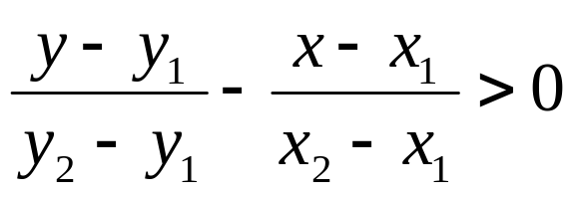
Sutherland-Hodgeman Polygon Clipping
Inside/Outside Test:
Let P(x,y) be the polygon vertex which is to be tested against edge E defined form A(x₁, y₁) to B(x₂, y₂). Point P is to be said to the left (inside) of E or AB iff
or C = (x₂ – x₁) (y – y₁) – (y₂ – y₁)(x – x₁) > 0
otherwise it is said to be the right/Outside of edge E
Computer Graphics

Slide 70
Weiler-Atherton Polygon Clipping
Problem with Sutherland-Hodgeman:
  Concavities can end up linked
Weiler-Atherton creates separate polygons in such cases
Remember
me?
Computer Graphics

Slide 71
Weiler-Atherton Polygon Clipping
Example
add clip pt.
and end pt.
add end pt.
add clip pt.
cache old dir.
follow clip edge until
new crossing
found
b) reach pt. already
added
Computer Graphics

Slide 72
Weiler-Atherton Polygon Clipping
Example (cont)
continue from
cached location
add clip pt.
and end pt.
add clip pt.
cache dir.
follow clip edge until
a) new crossing
found
b) reach pt. already
added
Computer Graphics

Slide 73
Weiler-Atherton Polygon Clipping
Example (concluded)
continue from
cached location
nothing added
finished
Final result:
Two unconnected
polygons
Computer Graphics

Slide 74
Weiler-Atherton Polygon Clipping
Difficulties:
  What if the polygon re-crosses edge?
  How many “cached” crosses?
  Your geometry step must be able to create new polygons
    Instead of 1-in-1-out
Computer Graphics

Slide 75
Other Area Clipping Concerns
Clipping concave areas can be a little more tricky as often superfluous lines must be removed
Clipping curves requires more work
  For circles we must find the two intersection points on the window boundary
Window
Window
Window
Window
Computer Graphics

Slide 76
2D Clipping
Introduction
Point Clipping
Line Clipping
Polygon/Area Clipping
Text Clipping
Computer Graphics

Slide 77


Text Clipping
Text clipping relies on the concept of bounding rectangle
TYPES
  All or None String Clipping: The bounding rectangle is on the word.
  All or None Character Clipping: The bounding rectangle is on the character.
  Character Clipping
STRING
S T R I N G
Computer Graphics

Slide 78
Text Clipping
METHODS
  Point Clipping in case of Bit Mapped Fonts
  Curve, Line or Polygon clipping in case of Outlined fonts
Computer Graphics

Slide 79
2D Viewing Transformation
Definition
2D Viewing Pipeline
Approaches
Aspect Ratio
Computer Graphics

Slide 80
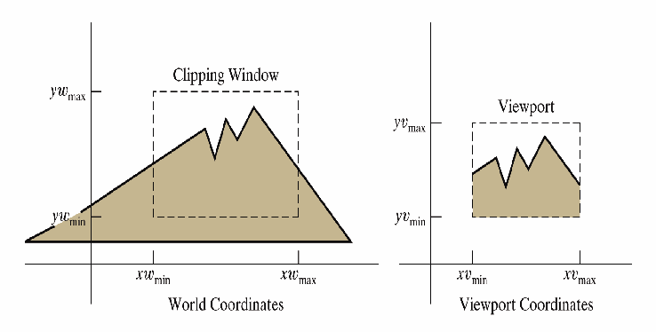
2D Viewing Transformation
1. Definitions: It is defined as a process for displaying views of a two-dimensional picture on an output device:
  Specify which parts of the object to display (clipping window, or world window, or viewing window)
  Where on the screen to display these parts (view port).
Computer Graphics

Slide 81
2D Viewing Transformation
  World Co – Ordinate System is a right handed Cartesian coordinate system in which picture is actually defined.
  Physical Device Co – Ordinate System is a coordinate system that correspond to output device or work stations where image to be displayed. E.g. with our monitor it is a Left handed Cartesian coordinate system.
  Normalized Co – Ordinate System It is a right handed coordinate system in which display area of virtual display device correspond to the unit square (1x1).
Computer Graphics

Slide 82
2D Viewing Transformation
  Window or Clipping window is the selected section of a scene that is displayed on a display window. It is a finite region from World Coordinate System.
  View port is the window where the object is viewed on the output device. It is a finite region from Device Coordinate System.
Computer Graphics

Slide 83
2D Viewing Transformation
Definition
2D Viewing Pipeline
Approaches
Aspect Ratio
Computer Graphics

Slide 84
2D Viewing Transformation
2. 2D viewing pipeline
  Construct world-coordinate scene using modeling-coordinate transformations
  Convert world-coordinates to viewing coordinates
  Transform viewing-coordinates to normalized-coordinates (ex: between 0 and 1, or between -1 and 1)
  Map normalized-coordinates to device-coordinates.
CONSTRUCT WORLD COORDINATE SCENE
CONVERT
WORLD CORD TO
VIEW CORD
MAP
VIEW CORD
TO
NORM VIEW CO
MAP NORM VIEW CORD
TO
DEVICE CORD
MC
WC
VC
NC
DC
Computer Graphics

Slide 85
2D Viewing Transformation
Definition
2D Viewing Pipeline
Approaches
Aspect Ratio
Computer Graphics

Slide 86
2D Viewing Transformation
3. Approaches
  Two main approaches to 2D viewing Transformation are
    Direct Approach
    Normalized Approach
Computer Graphics

Slide 87
2D Viewing Transformation
3.1. Direct Approach
  Mapping the clipping window into a view port which may be normalized
  Its involves
    translating the origin of the clipping window to that of the view port
    scaling the clipping window to the size of the view port
  We can drive it by three methods
Computer Graphics

Slide 88
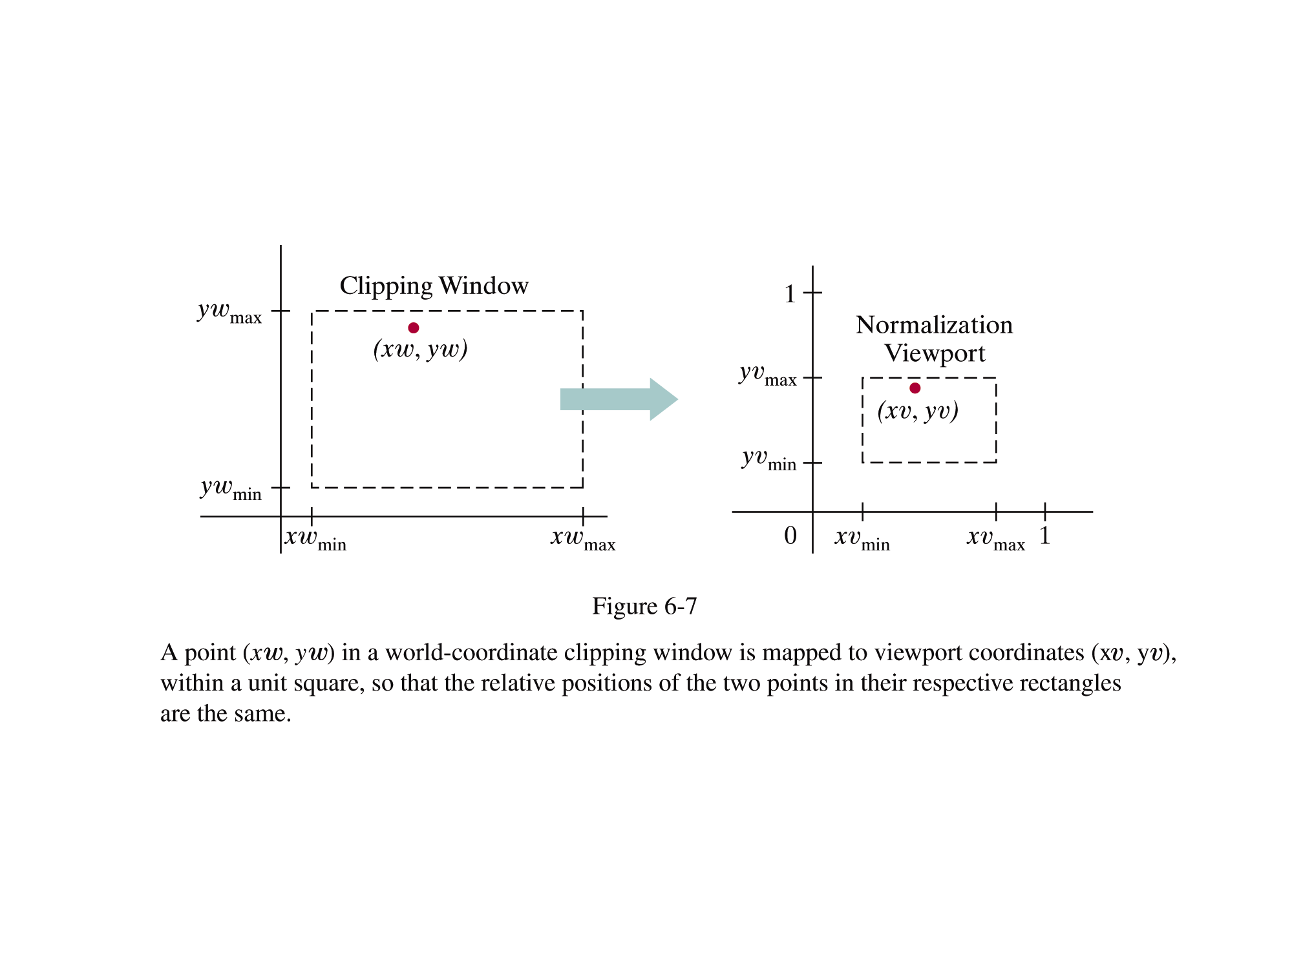
2D Viewing Transformation
(from Donald Hearn and Pauline Baker)
Computer Graphics

Slide 89
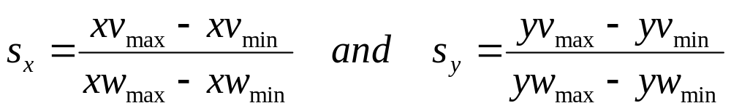
2D Viewing Transformation
Method 1: Let P (xw,yw) be any point in the window, which is to be mapped to P’ (xv,yv) in the associated view port. The two steps required are:
Translation T_{v} that takes (xw_{min},yw_{min}) to (xv_{min},yv_{min}) , where v = (xv_{min} – xw_{min})I + (yv_{min} – yw_{min})J
Scaling by following scaling factors about point (xv_{min},yv_{min})
Computer Graphics

Slide 90
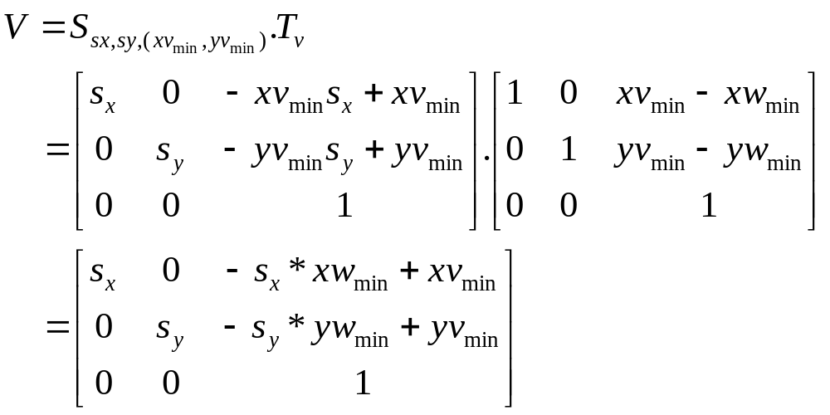
2D Viewing Transformation
Method
Computer Graphics

Slide 91
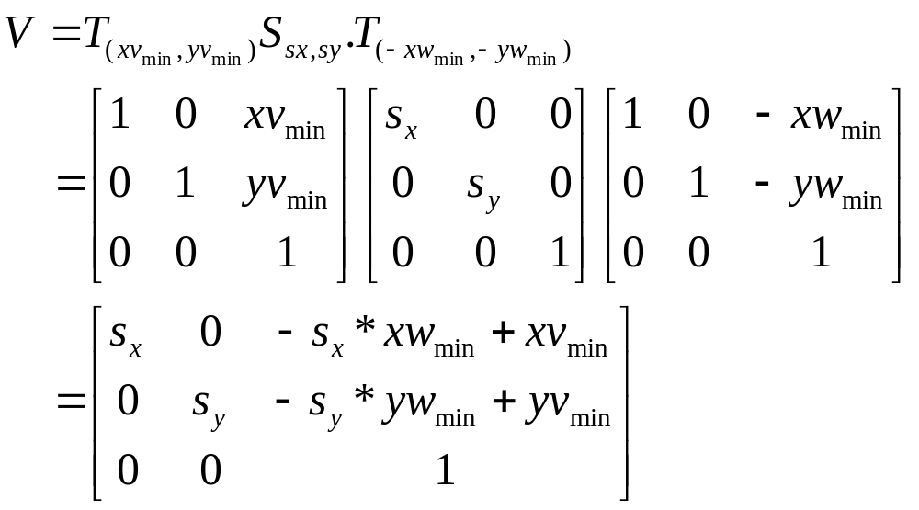
2D Viewing Transformation
Method 2: We get the same result if we perform
Computer Graphics

Slide 92
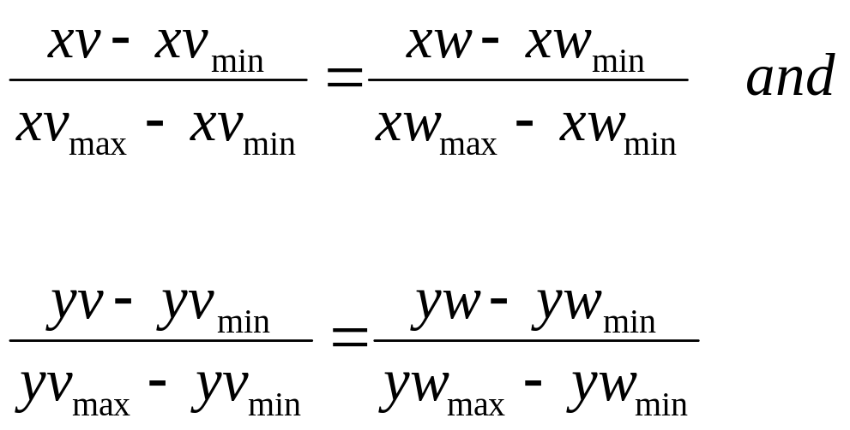
2D Viewing Transformation
Method 3: Let P (xw,yw) be any point in the window, which is to be mapped to P’ (xv,yv) in the associated view port. To maintain the same relative placement in the view port as in window, we require that
Computer Graphics

Slide 93
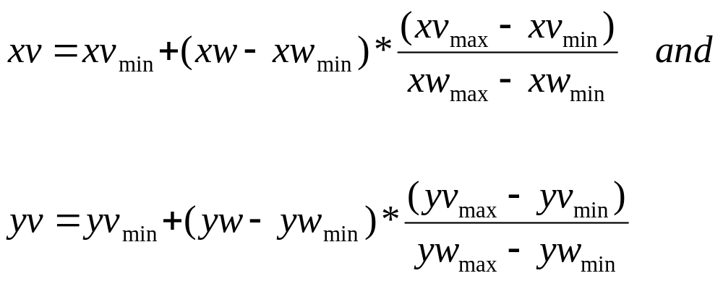
2D Viewing Transformation
Which means
Put these equations in the matrix form.
Computer Graphics

Slide 94
2D Viewing Transformation
3. 2 Normalized Approach
  Mapping the clipping window into a normalized square
  It involves
    transforming the clipping window into a normalized square
    Then clipping in normalized coordinates (ex: -1 to 1) or (ex: 0 to 1)
    Then transferring the scene description to a view port specified in screen coordinates.
    Finally positioning the view port area in the display window.
  Thus V = W.N, where N is a transformation that maps window to normalized view port and W maps Normalized points to view port.
Computer Graphics

Slide 95
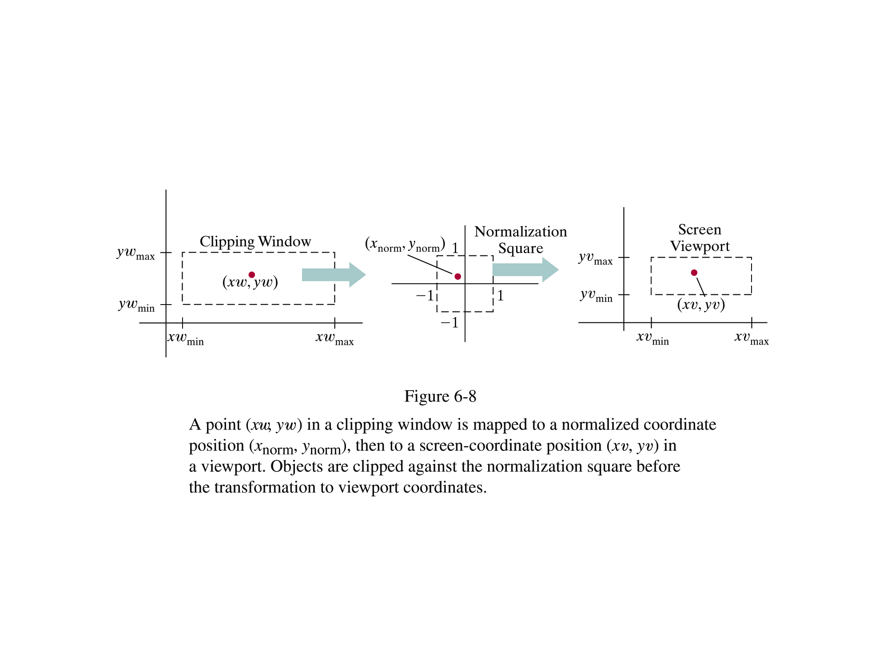
2D Viewing Transformation
(from Donald Hearn and Pauline Baker)
Computer Graphics

Slide 96
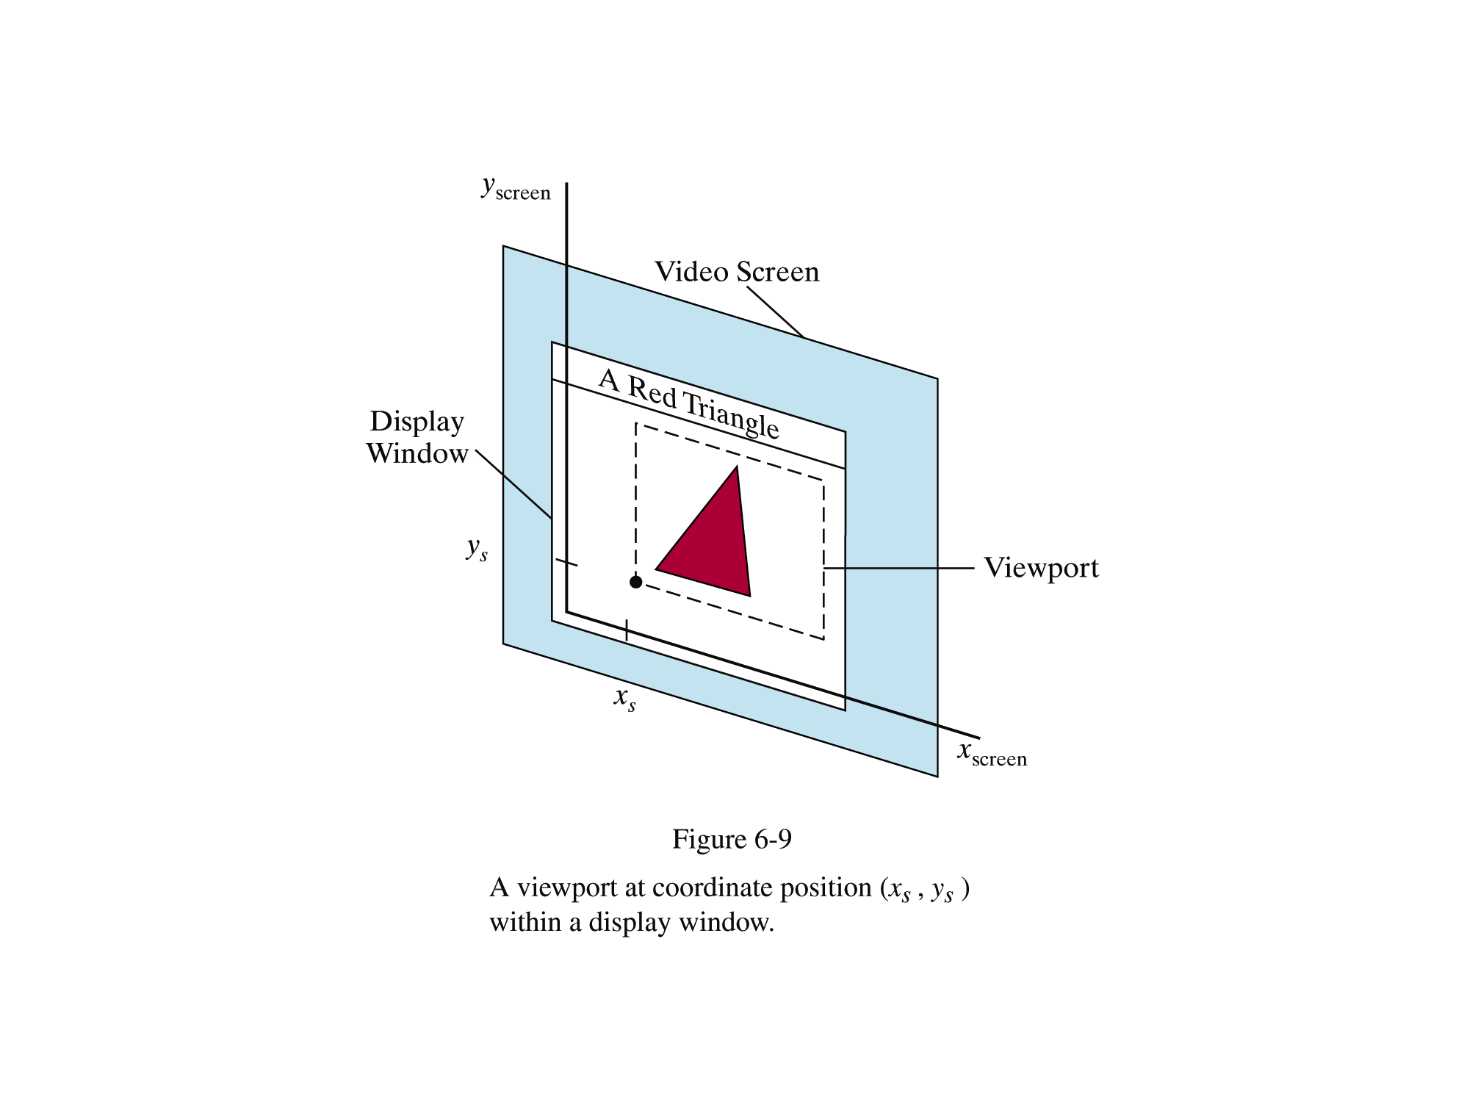
2D Viewing Transformation
(from Donald Hearn and Pauline Baker)
Computer Graphics

Slide 97
2D Viewing Transformation
Definition
2D Viewing Pipeline
Approaches
Aspect Ratio
Computer Graphics

Slide 98
2D Viewing Transformation
4. Aspect Ratio
  Since viewing involves scaling, so undesirable distortions may be introduced when sx ≠ sy
  Aspect ratio is defined as (y_{max}-y_{min})/ (x_{max}-x_{min})
  If a_{w}= a_{v} => no distortion
  If a_{w}> a_{v} => Horizontal spanning
  If a_{w}< a_{v} => Vertical spanning
Window
(aw = 1)
Centered
Sub view
(av=3/4)
Computer Graphics

Slide 99
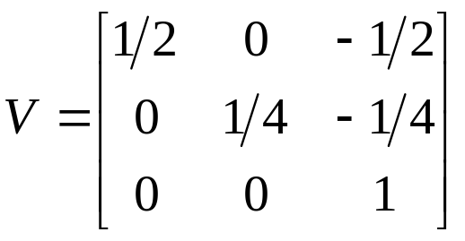
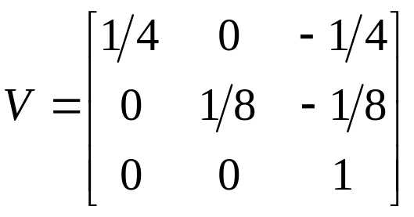
Exercise 1
Find the normalization transformation that maps a window defined by (1,1) to (3,5) on to
  The view port that is entire normalized device.
  Has lower left corner (0,0) and upper right corner as (1/2,1/2)
Computer Graphics

Slide 100
Exercise 2
Find the complete viewing transformation that
  First maps a window defined by (1,1) to (10,10) on to a view port of size(1/4,0) to (3/4,1/2) in normalized device space
  Then maps a window of (1/4,1/4) to (1/2,1/2) in normalized device space to view port of (1,1) to (10,10)
Computer Graphics

Slide 101
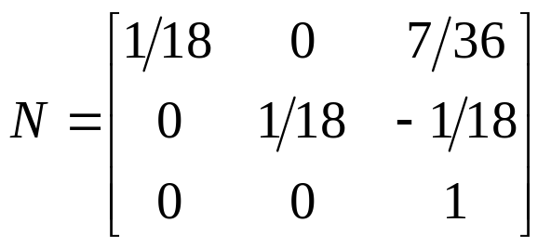
Exercise 2
First maps a window defined by (1,1) to (10,10) on to a view port of size(1/4,0) to (3/4,1/2) in normalized device space
(10,10)
(1,1)
P(x,y)
(0,0)
(1,1)
Computer Graphics

Slide 102
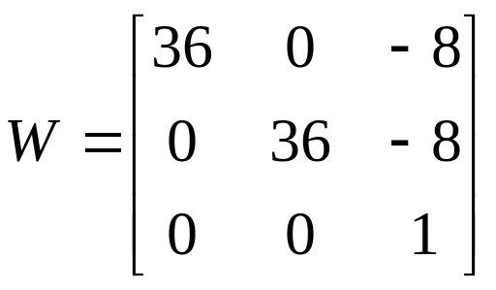
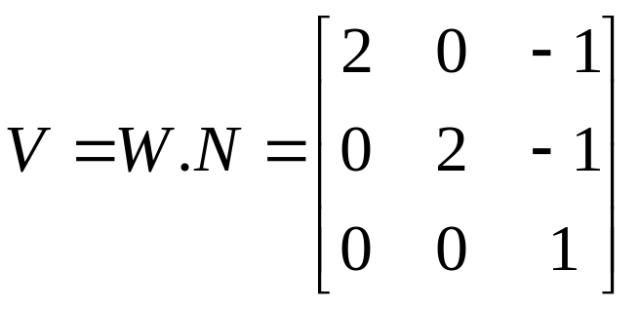
Exercise 2
  Then maps a window of (1/4,1/4) to (1/2,1/2) in normalized device space to view port of (1,1) to (10,10)
(10,10)
(1,1)
P(x,y)
(0,0)
(1,1)
Computer Graphics

Slide 103
Exercise 2
  First maps a window defined by (1,1) to (10,10) on to a view port of size(1/4,0) to (3/4,1/2) in normalized device space
  Then maps a window of (1/4,1/4) to (1/2,1/2) in normalized device space to view port of (1,1) to (10,10)
Computer Graphics

Slide 104
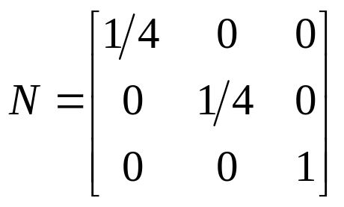
Exercise 3
Find the normalization transformation that maps a window defined by (0,0) to (4,3) on to normalized device screen keeping aspect ratio preserved.
Sol: aw = ¾
av = 1
In normalized device we will keep
x extent 0 to 1 and y extent 0 to ¾
S_{x} = (1-0)/(4-0) = ¼
S_{y}=( ¾ - 0)/(3-0) = ¼
Computer Graphics

Slide 105
Exercise 4
Find the normalization transformation that maps a window defined by A(1,1) B(5,3) C(4,5) and D(0,3) on to normalized device screen.
Computer Graphics

Slide 106
Exercise 4
y
6
5
C(4,5)
4
D(0,3)
3
B(5,3)
2
1
A(1,1)
0
1
2
3
4
5
6
7
8
9
10
x
Computer Graphics

Slide 107
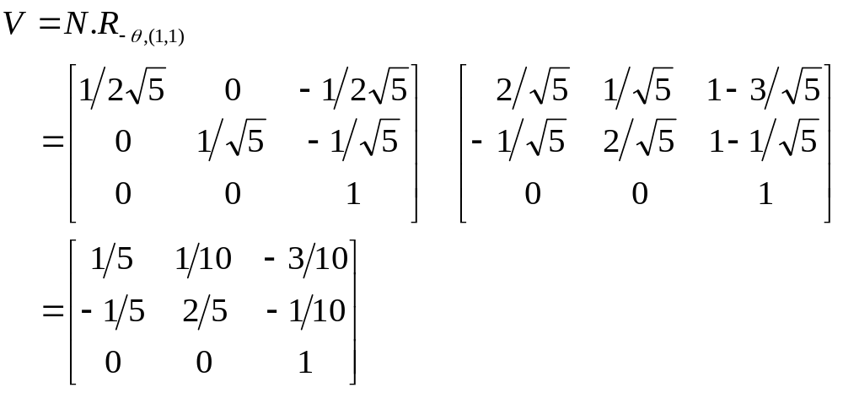
Exercise 4
The normalization transformation that maps a window defined by A(1,1) B(5,3) C(4,5) and D(0,3) on to normalized device screen first require rotation about point (1,1).
Computer Graphics

