Slide 1
Chapter 11
3D Clipping

Slide 2
3D Viewing Pipeline
Primitives
Object space
Modeling Transformation
World space
Viewing Transformation
Camera space
Hidden Surface Removal
Lighting & Shading
3D-Clipping
Projection
Normalized view space
Scan conversion, Hiding
Image space,
Device coordinates
Image

Slide 3
Contents
Introduction
Clipping Volume
Clipping Strategies
Clipping Algorithm

Slide 4
3D Clipping
Just like the case in two dimensions, clipping removes objects that will not be visible from the scene
The point of this is to remove computational effort
3-D clipping is achieved in two basic steps
  Discard objects that can’t be viewed
    i.e. objects that are behind the camera, outside the field of view, or too far away
  Clip objects that intersect with any clipping plane

Slide 5
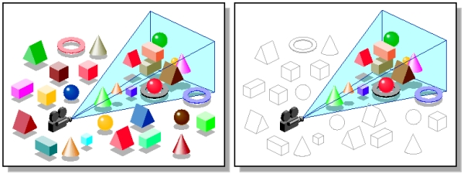
3D Clipping
Discarding objects that cannot possibly be seen involves comparing an objects bounding box/sphere against the dimensions of the view volume
  Can be done before or after projection

Slide 6
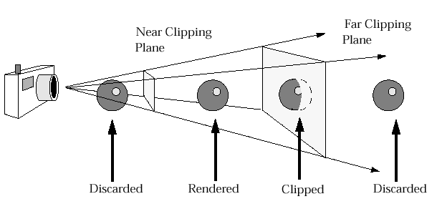
3D Clipping
Objects that are partially within the viewing volume need to be clipped – just like the 2D case

Slide 7
Contents
Introduction
Clipping Volume
Clipping Strategies
Clipping Algorithm

Slide 8
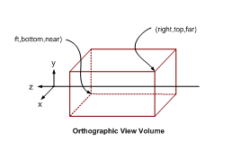
The Clipping Volume
In case of Parallel projections the infinite Parallelepiped is bounded by Near/front/hither and far/back/yon planes for clipping.

Slide 9
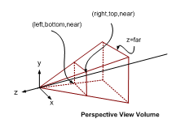
The Clipping Volume
In case of Perspective projections the semi Infinite Pyramid is also bounded by Near/front/hither and far/back/yon planes for clipping

Slide 10
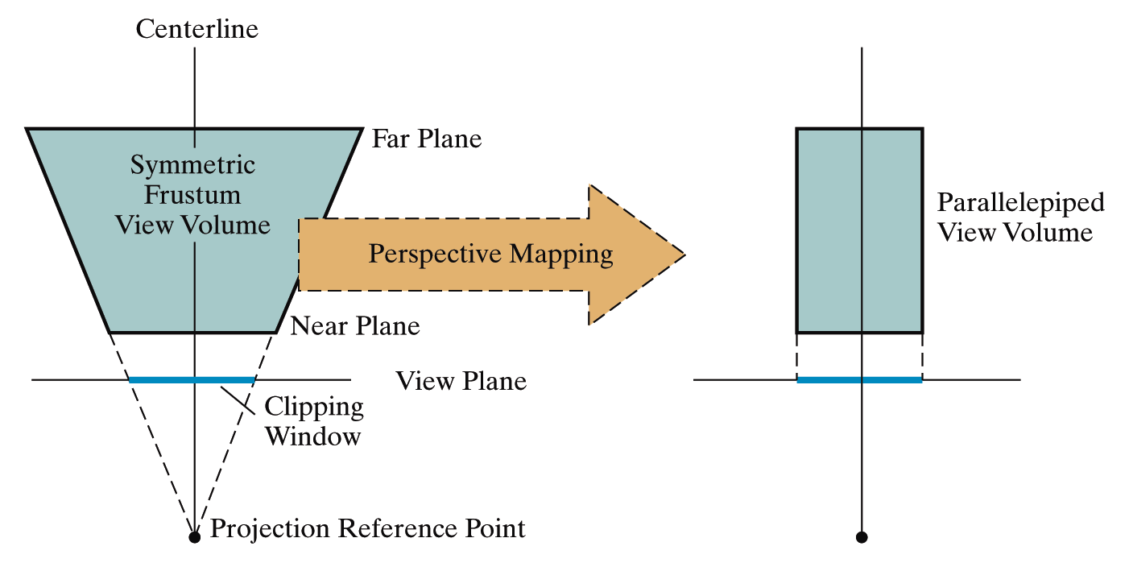
The Clipping Volume
After the perspective transformation is complete the frustum shaped viewing volume has been converted to a parallelepiped - remember we preserved all z coordinate depth information

Slide 11
Contents
Introduction
Clipping Volume
Clipping Strategies
Clipping Algorithm

Slide 12
Clipping Strategies
Because of the extraordinary computational effort required, two types of clipping strategies are followed:
  Direct Clipping: The clipping is done directly against the view volume.
  Canonical Clipping: Normalization transformations are applied which transform the original view volume into normalized (canonical) view volume. Clipping is then performed against canonical view volume.

Slide 13
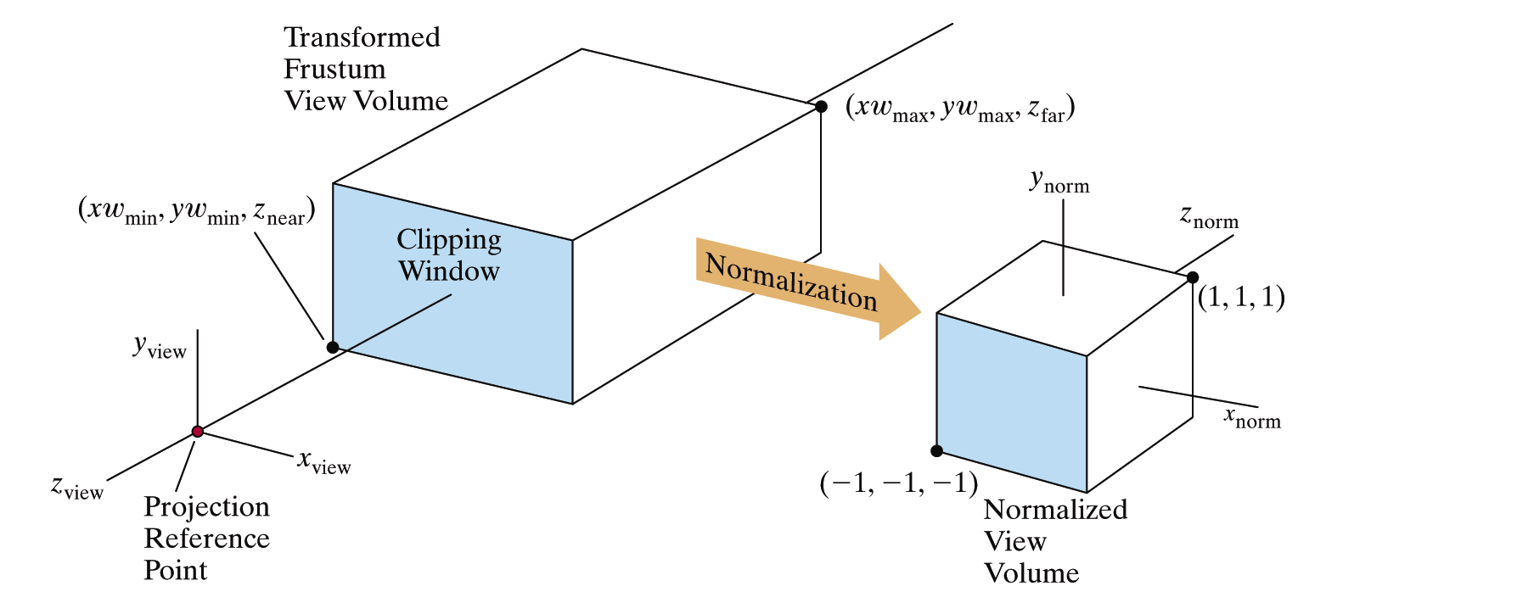
Clipping Strategies
The canonical view volume for parallel projection is the unit cube whose faces are defined by planes
x = 0 ; x = 1 y = 0; y = 1 z = 0; z = 1

Slide 14
Clipping Strategies
The canonical view volume for perspective projection is the truncated normalized pyramid whose faces are defined by planes
x = z ; x = -z y = z; y = -z z = z_{f}; z = 1
y
y
clipped line
x
clipped line
x
1
1
near
far
z
z
0
1
image plane
near
far

Slide 15
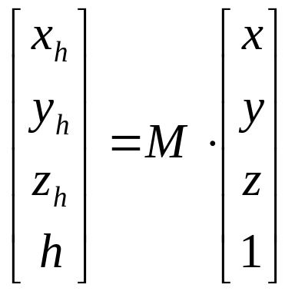
Clipping Strategies
We perform clipping after the projection transformation and normalizations are complete.
So, we have the following:
We apply all clipping to these homogeneous coordinates

Slide 16
Clipping Strategies
The basis of canonical clipping is the fact that intersection of line segments with the faces of canonical view volume require minimal calculations.
For perspective views, additional clipping may be required to avoid perspective anomalies produced by the projecting objects that are behind view point.

Slide 17
Contents
Introduction
Clipping Volume
Clipping Strategies
Clipping Algorithm

Slide 18
Clipping Algorithms
3D clipping algorithms are direct adaptation of 2D clipping algorithms with following modifications:
For Cohen Sutherland: Assignment of out codes
For Liang-Barsky: Introduction of new equations
For Sutherland Hodgeman: Inside/Out side Test
In general: Finding the intersection of Line with plane.

Slide 19
3D Cohen-Sutherland Line Clipping
Similar to the case in two dimensions, we divide the world into regions
This time we use a 6-bit region code to give us 27 different region codes
The bits in these regions codes are as follows:
bit 1 Above | bit 2 Below | bit 3 Right | bit 4 Left | bit 5 Behind | bit 6 Front

Slide 20
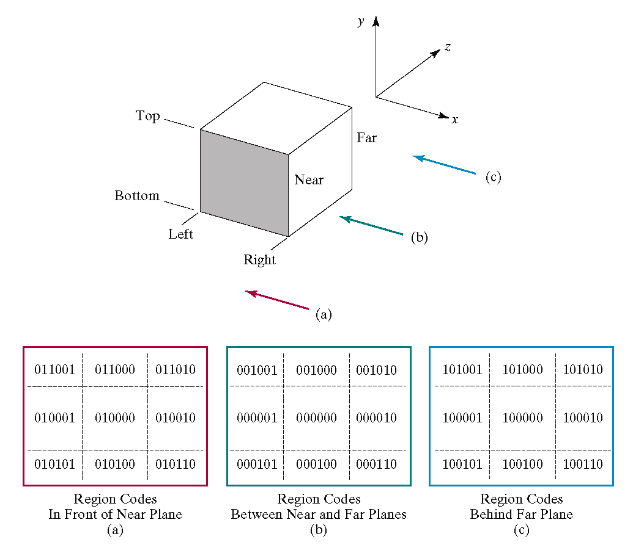
3D Cohen-Sutherland Line Clipping

Slide 21
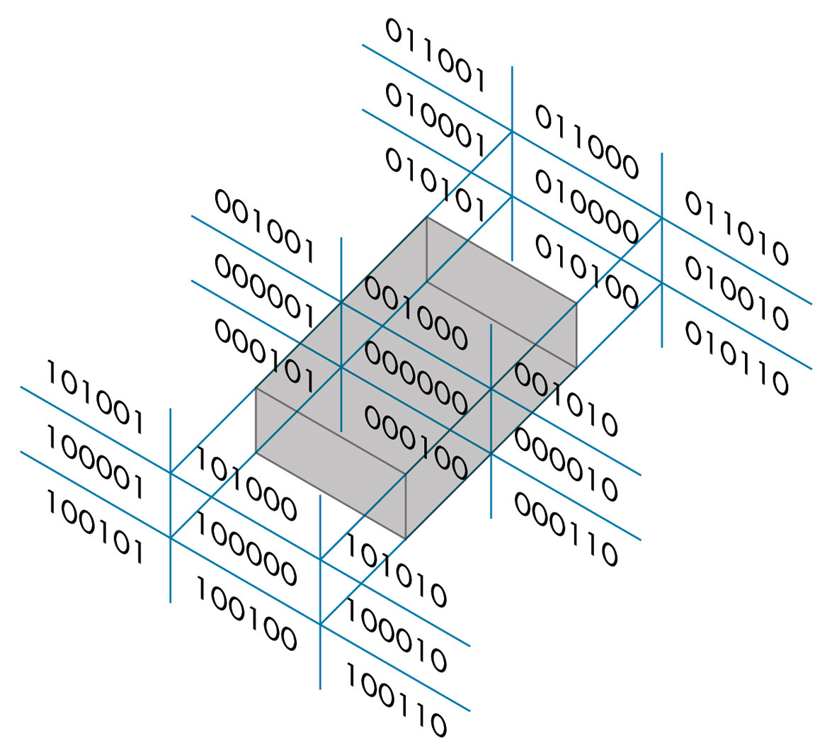
3D Cohen-Sutherland Line Clipping
Now we use a 6 bit out code to handle the near and far plane.
The testing strategy is virtually identical to the 2D case.

Slide 22
3D Cohen-Sutherland Line Clipping
CASE – I Assigning region codes to endpoints for Canonical Parallel View Volume defined by:
x = 0 , x = 1; y = 0, y = 1; z = 0, z = 1
The bit codes can be set to true(1) or false(0) for depending on the test for these equations as follows:
Bit 1 ≡ endpoint is Above view volume = sign (y-1)
Bit 2 ≡ endpoint is Below view volume = sign (-y)
Bit 3 ≡ endpoint is Right view volume = sign (x-1)
Bit 4 ≡ endpoint is Left view volume = sign (-x)
Bit 5 ≡ endpoint is Behind view volume = sign (z-1)
Bit 6 ≡ endpoint is Front view volume = sign (-z)

Slide 23
3D Cohen-Sutherland Line Clipping
CASE – II Assigning region codes to endpoints for Canonical Perspective View Volume defined by:
x = -z , x = z; y = -z, y = z; z = z_{f} , z = 1
The bit codes can be set to true(1) or false(0) for depending on the test for these equations as follows:
Bit 1 ≡ endpoint is Above view volume = sign (y-z)
Bit 2 ≡ endpoint is Below view volume = sign (-z-y)
Bit 3 ≡ endpoint is Right view volume = sign (x-z)
Bit 4 ≡ endpoint is Left view volume = sign (-z-x)
Bit 5 ≡ endpoint is Behind view volume = sign (z-1)
Bit 6 ≡ endpoint is Front view volume = sign (z_{f}-z)

Slide 24
3D Cohen-Sutherland Line Clipping
To clip lines we first label all end points with the appropriate region codes.
Classify the category of the Line segment as follows
  Visible: if both end points are 000000
  Invisible: if the bitwise logical AND is not 000000
  Clipping Candidate: if the bitwise logical AND is 000000
We can trivially accept all lines with both end-points in the [000000] region.
We can trivially reject all lines whose end points share a common bit in any position.

Slide 25
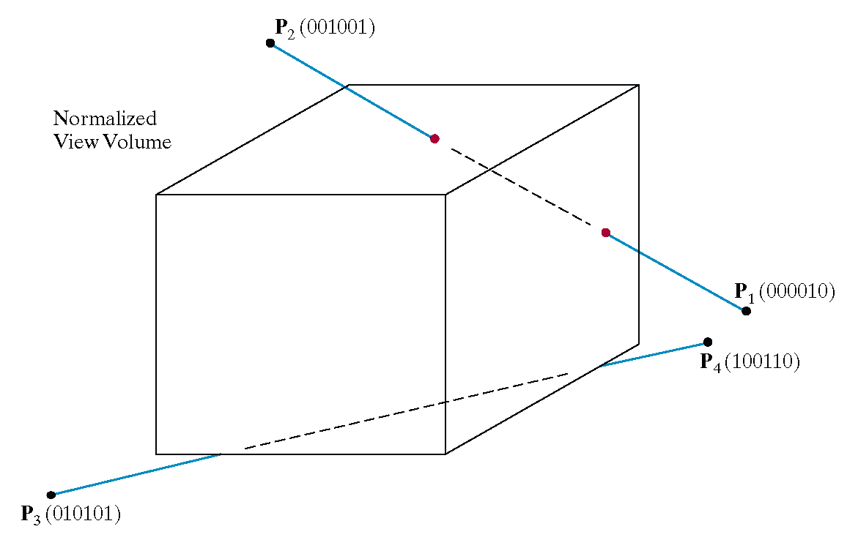
3D Cohen-Sutherland Line Clipping

Slide 26


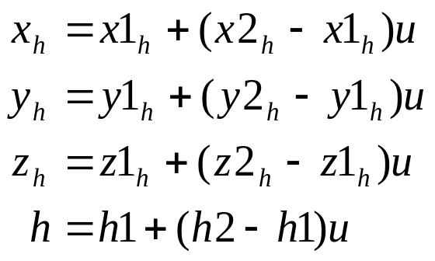
3D Cohen-Sutherland Line Clipping
For clipping equations for three dimensional line segments are given in their parametric form.
For a line segment with end points P₁(x1_{h}, y1_{h}, z1_{h}, h1) and P₂(x2_{h}, y2_{h}, z2_{h}, h2) the parametric equation describing any point on the line is:
From this parametric equation of a line we can generate the equations for the homogeneous coordinates:

Slide 27
3D Cohen-Sutherland Line Clipping
Consider the line P₁[000010] to P₂[001001]
Because the lines have different values in bit 2 we know the line crosses the right boundary

Slide 28
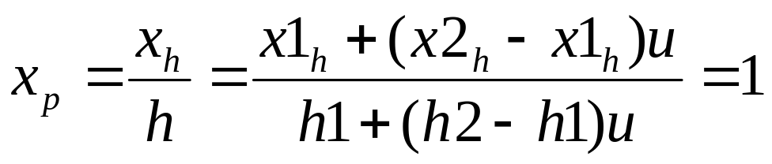
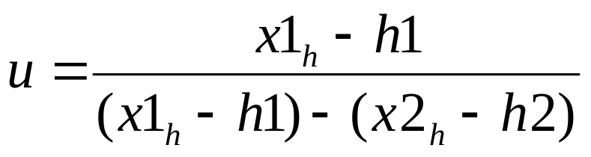
3D Cohen-Sutherland Line Clipping
Since the right boundary is at x = 1 we now know the following holds:
which we can solve for u as follows:
using this value for u we can then solve for y_{p} and z_{p} similarly
Then simply continue as per the two dimensional line clipping algorithm

Slide 29
3D Liang-Barsky Line Clipping
We now add a third equation
z(u) = z₁ + u Δz where Δz = (z₂ – z₁)
to obtain the 3D parametric representation of the line segment.
We now have to consider six intersections with the surfaces that form the clipping volume, but we can use the same logic we used in the 2D case.
Clippers constructed as a pipeline just add two modules for either algorithm to clip against the near and far planes of the clipping volume.

Slide 30
3D Liang-Barsky Line Clipping
Now we need to determine the inequalities that are needed to extend in 2D clipping for the canonical parallel and perspective view volumes.
Let P₁(x₁,y₁,z₁) and P₂(x₂,y₂,z₂) be the endpoints of line then the parametric equation of line is:
x(u) = x₁ + Δx.u where Δx = (x₂ – x₁)
y(u) = y₁ + Δy.u where Δy = (y₂ – y₁)
z(u) = z₁ + Δz.u where Δz = (z₂ – z₁)
0≤u ≤1

Slide 31
3D Liang-Barsky Line Clipping
CASE – I Points in side the Canonical Parallel View Volume defined by:
x = 0 , x = 1; y = 0, y = 1; z = 0, z = 1
satisfy
x_{min}≤ x₁ + Δx.u ≤ x_{max}
y_{min}≤ y₁ + Δy.u ≤ y_{max}
z_{min}≤ z₁ + Δz.u ≤ z_{max}
where
x_{min} = y_{min} = z_{min} = 0
x_{max} = y_{max} = z_{max} = 1
– We can write six inequalities as
u*(p_{k}) <= (q_{k}) k = 1,2,3,4,5,6
where
p₁ = -Δx q₁ = x₁ – x_{min} (left)
p₂ = Δx q₂ = x_{max} – x₁ (right)
p₃ = -Δy q₃ = y₁ – y_{min} (bottom)
p₄ = Δy q₄ = y_{max} – y₁ (top)
p₅ = -Δz q₅ = z₁ – z_{min} (front)
p₆ = Δz q₆ = z_{max} – z₁ (back)

Slide 32
3D Liang-Barsky Line Clipping
CASE – II Points in side the Canonical Perspective View Volume defined by:
x = -z , x = z; y = -z, y = z; z = z_{f}, z = 1
satisfy
-z≤ x₁ + Δx.u ≤ z
-z≤ y₁ + Δy.u ≤ z
z_{f}≤ z₁ + Δz.u ≤ 1
– We can write six inequalities as
u*(p_{k}) <= (q_{k}) k = 1,2,3,4,5,6
where
p₁ = -Δx -Δz q₁ = x₁ + z₁ (left)
p₂ = Δx -Δz q₂ = z₁ – x₁ (right)
p₃ = -Δy -Δz q₃ = y₁ + z₁ (bottom)
p₄ = Δy -Δz q₄ = z₁ – y₁ (top)
p₅ = -Δz q₅ = z₁ - z_{min} (front)
p₆ = Δz q₆ = 1 – z₁ (back)

Slide 33
3D Sutherland Hodgeman Clipping
We need to determine whether the point P lies inside or outside the view volume.
  Remember in 2D we used to have Left/Right Test
A plane divides the space into two sides.
The general equation of the plane is given by
f(P)≡f(x,y,z) = n₁(x-x₀)+ n₂(y-y₀)+ n₃(z-z₀)
A point P is said to lie on the same side as point Q if
Sign f(P) = Sign f(Q)

Slide 34
3D Sutherland Hodgeman Clipping
Let f_{T} , f_{B} , f_{R} , f_{L} , f_{N} and f_{F} be the six bounding planes of the view volume.
Further let L and R be the Lower left and upper right corners of the window and P_{b} and P_{f} are the reference points of back and front planes.
A point P is inside the view volume if
  P is on the same side as L w.r.t f_{T} ⇒ Sign f_{T}(P) = Sign f_{T}(L)
  P is on the same side as R w.r.t f_{B} ⇒ Sign f_{B}(P) = Sign f_{B}(R)
  P is on the same side as L w.r.t f_{R} ⇒ Sign f_{R}(P) = Sign f_{R}(L)
  P is on the same side as R w.r.t f_{L} ⇒ Sign f_{L}(P) = Sign f_{L}(R)
  P is on the same side as P_{b} w.r.t f_{N} ⇒ Sign f_{N}(P) = Sign f_{N}(P_{b})
  P is on the same side as P_{f} w.r.t f_{F} ⇒ Sign f_{F}(P) = Sign f_{F}(P_{f})

Slide 35
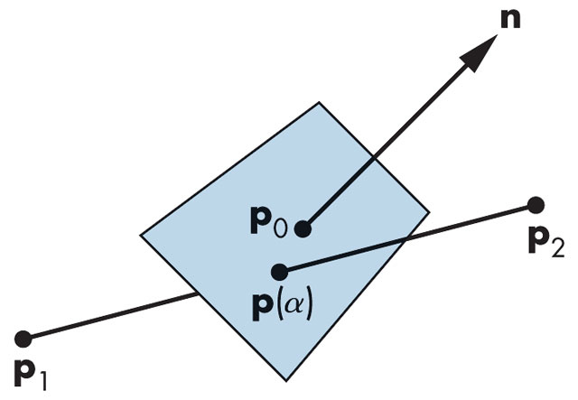
Intersection of Line with Plane
Let P₁(x₁,y₁,z₁) and P₂(x₂,y₂,z₂) be the endpoints of line then the parametric equation of line is:
x = x₁ + (x₂ – x₁).α
y = y₁ + (y₂ – y₁).α where 0≤ α ≤1
z = z₁ + (z₂ – z₁).α
……………..(1)
The equation of plane with normal N and Reference point P₀ is
n₁(x – x₀)+ n₂(y – y₀)+ n₃(z – z₀) = 0
………………(2)

Slide 36
Intersection of Line with Plane
At the point of intersection P(x,y,z) lies on both the line and the plane. Hence solving (1) and (2) for α
n₁(x₁ + (x₂ – x₁).α – x₀)+ n₂(y₁ + (y₂ – y₁).α – y₀)+ n₃(z₁ + (z₂ – z₁).α – z₀) = 0
n₁(x₁ – x₀ )+ n₂(y₁ – y₀ )+ n₃(z₁ – z₀) N.R₀P₁
α = − ––––––––––––––––––––––––––––– = − ––––––
n₁(x₂ – x₁ )+ n₂(y₂ – y₁ )+ n₃(z₂ – z₁) N.P₁P₂
If 0≤ α ≤ 1 then the point of intersection can be found by putting the value α of in the equation of line (1)

Slide 37
Any Question !

