Slide 1
Introduction to CRC Cards
CRC Card = Class Responsibility Collaborator Card
Invented in 1989 by Kent Back and Ward Cunningham
Help explore objects
Provide an ’easy' introduction
Starting point of many methodologies
Used in industry

Slide 2
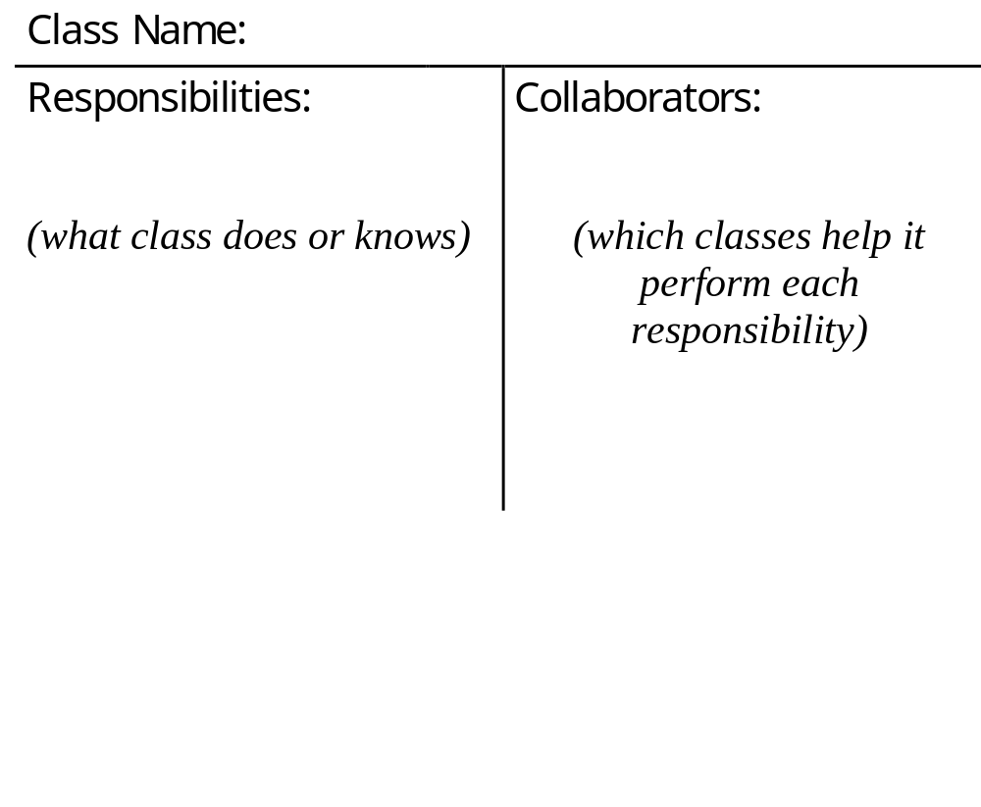
Format of CRC CARDS
A CRC card contains the following information:

Slide 3
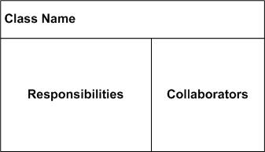
Format of CRC CARDS

Slide 4
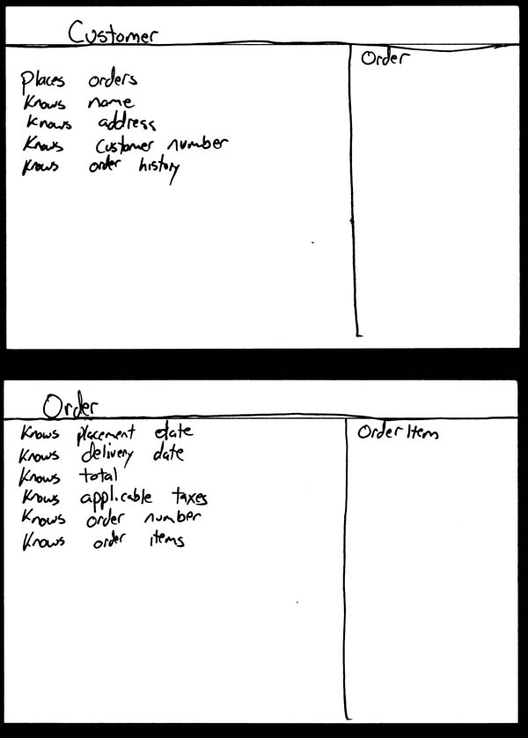
Example

Slide 5
CRC Terms versus UML Terms
CRC are similar to classes, but are treated like objects
attributes are the same in both CRC and UML
“responsibilities” are “operations”
Superclass and subclass describe inheritance relations
Collaborators are “associations”

Slide 6
FINDING CLASSES Method:
  1. Read specification
  2. Work through requirements, highlighting nouns and noun phrases to give candidate classes.
  3. Work through candidates, deciding likely classes and rejecting unlikely.

Slide 7
READ SPECIFICATION
If you don't have one, WRITE your own.
The specification should:
  describe the goals of the design
  discuss the things the system should do
i.e. desired responses to expected inputs

Slide 8
HIGHLIGHTING NOUN PHRASES
convert plurals to singulars
discard obvious nonsense classes (but keep all rest)
remove synonyms (but keep BEST descriptor)
beware adjectives (they can be irrelevant, but can mean a whole new class exists)

Slide 9
IDENTIFYING RESPONSIBILITIES
Responsibilities are concerned with:
  the maintenance of knowledge
  the actions the object can perform
Technique:
  Highlight verbs/phrases in requirements

Slide 10
What are Responsibilities?
They contain two key items:
  the knowledge that the object maintains
  the actions the object can perform
They say WHAT gets done, not HOW its done

Slide 11
Identifying Responsibilities
Read requirements & highlight:
  verbs
  information (which some object must maintain)
Check these are actions that a system object must perform
Check all your classes are doing something useful

Slide 12
Look at Relationships between Classes
Taking classes from within your system, see if there are examples of:
is-kind-of
  maybe superclass should have responsibility?
is-analogous-to
  if have similar responsibilities, perhaps should be common superclass with it?
is-part-of
  therefore clarify responsibilities between parts of an aggregate class

Slide 13
COLLABORATIONS
A collaboration is where one class (a client) needs another one (a server) in order to perform its own responsibilities.
Each responsibility may have:
  no collaborations
  one collaboration
  many collaborations

Slide 14
FINDING COLLABORATIONS (1)
Using CRC cards, work through ALL responsibilities identifying collaborators.
Therefore, for each responsibility ask:
  can the class do it alone?
  if not:
    what knowledge does it need?
    what processing does it need?
    which classes have what it needs?

Slide 15
FINDING COLLABORATIONS (2)
For each CRC card class ask:
  what does it do or know?
  what classes need this service or knowledge?
  are those classes collaborating with this class?
Confirm by looking at classes and ensure if a class does/knows something, it is being used

Slide 16
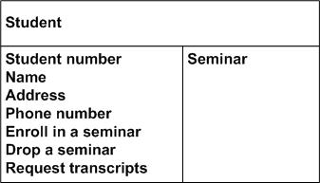
Example… student CRC card

Slide 17
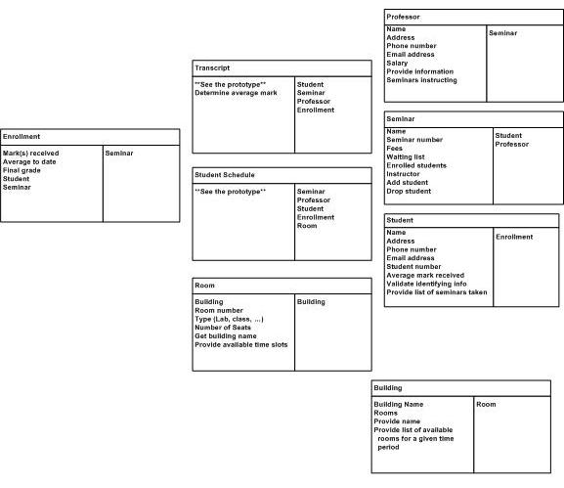
Example: Student CRC card

Slide 18
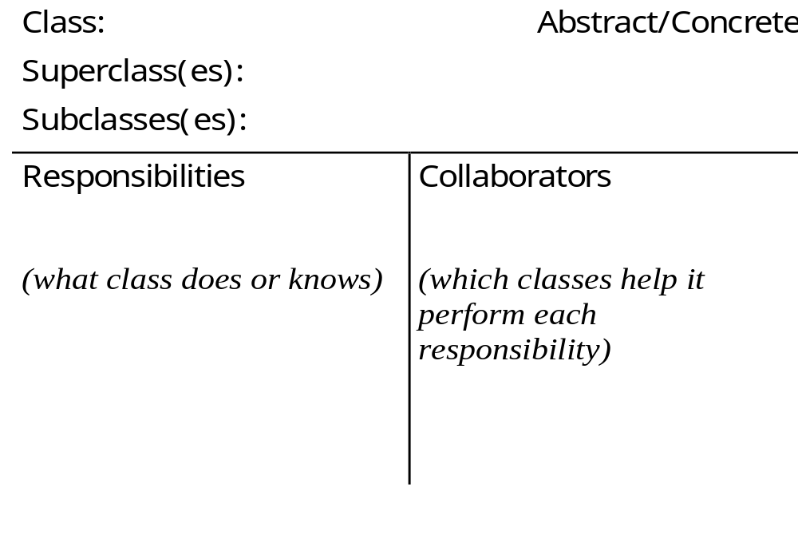
CRC CARDS
Additional information:

