Slide 1
Processes and Threads
A process is a heavyweight flow that can execute concurrently with other processes.
A thread is a lightweight flow that can execute concurrently with other threads within the same process.
An active object is an object that owns a process or thread and can initiate control activity.
An active class is a class whose instances are active objects.
Graphically, an active class is rendered as a rectangle with thick lines. Processes and threads are rendered as stereotyped active classes

Slide 2
Flow of Control
In a sequential system, there is a single flow of control. i.e, one thing, and one thing only, can take place at a time.
In a concurrent system, there is multiple simultaneous flow of control i.e, more than one thing can take place at a time.

Slide 3
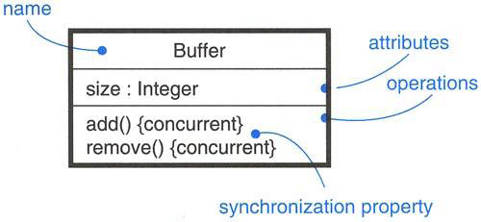
Synchronization
Three approaches are there to handle synchronization:
Sequential – Callers must coordinate outside the object so that only one flow is in the object at a time.
Guarded – multiple flow of control is sequentialized with the help of object’s guarded operations. in effect it becomes sequential.
Concurrent – multiple flow of control is guaranteed by treating each operation as atomic

Slide 4
Time and Space
A distributed system is one in which components may be physically distributed across nodes. These nodes may represent different processors physically located in the same box, or they may even represent computers that are located half a world away from one another.
To represent the modeling needs of real time and distributed systems, the UML provides a graphic representation for timing marks, time expressions, timing constraints, and location.

Slide 5
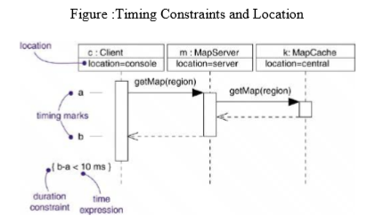

Slide 6
A timing mark is a denotation for the time at which an event occurs. Graphically, a timing mark is depicted as a small hash mark (horizontal line) on the border of a sequence diagram.
A time expression is an expression that evaluates to an absolute or relative value of time. A time expression can also be formed using the name of a message and an indication of a stage in its processing, for example, request.sendTime or request.receiveTime.

Slide 7
A timing constraint is a semantic statement about the relative or absolute value of time. Graphically, a timing constraint is rendered as for any constraint-that is, a string enclosed by brackets and generally connected to an element by a dependency relationship.
Location is the placement of a component on a node. Location is an attribute of an object.

