Slide 1

Requirements

Slide 2
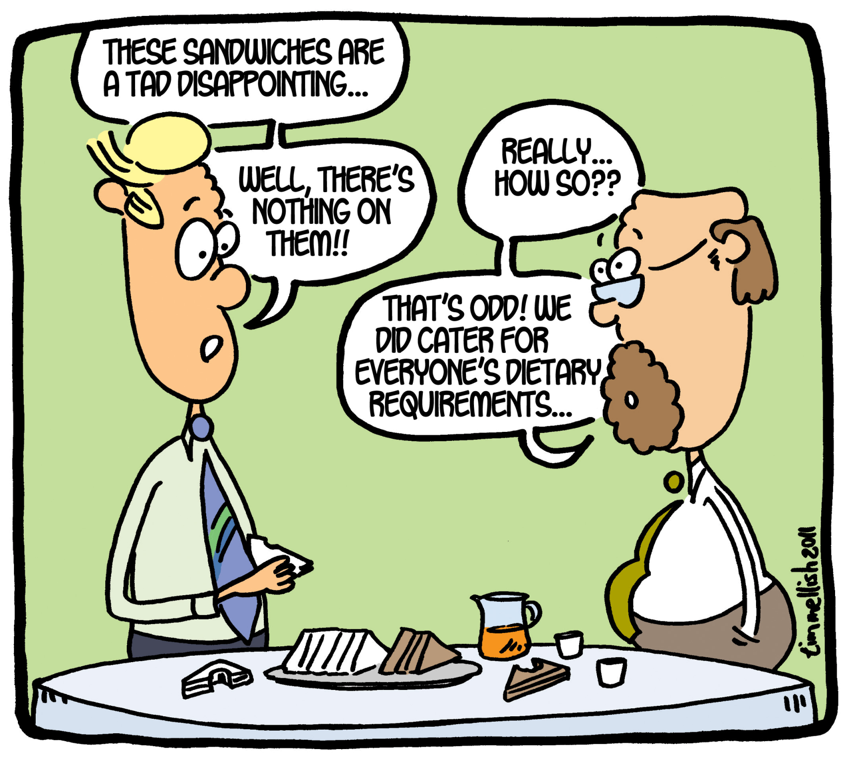

Slide 3
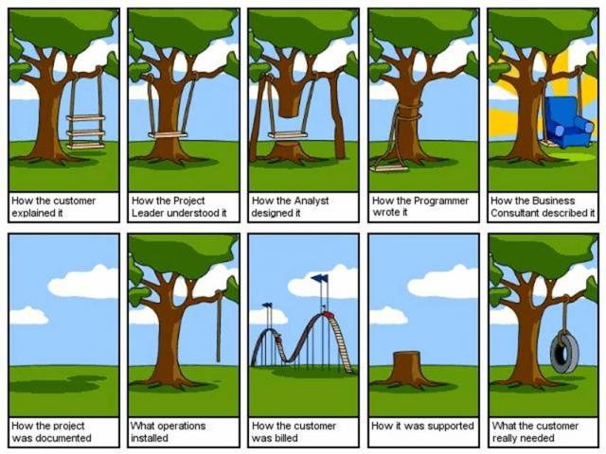

Slide 4

Requirement Engineering
It is the practice of collecting the requirements of a system from users, customers and other stakeholders.

Slide 5
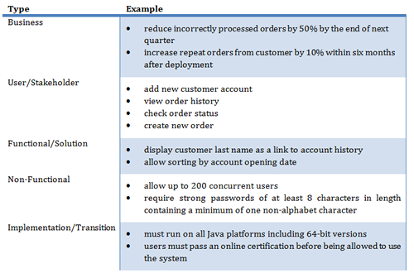

Slide 6

Types of Requirements
Business Requirements
User Requirements
Functional Requirement
Non-functional Requirement
Notes:
Business requirement:
What kind of information drives?
Who is going to generate information?
From where information comes and goes?
How?

Slide 7
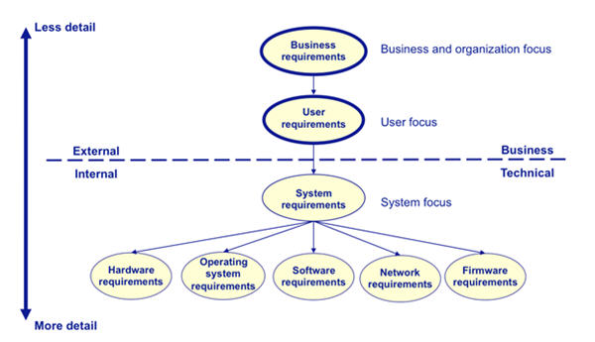

Slide 8
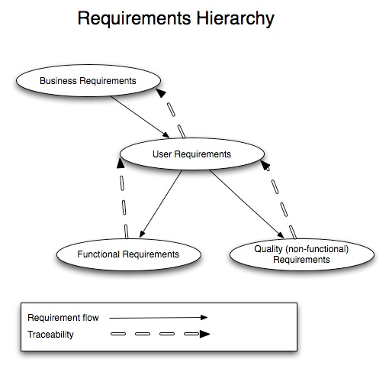

Slide 9
Functional requirements
Describe functionality or system services.
Depend on the type of software, expected users and the type of system where the software is used.
Functional user requirements may be high-level statements of what the system should do and should describe the system services in detail.

Slide 10
Examples of functional requirements
The user shall be able to search either all of the initial set of databases or select a subset from it.
The system shall provide appropriate viewers for the user to read documents in the document store.
Every order shall be allocated a unique identifier (ORDER_ID).

Slide 11
Non-functional requirements
Define system properties and constraints e.g. reliability, response time and storage requirements.
Constraints are I/O device capability, system representations, etc.
Non-functional requirements may be more critical than functional requirements. If these are not met, the system is useless.

Slide 12
Non-functional classifications
Product requirements
Requirements which specify that the delivered product must behave in a particular way e.g. execution speed, reliability, etc.
Organisational requirements
Requirements which are a consequence of organisational policies and procedures e.g. process standards used, implementation requirements, etc.
External requirements
Requirements which arise from factors which are external to the system and its development process e.g. interoperability requirements, legislative requirements, etc.

Slide 13
