Slide 1
Interaction Model

Slide 2
Interaction Model
The class model describes the objects in a system and their relationships
The state model describes the life cycles of the objects
The interaction model describes how the objects interact
Both state model and interaction model are needed to describe behavior fully. They view behavior from different perspective

Slide 3
Interaction Model
Can be modelled at different level of abstraction
At high level, Use cases describes how a system interacts with outside actors
Sequence diagrams provide more detail and show the messages exchanged among a set of objects over time
Activity diagrams provide details and show the flow of control among the steps of a computation (data flow and control flow)

Slide 4
Sequence Diagram
Sequence diagram
Shows the participants in an interaction and the sequence of messages among them
Shows the interaction of a system with its actors to perform all or part of a use case

Slide 5
Key parts of a Sequence Diagram
participant: an object or entity that acts in the sequence diagram
message: communication between participant objects
The axes in a sequence diagram:
horizontal: which object/participant is acting
vertical: lifeline ( time – top -> bottom ) (spacing is irrelevant)

Slide 6
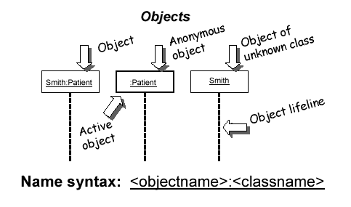
Representing objects
Squares with object type, optionally preceded by object name and colon
write object's name if it clarifies the diagram
object's "life line" represented by dashed vert. line

Slide 7
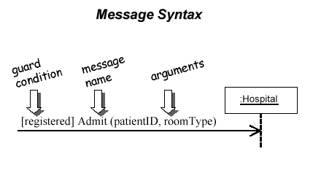
Messages between objects
message (method call) indicated by horizontal arrow to other object
write message name and arguments above arrow

Slide 8
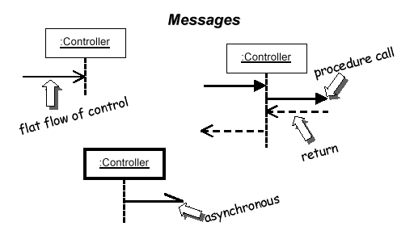
Messages, continued
message (method call) indicated by horizontal arrow to other object
dashed arrow back indicates return
different arrowheads for normal / concurrent (asynchronous) methods

Slide 9
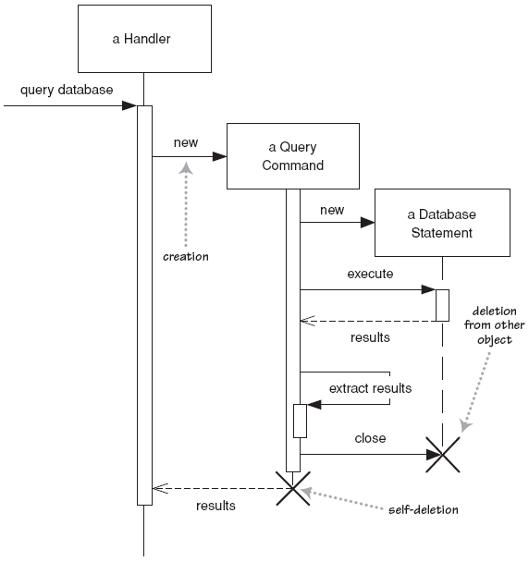
Lifetime of objects
creation: arrow with 'new' written above it
notice that an object created after the start of the scenario appears lower than the others
deletion: an X at bottom of object's lifeline

Slide 10
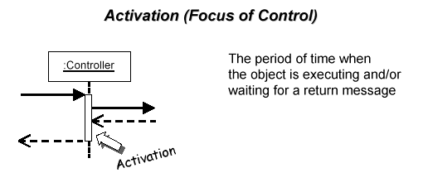
Indicating method calls
activation: thick box over object's life line; drawn when object's method is on the stack
either that object is running its code, or it is on the stack waiting for another object's method to finish
nest to indicate recursion
Activation
Nesting

Slide 11
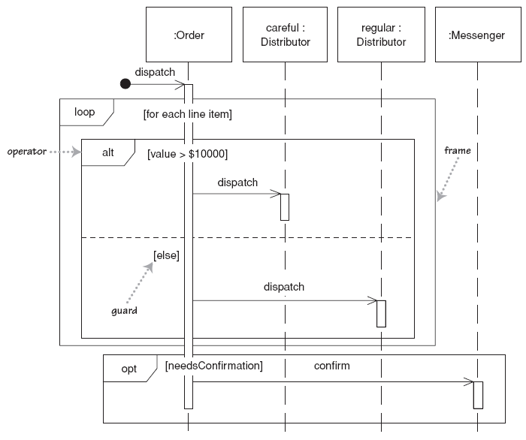
Indicating selection and loops
frame: box around part of a sequence diagram to indicate selection or loop
if -> (opt) [condition]
if/else -> (alt) [condition], separated by horizontal dashed line
loop -> (loop) [condition or items to loop over]

