Slide 1
Activity Diagram

Slide 2
Activity Model
Shows the sequence of steps that make up a complex process, such as an algorithm or workflow
Shows flow of control, focus is on operations
Like a traditional flowchart, it shows the flow of control step by step
But activity diagram can show both sequential and concurrent flow of control.

Slide 3
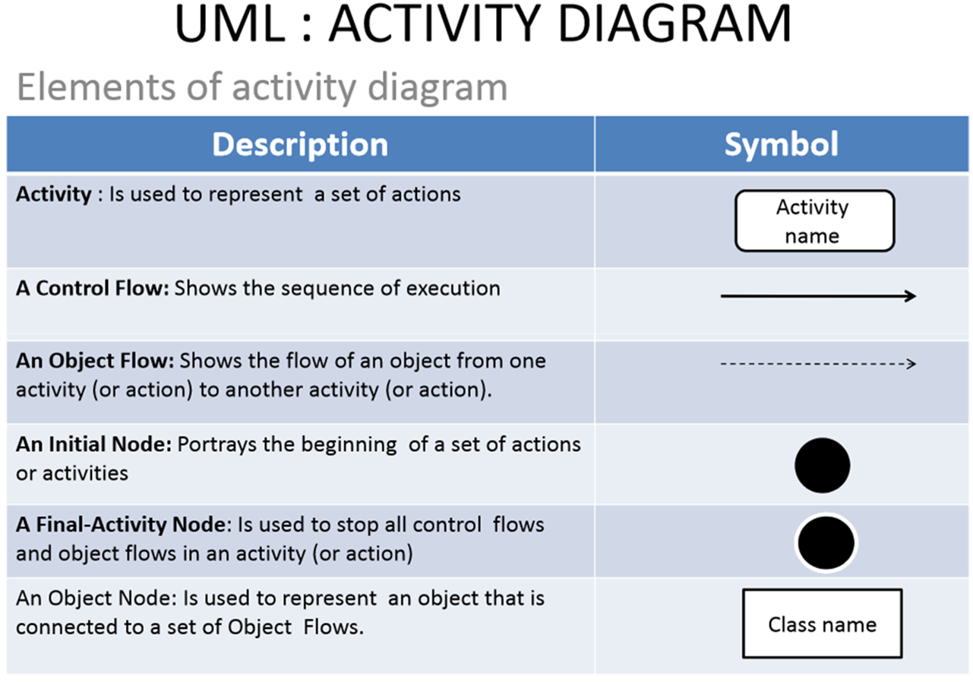

Slide 4
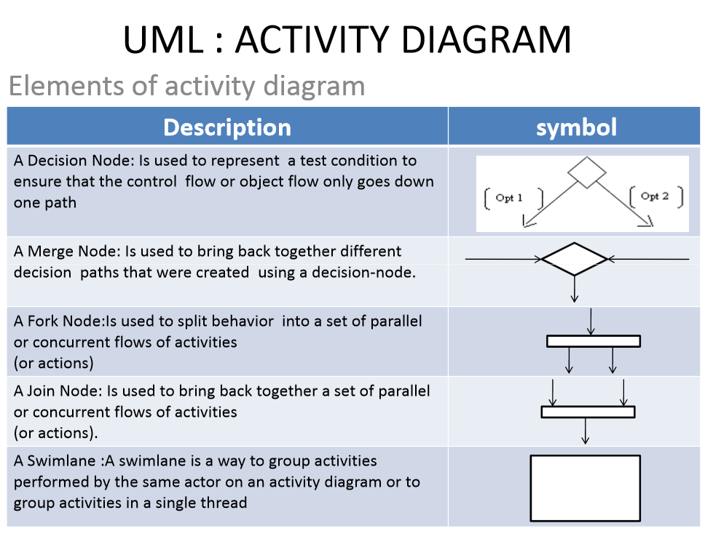

Slide 5
Start
Activity 1
Fork/Branch
Activity 2
Activity 3
Branch
Activity 4
Activity 5
Merge
Join
Activity 6
Stop/End

Slide 6
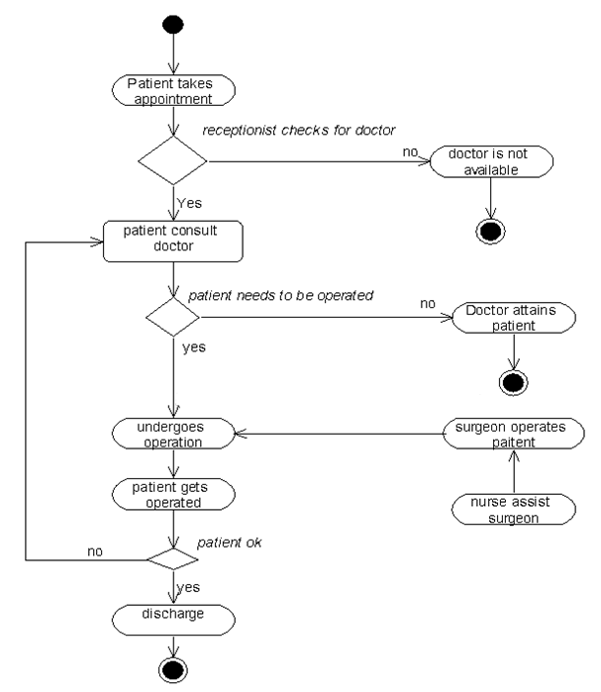
Hospital management system

