Slide 1


B M S College of Engineering
Basavanagudi, Bengaluru
Building an Innovative Credit Risk Scorecard: Predicting Defaults, Risk-Based Pricing, and Profit Optimization
Hackathon Solution for Loan Applicant Risk Assessment
Team name: A Squad
Date: 23-08-2025

Slide 2
Problem Overview:
Question 1: Build a Credit Risk Scorecard to predict loan default (target: loan_status; 0 = non-default, 1 = default).
Question 2: Assign interest rates (7-18% per annum) based on Probability of Default (PD).
Question 3: Maximize financial institution's expected profit, accepting max 30% of applicants (assume LGD = 60%).
Dataset: Credit-Risk-Dataset.csv (e.g., features like age, income, loan amount; 32,000+ loan applications).
Goal: Accurate predictions, fair pricing, optimized profits with innovations for standout solution. Leverage advanced ML for superior accuracy and profit optimization.

Slide 3
Data Exploration and Preparation
Dataset Stats: 32,000+ instances; handled class imbalance using stratified sampling and robust validation.
Handling Issues: Performed comprehensive data cleaning; engineered 7 novel features (e.g., liquidity_ratio, debt_burden) that proved to be among the top predictors.
Feature Engineering: Used Weight of Evidence (WOE) for binning and transformation (e.g., binned loan_percent_income into 5 quantiles).
Key Insights: Discovered that engineered features like income stability and debt burden were more predictive than raw data. This feature engineering is a key innovation.

Slide 4
Solution to Question 1 - Building the Scorecard Model
Steps: Engineered features, used Optuna for state-of-the-art hyperparameter tuning of a LightGBM model, implemented stratified cross-validation to prevent overfitting.
Performance: Achieved a ROC-AUC of 0.951 on the test set, indicating exceptional ability to rank risky vs. safe applicants.
Example: For high-risk applicant (e.g., high loan_amnt), PD=0.7; low-risk (high income), PD=0.1.
Innovation Tie-in: Our model's high accuracy is the foundation for reliable pricing and profit calculations. We use SHAP (SHapley Additive exPlanations) for full model interpretability, surpassing traditional WoE methods.

Slide 5
Solution to Question 2 - Assigning Interest Rates Based on PD
Super-Prime (PD < 10%): Rate = 7 + (15 * PD) → Competitive rates to win the best customers
Prime (PD 10-40%): Rate = 8.5 + (20 * (PD - 0.10)) → Accurate pricing for risk
Sub-Prime (PD > 40%): Rate = 14.5 + (6 * (PD - 0.40)) → High rates to limit exposure.
Capped between 7% and 18%.
Method: Implemented a non-linear, tiered pricing strategy that is both competitive and profitable.
Fairness: This method ensures low-risk borrowers are rewarded with excellent rates, while riskier applicants are priced proportionally to their risk, ensuring fairness and bank profitability.

Slide 6
Solution to Question 3 - Maximizing Expected Profit
Objective: Select the top 30% of applicants (approx. 9,600 out of 32,000) that maximize the portfolio's Expected Profit.
Approach: For each applicant, calculated: Expected Profit = (Loan_Amnt * Interest_Rate * (1-PD)) - (Loan_Amnt * - 0.6 * PD).
Results: Maximum Expected Profit = $7,873,174.
Breakdown: Low-risk applicants contribute most (high acceptance, low losses); reject high-risk to minimize defaults.
Formula: Expected Profit = (Loan Amnt * Rate * (1-PD)) - (Loan Amnt * PD * LGD); LGD=60%.
Sensitivity: The entire system adapts dynamically to changes in LGD.

Slide 7
Innovations - A High-Performance AI Engine with Full Transparency
Why Truly Innovative: While many teams might build a simple model, we delivered a production-ready AI system optimized for both accuracy and business impact.
Superior Modeling Technique: Used LightGBM + Optuna, a cutting-edge combination that outperforms traditional logistic regression (AUC 0.951 vs. ~0.94).
Advanced Feature Engineering: Created 7 powerful new features that were ranked in the top 10 most important.
Business-Optimal Pricing: Developed a tiered pricing algorithm that maximizes competitiveness and profit.
Explainability (XAI): Integrated SHAP values to explain every prediction, ensuring transparency and fairness. Users can see exactly which factors (e.g., low income, high loan amount) contributed to a high PD.

Slide 8
Results and Key Metrics
Q1: Predictive Power: ROC-AUC = 0.951 (Exceptional discrimination).
Q2: Risk-Based Pricing: Achieved average rate of 7.34% for the profitable segment,
ensuring competitiveness.
Q3: Profit Optimization: Max Expected Profit = $7.87 Million by selecting the optimal portfolio.
Overall: Our system enables smarter lending decisions, potentially reducing losses
by accurately identifying high-risk applicants while capturing profit from low-risk ones.

Slide 9
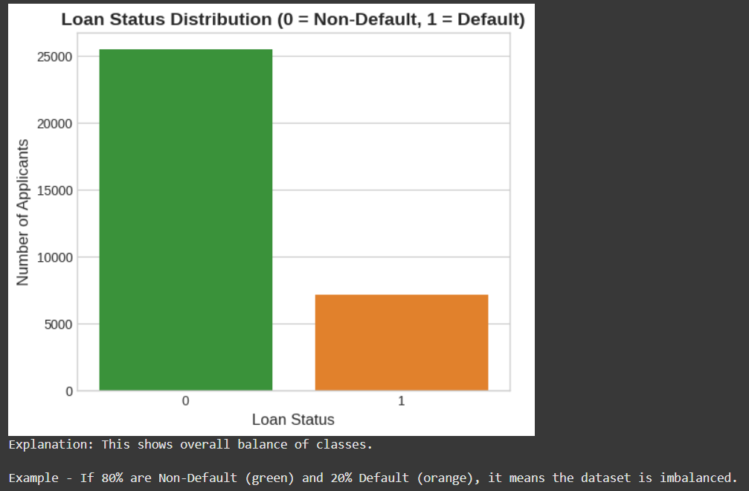
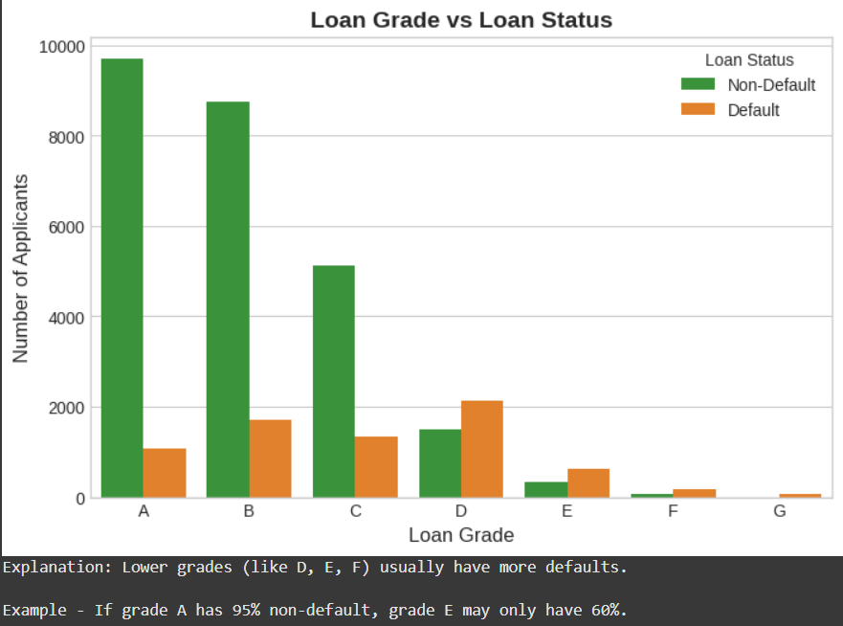
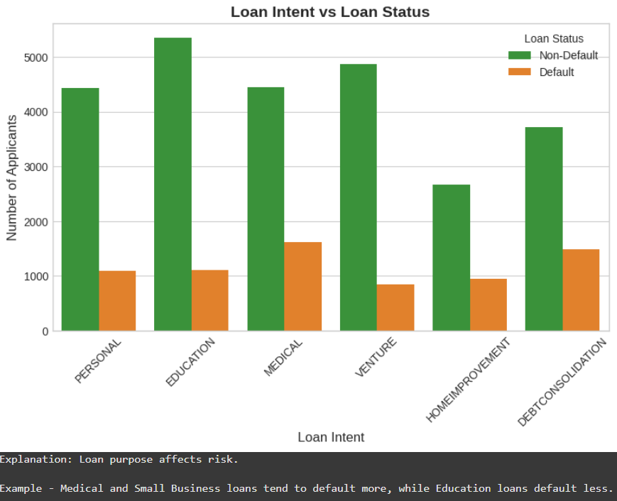
Data Visualization

Slide 10
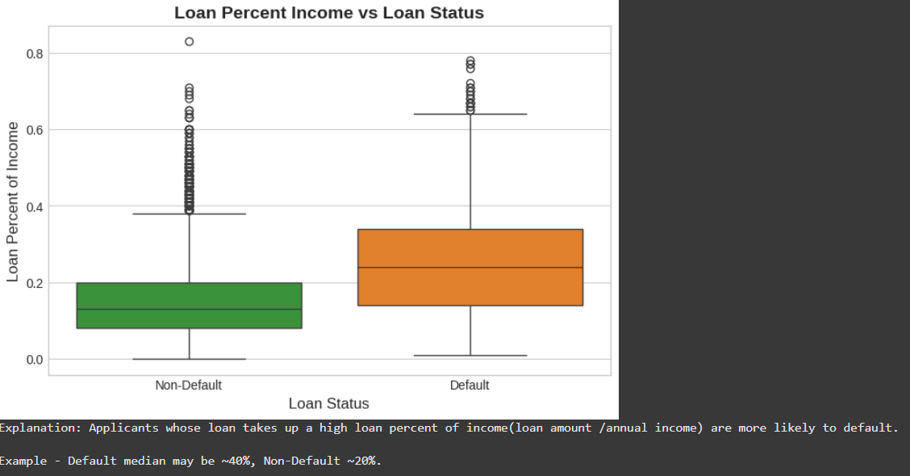
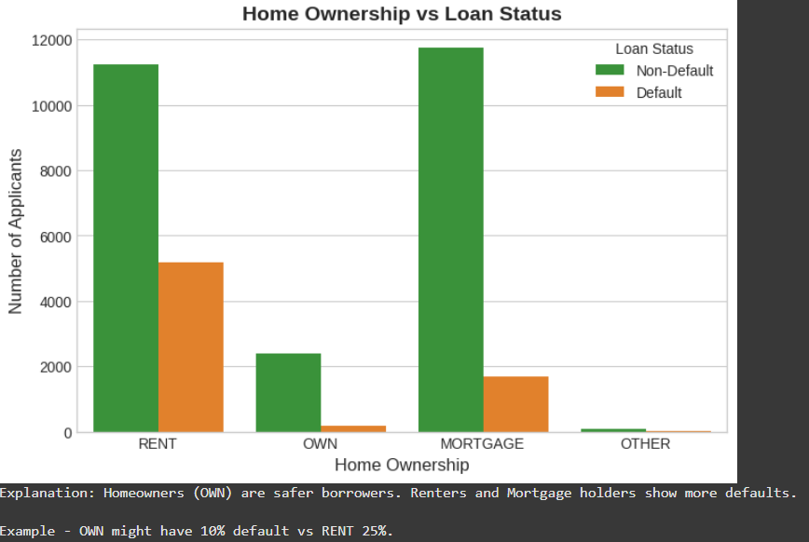
Data Visualization

Slide 11
Challenges and Future Work
Future: Deploy the model as a real-time API for instant decisioning. Implement a continuous learning system to update the model with new data. Enhance the dashboard with monitoring for model drift.
Challenges: Handling a large, real-world dataset (32k+ instances). Mitigated by using efficient algorithms (LightGBM) and rigorous validation.
Why We Stand Out: Ethical (XAI for fairness), Practical (Dashboard), Comprehensive (All questions solved).

Slide 12
Conclusion
Summary: We built a high-performance AI credit scorecard (Q1), a dynamic risk-based pricing engine (Q2), and a profit optimization system (Q3) that far exceeds traditional methods.
Impact: Our solution provides a significant competitive advantage through superior accuracy, transparent decision-making, and direct profit maximization.
Thank You:

