Slide 1
Support Vector Machines (SVM)
BY
Abinash Panda 20051435
Gaurav Jha 20051145

Slide 2
CONTENTS
Introduction and
Working
Linear and
Non Linear
Kernel
Applications

Slide 3
Introduction

Slide 4
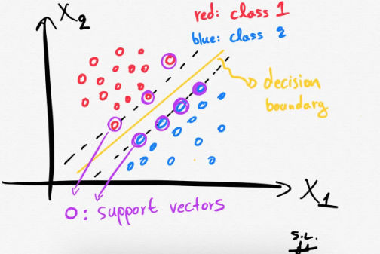
Introduction
What is SVM?
Support Vector Machine (SVM) is a supervised machine learning algorithm used for classification and regression analysis. It finds the best decision boundary (hyperplane) that separates the data into different classes while maximizing the margin between the classes.

Slide 5
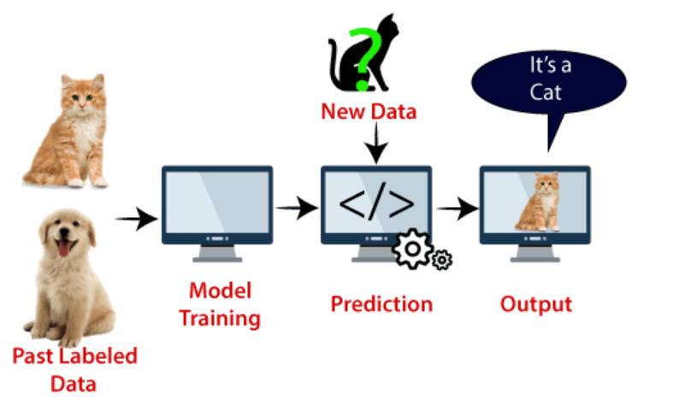
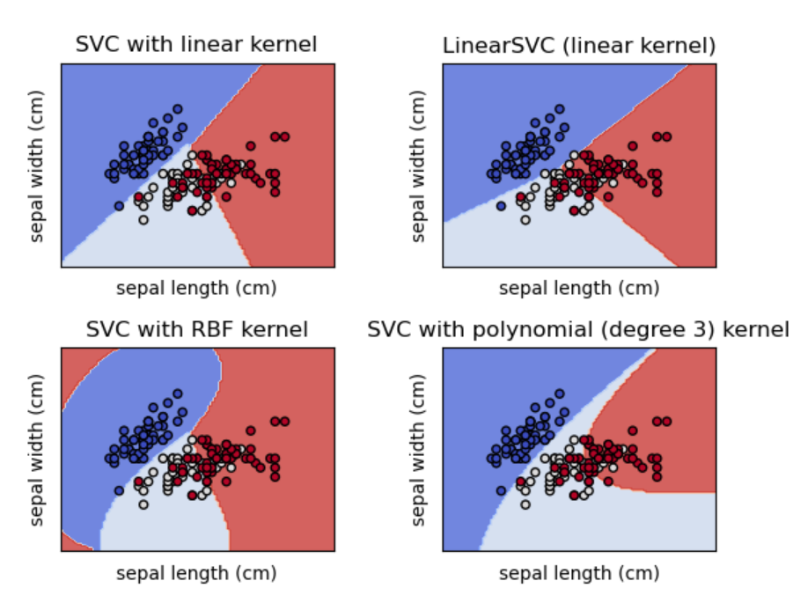
Introduction
Goal
The goal is to find the optimal hyperplane that separates the data into different classes while maximizing the margin between the classes. The optimal hyperplane is defined by the equation:
w^{T} x + b = 0
where w:weight vector ┴ hyperplane
What is Hyperplane?
There can be multiple lines/decision boundaries to segregate the classes in n-dimensional space, but we need to find out the best decision boundary that helps to classify the data points. This best boundary is known as the hyperplane of SVM.

Slide 6
Advantages and
Disadvantages
Advantages of SVM over other machine learning algorithms:
It works well with both linearly and non-linearly separable data.
It is effective in high-dimensional spaces and can handle a large number of features.
It is less prone to overfitting.
It is computationally efficient.
SVM is sensitive to hyperparameters
Training an SVM model can be computationally intensive, especially for large datasets with many features.
SVM is sensitive to noisy data and outliers, which can lead to overfitting and poor performance.
SVM is a binary classification algorithm and may require additional techniques to handle multi-class problems.
The decision boundary in SVM is not easily interpretable.
SVM may not perform well on imbalanced datasets where one class has much fewer data points than the other.
Advantages
Disadvantages

Slide 7
Linear and Non-Linear SVM

Slide 8
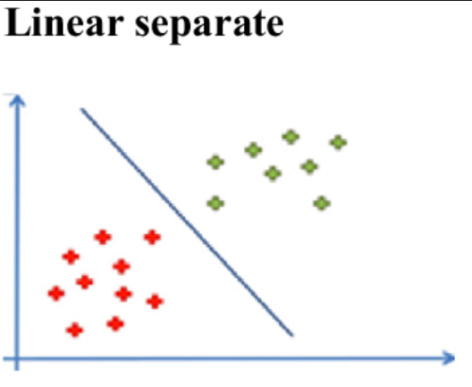
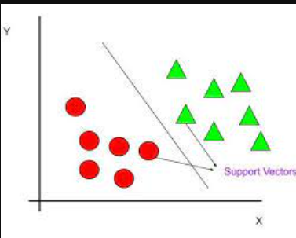
Linear SVM
Linear SVM
Disadvantages
A linear SVM is a type of SVM that tries to find a linear decision boundary that separates the data into two classes. The decision boundary is defined by a hyperplane that maximizes the margin between the classes. Linear SVM is used when the data can be separated by a straight line, plane or hyperplane. It is the simplest form of SVM and has low computational complexity. Linear SVM is effective when the data is linearly separable, but it may not perform well when the data is not separable by a straight line.
Limited flexibility: Linear SVM is limited to finding linear decision boundaries. This means it may not perform well on data that is not linearly separable.
Sensitivity to feature scaling: Linear SVM is sensitive to feature scaling, which means that it can perform poorly if the features have different scales.
Limited accuracy: Linear SVM may not achieve high accuracy on complex classification problems, such as those with non-linear decision boundaries.
Difficulty in handling noise: While Linear SVM is generally robust to noise, in some cases, it may not perform well on datasets that contain high levels of noise.
Advantages
Simplicity: Linear SVM is the simplest form of SVM and has a low computational complexity. It can be trained efficiently on large datasets with many features.
Interpretability: The decision boundary of linear SVM is a hyperplane, which is easily interpretable. This means that the classifier can be explained in simple terms, making it useful for applications where transparency is important.
Robustness: Linear SVM is robust to overfitting and can handle noisy data. This is because the hyperplane decision boundary is less prone to being affected by outliers.
Scalability: Linear SVM can be scaled to handle large datasets with high-dimensional feature spaces.

Slide 9
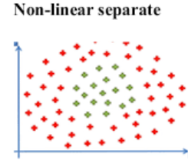
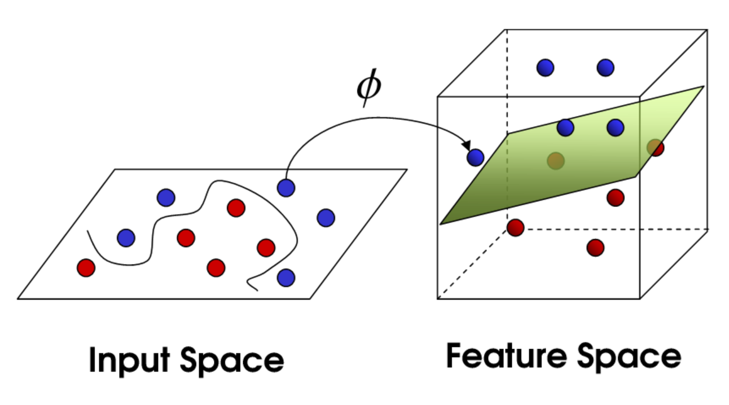
Non-Linear SVM
Non-Linear SVM
A non-linear SVM is used when the data cannot be separated by a straight line in the input space. Non-linear SVM uses a kernel function to transform the input data into a higher-dimensional feature space where it can be linearly separated. This allows non-linear decision boundaries to be defined in the original input space. Commonly used kernel functions are the polynomial kernel, radial basis function (RBF) kernel, and sigmoid kernel. Non-linear SVM can be more computationally complex than linear SVM, but it can handle complex decision boundaries in the data.
Disadvantages
Non-linear SVM can be more computationally intensive than linear SVM, especially when using kernel functions that require a lot of computation.
Non-linear SVM can be sensitive to the choice of kernel function and its associated hyperparameters. Choosing the wrong kernel or hyperparameters can lead to poor performance.
Non-linear SVM can be sensitive to the presence of outliers in the data, which can affect the choice of the kernel function and its hyperparameters.
Non-linear SVM can be more difficult to interpret than linear SVM, as the decision boundary is defined in a higher-dimensional space and may not be easily visualized in the input space.
Advantages
Non-linear SVM can handle complex decision boundaries that cannot be represented by a linear boundary.
Non-linear SVM can handle high-dimensional data and can capture complex patterns in the data.
Non-linear SVM can be more accurate than linear SVM in certain cases, especially when the data is not linearly separable.

Slide 10
Kernel

Slide 11
Kernel
Definition
Kernel function is a key component of non-linear SVM, which allows the algorithm to map the input data into a higher-dimensional feature space where it can be linearly separated. The kernel function takes two input vectors and calculates their similarity or distance in the feature space. The resulting value is used to define the decision boundary between the classes.
Most Commonly used Kernels:
Linear kernel:
Polynomial kernel
Radial basis function (RBF) kernel
Sigmoid kernel

Slide 12
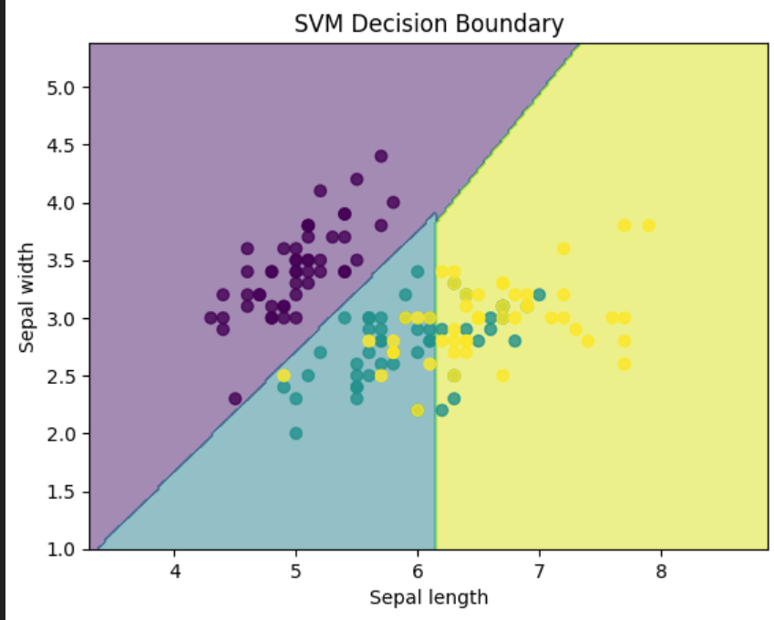
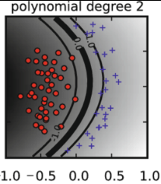
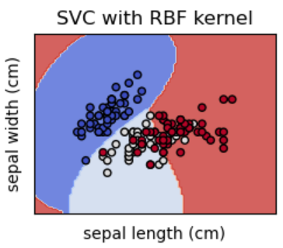
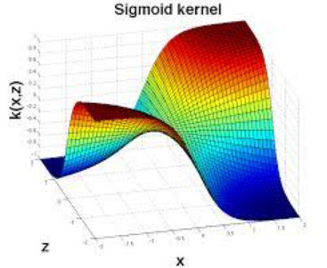
Types Of Kernels
Linear kernel
Polynomial kernel
The linear kernel is used when the data is already linearly separable or when the data can be transformed into a linearly separable form by scaling or normalization.
The polynomial kernel calculates the similarity between two input vectors by raising the dot product of the vectors to a power. The degree of the polynomial is a hyperparameter that can be tuned to adjust the complexity of the decision boundary.
RBF Kernel
Sygmoid Kernel
The RBF kernel is a popular kernel function that is used when the data is not linearly separable. The RBF kernel calculates the similarity between two input vectors by using the Gaussian function of their Euclidean distance. The width of the Gaussian function is a hyperparameter that controls the smoothness of the decision boundary.
The sigmoid kernel is used when the data is not separable by a hyperplane in the input space. The sigmoid kernel calculates the similarity between two input vectors using a sigmoid function of their dot product. The parameters of the sigmoid function are hyperparameters that can be tuned to adjust the shape and position of the decision boundary.

Slide 13
Applications

Slide 14
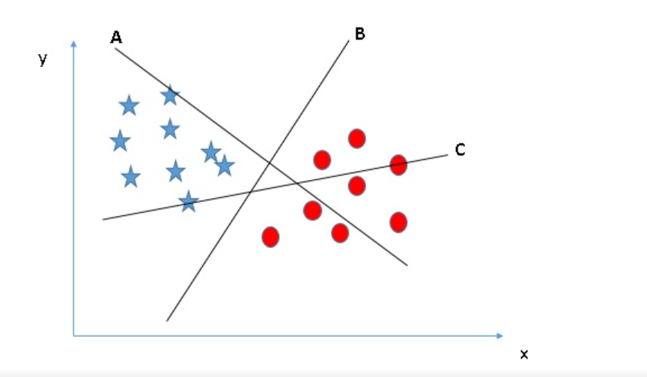
Applications
Applications of SVM in real-world scenarios:
Image classification
Text classification
Bioinformatics
Fraud detection
Predictive maintenance
Stock market forecasting

Slide 15
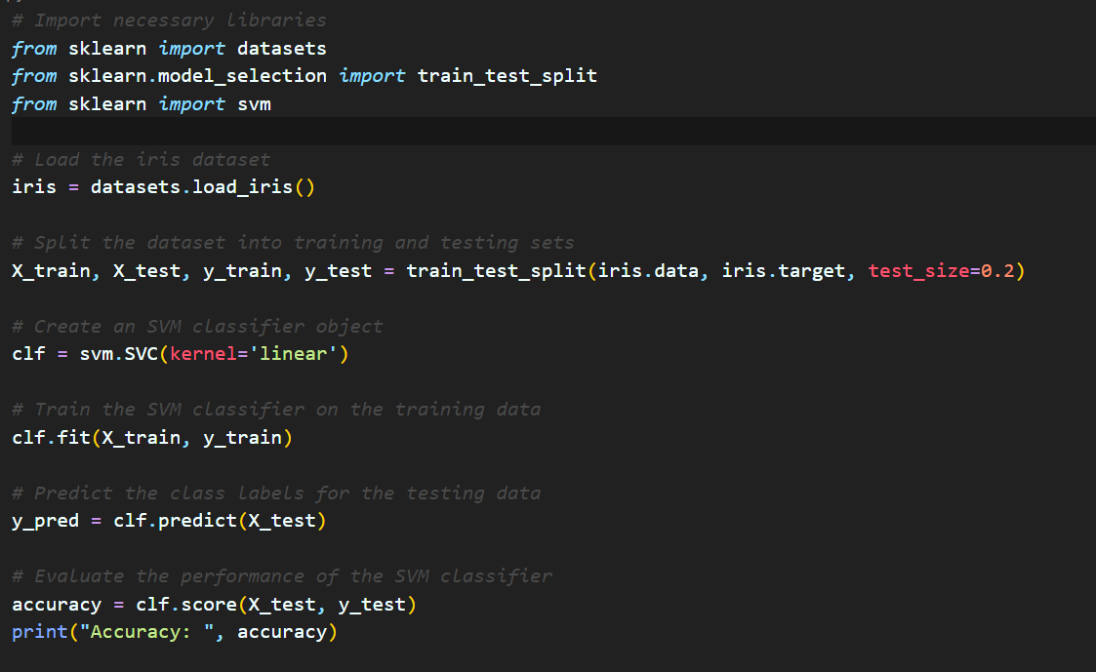
Code

Slide 16
Output

Slide 17
Thank you for listening

