Slide 1
Job Recommender System
By Abraham Audu

Slide 2
TOC
Overview
Project objective
Benefits
Architecture
Data Pre-Processing
Model Training and Evaluation
Data Validation
Deployment
Q & A

Slide 3
Overview
In the ever-expanding online job market, opportunities flood various platforms, necessitating user-friendly navigation amidst the multitude. This project targets this by crafting a web application that consolidates listings from diverse job websites. This innovative tool employs user profiles, activity patterns, and search inputs to suggest tailored job recommendations, aiming to streamline the overwhelming job search process.

Slide 4
Project objective
To create a deep learning solution which is able to use user profile information and usage metadata to recommend jobs when searches are made.
A web app which enables users to create accounts, set preferences, and search. It will scrape jobs from various platforms, store them in a database, and use vectors for contextual search — basically a document-based recommender system.

Slide 5
Benefits
01
Automated scraping of jobs from multiple websites
02
Contextually relevant job results for user
03
Save time used to search multiple platforms individually

Slide 6
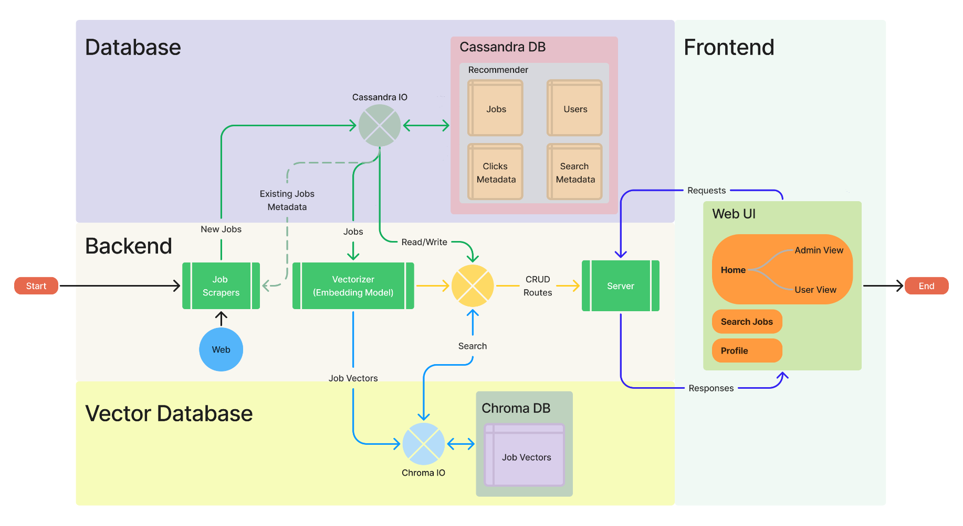
Architecture

Slide 7
Data Pre-processing
The pre-processing stage involved parsing the HTML data to retrieve the relevant fields to form the data for each job listing.
In addition, the text data representing each job listing was embedded into vector representations and saved to a vector database in order to minimize inference time during search.

Slide 8
Model Training and Evaluation
A pre-trained Sentence Transformer Model (all-mpnet-base-v2) from Hugging Face was used as the language model for embedding texts to vectors.

Slide 9
Data Validation
All the data input and output from the databases were carried out using predetermined data models with defined types for each field to ensure that all data transactions are validated.

Slide 10
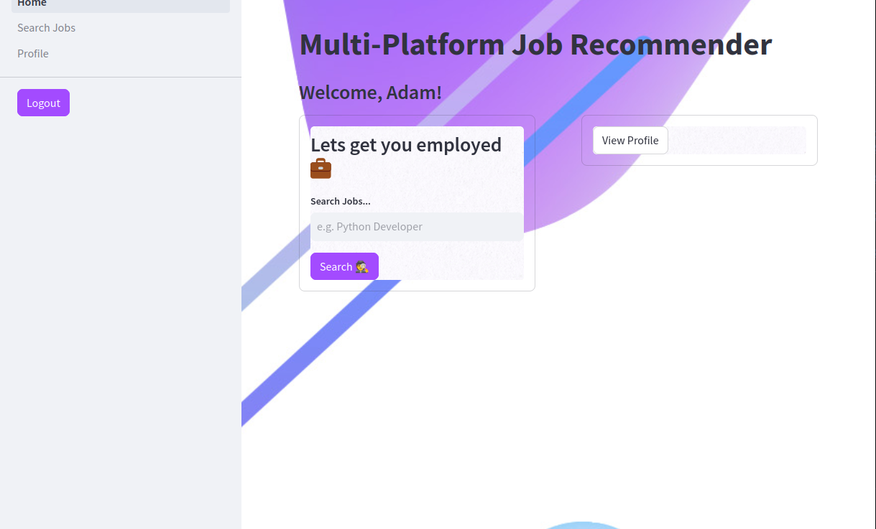



Deployment
Frontend built with Python Streamlit package.
Server built with Python FastAPI package.
Containerized with Docker

Slide 11
Q & A
Q1: What’s the source of data?
Jobs data scraped from LinkedIn, Indeed, Jobberman
Q2: What’s the type/nature of the data?
Unstructured text data
Q3: How are exceptions handled?
Sections of code with expected dynamic behaviour are enclosed in try-except blocks
Q4: How are logs managed?
Logs for the different layers of the software are stored in separate log files

Slide 12
Thank you!
Project developed as part of iNeuron Internship Program.

