Slide 1
Credit Card Default Prediction
By Abraham Audu

Slide 2
TOC
Overview
Project objective
Benefits
Architecture
Data Pre-Processing
Model Training and Evaluation
Data Validation
Deployment
Q & A

Slide 3
Overview
Banking institutions offer credit to customers as one of their major businesses and this comes with some associated credit risk. WIth millions of customers, it is important to have an automated system which can filter through customer information and financial history to determine the probability that a card owner will default in order to limit their access to current or future credit services and minimise risk to the issuing organisation.

Slide 4
Project objective
To create a machine learning solution which is able to use credit card user information and payment history to determine the probability that a card owner will be a defaulter in monthly payments.
The solution proposed here is a simple web app which allows the user to upload a credit card owner’s historical data and receive a probability score that the said credit card owner will default on future monthly payments.

Slide 5
Benefits
01
Automated filtering to make card issuance decision
02
Reduced error in analysis due to human factor
03
Faster Credit Card application processing time

Slide 6
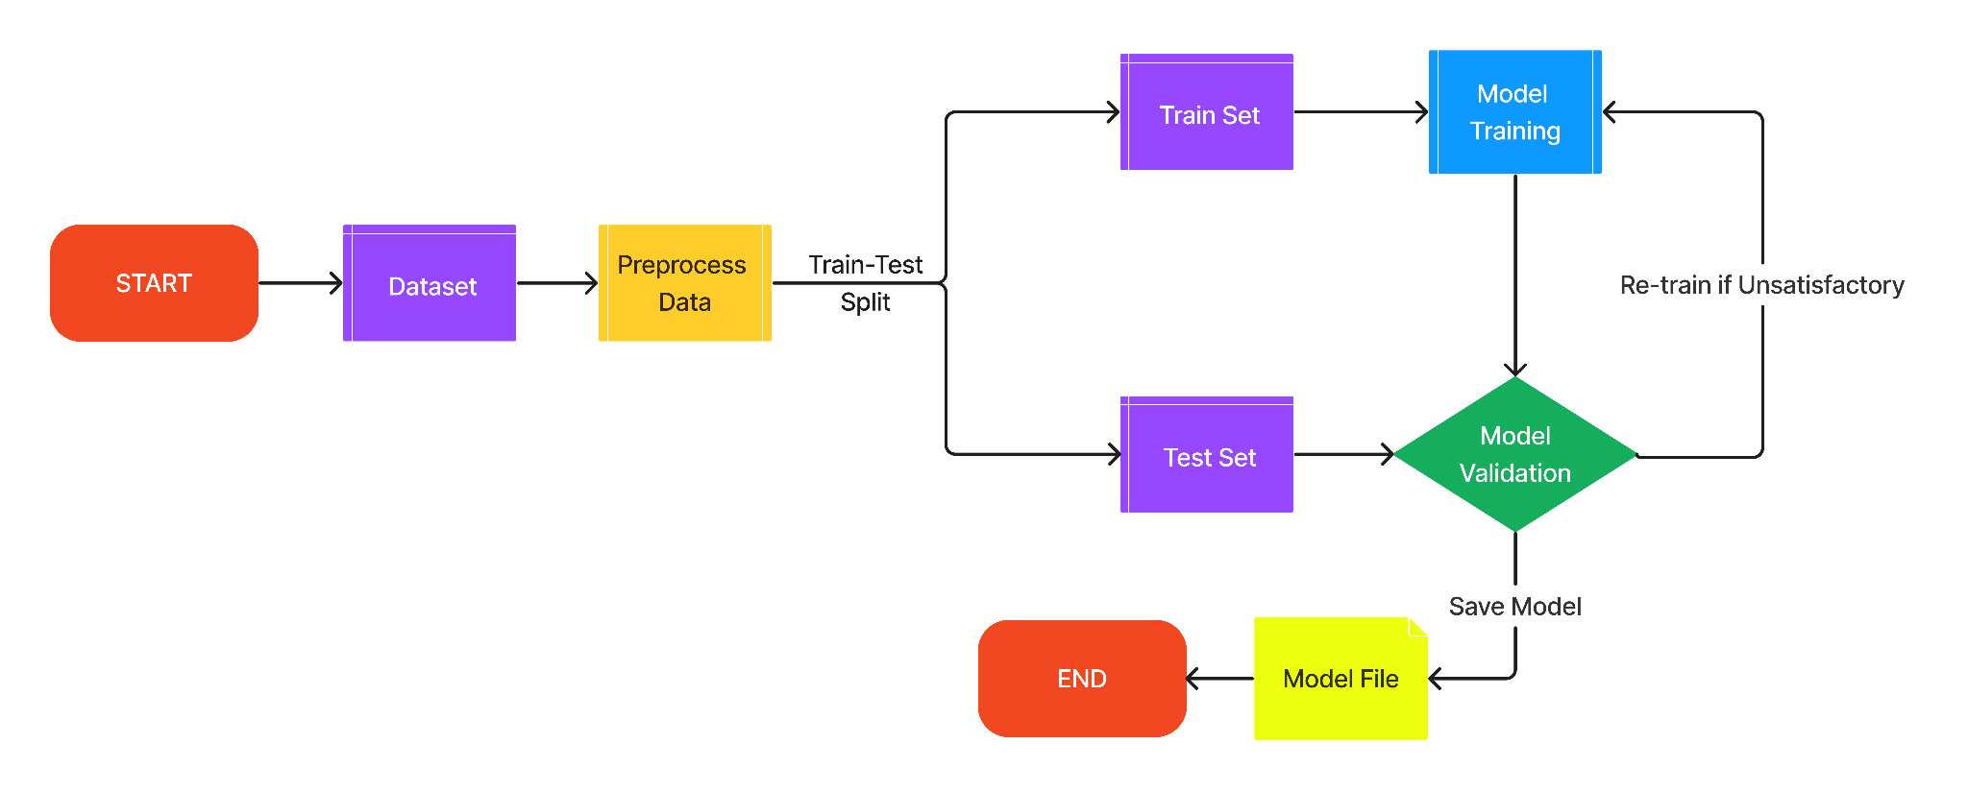
Architecture - Development Workflow

Slide 7
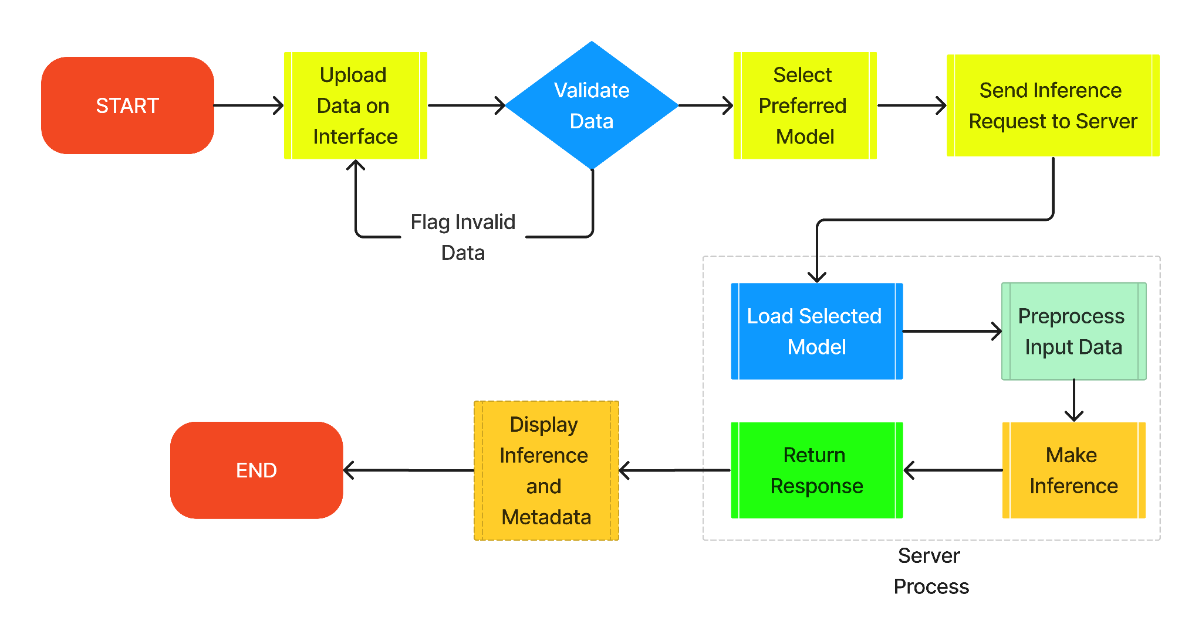
Architecture - Deployment Workflow

Slide 8
Data Pre-processing
The pre-processing stage involved removing irrelevant columns such as the customer ID column.
Columns holding categorical information were encoded to have numerical representation.
Class imbalance, characteristic of financial data, was addressed by undersampling the over-represented class
After splitting the data into train and test sets, the data was scaled using a fit on the training set

Slide 9
Model Training and Evaluation
Logistic Regression, Support Vector Machine, Multi-Layer Perceptron Classifier and Random Forest models were trained with best parameters based on GridSearchCV from model experimentation phase.
The models were evaluated based on the weighted f1 score of both target classes.

Slide 10
Data Validation
The user is expected to upload a CSV file containing the records of the credit card owner being evaluated via the user interface of the Credit Card Default Prediction app.
The data supplied by the user is validated for completeness and data types for the individual features required by the model.

Slide 11
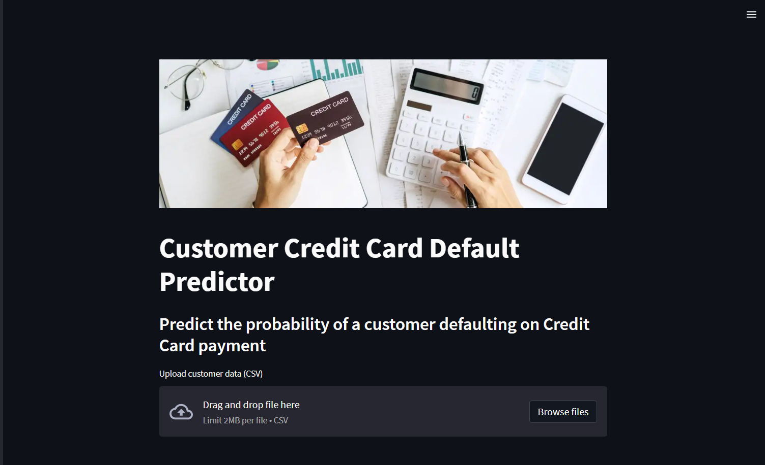


Deployment – Local Machine
Frontend built with Python Streamlit package.
Backend built with Python FastAPI package.

Slide 12
Q & A
Q1: What’s the source of data?
UCI credit card default dataset
Q2: What’s the type/nature of the data?
Tabular data with numerical and categorical features
Q3: How are exceptions handled?
Sections of code with expected dynamic behaviour are enclosed in try-except blocks
Q4: How are logs managed?
Logs for the different layers of the software are stored in separate log files

Slide 13
Thank you!
Project developed as part of iNeuron Internship Program.

