Slide 1
jQuery $(Begins)
Day 10
April 16, 2016

Slide 2
Admin Items

Slide 3
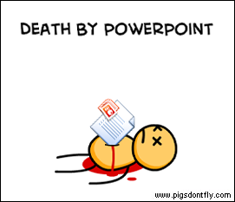
Not the Way to Learn Coding

Slide 4
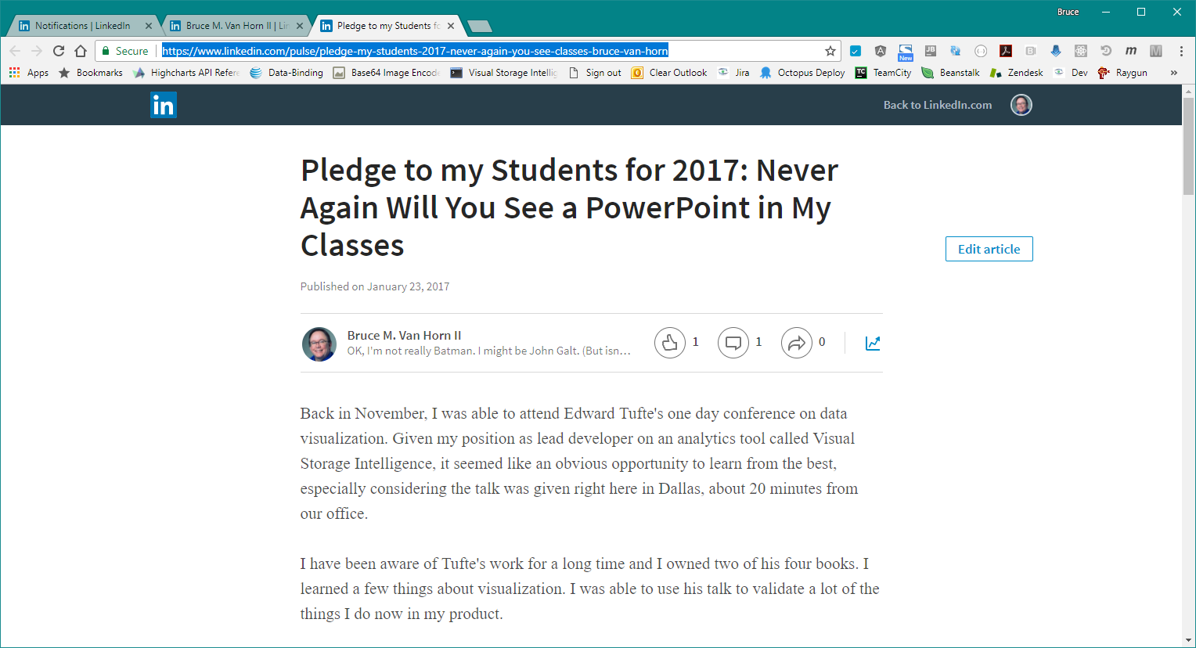
Not the Way to Learn Coding
https://www.linkedin.com/pulse/pledge-my-students-2017-never-again-you-see-classes-bruce-van-horn
https://www.edwardtufte.com/tufte/courses

Slide 5

True Way to Learn Coding

Slide 6
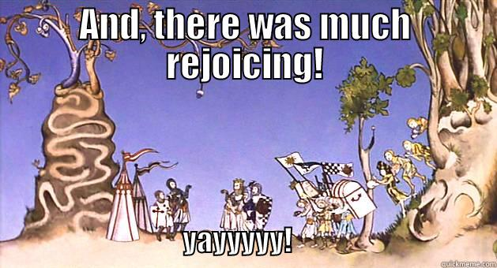
A New Era of Class
Be prepared to have classes that are increasingly “just code”

Slide 7
Today’s Class

Slide 8
Objectives
In today’s class we’ll be covering:
DOM Manipulation using Plain Javascript
DOM Manipulation using jQuery
Responding to click events

Slide 9
Pr0grammer W0rds
Document Object Model (DOM) is the structure of the HTML elements in the page.
Structured content is content that has a tag structure (like HTML) within it to define it vs. unstructured content, which is raw text with no defined structure.
Append means “adding to the end”
Prepend means “adding to the front”
Minified means all the spaces, comments, empty lines, etc. have been removed from a file to make it smaller.

Slide 10
DOM Manipulation

Slide 11
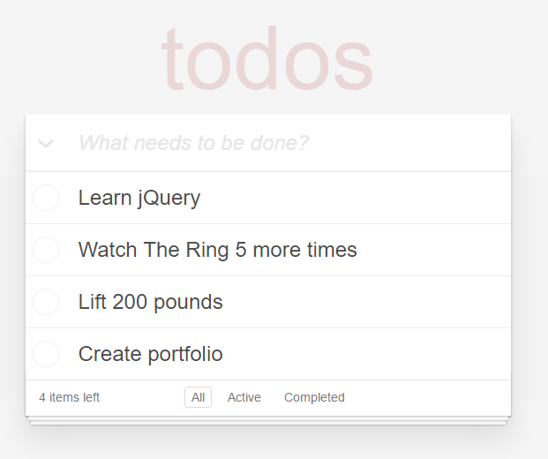
Understanding the “DOM”
Every HTML page begins as static content..
However, with Javascript / jQuery we can “modify the DOM” and change this static content in real-time.
This allows us to build dynamic sites.
Basic Example: http://todomvc.com/examples/jquery/#/all

Slide 12
Demo Time
Instructor: Demo
(1-5.html | 1-JSGenerators)

Slide 13
> YOUR TURN!!
Activity: 2-JSDrinkList | Suggested Time: 15 min
Code Creation: Generating HTML with Javascript
Using the file sent to you as a starting point, add the missing code such that your Javascript generates HTML content that displays all of the drink options.
HINT: You will need a for-loop. Inside your for loop you will need to use each of the following methods: createElement, innerHTML, and appendChild.

Slide 14
Intro to jQuery

Slide 15
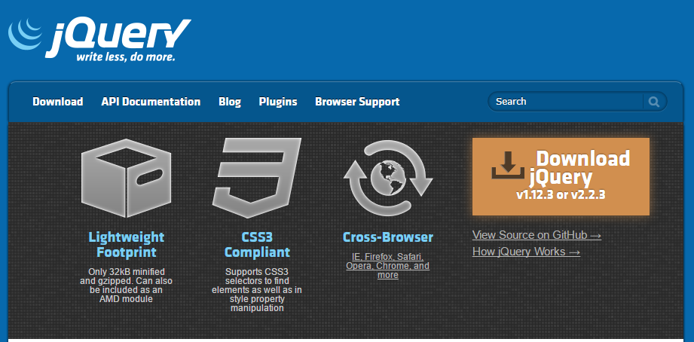
Intro to jQuery
https://jquery.com/
jQuery is a cross-platform Javascript library for easier of client-side HTML scripting.

Slide 16

jQuery Helper Library
jQuery can be useful for tasks like:
Dynamically Inserting, Updating, or Removing HTML
Registering click or other change events
Animating HTML elements
Download data from databases
And much more!

Slide 17


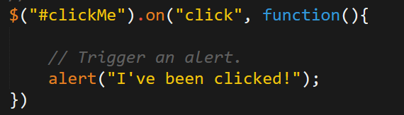
Working with jQuery generally involves…
1. Including a CDN Link to the jQuery script…
2. Utilizing the jQuery specific ($) selector…
3. Then applying jQuery methods on the selected elements.

Slide 18
But First, A Few Reminders
There are no magic secrets here. jQuery is “just JavaScript”
It provides a more convenient syntax
$() is what????
One big “gotcha” with jQuery : It is a function that returns a jQuery object which is similar to, but not the same as the object you’d get from “vanilla JavaScript”
jQuery is “the way it’s done” in most modern web sites, so not learning it and using it is probably not an option.

Slide 19
To reiterate
≠
document.getElementById(“foo”);
$(“#foo”)
Vanilla JavaScript returns a DOM object
jQuery Equivalent returns a jQuery object

Slide 20
Demo Time
Instructor: Demo
(1-3.html | 3-jQueryGenerators)

Slide 21
> YOUR TURN!!
Activity: 4-jQueryDrinkList | Suggested Time: 12 min
Code Creation: Generating HTML with jQuery
Re-factor (re-write) your previous drinkList code from earlier, but this time use jQuery to complete all of the same tasks.
Your final code should NOT have any of the following methods: createElement, innerHTML, or appendChild.
HINT: Don’t forget to “incorporate” jQuery before you begin.
BONUS: Instead of using a `for` loop try searching about the use of the jQuery `.each` method.

Slide 22
Demo Time
Instructor: Demo
(OnClick.html | 5-OnClickBasic)

Slide 23
> YOUR TURN!!
Activity: 6-SandwichClick | Suggested Time: 20 min
Code Creation: Click Events with jQuery
Add in the missing code such that clicking any of the sandwiches causes…
An alert message to popup saying something snarky about the sandwich type.
A second alert message that displays to the user the number of that specific sandwich they’ve eaten.
HINT: You will need counter variables.
BONUS: Add an image to the `image-div` on the click event.

Slide 24
> YOUR TURN!!
Activity: 7-TriggerRandom | Suggested Time: 12 min
Code Creation: Generating Numbers with jQuery
Add in the missing code such that clicking the big blue button triggers a random number (between 1 and 1000) to be selected and prominently displayed in the randomNumber div.
Hint: None. You got this.

Slide 25
> YOUR TURN!!
Activity: 8-LotteryGenerator | Suggested Time: 20 min
Code Creation: Lottery Numbers with jQuery
Using the code from the previous random number generator as a starting point, create a lottery generator.
In our case, the lottery number should pick 9 random numbers (and always 9 numbers). As an example 886563264.
Display this number in the randomNumber div.
Then when a user clicks again, have the code create a new row with the latest number at the top.

Slide 26
Questions?

Slide 27
Extra!

Slide 28
> YOUR TURN!!
Activity: 9-NumberChecker | Suggested Time: 20 min
Code Creation: Checking Numbers with jQuery
Using the displayed application as an example, create code in which:
A computer picks a random number between 1 and 4
Users then “click” buttons numbered 1 – 4.
If the user’s number matches the computer’s number display text informing them of this in the Result panel. Otherwise, display text informing them they lost.
If you finish early, try to improve the aesthetics.

Slide 29
Questions

