Slide 1
CHINOOK
Music Store
SQL Analysis, Customer Insights & Business Recommendations
Exploring sales, customer behaviour, product performance, and growth opportunities using SQL
Sales
Customers
Growth
Sales Performance
Customer Insights
Regional Strategy
Presented by: Aditya Jadhav
• Chinook Music Store • SQL Analysis & Business Insights
1

Slide 2
Introduction & Problem Statement
STORY
Turning Chinook data into clear business decisions.
PROBLEM
Business context
Sales & Product Drivers
Chinook wants to understand music sales, customer behavior and regional performance so management can improve promotion, retention and growth in the physical music market.
Which specific genres, tracks, and albums generate the majority of store revenue?
Customer Retention & Churn
Who are the highest-value accounts, and which customers are at risk of churning?
Regional Expansion
Which international markets and cities show the highest revenue density for growth?
• Chinook Music Store • SQL Analysis & Business Insights
2

Slide 3
Project Objectives
SCOPE
The analysis covers four-part analytical framework.
01 Data Quality
Check duplicates, NULL values, and verify data completeness across schema.
02 Sales & Products
Analyze overall store revenue, top genres, top artists and album sales.
03 Customer Analytics
Evaluate individual purchase frequency, lifetime spend, and churn risk.
04 Regional Strategy
Analyze geographic revenue patterns to optimize localized pricing, marketing, and expansion.
11 Core Tables • 59 Customers • 24 Countries • 2017-2020 Invoice Coverage
• Chinook Music Store • SQL Analysis & Business Insights
3

Slide 4
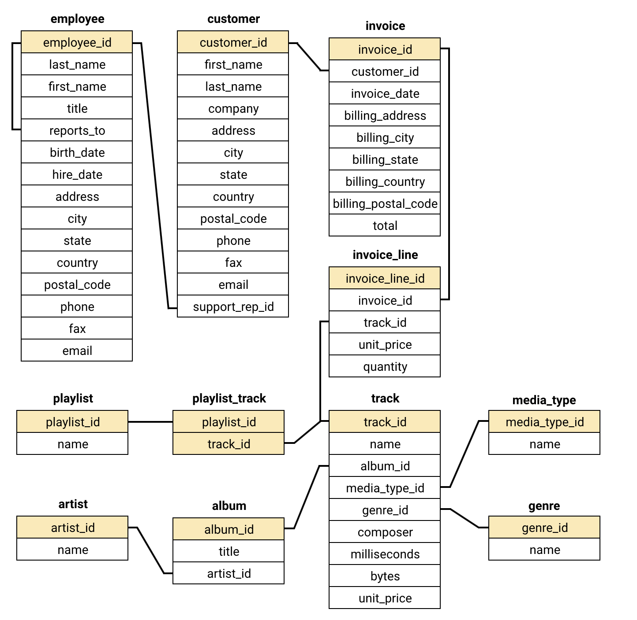
Data Overview & Database Schema
DATA
The analysis uses the supplied Chinook SQL database and its relational structure.
11
Core tables
59
Customers
24
Countries
2017- 2020
Invoice period
Data Quality
No duplicate records were found across the database. NULL values were identified in some optional fields.
• Chinook Music Store • SQL Analysis & Business Insights
4

Slide 5
Methodology
METHOD
A repeatable SQL workflow was used from data validation through recommendations.
1
2
3
4
5
Understand
Validate
Analyze
Visualize
Recommend
Review tables, keys, relationships and business questions.
Check NULLs and duplicates; understand data limitations.
Use joins, GROUP BY, aggregates, CTEs and window functions.
Use charts/tables to make patterns easy to compare.
Tie actions directly to observed sales, customer and regional evidence.
SQL TOOLKIT USED
Joins
Aggregations
CTEs
Customer, invoice, line, track, album, artist, genre
SUM, COUNT, AVG, MAX, GROUP BY, HAVING
Readable multi-step analysis
Window functions
Date logic
DDL
RANK(), ROW_NUMBER()
DATEDIFF(), DATE_SUB(), MAX(invoice_date)
ALTER TABLE + DESC verification
• Chinook Music Store • SQL Analysis & Business Insights
5

Slide 6
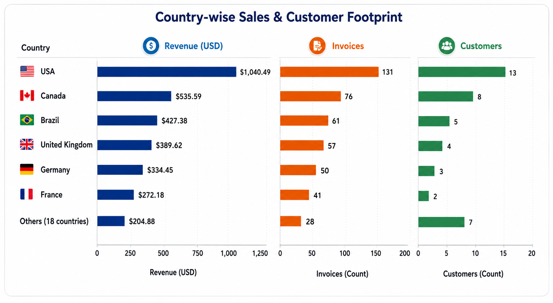
Analysis 1 - Data Quality, USA Sales & Geographic Insights
DATA QUALITY
No duplicate records found. NULLs are concentrated in optional fields
like composer, company, phone and state.
USA TOP TRACKS
War Pigs leads USA track sales at $5.94.
Van Halen is the top artist at $42.57; Rock is the top genre for Van Halen.
CUSTOMER ANALYTICS
USA has the largest customer base (13), followed by Canada (8).
15 of 24 countries have only one customer.
REVENUE & INVOICES
USA leads with $1,040.49 revenue and 131 invoices.
Canada is second with $535.59 and 76 invoices.
• Chinook Music Store • SQL Analysis & Business Insights
6

Slide 7
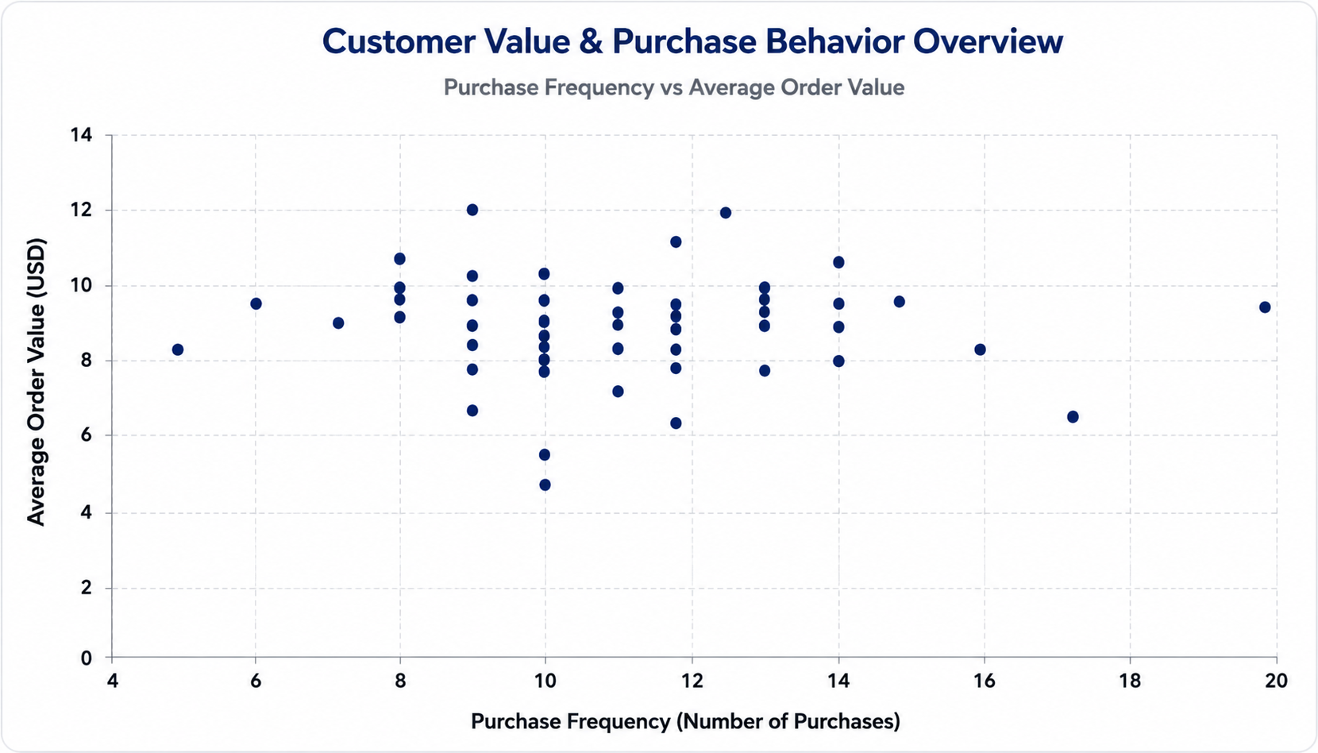
Analysis 2 – Customer Behaviour, Purchase Patterns & Churn
TOP CUSTOMER BY TOTAL REVENUE
Frantisek Wichterlova is the top customer overall with $144.54 in total revenue.
TOP-SELLING TRACK PER CUSTOMER
Most customers top-selling tracks are priced at $0.99; a few are $1.98.
PURCHASE BEHAVIOR
Most customers cluster around 8-13 purchases and $7-$9 average order value.
CHURN RATE
2017: 7.02% | 2018: 9.09% | 2019: 1.85%.
2020 appears as 100% because the dataset ends in 2020,
it is a data limitation, not a normal churn observation.
• Chinook Music Store • SQL Analysis & Business Insights
7

Slide 8
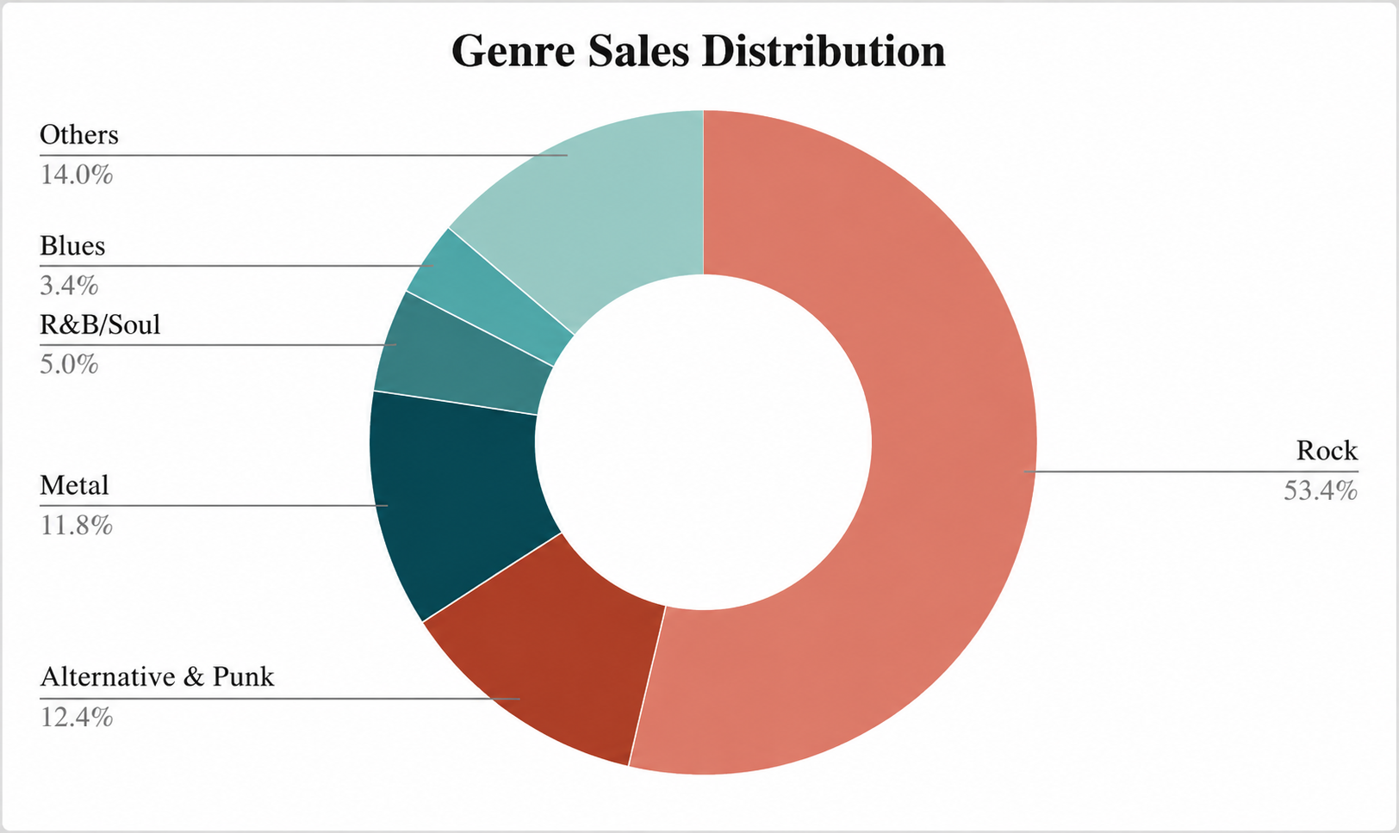
Analysis 3 - Genre Performance, Diversity & Inactivity
USA GENRE CONTRIBUTION
Rock contributes 53.4% of USA sales ($555.39),
followed by Alternative & Punk (12.4%) and Metal (11.8%)
GENRE DIVERSITY
Leonie Kohler purchased from 14 genres - the highest in the result.
All returned customers bought from at least 5 genres.
GENRE RANKING
Rock ranks #1 with $555.39 - nearly 4× Alternative & Punk.
Latin and Pop tie at rank 7.
TV Shows ranks last with $0.99.
INACTIVE CUSTOMERS
22 customers had no purchase in the last 3 months.
Daan Peeters has the longest inactivity gap,
Fynn Zimmermann is the most recently inactive.
• Chinook Music Store • SQL Analysis & Business Insights
8

Slide 9
Analysis 4 - Promotion, Global Genres & Product Affinity
USA ALBUM PROMOTION
Global Genre Reach & Product Affinity
• Rock: From The Muddy Banks Of The Wishkah [live] - Nirvana - $27.72.
• Alternative & Punk: Green - R.E.M. - $24.75.
• Metal: Mezmerize - System Of A Down - $21.78.
• Using one album from each top genre broadens campaign reach.
TOP GENRES OUTSIDE USA
• Rock is #1 in 22 of 23 non-USA countries.
• Argentina is the exception: Alternative & Punk ($16.83) leads over Rock ($10.89)
• Metal and Alternative & Punk recur across many countries.
PRODUCT AFFINITY
CUSTOMER BEHAVIOR
• The Doors and Mezmerize each appear in combinations purchased by 41 customers.
• 7 of the top 10 combinations are Rock.
• Use Rock → Metal recommendations for cross-sell.
• All 59 customers are classified as Long-Term in this dataset.
• Average purchase frequency = 10.41; average order value = $9.77.
• Average total spending per customer = $805.14.
Q3 • CUSTOMER BEHAVIOR
• Chinook Music Store • SQL Analysis & Business Insights
9

Slide 10
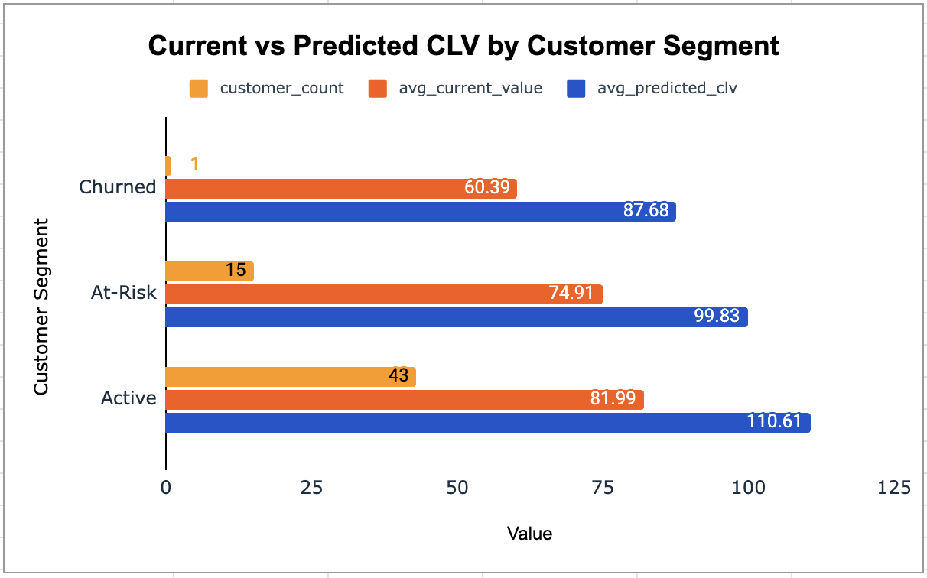
Analysis 5 - Regional Performance, Customer Risk & CLV
REGIONAL MARKET
Prague: Highest average spending - $136.62.
Dublin: Strong average spending - $114.84, despite a smaller customer base.
Brussels: 100% churn, making it a key retention concern.
CUSTOMER RISK
High Risk: 1 customer - Daan Peeters, inactive for 466 days.
Medium Risk: 15 customers - inactive for 180 - 365 days.
Low Risk: 43 customers - active within the last 180 days.
Key risk factor: Longer inactivity indicates higher churn risk.
CUSTOMER LIFETIME VALUE
Active: 43 customers; predicted 5-year CLV $110.61.
At-Risk: 15 customers; predicted CLV $99.83.
Churned: 1 customer; predicted CLV $87.68.
Predicted CLV exceeds current value for all segments.
• Chinook Music Store • SQL Analysis & Business Insights
10

Slide 11
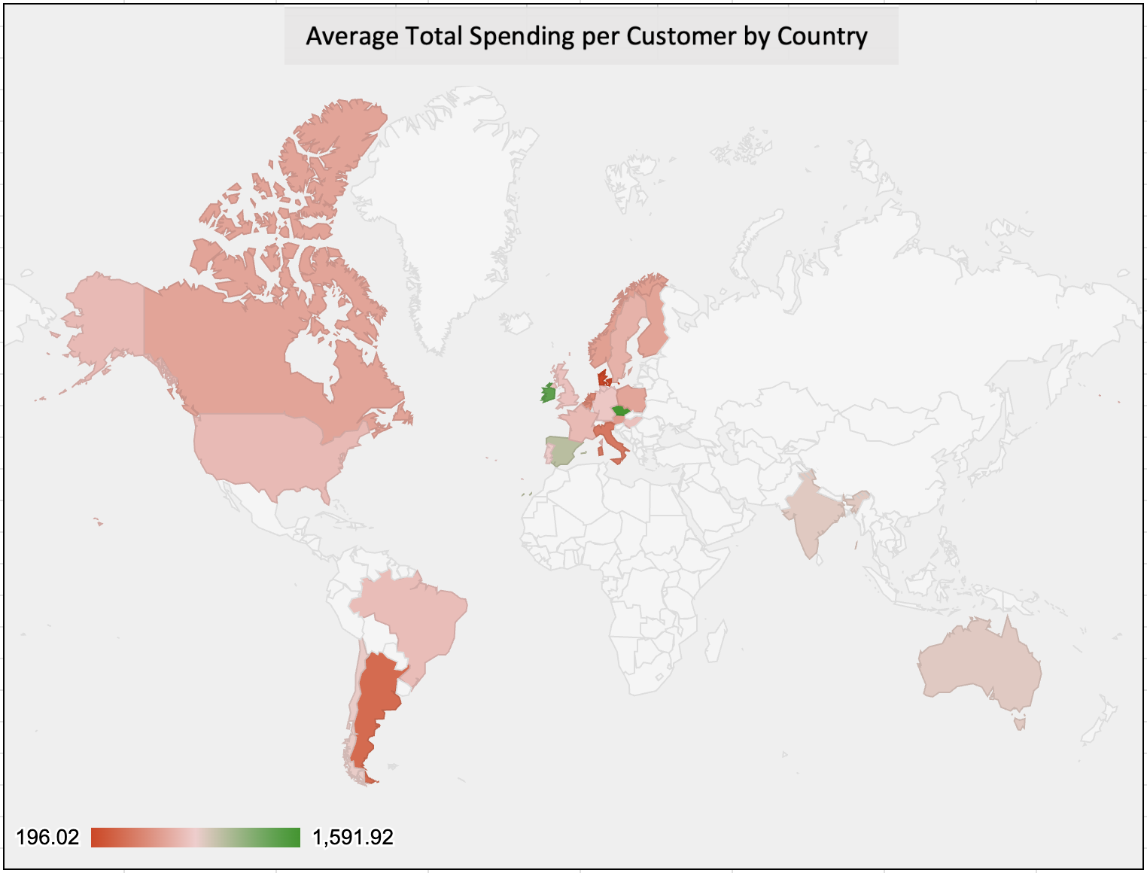
Analysis 6 - Campaigns, Open-Ended Analysis, Database Updates & Geographic Spending
CAMPAIGN MEASUREMENT
Campaign data is unavailable, so campaign effectiveness cannot be measured directly.
Measurement Framework:
Acquisition → New Customers | Retention → Repeat Customers |
Sales → Revenue, Orders & AOV
APPROACH TO OPEN-ENDED ANALYSIS
1. Understand the business and schema.
2. Validate NULLs and duplicates.
3. Explore customers, products and sales.
4. Analyze customer, product and regional behaviour.
5. Turn patterns into management actions.
DATABASE STRUCTURE UPDATE (DDL)
Added ReleaseYear to the Album table and verified the updated structure using DESC.
SQL: ALTER TABLE album ADD COLUMN ReleaseYear INTEGER;
DESC album;
GEOGRAPHIC SPENDING BY COUNTRY
Czech Republic: Highest average spending - $1,591.92.
Ireland: $1,433.52, followed by Spain at $1,076.13.
USA: Largest customer base (13 customers) with $800.45 average spending.
Denmark and Argentina: Lowest average spending - $196.02 and $396.00.
• Chinook Music Store • SQL Analysis & Business Insights
11

Slide 12
Strategic Recommendations I - Sales & Product
Prioritize proven demand first, then use affinity data to expand basket value.
1 Promote the strongest USA genres
2 Promote one album per top genre
3 Build cross-sell bundles
Rock contributes 53.4% of USA sales. Build the core promotion around Rock, while maintaining Alternative & Punk and Metal as secondary campaigns.
Prioritize Nirvana's From The Muddy Banks Of The Wishkah [live], R.E.M.'s Green and System Of A Down's Mezmerize to cover three high-performing genres.
Use Rock → Metal affinity and the strong combinations around The Doors, Mezmerize and Dark Side Of The Moon to create bundles and recommendations.
EXPECTED IMPACT
53.4%
USA sales from Rock
$27.72
Sales of the top recommended album
41
Customers in top affinity combinations
3
Core promotional genres
• Use genre-specific messaging instead of one generic campaign.
• Test bundles that combine Rock with Metal or complementary high-affinity albums.
• Chinook Music Store • SQL Analysis & Business Insights
12

Slide 13
Strategic Recommendations II - Customer Retention & Value
Protect high-value customers before inactivity becomes churn.
Immediate: High Risk
Priority: Medium Risk
Protect: Active
Re-engage Daan Peeters, the only High Risk customer, with a personalized offer based on past purchases.
Target 15 Medium Risk customers before they cross 365 days of inactivity. High-value examples include Francois Tremblay and Enrique Munoz.
Keep 43 Active customers engaged with loyalty rewards, personalized recommendations and early access.
CUSTOMER VALUE
$110.61
$99.83
Predicted 5-year CLV • Active
Predicted 5-year CLV • At-Risk
• Predicted CLV is higher than current value in every segment.
• That makes re-engagement economically meaningful, not just a retention exercise.
• Chinook Music Store • SQL Analysis & Business Insights
13

Slide 14
Strategic Recommendations III - Regional Growth & Data Improvements
Use strong markets for expansion and unique regional preferences for localization.
Prioritize Prague
Re-engage Brussels
Localize by genre
Prague combines the highest average spending ($136.62) with 30 total purchases. Use it as a benchmark market for local promotions.
Brussels is the only city with 100% churn in the regional analysis. Investigate the customer journey and test a targeted win-back offer.
Rock is broadly dominant, but Argentina, Austria, Germany, Spain, Ireland, Poland, and the Netherlands show useful genre differences.
FUTURE DATA PRIORITIES
• Capture age and gender fields to strengthen customer segmentation.
• Capture payment method to complete purchasing-behavior analysis.
• Capture campaign IDs and exposure dates to measure acquisition and retention impact.
• Maintain clear dates and customer-level history so churn and CLV remain reusable.
• Chinook Music Store • SQL Analysis & Business Insights
14

Slide 15
Conclusion
From SQL evidence to practical business action.
1 Product demand
2 Customer value
3 Regional opportunity
Rock leads USA sales and remains the dominant genre across most international markets.
Most customers are low risk, but the 1 High Risk and 15 Medium Risk customers need timely retention action.
High-spending markets such as the Czech Republic, Ireland and Spain show opportunities for localized growth.
53.38%
Strongest product demand
22 / 23
Rock ranks #1
16 Customers
Retention priority
USA sales from Rock
non-USA countries
High + Medium Risk
WHAT CHINOOK SHOULD DO NEXT
01
Promote proven demand
02
Re-engage at-risk customers
03
Target high-value markets
04
Capture better business data
SQL creates business value when insights become decisions, and decisions become action.

