Slide 1

AstroSage Call Center Optimization & Performance Analysis
Using Data to Improve Efficiency, Customer Satisfaction & Profitability
Name: Aditya Avinash Jadhav

Slide 2
PROBLEM STATEMENT
AstroSage has received an investment of ₹1 crore and wants to improve its call center operations. The key challenge is to decide how this investment should be allocated effectively.
The company aims to:
Improve operational efficiency.
Enhance customer satisfaction.
Increase overall profitability.
To address this, we analyzed historical call data, performance metrics, and trends using Excel and created a dashboard to support better decision-making.

Slide 3
INTRODUCTION AND OBJECTIVES
In today’s service-based industry, call centers play a critical role in customer experience and business growth. Even small inefficiencies can impact customer satisfaction and overall profitability.
AstroSage, after receiving an investment of ₹1 crore, needs to make the right decisions on how to utilize these resources effectively.
The main objective of this project is to analyze call center data and:
Understand operational performance and call trends.
Evaluate agent efficiency and workload distribution.
Analyze customer satisfaction through ratings.
Identify revenue and cost patterns.
Provide data-driven recommendations for better decision-making.

Slide 4
DATA OVERVIEW
📞 Calls 👤 Users ⭐ Ratings 💰 Revenue
The dataset contains historical call center data from AstroSage
Key fields include:
Call duration
Call status (completed, missed, etc.)
Agent performance details
Customer ratings
Revenue generated
Operational cost
Data Cleaning Steps:
Removed missing or inconsistent values
Formatted date and time columns properly
Ensured all numerical values (revenue, duration, cost) were accurate
This data is important because it helps in:
Understanding call center performance
Identifying trends and patterns
Making data-driven decisions for investment allocation

Slide 5
METHODOLOGY
Data Preparation
Reviewed dataset for missing values and inconsistencies
Standardized date, time, and key fields
Prepared structured data for analysis
Analysis Performed
Trend analysis for call volume (hourly, daily, monthly)
Agent performance and workload analysis
Customer satisfaction analysis using ratings
Revenue and cost pattern analysis
Dashboard Development
Created interactive dashboard for visualization
Designed KPI cards (calls, revenue, ratings, cost)
Added filters and charts for better insights
Tools & Features Used
Pivot Tables & Charts
Excel formulas (SUM, AVERAGE, COUNTIF)
Slicers and dashboard components

Slide 6
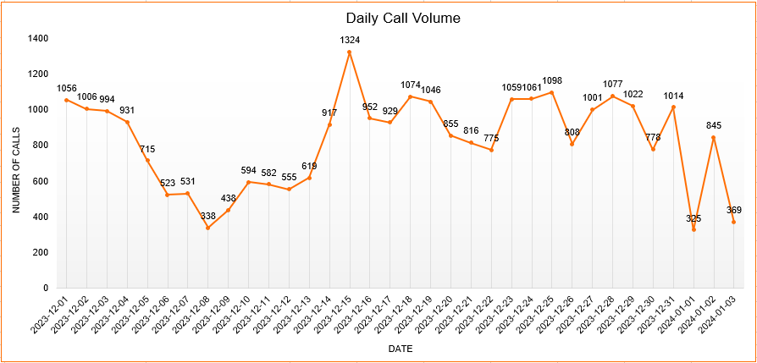
CALL VOLUME & TREND ANALYSIS
Chart Name: Daily Call Volume
Call volume fluctuates across different days.
Certain days show peak customer activity.
Low-volume periods indicate underutilization.
Helps in better workforce planning.

Slide 7
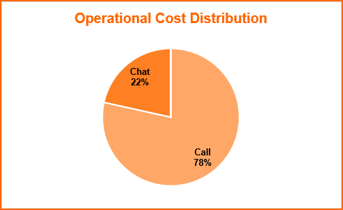
ANALYSIS OF OPERATIONAL COST
Chart Name: Operational Cost Distribution
Most of the operational cost comes from call category (78%)
Other channels contribute much less (22%)
Cost distribution is not balanced
This may be because one service is used more frequently
Higher usage can lead to higher operational expenses

Slide 8
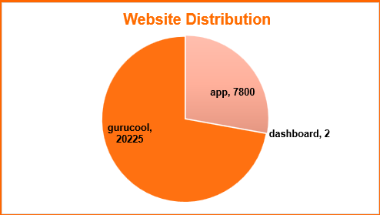
PLATFORM-WISE CALL ANALYSIS
Chart Name: Website Call Distribution
Majority of calls are from one platform (gurucool)
App also contributes a noticeable number of calls
Dashboard has very low usage
Users seem to prefer one platform over others
This could be due to better usability or accessibility

Slide 9
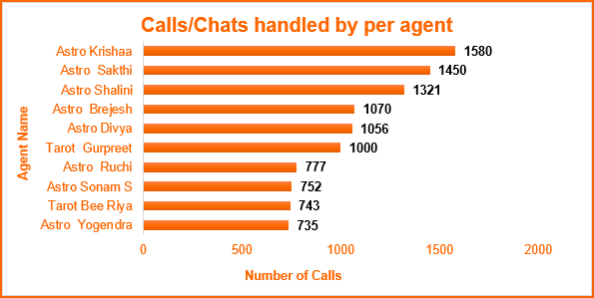
AGENT PERFORMANCE ANALYSIS
Chart Name: Calls/Chats handled by per Agent
Some agents handled more calls than others.
A few agents have noticeably higher numbers.
Some agents handled fewer calls.
Work is not equally distributed among agents.

Slide 10
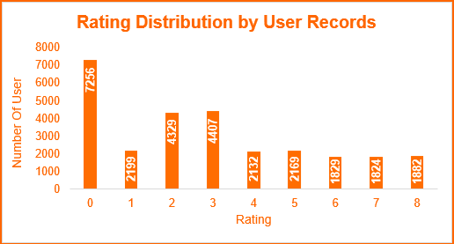
CUSTOMER SATISFACTION ANALYSIS
Chart Name: Rating Distribution by User Records
Rating 0 has the highest number of users
Ratings 2 and 3 are also quite high
Higher ratings (6–8) have fewer users
Overall, most ratings are on the lower to middle side

Slide 11
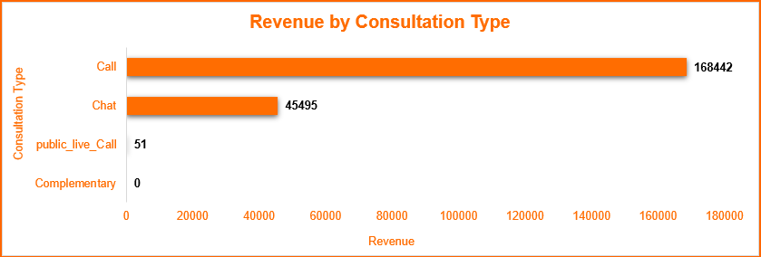
CONSULTATION TYPE CONTRIBUTION TO OVERALL REVENUE
Chart Name: Revenue by Consultation Type
Call consultations generate significantly higher revenue compared to chat
Chat contributes much less despite having a good number of interactions
Revenue is heavily dependent on one service (calls)
This shows that users prefer calls for serious or paid consultations
Chat may be used more for basic or initial queries

Slide 12
ENHANCING AGENT EFFICIENCY AND PRODUCTIVITY
Provide targeted training for low-performing agents
Based on performance analysis, some agents handle fewer calls or have lower efficiency.
Impact: Improves overall team productivity and consistency.
Standardize best practices from top-performing agents
Identify high performers and replicate their approach across the team.
Impact: Increases average calls handled per agent.
Optimize workload distribution
Balance call allocation among agents to avoid under/over-utilization.
Impact: Reduces idle time and improves operational efficiency.

Slide 13
STRATEGIES TO ENHANCE CUSTOMER EXPERIENCE
Reduce call waiting time
High call volumes during peak hours may impact satisfaction.
Impact: Faster service leads to better customer experience.
Focus on quality of interaction
Moderate positive correlation between call duration and satisfaction (0.53)
Impact: Better conversations = higher satisfaction scores.
Identify and support low-rated agents
Some agents consistently receive lower satisfaction ratings.
Impact: Improves overall customer feedback and retention.

Slide 14
DRIVING REVENUE AND CUSTOMER RETENTION
Promote high-revenue consultation types
Certain consultation categories contribute more to total revenue.
Impact: Increases overall revenue and profitability.
Encourage repeat customers through loyalty strategies
Significant portion of users are repeat callers.
Impact: Higher customer retention and lifetime value.
Introduce targeted marketing during peak months
Monthly trends show fluctuations in demand.
Impact: Maximizes revenue during high-demand periods.

Slide 15
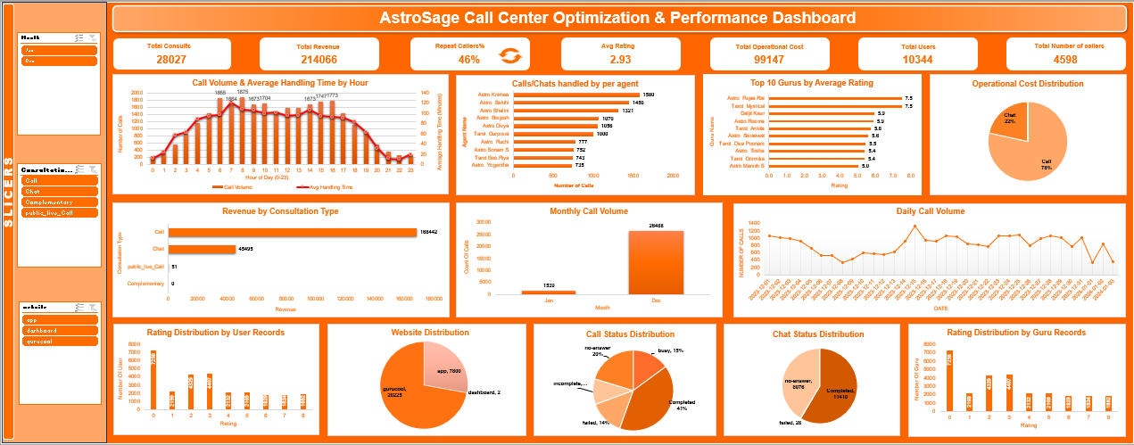
CALL CENTER ANALYTICS & VISUALIZATION

Slide 16
Centralized view of key performance metrics
Displays KPIs like total calls, revenue, customer satisfaction, and operational cost.
Trend analysis for data-driven decisions
Visualizes hourly, daily, and monthly call patterns to identify peak periods.
Agent performance tracking
Compares number of calls handled and efficiency across agents.
Revenue and consultation insights
Highlights high-performing consultation types contributing to revenue.
Interactive filtering for deeper analysis
Enables dynamic exploration by call type, consultation type, and user behavior.

Slide 17
CONCLUSION & KEY INSIGHTS
Identified key patterns in call volume and peak demand periods
Enables better workforce planning and reduced wait times.
Highlighted variation in agent performance and efficiency
Supports targeted training and improved productivity.
Established link between service quality and customer satisfaction
Emphasizes importance of interaction quality over speed alone.
Analyzed revenue distribution across consultation types
Helps prioritize high-value services for business growth.

