Slide 1
Applications of AI to Predictive Maintenance

Slide 2
Lab 2: Training GPU LSTM models using Keras + Tensorflow for Time Series

Slide 3
LAB 2 OVERVIEW
In this lab, we will leverage the Backblaze Hard Drive SMART data to train an LSTM model that will predict potential future failures. Unlike the previous lab, where the XGBoost model predicted based on current data, the LSTM model will leverage time series data to look for trends prior to a failure.
We will walk through creating the "normal" and "failing" sequences that will indicate when we expect to see early warning signs of a disk failure. Then we will use that data to train our model.
Notes:
Instructor: Make sure audience is aligned with the purpose of this DLI.

Slide 4
workshop structure
LAB 1 (2 hrs.)
LAB 2 (2 hrs.)
Training GPU XGBoost models with RAPIDS for Time Series
Training GPU LSTM models using Keras+Tensorflow for Time Series
Discuss predictive maintenance, Blackblaze hard drive data, challenges of dealing with large noisy datasets.
Scope into short-term ML automation problem.
Ingest raw real dataset from GPU production line for XGBoost model.
Format DataFrames and into DMatrices to fit into model.
Analyze dataset statistics (i.e. false positives, true positives.)
Examine XGBoost performance over the model.
Learn how to balance imbalanced data and measure relevant KPIs to assess the model.
Discuss Recurrent Networks and Long Short-Term Memory (LSTMs).
Learn how to mitigate Vanishing Gradient Problem using LSTMs and get familiarized with their cell structure.
Learn how to create sequences of data to feed the temporal nature of RNNs.
Design different RNN architectures and even create your own model.
Learn how to create the confusion matrix and adjust the threshold to different f-1 scores.
LAB 3 (2 hrs.)
Training Autoencoder for Anomaly Detection
Focus on a different deep learning technique, which is called anomaly detection.
Learn how to use unsupervised learning algorithms like a deep autoencoder network to perform anomaly detection.
Learn how to create different autoencoder models in Keras.
General discussion on hyperparameter tuning and threshold settings.

Slide 5
Recurrent Neural Networks

Slide 6
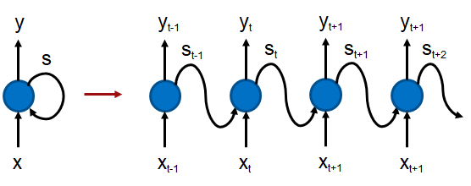
Recurrent Neural Networks
RNNs are created to solve the memory-persistence issue found in conventional feed forward networks.
RNNs maintain a loop that allows the information to be persistent in the network.
At each time step 𝑡 , the network receives input 𝑋𝑡 and outputs a value of 𝑦𝑡 . The left side of the figure shows an RNN cell with input 𝑋 and output 𝑦 . There is also a loop-back of the state, which represents the memory. At a given timestep 𝑡 , the output also depends on all previous timesteps 𝑡−1,𝑡−2,...,0 .
y_{t+2}
x_{t+2}

Slide 7
Vanishing Gradient Problem and LSTMs
A simple RNN model only has a single hidden RNN layer while a stacked RNN model (needed for advanced applications) has multiple RNN hidden layers. A common problem in deep networks is the “vanishing gradient” problem, where the gradient gets smaller and smaller with each layer until it is too small to affect the deepest layers.
This is because small gradients or weights (values less than 1) are multiplied many times over through the multiple time steps, and the gradients shrink asymptotically to zero.
With the memory cell in LSTMs, we have continuous gradient flow (errors maintain their value) which thus eliminates the vanishing gradient problem and enables learning from sequences which are hundreds of time steps long.

Slide 8
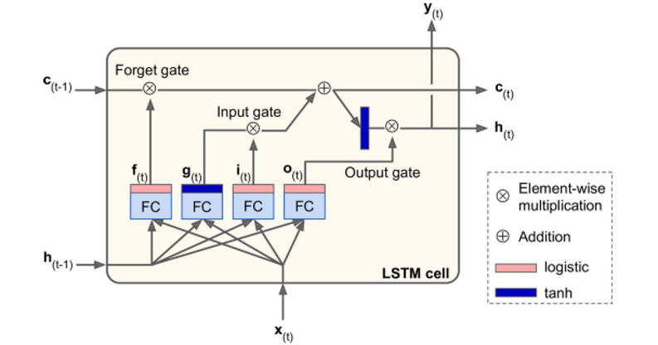
LSTM Model
Image from book: Hands-On Machine Learning with Scikit-Learn and TensorFlow: Concepts, Tools, and Techniques to Build Intelligent Systems by Aurélien Géron

Slide 9
LSTM Applications
LSTMs, due to their ability to learn long term dependencies, are applicable to a number of sequence learning problems. These problems include language modeling and translation, acoustic modeling of speech, speech synthesis, speech recognition, audio and video data analysis, handwriting recognition and generation, sequence prediction, and protein secondary structure prediction.
In this lab, we apply the LSTM model to the Backblaze data we introduced in the previous lab to create a model that predicts the hard disk failure based on the recorded data-points at least a few days before the actual failure.

Slide 10
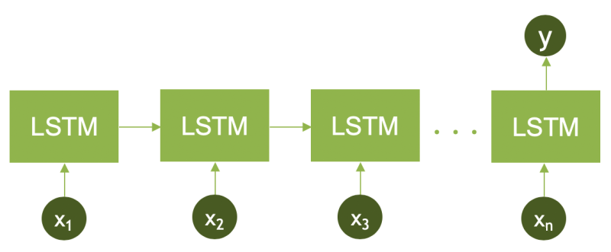
LSTM - create sequences of data based on the serial number
Here we have n time steps representing each data point in the DataFrame.
Also, only the last RNN (LSTM) cell is outputting the value 𝑦 , which in our model indicates whether the data sequence ends up in a failure state or not. Note that the input values 𝑥1,𝑥2,…,𝑥𝑛 are multi-dimensional values and not single scalars.

Slide 11
Stacked LSTMs
In reality, one-layer LSTM nodes are barely enough to capture the information encoded within a sequence. Alternatively, stacked LSTMs allow capturing more data complexity. In our model, we are going to use three layers of stacked LSTMs as shown in the next slide.

Slide 12
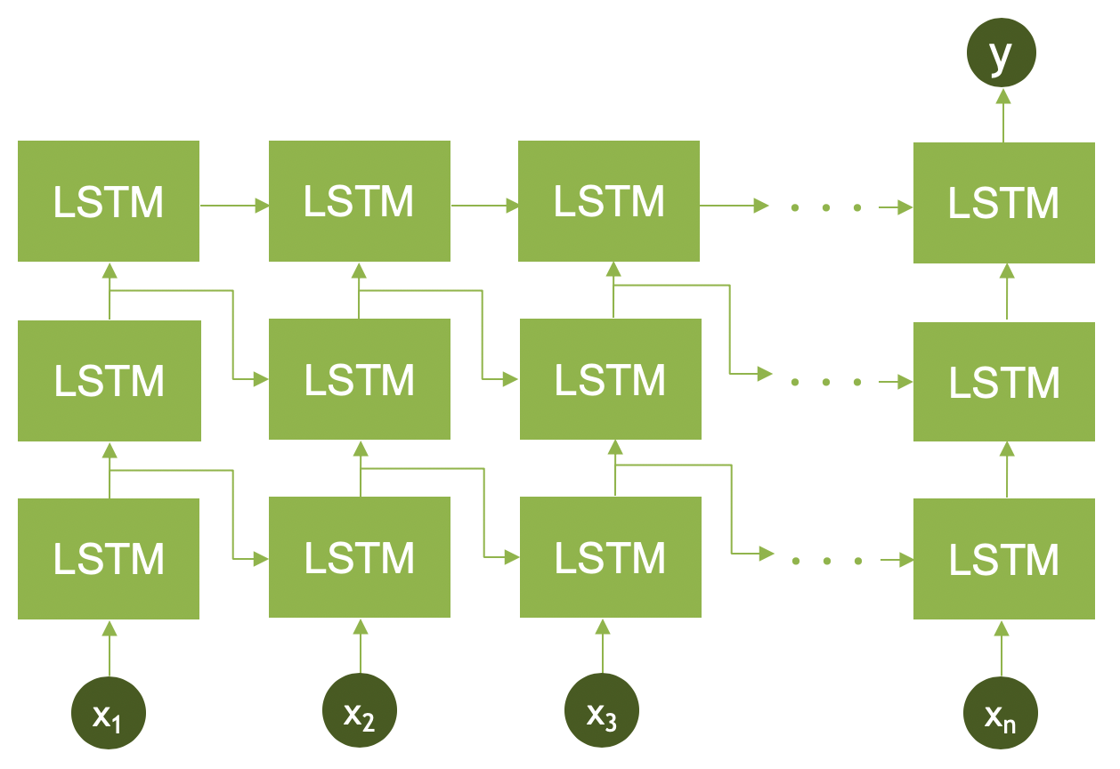
Stacked LSTMs

Slide 13
CNN LSTM Architecture
The CNN LSTM uses a convolutional neural layer to extract features from the sequence on top of the LSTM layers, which also inherently extract features. Since we are dealing with a one dimensional time series, we are going to use 1D convolutional network, starting with a kernel size of 12 and 50 filters. We also use a max pooling layer of size 2 to shrink the dimension of the data.

Slide 14
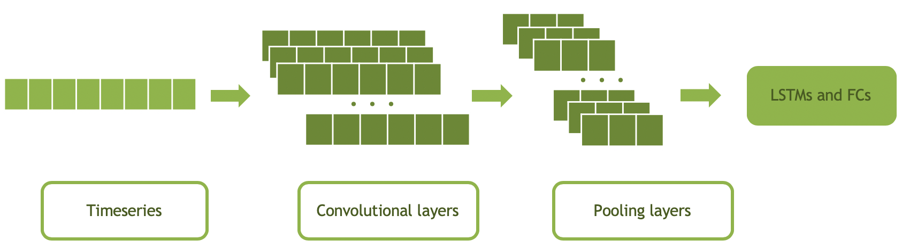
CNN LSTM Architecture

Slide 15
Keras

Slide 16
Keras
Keras: an API for specifying & training differentiable programs
“Keras is a high-level neural networks API, written in Python and capable of running on top of TensorFlow, CNTK, or Theano. It was developed with a focus on enabling fast experimentation. Being able to go from idea to result with the least possible delay is key to doing good research.
Allows for easy and fast prototyping (through user friendliness, modularity, and extensibility).
Supports both convolutional networks and recurrent networks, as well as combinations of the two.
Runs seamlessly on CPU and GPU.”
Source: https://keras.io/

Slide 17
Keras
Keras: an API for specifying & training differentiable programs
KERAS API
TensorFlow, CNTK, MXNET, …
CPU
GPU

Slide 18
Keras – CODE SIMPLICITY
# load model definition API
from keras.models import Sequential
model = Sequential()
# load appropriate Keras layers and add to model
from keras.layers import Dense
model.add(Dense(units=64, activation='relu', input_dim=100))
model.add(Dense(units=10, activation='softmax'))
# load appropriate optimizer and compile model
from keras.optimizers import SGD
optimizer1 = SGD(lr=0.01, momentum=0.9, nesterov=True)
model.compile(loss=‘categorical_crossentropy’, optimizer=optimizer1, metrics=['accuracy'])

Slide 19
Keras – CODE SIMPLICITY
# visualize model
model.summary()
Model: "sequential_1"
_________________________________________________________________
Layer (type) Output Shape Param #
=================================================================
dense_1 (Dense) (None, 64) 6464
_________________________________________________________________
dense_2 (Dense) (None, 10) 650
=================================================================
Total params: 7,114
Trainable params: 7,114
Non-trainable params: 0
_________________________________________________________________

Slide 20
NOTE ABOUT LAB AND RUL
Day N+1
Day N+2
Day N+3
Day N+4
Day N+RUL1
Day N+RUL2
Day N+RUL3
Day N
Failed
Sensor 1
Sensor 2
. . . . .
. . . . .
. . . . .
Sensor 3
Sensor 4
For Lab 2, we will be training the model based with 5-day sequences and will use a 2-day look ahead to classify the sequence as failed or not.
Typically, you would train multiple models using the failed state from a date in the future (Ex: 2 weeks out, 1 month out, 3 months out)

Slide 21
STARTING the lab

Slide 22

LAB 2 MODEL SUMMARY - LSTM
Train LSTM Model with sequences of length ‘S’ to predict failure ‘L’ days in future
Training: Use multi-day sequences of SMART features (from an individual hard drive) to train a LSTM model on whether a drive will fail ‘L’ days in the future
Inference: Pass sequence of SMART values for an individual hard drive over the last ‘S’ days to see if drive will fail ‘L’ days in the future
Day
Features (SMART Values for individual drive over ‘S’ days)
Label
Day
Features (SMART Values for individual drive over last ‘S’ days)
N+0
01
02
03
04
…
18
19
20
21
N-S+1
01
02
03
04
…
18
19
20
21
N+1
01
02
03
04
…
18
19
20
21
N-S+2
01
02
03
04
…
18
19
20
21
N+2
01
02
03
04
…
18
19
20
21
N-S+3
01
02
03
04
…
18
19
20
21
…
…
…
…
…
…
…
…
…
…
…
…
…
…
…
…
…
…
N+S-1
01
02
03
04
…
18
19
20
21
N
01
02
03
04
…
18
19
20
21
N+S+L-1
FAILED
LSTM Model
LSTM Model
Future Failure at day N+L
True / False

Slide 23
LAB 2 MODEL SUMMARY – 1D CONV / LSTM
Train LSTM Model with sequences of length ‘S’ to predict failure ‘L’ days in future
Training: Use multi-day sequences of SMART features (from an individual hard drive) to train a 1D CONV / LSTM model on whether a drive will fail ‘L’ days in the future
Inference: Pass sequence of SMART values for an individual hard drive over the last ‘S’ days to see if drive will fail ‘L’ days in the future
Day
Features (SMART Values for individual drive over ‘S’ days)
Label
Day
Features (SMART Values for individual drive over last ‘S’ days)
N+0
01
02
03
04
…
18
19
20
21
N-S+1
01
02
03
04
…
18
19
20
21
N+1
01
02
03
04
…
18
19
20
21
N-S+2
01
02
03
04
…
18
19
20
21
N+2
01
02
03
04
…
18
19
20
21
N-S+3
01
02
03
04
…
18
19
20
21
…
…
…
…
…
…
…
…
…
…
…
…
…
…
…
…
…
…
N+S-1
01
02
03
04
…
18
19
20
21
N
01
02
03
04
…
18
19
20
21
N+S+L-1
FAILED
1D CONV / LSTM Model
1D CONV / LSTM Model
Future Failure at day N+L
True / False

Slide 24
Summary

Slide 25
LAB 2 SUMMARY
Training GPU LSTM models using Keras+Tensorflow for Time Series
Discuss Recurrent Networks and Long Short-Term Memory (LSTMs).
Learn how to mitigate Vanishing Gradient Problem using LSTMs and get familiarized with their cell structure.
Learn how to create sequences of data to feed the temporal nature of RNNs.
Design different RNN architectures and even create your own model.
Learn how to create the confusion matrix and adjust the threshold to different f-1 scores.

Slide 26
WHAT’S NEXT (LAB 3)?
Training Autoencoder for Anomaly Detection
Focus on a different deep learning technique, which is called anomaly detection.
Learn how to use unsupervised learning algorithms like a deep autoencoder network to perform anomaly detection.
Learn how to create different autoencoder models in Keras.
Discuss how to create and deploy GAN models for detecting anomalies.
General discussion on hyperparameter tuning and threshold settings.

