Slide 1

Predicting Stresses in Trees Using Hyperspectral Data
Aditya Tiwari, John Couture
EA/EOU

Slide 2
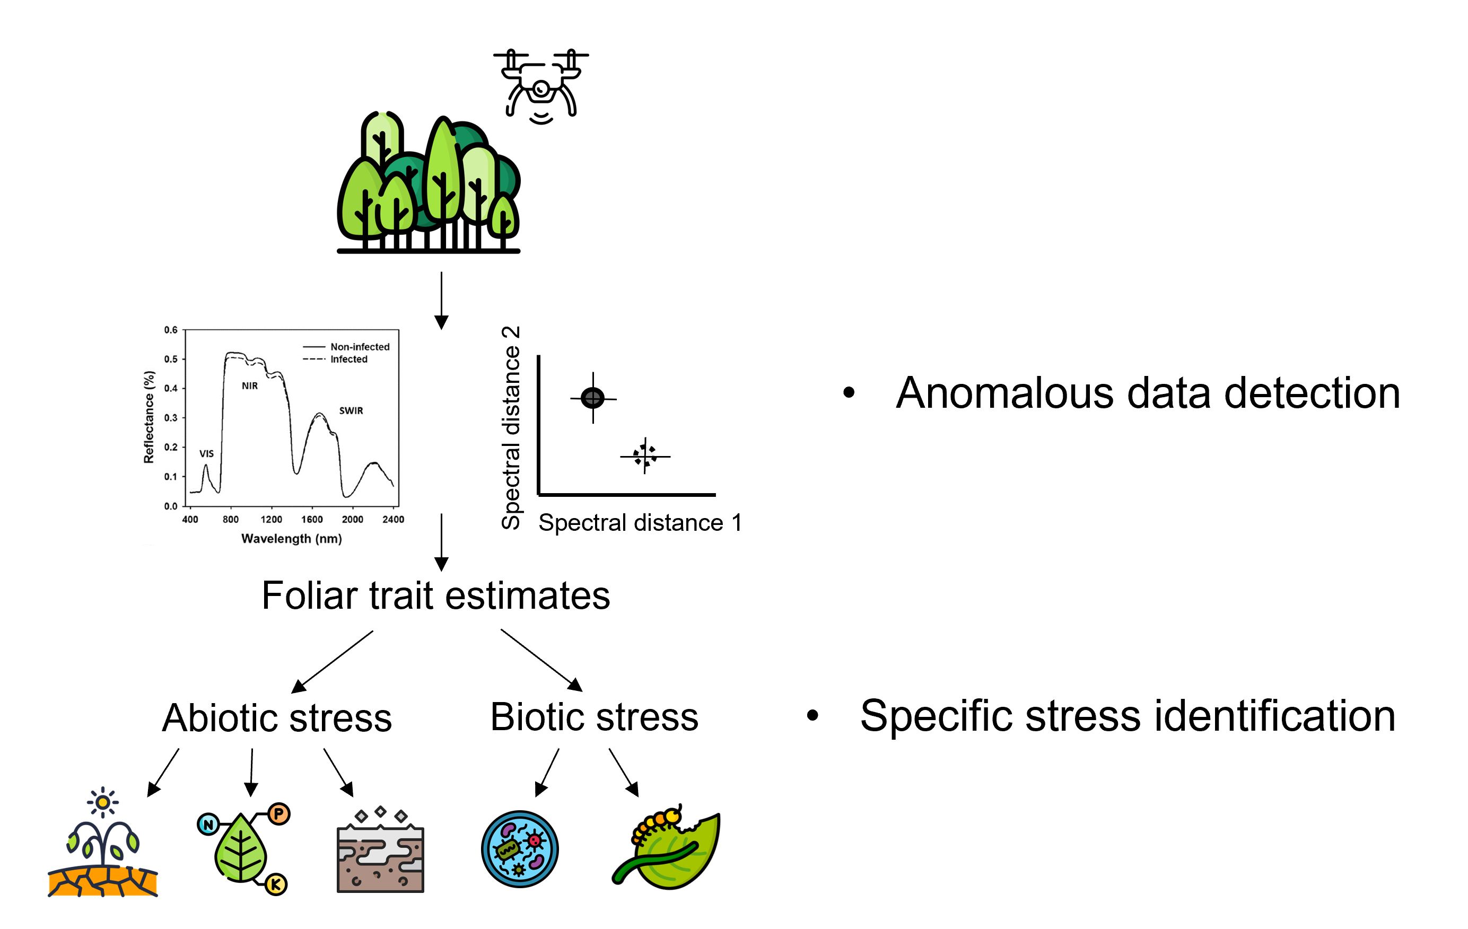
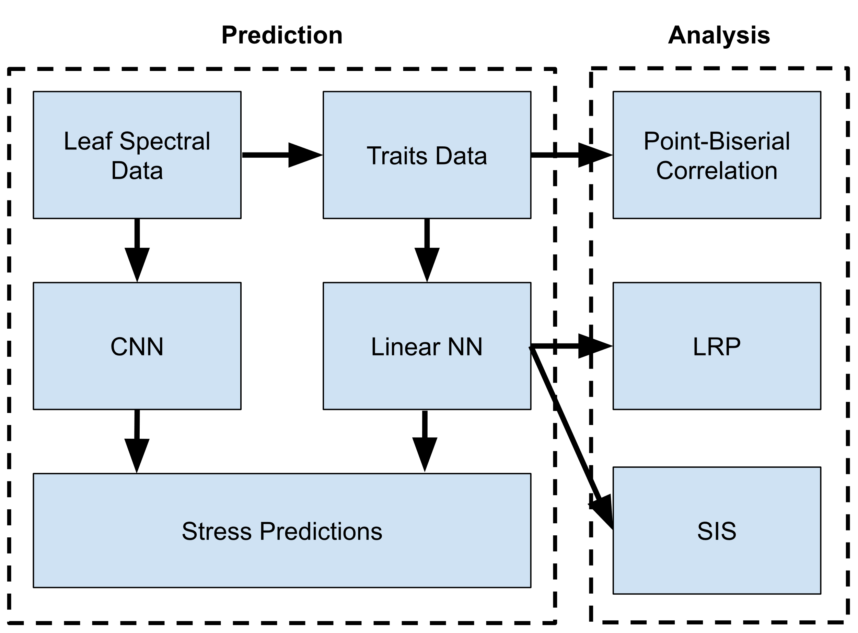

Challenge
Progress
Develop a framework for predicting the stresses that a tree is under using spectroscopic data
Determine what biochemical traits are associated with what stresses.
Spectral CNN Accuracy | Traits NN Accuracy
99.57% | 99.81%
No significant correlations between any individual trait and any stress were found using point-biserial correlation
LRP - Selected important traits for each stress, sorted by descending relevance:
Geosmithia morbida: Glucose
Drought: N, Gal, Fv_Fo, Performance Index
Nutrient Deficiency: Fv_Fo
Fusarium solani: N, Gal, Performance Index
Salinity: Fv_Fo, WUEin, Zeaxanthin
SIS - Selected not-unimportant traits for each stress, unsorted:
Geosmithia morbida : Sugars, Rut, Condensed Tannins
Drought: Water Potential, N, C, Violaxanthin, Lutein, Zeaxanthin, Chl_b, B_carotene, Glucose
Nutrient Deficiency: Gal
Fusarium solani : LWC, Chl_a, Sucrose, Rut, Condensed Tannins
Salinity: Violaxanthin, Lutein, Zeaxanthin, Chl_b, Chl_a, B_carotene, Glucose, Fructose, Sucrose, Sugars, Starch, Ellagic, Gal, Rut, Condensed Tannins
Approach
Expected Outcomes
Black walnut and red oak seedlings were exposed to various combinations of stresses
Spectroscopic data was collected from leaves using a Spectra Vista HR 1024i spectroradiometer
Leaf traits were derived from the spectral data using partial-least-squares-based predictive models
The trait-stress associations could be used to develop a more efficient prediction model and to inform further research
The stress prediction model could be implemented into UAVs to make managing forests easier and cheaper.
The general framework of meta-analyzing neural networks after training could be used to aid the development of machine learning models for other purposes.
A CNN was trained on the spectral data
A linear NN was trained on the traits data
Meta Analysis of the traits model was performed to determine trait associations (Layer-wise Relevance Propagation (LRP), Sufficient Input Subsets (SIS))

