Slide 1

Web Scraping –
Restaurant Reviews
and Sentiment Analysis

Slide 2



Motivation
Experience turns out to be poor when we depend on overall rating
Sometimes food is good but service is bad
Everything is bad
Rating does not match our preferences
Going through 100s of reviews is tiring and time consuming

Slide 3
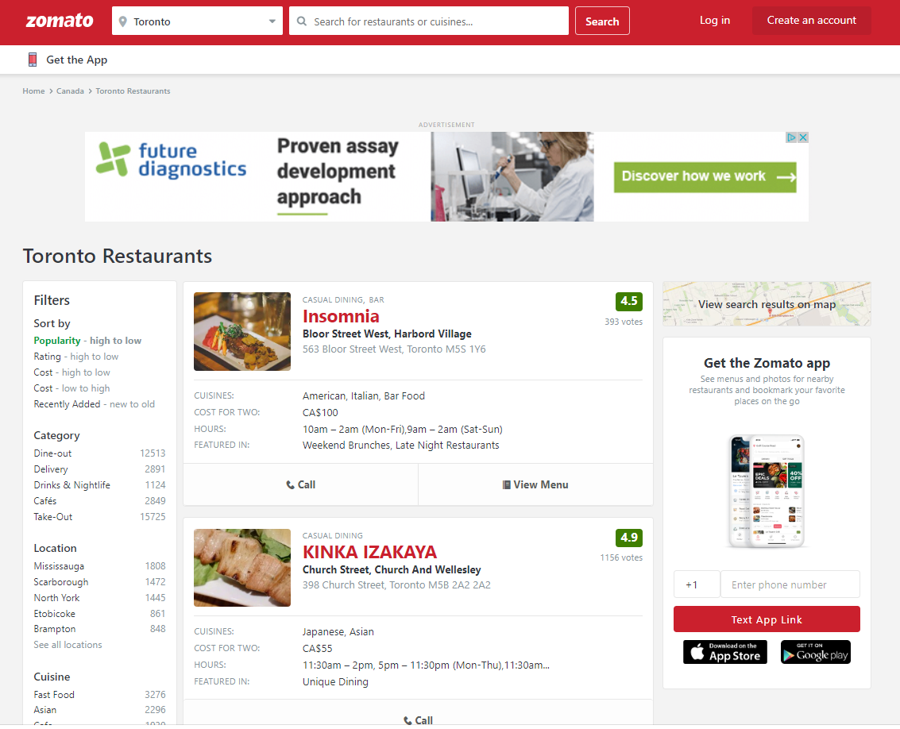
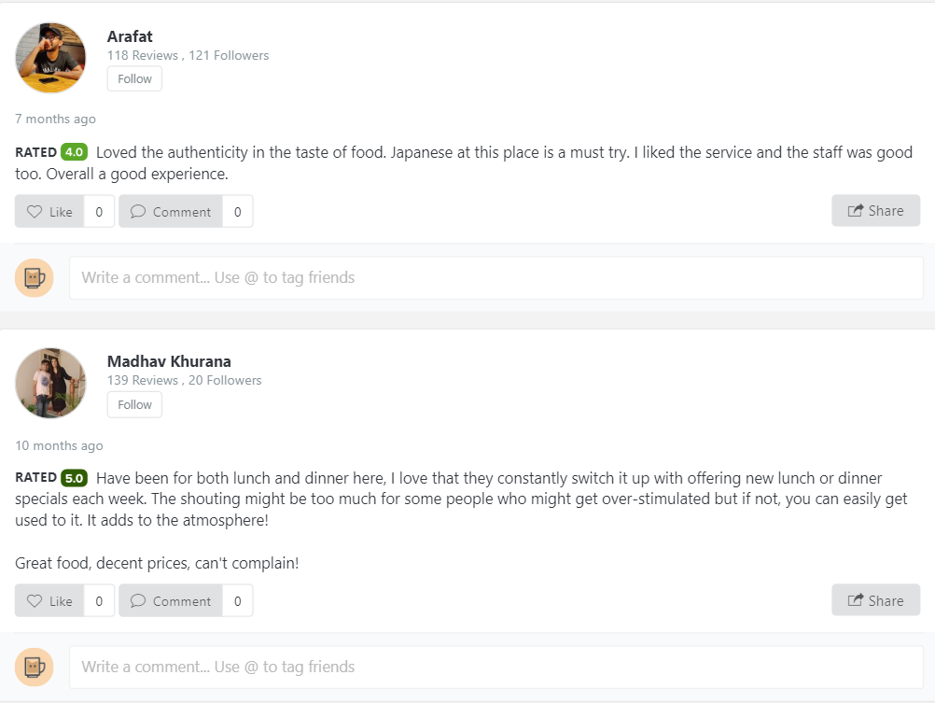
Company Info
Business Offering: Provide information, menus
and user-reviews of restaurants
Total data set : ~6500 Reviews, 167 Restaurants
Website hierarchy : Flat
Link: https://www.zomato.com/toronto/restaurants

Slide 4
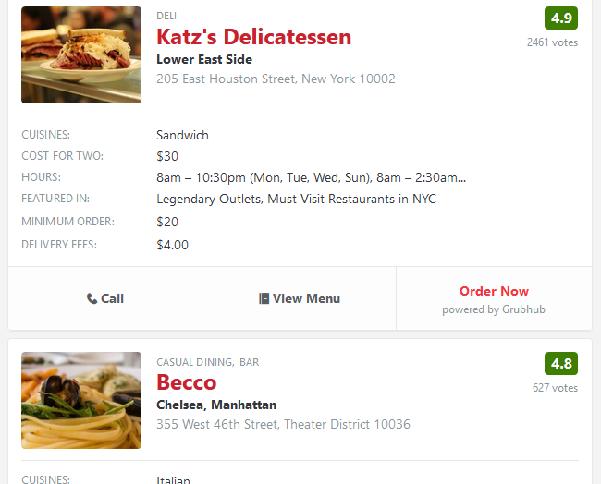
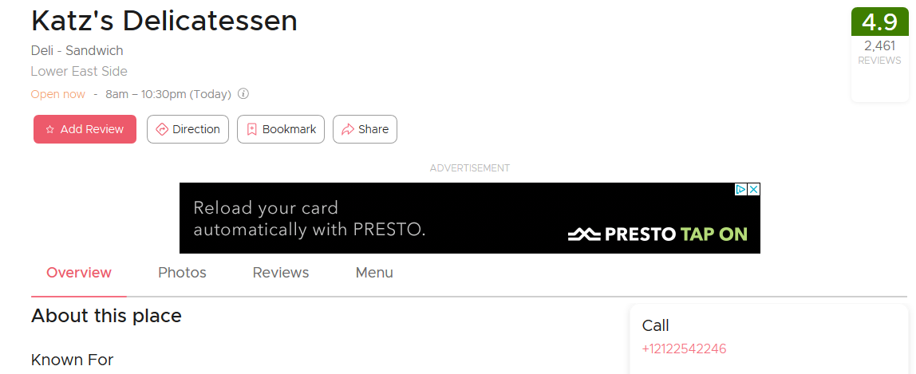
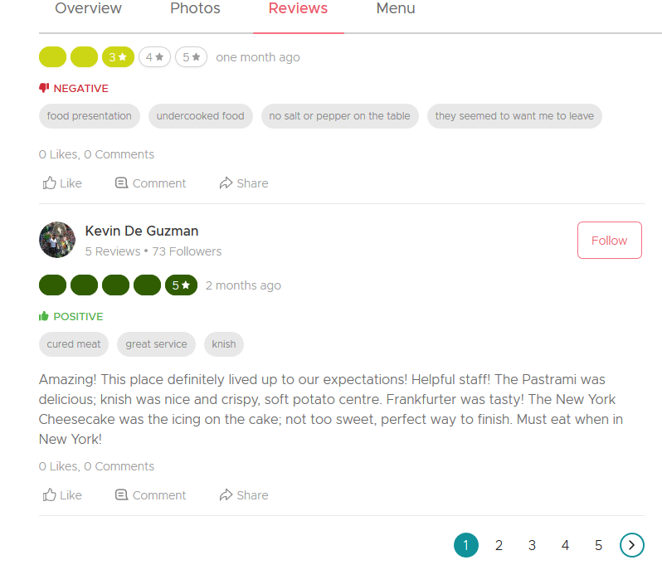
Selenium
High-level Flow – Scraping
Beautiful Soup
Results Page
Restaurant Profile Page
Reviews Tab
1. Click restaurant link
2. Scrape Top-Level Details:
Name
Cuisine
Cost
Overall rating
Location
number of reviews
Click all review pages
3. Scrape reviews:
Comment
Rating by commenter

Slide 5
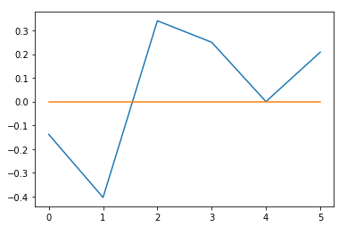
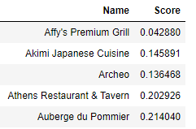
TextBlob
High-level Flow – Sentiment Analysis
Wordcloud
Sentiment Score for
each comment
Average Score per Restaurant
Set a Cut-Off for
Score Groups
Negative: <= 0.1
Positive: > 0.1
Sentence no.
Identify top areas
of concern
Extract Nouns and Adjectives for each group

Slide 6
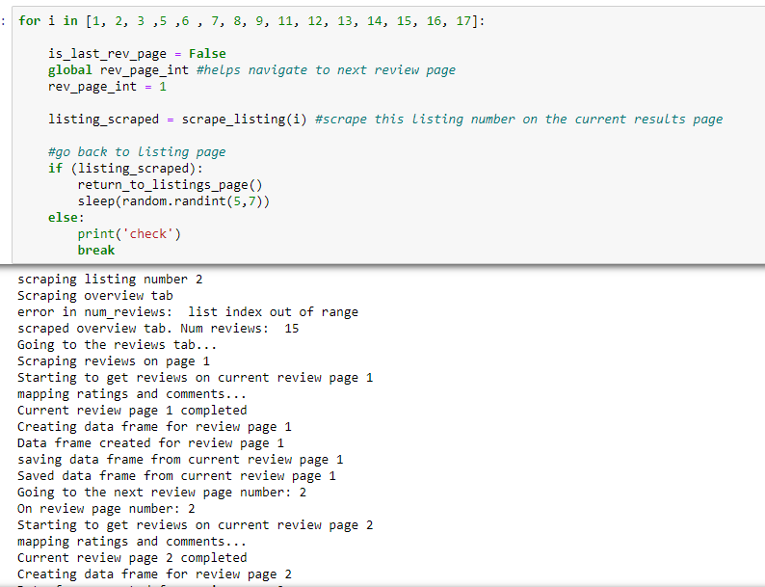
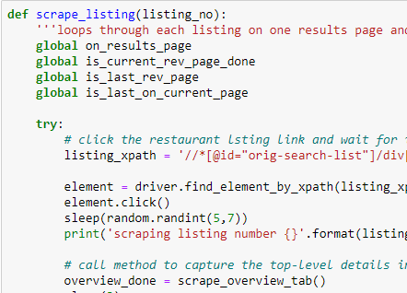
Loop to go inside all listings on the results page
and call the different methods
Log each key step to know where the code broke if we need to manually change a tag or change VPN or reload the page.

Slide 7
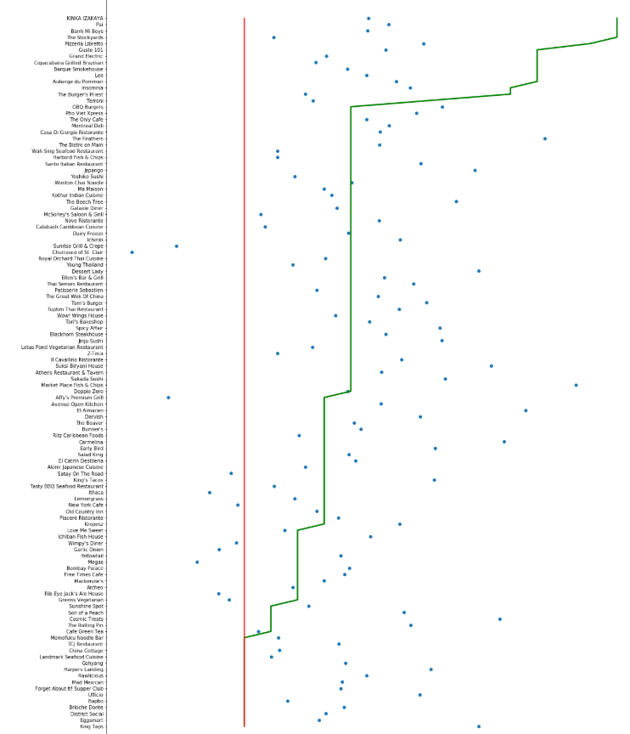

Sentiment Score v/s Zomato Rating
3
Low Sentiment Scores
3.5
4
High Zomato Ratings
5
Notes:
Talk about how we scaled score to get on the same range as in the overall rating so it was easier to compare the two.

Slide 8
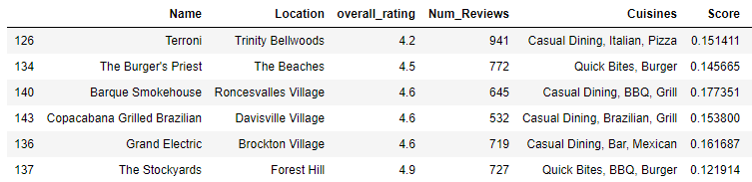
Sentiment Score v/s Overall Rating
Insights
Some restaurants have High Zomato Rating but their Sentiment Score is below average

Slide 9
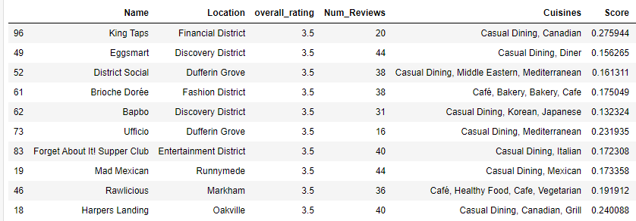
Sentiment Score v/s Overall Rating
Insights
Some restaurants have poor Zomato Rating but their Sentiment Score is Positive

Slide 10
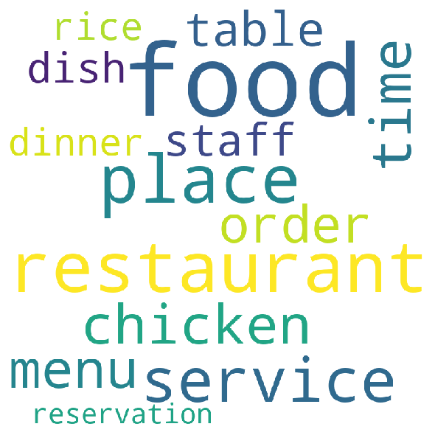
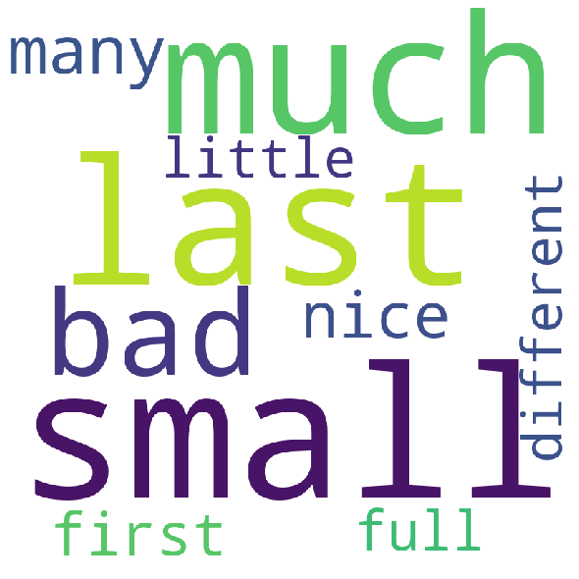
Top Areas of Concern
Adjectives used to Describe them
Notes:
Emphasize the themes we didn’t expect to see – chicken, rice, menu.
Accuracy issue in Adjectives – ‘nice’. Could have been taken out of context.

Slide 11
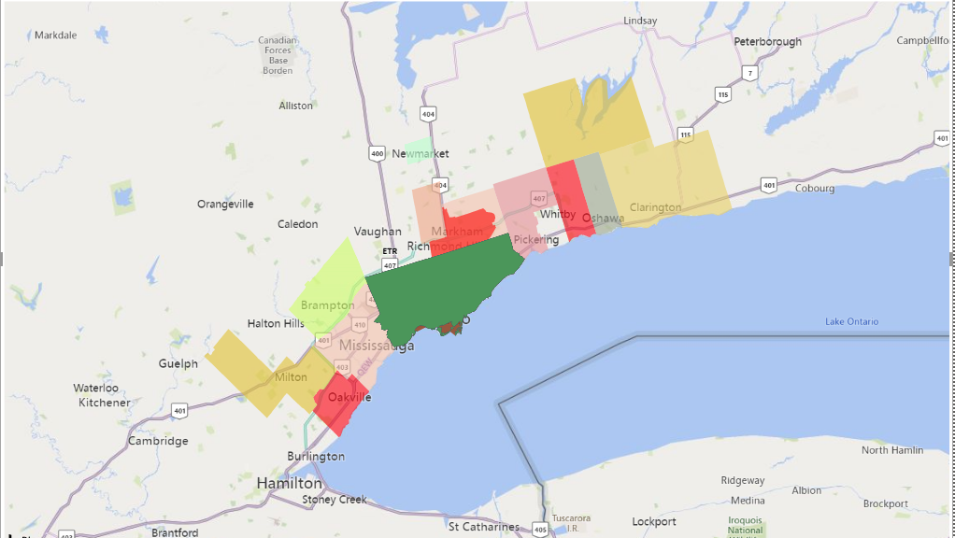
Sentiment Score vs. Restaurant Location

Slide 12
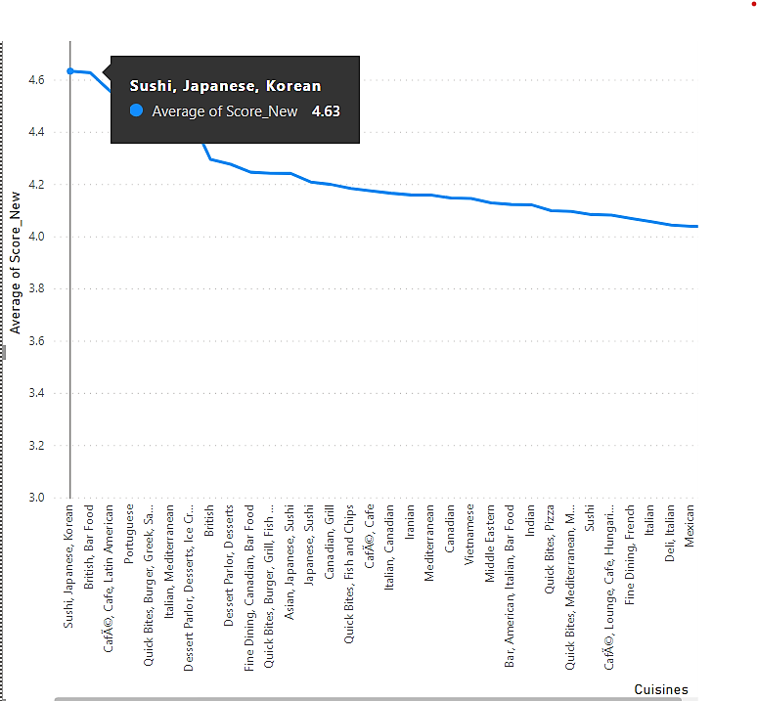
Top Cuisines by Sentiment Score

Slide 13
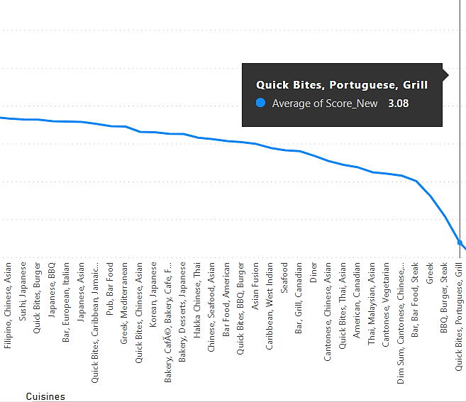
Bottom Cuisines by Sentiment Score

Slide 14
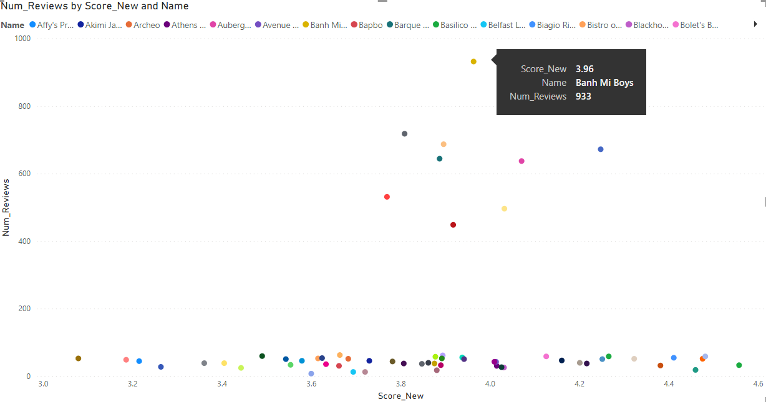
Sentiment Score vs. Number of Reviews
Majority of the listings fell under <200 reviews

Slide 15

We cannot always trust overall ratings of the restaurants – as its easier to give a 5-star rating compared to writing a review
Displaying sentiment scores across crucial aspects such as quality, service, staff etc. would be a better indicator
Restaurant ratings need to be more personalized as experiences can be subjective
Could not derive a clear relationship between the number of reviews and sentiment score.
With more data and other statistical methods, the analysis might improve
Conclusion

Slide 16
Challenge 1: Zomato does not allow selenium to select options in a drop-down and enter text in the location cell.
Challenge 2: Each restaurant had a unique URL so we could not change source URL dynamically. We used selenium to click through these. The review pages were loaded within a frame with java script, so they did not have any URL at all so we again used selenium to navigate.
Challenge 3: After scraping 23 listings, the entire page structure changed, all xpaths and tags changed, The rating for a review had become an attribute than a content now. And some content which was in different tags started coming together under the same tag.
Challenge 4: The next review page button changed completely, earlier there were page numbers which a link called load more. And it does not hide the ones already seen.
Challenge 5: Sometimes on returning to the listing page, the page would not load. It would just go blank.
Challenge 6: If we use xpath, the xpath may point to a different element on some pages, so we need to be careful and check after few pages
Challenges
Notes:
Workaround: So we had to provide the city to search in the url
Workaround: Used Selenium PageSource
Workaround: Cleaning was required
Workaround: Write new logic for changing review pages
Workaround: Print the error and check periodically, load it manually and re-run the script
Workaround: Avoid xpath where possible, used only for automating listing clicks, raised exception and re-ran manually

Slide 17
Improve NLP model for identifying context better
Differentiate between sarcasm and actual positive sentences
Classify a review as a whole better than just by individual sentences
Incorporate Sentiment score across key topics of interest on the platform
Provide recommendation also as per review comments and not just as per ratings
Tailor to user based on their earlier written reviews
Strive to create a more accurate and relevant metric based on:
Sentiment score
Subjectivity
Overall Ratings
Classifying genuine review comments is still a challenge and needs more research
Recommend a meal plan given a budget for a week.
Future Scope

Slide 18


