Slide 1


Group Members & their IDs Sabbir Ahmed – 2171081102 Farhan Siddique – 2172081009 Afsana Alom - 2172081013
Presentation on Support Vector Machine

Slide 2

History
SVM is a classifier derived from stastical learning theory by Vapnik and Chervonenkis
SVMs introduced by Boser, Guyon, Vapnik in COLT-92
Initially popularized in the NIPS community, now an important and active filed of all Machine Learning research.
Special issues of Machine Learning Journal, and Journal of Machine Learning Research.

Slide 3
What is SVM?
SVM is a supervised learning algorithm which is widely used classification algorithm.
SVM is applicable for the data that are linearly separable
For non-linear data, kernel functions are used

Slide 4
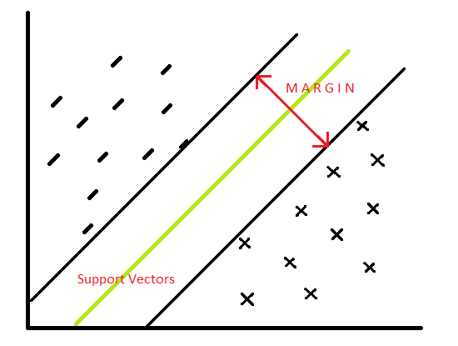
Linear SVM
Linear SVM is applicable when given datasets are linearly separable.
It Can easily be separated with a linear line which we can call separator.
It’s data is classified with the help of hyperplane

Slide 5
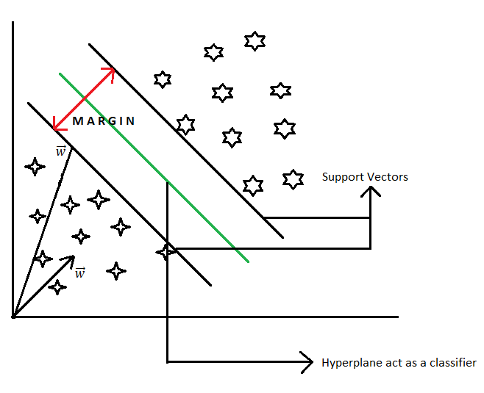
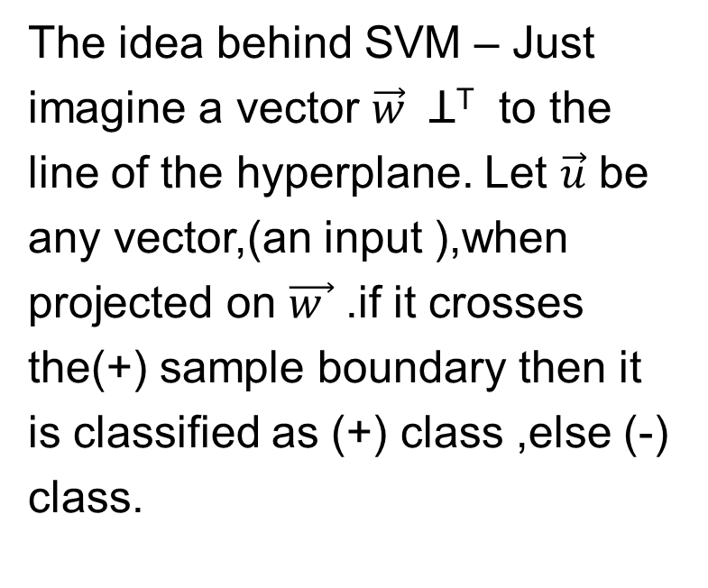
Mathematical Explanation
The idea behind SVM – Just imagine a vector $\vec{w}$ Ʇ^{T} to the line of the hyperplane. Let $\vec{u}$ be any vector,(an input ),when projected on $\vec{w }$ .if it crosses the(+) sample boundary then it is classified as (+) class ,else (-) class.

Slide 6
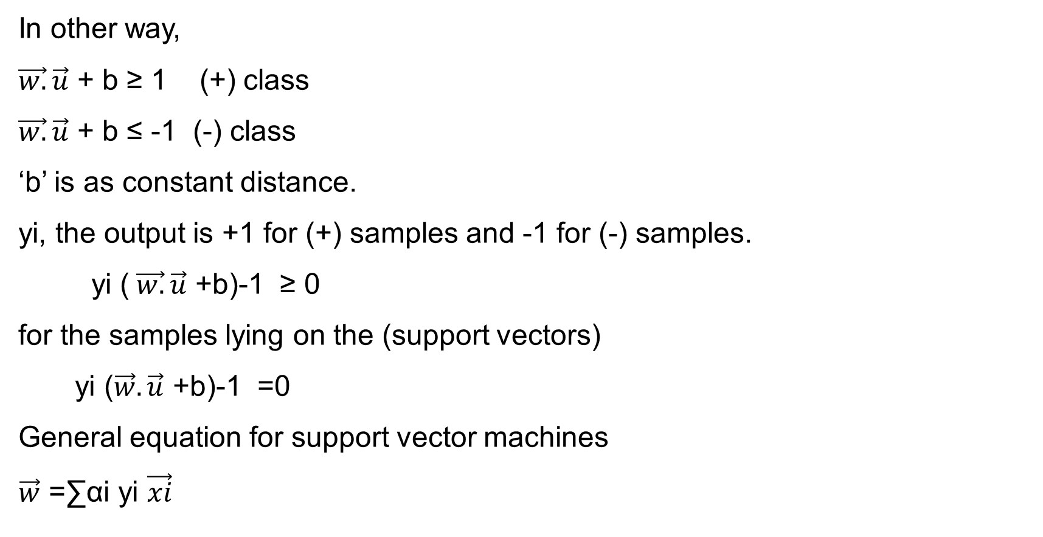
In other way,
$\vec{w.}\vec{u}$ + b ≥ 1 (+) class
$\vec{w.}\vec{u}$ + b ≤ -1 (-) class
‘b’ is as constant distance.
yi, the output is +1 for (+) samples and -1 for (-) samples.
yi ($\vec{w.}\vec{u}$ +b)-1 ≥ 0
for the samples lying on the (support vectors)
yi ($\vec{w}.\vec{u}$ +b)-1 =0
General equation for support vector machines
$\vec{w}$ =∑αi yi $\vec{xi}$

Slide 7
Non-Linear SVM
According to Non-Linear SVM, it cannot be easilty separated with a linear line
For this Kernels are used to make non-separable data into separable data.

Slide 8
Advantages
Good for smaller cleaner datasets.
Accurate results.
Useful for both linearly separable data and non – linearly separable data.
Effective in high dimensional spaces.
Disadvantages
It is sensitive to noise
Not suitable for large datasets

Slide 9
Application of SVM
Sentiment analysis.
Spam Detection.
Handwritten digit recognition.
Image recognition challenges
Text and Hypertext Categorization

Slide 10
Conclusion
Many Alternate forms include Transductive SVMs, Sequential SVMs, Support Vector Regression, Relevance Vactor Machines, and data-driven kernels.
Key lesson learned: a linear algorithm in the feature space is equivalent to a nonlinear algorithm in the input space. Standard linear algorithms can be generalized.

Slide 11
Thank You

