Slide 1


Slide 2
daemon.ajvanbeest.com
github.com/theaj42
- presentations
- sourdough.ai
ajvanbeest@protonmail.com

Slide 3
Threat intel is hard

Slide 4
25 Focused threat actors
8 APTs

Slide 5
11,275 discrete applications

Slide 6
Also, there’s “news.”

Slide 7
Zero FTEs

Slide 8
So I built a thing

Slide 9
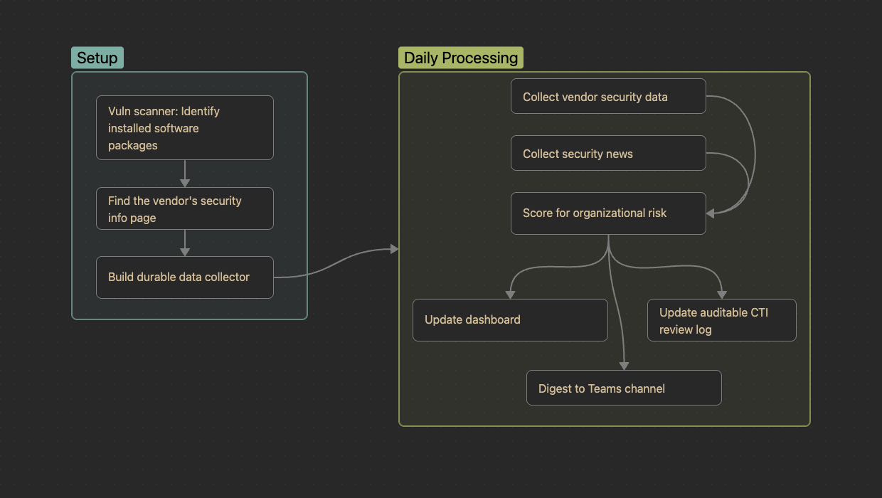

Slide 10
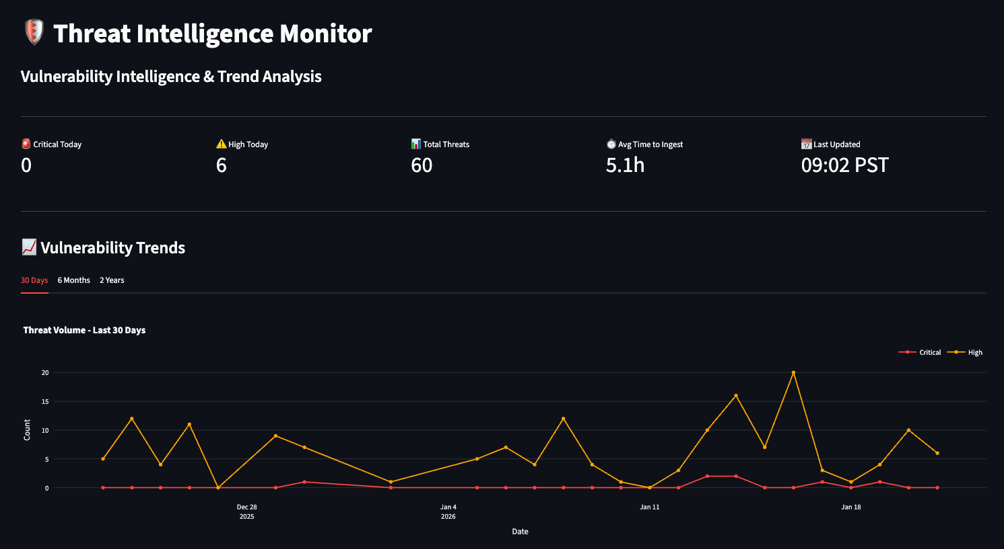

Slide 11
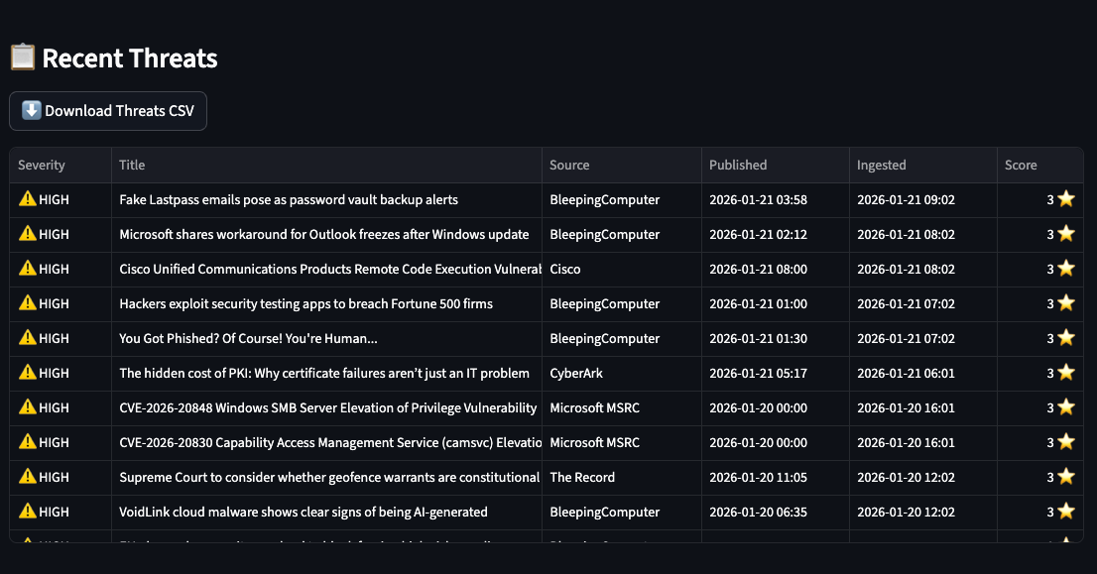

Slide 12
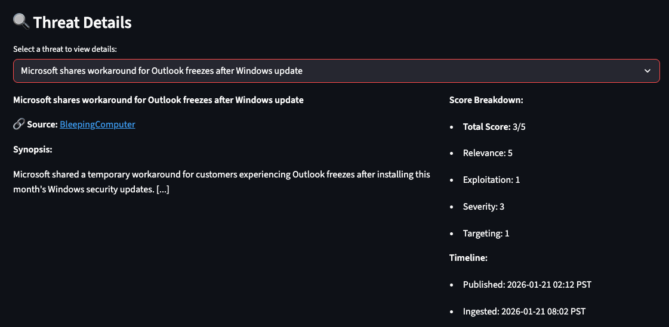

Slide 13
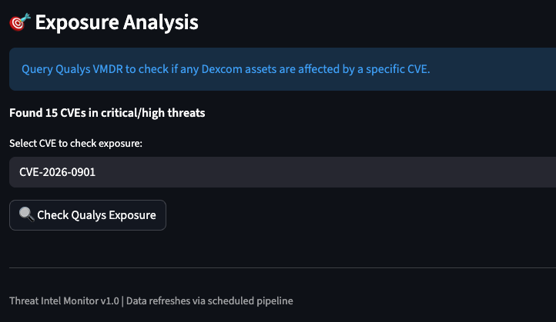

Slide 14
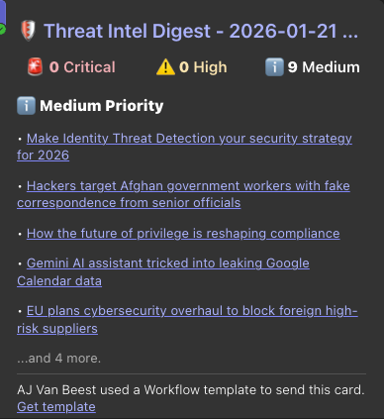

Slide 15
The patterns

Slide 16
Use good tools

Slide 17
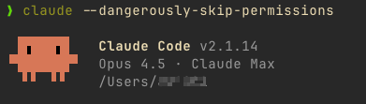

Slide 18
Use spec-driven development:
What vs. How

Slide 19
Use real data

Slide 20
What is “Good?”

Slide 21
Let the robot cook

Slide 22
Your turn
(a cookbook)

Slide 23
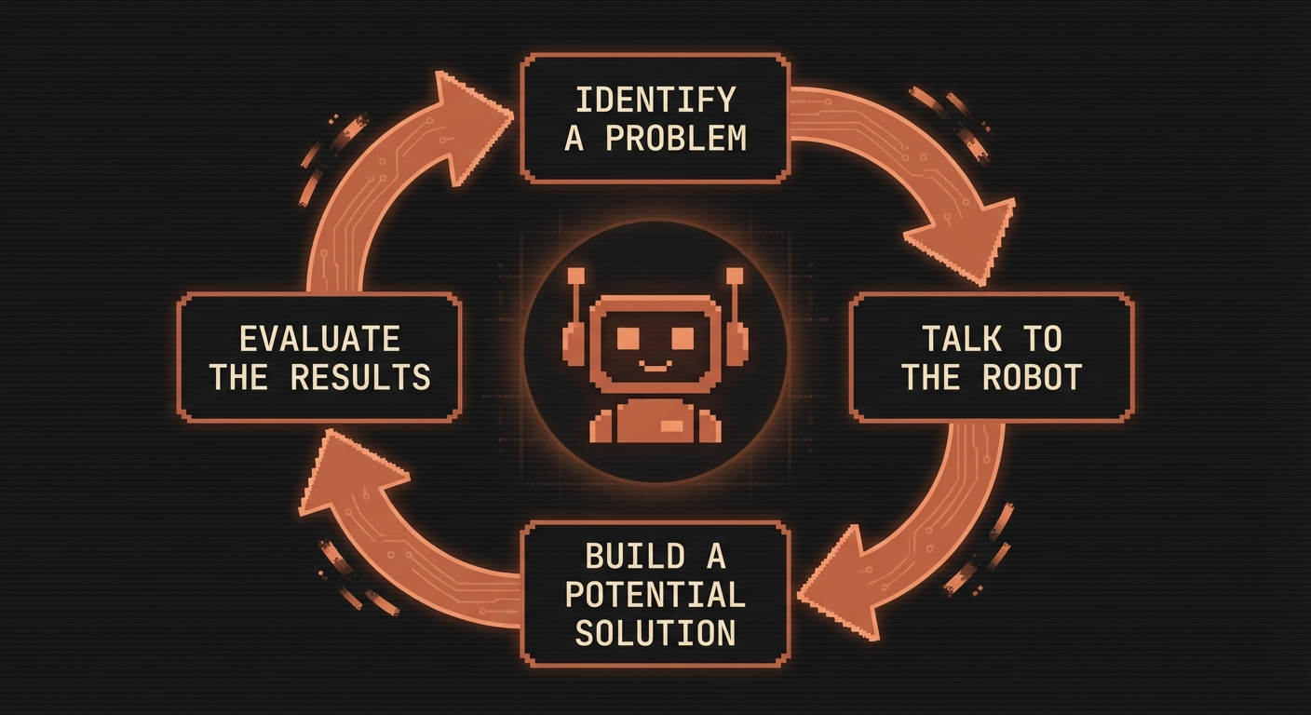

Slide 24
Tip: *Talk* to the robot

Slide 25
Tip: *Ask* the robot

Slide 26
CRITICAL NOTE…

Slide 27
You own the outcome

Slide 28
Kthxbye
daemon.ajvanbeest.com
github.com/theaj42
ajvanbeest@protonmail.com

