Slide 1
Text Editor Tricks for Blue Teamers

Slide 2
whoami

Slide 3
TOC

Slide 4
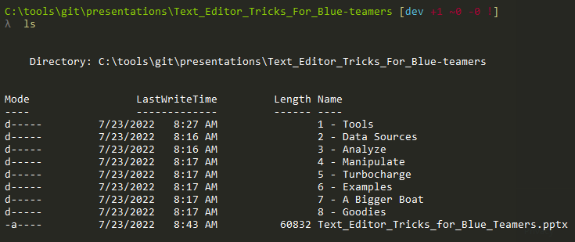

Slide 5
C:\TextEditor\Tools

Slide 6
C:\TextEditor\Data

Slide 7
C:\TextEditor\Analysis

Slide 8
C:\TextEditor\Turbo

Slide 9
C:\TextEditor\Examples

Slide 10
C:\TimeForOtherTools

Slide 11
C:\TextEditor\Goodies

Slide 12
kthxbye

