Slide 1
Building an
Agentic Threat Intel System

Slide 2


Slide 3
daemon.ajvanbeest.com
github.com/theaj42
- presentations
- sourdough.ai
ajvanbeest@protonmail.com

Slide 4
Threat intel is hard

Slide 5
25 Focused threat actors
8 APTs

Slide 6
11,275 discrete applications

Slide 7
Also, there’s “news.”

Slide 8
Whaddya mean, Agentic?

Slide 9
The system is empowered:

Slide 10
It can make choices and take actions…

Slide 11
…without consulting a human.

Slide 12


Slide 13
So I built a thing

Slide 14
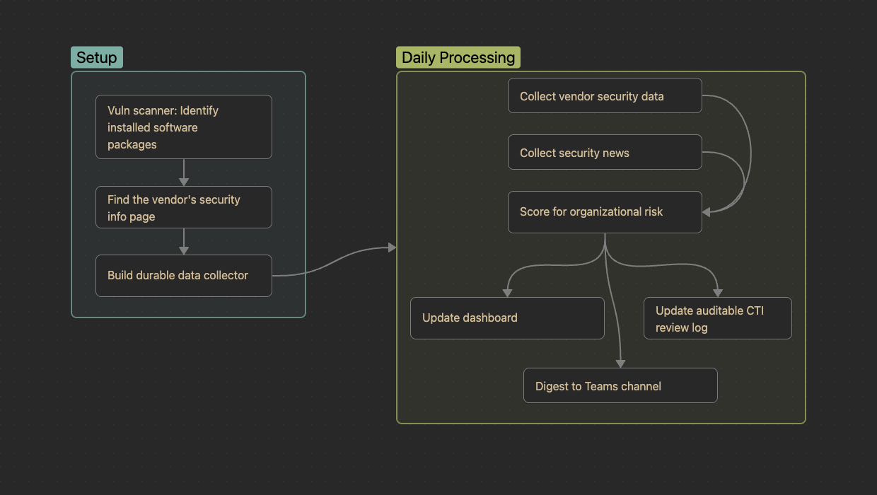

Slide 15
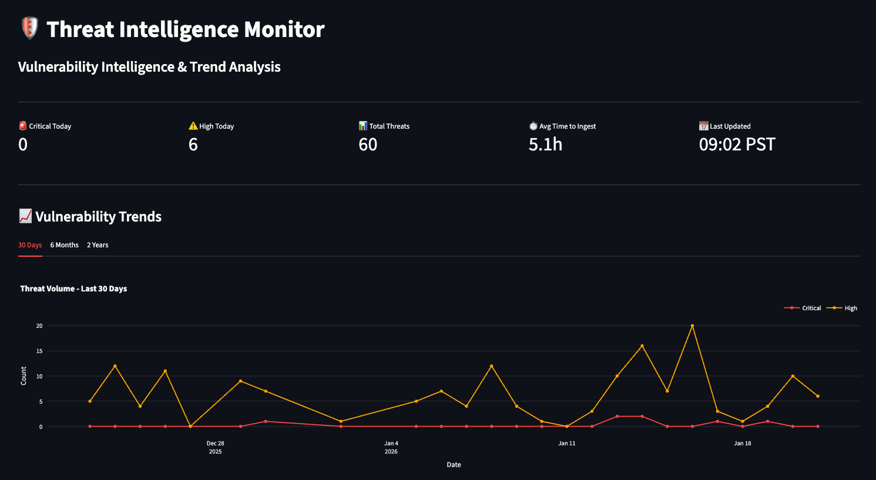

Slide 16
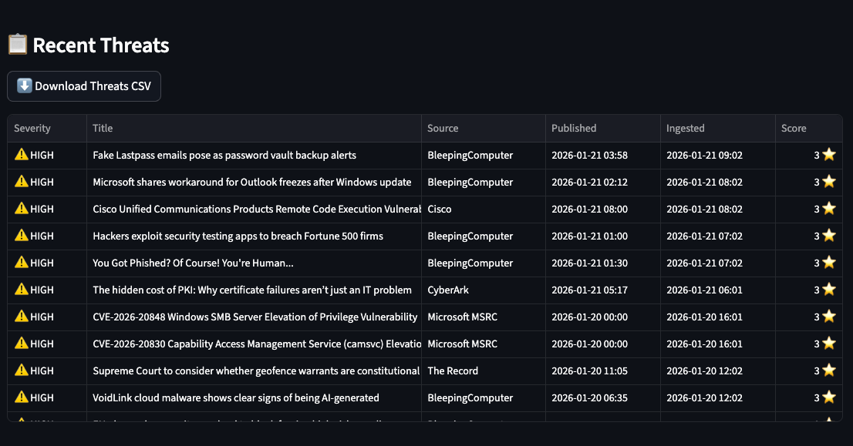

Slide 17
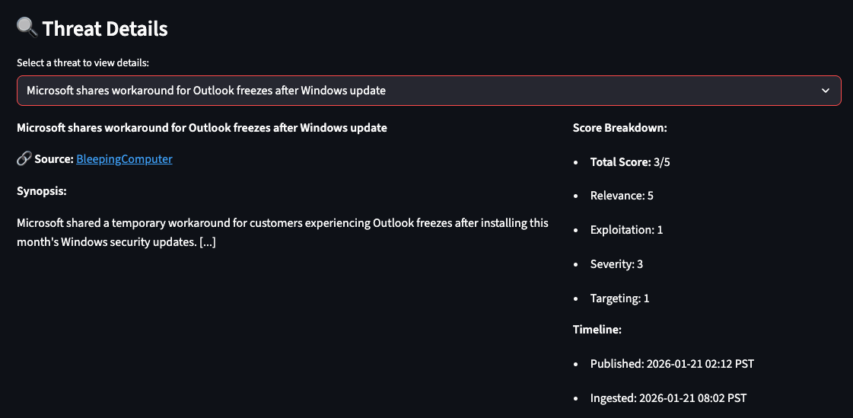

Slide 18
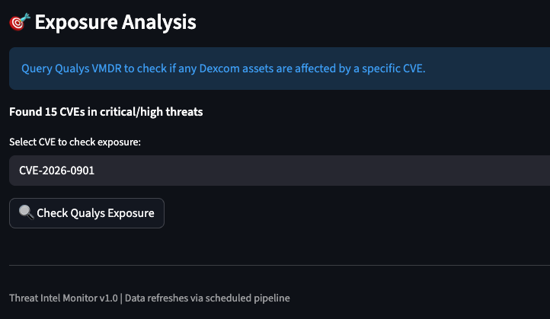

Slide 19
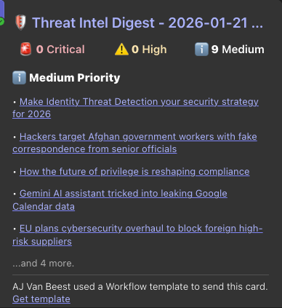

Slide 20
The patterns

Slide 21
Use good tools

Slide 22
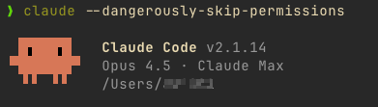

Slide 23
Use spec-driven development:
What vs. How

Slide 24
Use real data

Slide 25
What is “Good?”

Slide 26
Let the robot cook

Slide 27
Your turn: A cookbook

Slide 28
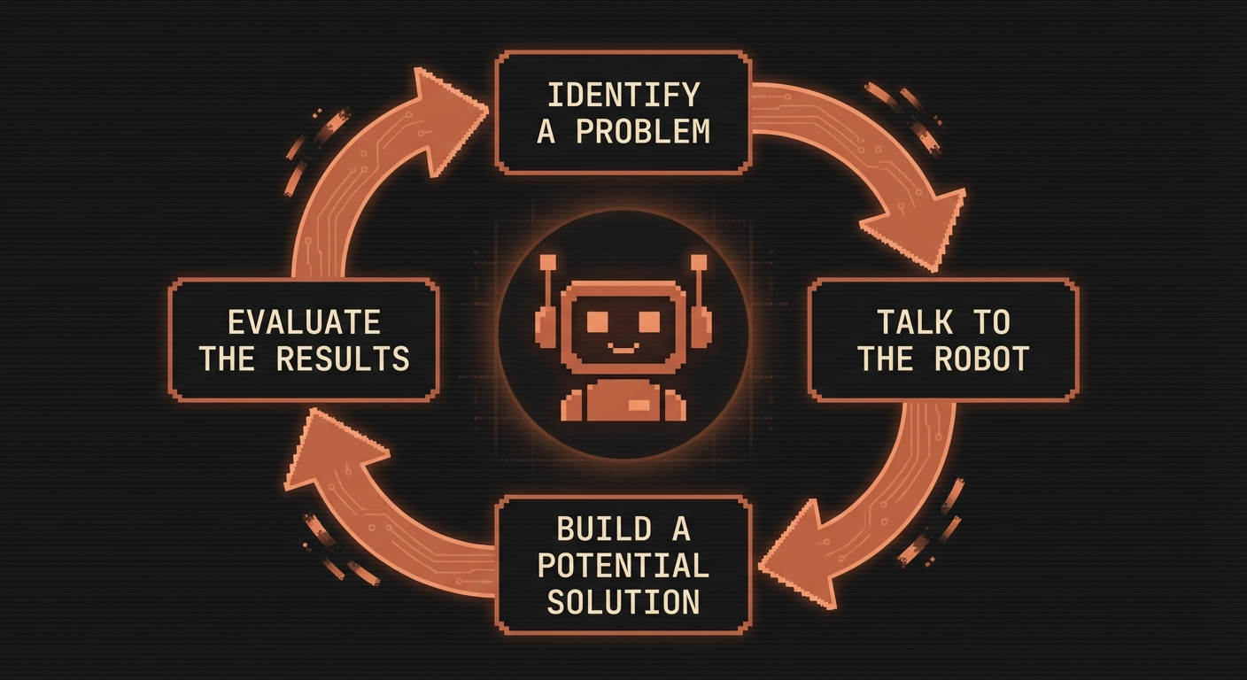

Slide 29
Tip: *Talk* to the robot

Slide 30
Tip: *Ask* the robot

Slide 31
CRITICAL NOTE…

Slide 32
You own the outcome

Slide 33
Kthxbye
daemon.ajvanbeest.com
github.com/theaj42
ajvanbeest@protonmail.com

