Slide 1


to Manage Heterogeneity in
Model-based Engineering Workflows
Alan Correa, Anil Yildiz, Julia Kowalski
correa@mbd.rwth-aachen.de
Methods for Model-based Development in Computational Engineering
RWTH Aachen University

Slide 2
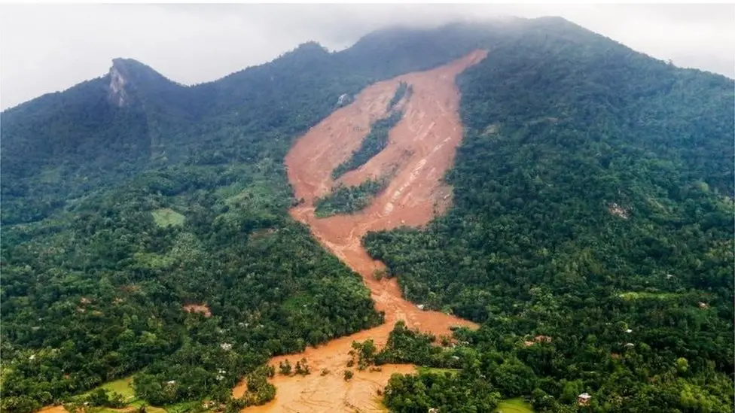
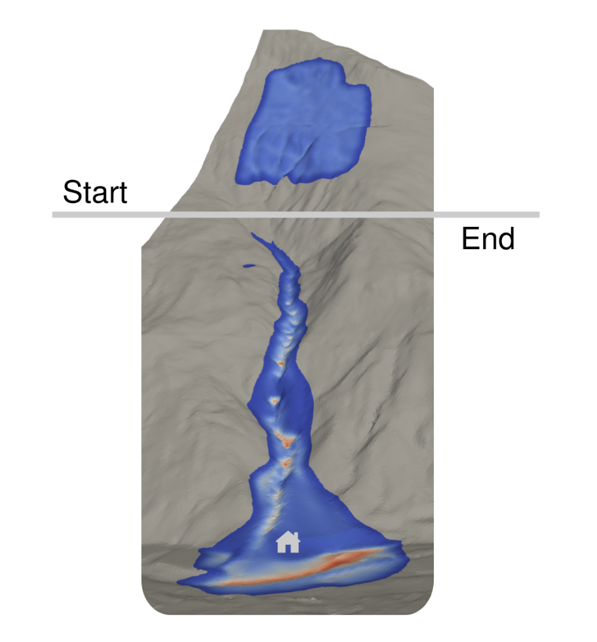
MBE Workflow
Physical Process
Computational Model
Analysis Tasks
Sensitivity Analysis
Optimization
Benchmarking
Parameter Calibration
Model Selection
Data Assimilation
...

Slide 3





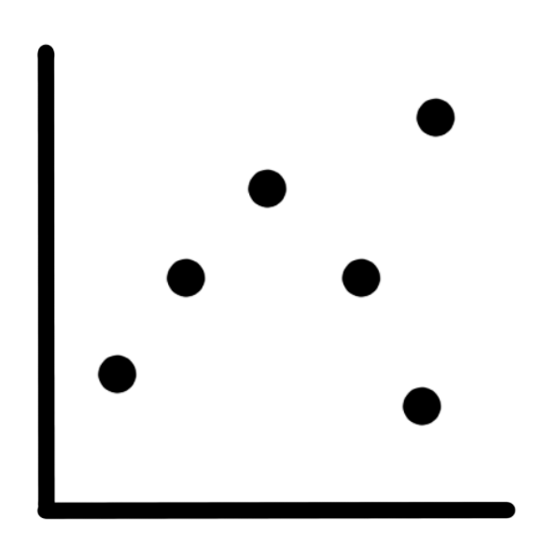







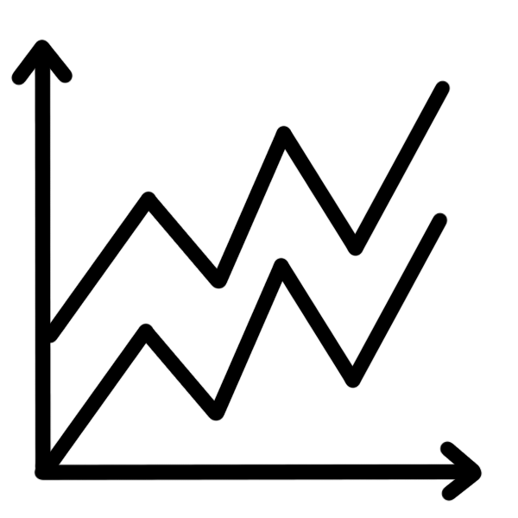

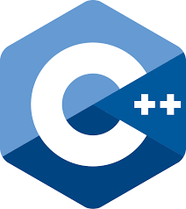
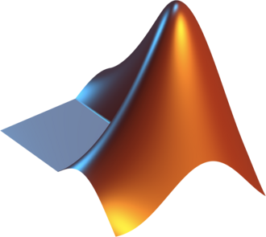


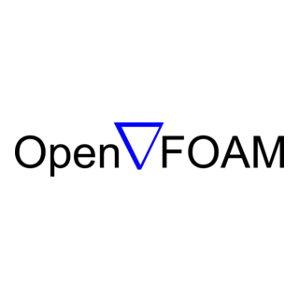







Inputs
Hardware Platform
Geometry
BC/IC
CPU
GPU
Local
HPC
Cloud
Parameter
Sample
Software Ecosystem
Outputs
Field
QoI
Visual
Report
RobustGaSP
Data
Models & Algorithms
Compute Environment

Slide 4
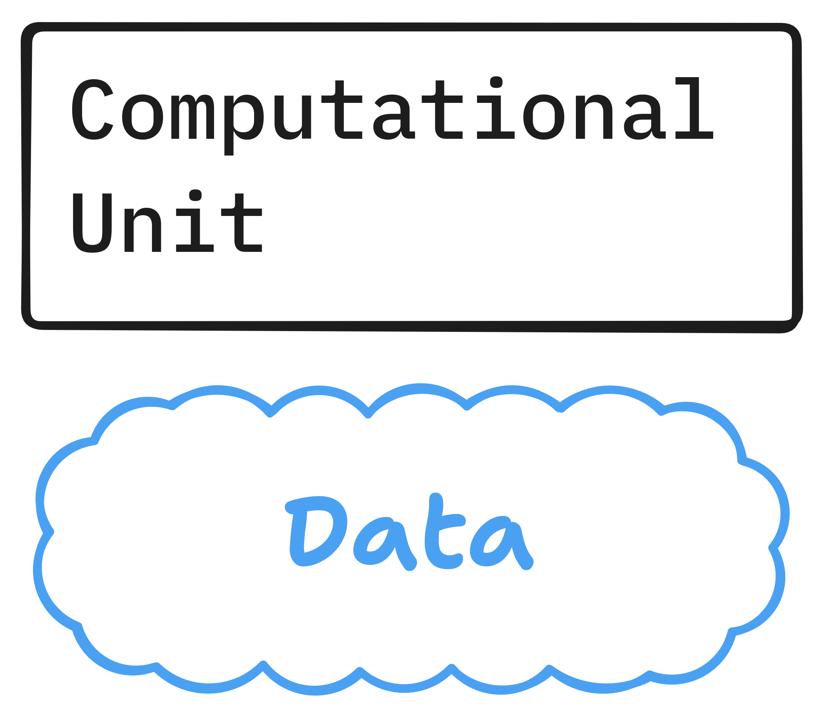
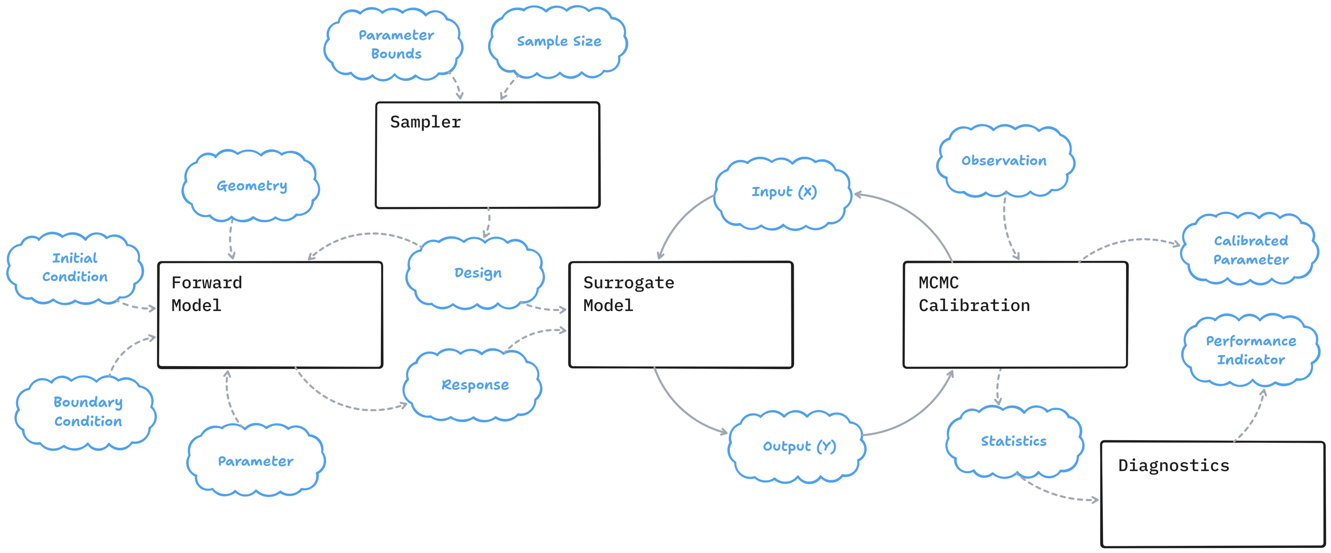



Approach – Data Feed-forward
Python
C/C++
Julia
Fortran
R
Matlab
CPU
GPU
Local
HPC
Cloud
Synx
Flow
RobustGaSP
Pidgeons.jl
Coda

Slide 5
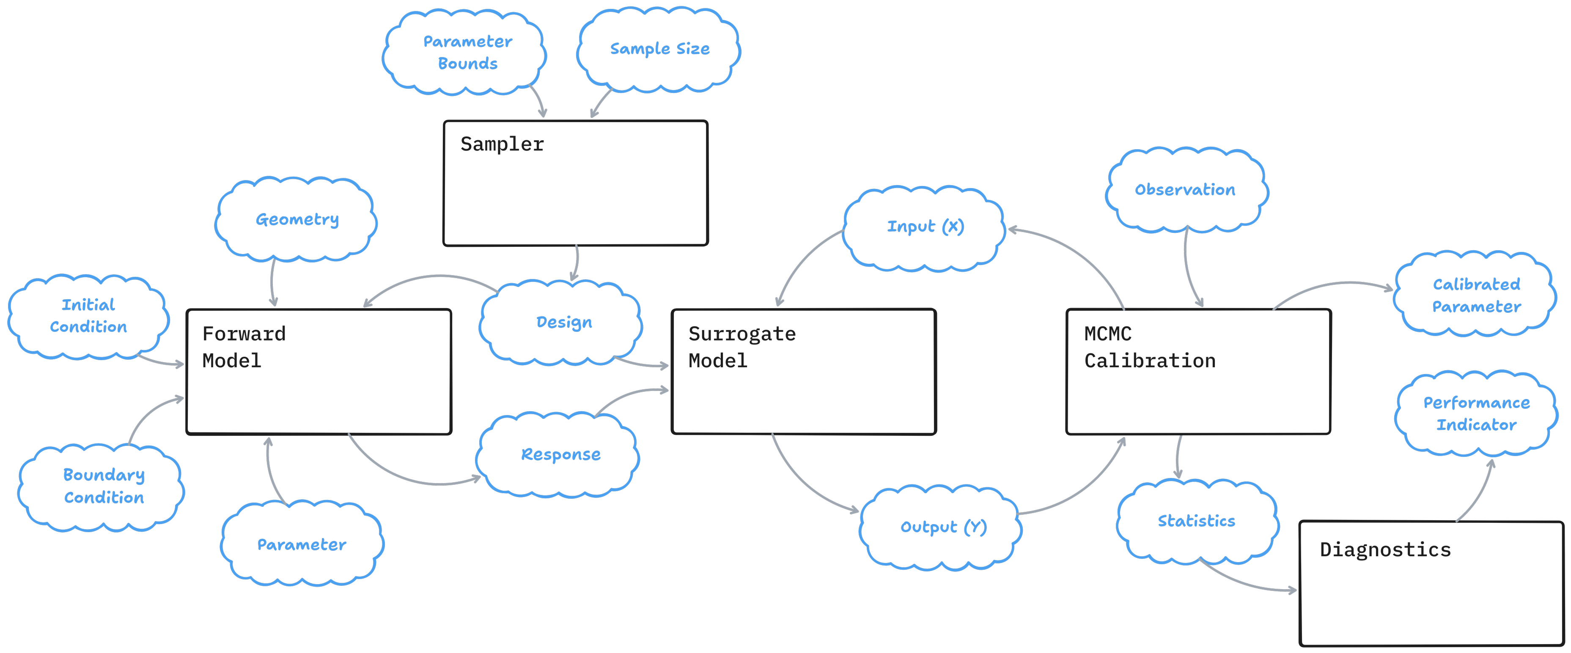
Approach – Software Wrapper
Python
C/C++
Julia
Fortran
R
Matlab
CPU
GPU
Local
HPC
Cloud
Synx
Flow
RobustGaSP
Pidgeons.jl
Coda

Slide 6






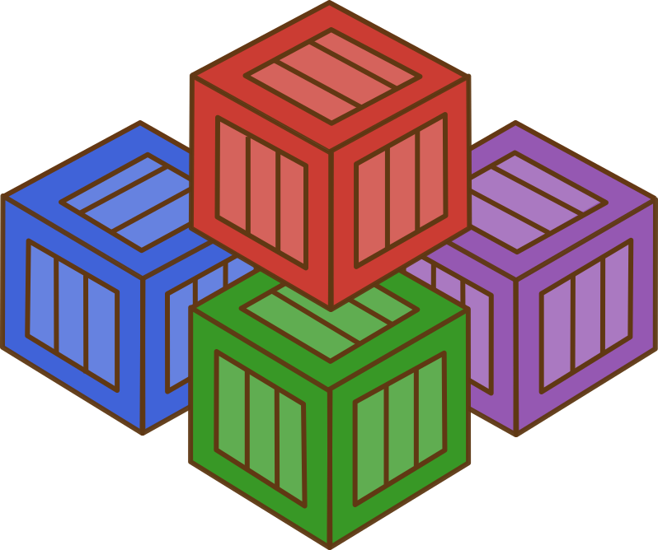




Automated Data Movement
Scheduling & Check-pointing
Monitoring & Metrics
Package Management
Containerization
Data Interchange
Data Exchange
Isolation
Interoperation
Orchestration

