Slide 3
Implementing and Embedded Digital Synthesizer
UVU Masters of Computer Science Capstone
Benjamin Stoneking, Candidate
Dr. Frank Jones, Advisor

Slide 4
Table of Contents:
Who am I?
Purpose
  What am I trying to do here?
  Why make “yet another” synth?
Requirements
  Minimal Viable Product
  Constraints
  “Stretch Goals”
Buzz words: What the hell is an amp envelope?
Architecture Description
  Data Processing Pipeline
  Event Driven System
  Modular Components
My Journey: mostly uncensored and uncut
  Step 1: Oscillators
  Step 2: Voices
  Step 3: Envelopes
  Step 4: Filters
  Step 5: Profit???
Results
  The end product
  Retrospect: Choices were made…
Future
Acknowledgements

Slide 5
Who am I?

Slide 6
Purpose
What am I trying to do here?

Slide 7
Purpose
What am I trying to do here?
Implement a complex embedded system

Slide 8
Purpose
What am I trying to do here?
Implement a complex embedded system
Learn the ropes of digital signal processing

Slide 9
Purpose
What am I trying to do here?
Implement a complex embedded system
Learn the ropes of digital signal processing
Fulfill the dream that kicked off my computer science journey in the first place…

Slide 10
Purpose
What am I trying to do here?
Implement a complex embedded system
Learn the ropes of digital signal processing
Fulfill the dream that kicked off my computer science journey in the first place…
Create instruments and software tools for musicians!

Slide 11
Purpose
Why make “yet another” synthesizer?

Slide 12
Purpose
Why make “yet another” synthesizer?
I know how they work

Slide 13
Purpose
Why make “yet another” synthesizer?
I know how they work
Complexity is right in the Goldilocks Zone

Slide 14
Purpose
Why make “yet another” synthesizer?
I know how they work
Complexity is right in the Goldilocks Zone
SYNTHESIZERS ARE SO COOL

Slide 15
Requirements
Minimal Viable Product

Slide 16
Requirements
Minimal Viable Product
  Subtractive audio synthesis
  Polyphonic
  Dynamic volume control
  Low pass and high pass filtering

Slide 17
Requirements
Minimal Viable Product
  Subtractive audio synthesis
  Polyphonic
  Dynamic volume control
  Low pass and high pass filtering
  Hardware interface with knobs, encoders, menu screen etc.

Slide 18
Requirements
Minimal Viable Product
  Subtractive audio synthesis
  Polyphonic
  Dynamic volume control
  Low pass and high pass filtering
  Hardware interface with knobs, encoders, menu screen etc.
  Plug and play compatibility with generic MIDI keyboards

Slide 19
Requirements
Constraints
  Implement in C with little to no C++. Avoid complex non-static data structures. Keep system efficient, transparent and extendable.

Slide 20
Requirements
Constraints
  Implement in C with little to no C++. Avoid complex non-static data structures. Keep system efficient, transparent and extendable.
  No special libraries. All DSP algorithms, data structures and tooling must be written from scratch. The purpose of this project is the journey, not the end product. HAL library is okay.

Slide 21
Requirements
Constraints
  Implement in C with little to no C++. Avoid complex non-static data structures. Keep system efficient, transparent and extendable.
  No special libraries. All DSP algorithms, data structures and tooling must be written from scratch. The purpose of this project is the journey, not the end product. HAL library is okay.
  Avoid referencing existing implementations. Learn the fundamental concepts. Implement the system as if I am the first person to make a digital version of a synthesizer.

Slide 22
Architecture

Slide 23
Architecture
Data Processing Pipeline

Slide 24
Architecture
Data Processing Pipeline
Event Driven System

Slide 25
Architecture
Data Processing Pipeline
Event Driven System
Modular Components

Slide 26
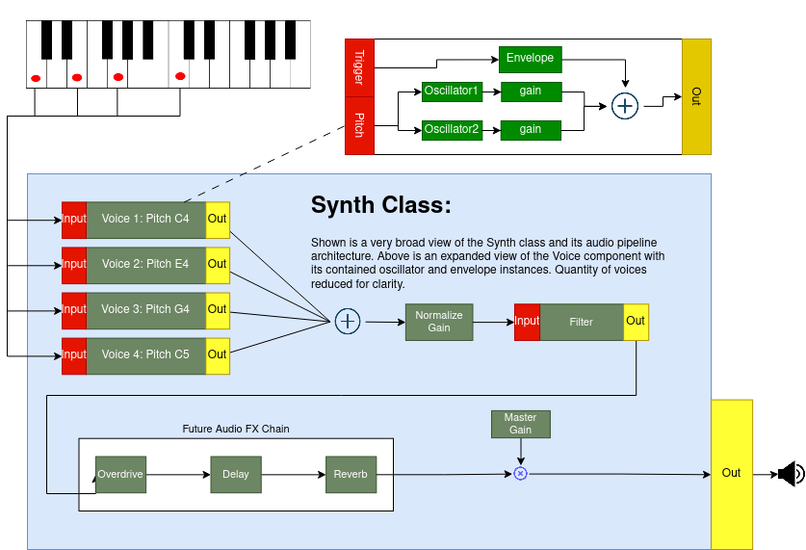
Data Processing Pipeline

Slide 27
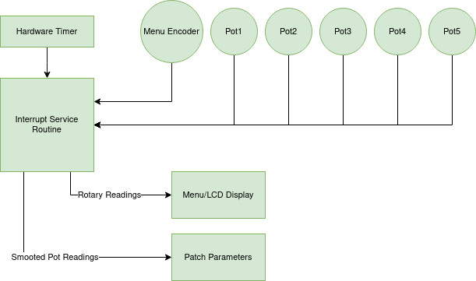
Event Driven System

Slide 28
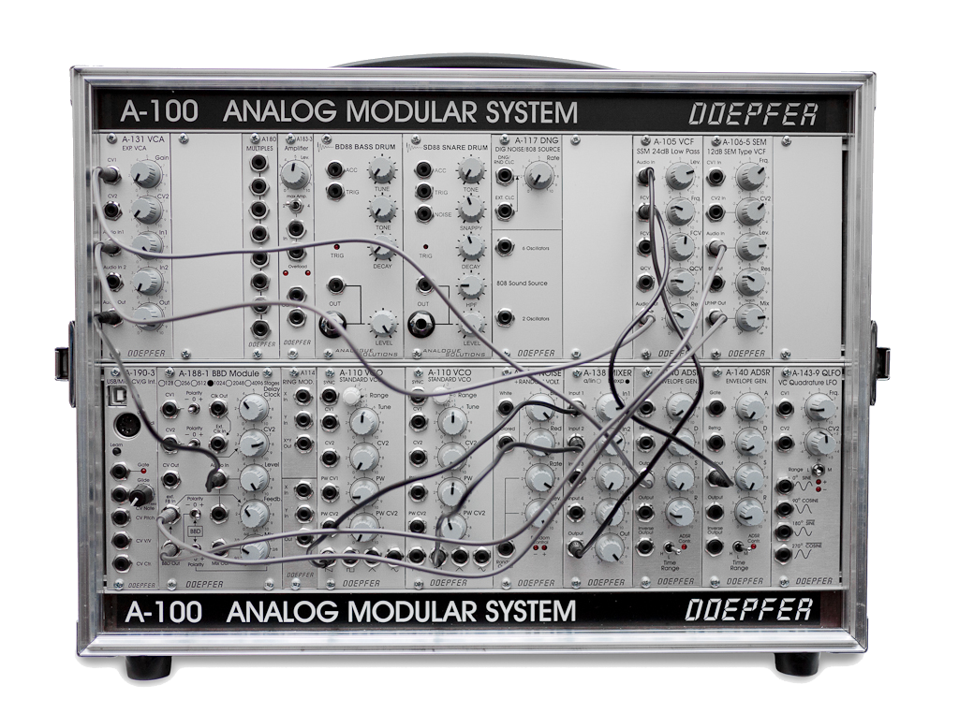
Modular Components

Slide 29
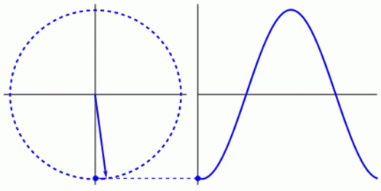
Oscillators
How it works:
Set the pitch in hertz
  Calculate phase delta: The constant by which phase should be incremented to generate a function signal at the desired pitch
Get sample from oscillator
  Oscillator passes phase into its function generator to get the next sample
  Increment phase by the calculated phase delta
  Return the sample
  Decrement phase by 2pi if phase has exceeded 2pi

Slide 30
Oscillators
Setting up the oscillator:
Hello world (with oscillators):
Create oscillator object in main and set pitch to 440hz

Slide 31
Oscillators
Setting up the oscillator:
Hello world (with oscillators):
Create oscillator object in main and set pitch to 440hz
Set up audio interrupt to get sample from oscillator and put samples into DAC output buffer

Slide 32
Oscillators
Setting up the oscillator:
Hello world (with oscillators):
Create oscillator object in main and set pitch to 440hz
Set up audio interrupt to get sample from oscillator and put samples into DAC output buffer
Build, flash, plugin speakers...

Slide 33


Oscillators
Setting up the oscillator:
Hello world (with oscillators):
Create oscillator object in main and set pitch to 440hz
Set up audio interrupt to get sample from oscillator and put samples into DAC output buffer
Build, flash, plugin speakers...
MUSIC!

Slide 34
Oscillators
WOW so neat! We have sound! What next?

Slide 35
Oscillators
WOW so neat! We have sound! What next?
Add pitch control in real time: Read MIDI Note On messages on hardware timer interrupt and set pitch on oscillator…

Slide 36
Oscillators
WOW so neat! We have sound! What next?
Add pitch control in real time: Read MIDI Note On messages on hardware timer interrupt and set pitch on oscillator…
Hey this works! But we need our notes to stop playing when we stop playing on the keyboard! What do we do?

Slide 37
Oscillators
WOW so neat! We have sound! What next?
Add pitch control in real time: Read MIDI Note On messages on hardware timer interrupt and set pitch on oscillator…
Hey this works! But we need our notes to stop playing when we stop playing on the keyboard! What do we do?
Easy! Just read MIDI Note Off messages and set the oscillator pitch to 0hz when note of messages come in!

Slide 38
Oscillators
Sweet! We can play notes but our only option is to play a sin waves and…

Slide 39
Oscillators
Sweet! We can play notes but our only option is to play a sin waves and…
SIN WAVES

Slide 40
Oscillators
Sweet! We can play notes but our only option is to play a sin waves and…
SIN WAVES ARE

Slide 41
Oscillators
Sweet! We can play notes but our only option is to play a sin waves and…
SIN WAVES ARE BORING

Slide 42
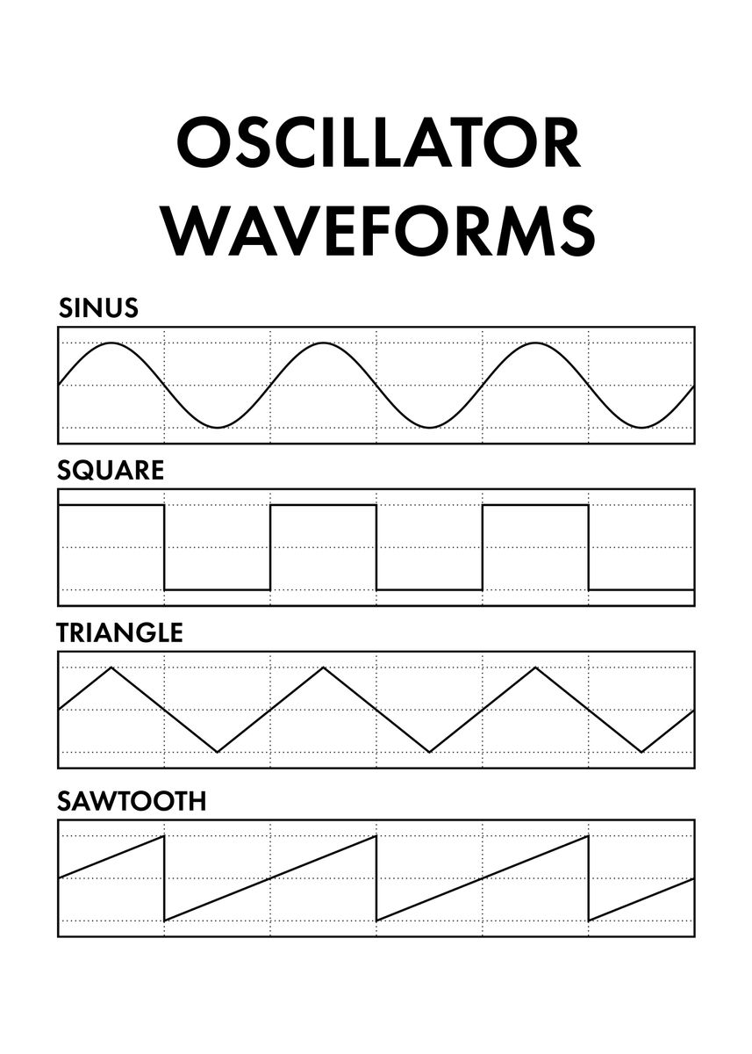
Oscillators
<--- Just a sin wave function
<--- Half the time output 1.0, the other half -1.0
<--- Sin wave with a linear form instead of curve
<--- Ramp from -1.0 to 1.0
Also white noise: Generate random samples between -1.0 and 1.0

Slide 43
Oscillators
Wow so far so good! But we can only play one note at a time!

Slide 44
Oscillators
Wow so far so good! But we can only play one note at a time!
And that’s not great...

Slide 45
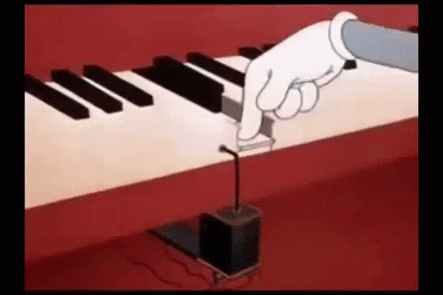
Oscillators
Wow so far so good! But we can only play one note at a time!
And that’s not great...
So how do we get from
Here

Slide 46
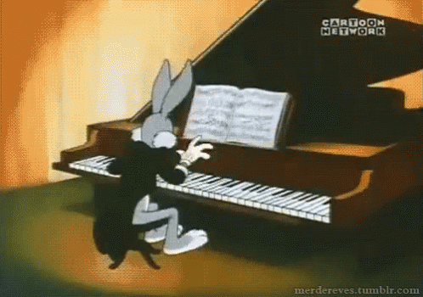
Oscillators
Wow so far so good! But we can only play one note at a time!
And that’s not great...
So how do we get from
Here to Here

Slide 47
Voices

Slide 48
Voices
Voices are a common structure in synthesizers

Slide 49
Voices
Voices are a common structure in synthesizers
Aggregation of
Two or more oscillators

Slide 50
Voices
Voices are a common structure in synthesizers
Aggregation of
Two or more oscillators
A sample mixer

Slide 51
Voices
Voices are a common structure in synthesizers
Aggregation of
Two or more oscillators
A sample mixer
A gain attenuation stage

Slide 52
Voices
Voices are a common structure in synthesizers
Aggregation of
Two or more oscillators
A sample mixer
A gain attenuation stage
An envelope signal (more on this later)

Slide 53
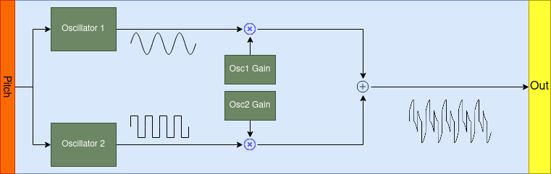
Voices

Slide 54
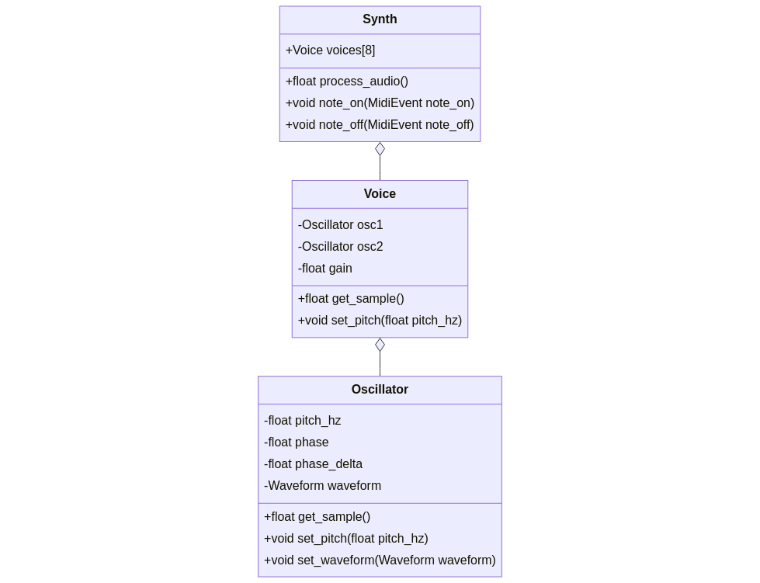
Voices

Slide 55
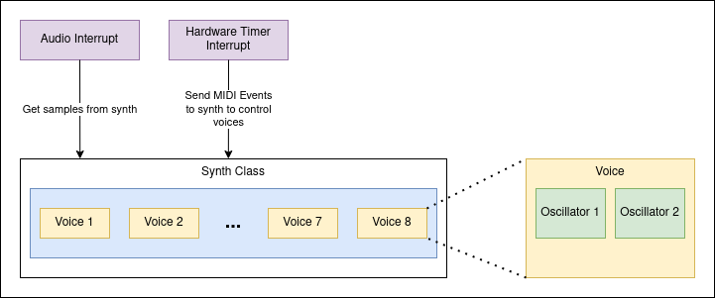
Voices

Slide 56
Voices
Audio Interrupt

Slide 57
Voices
Audio Interrupt -> Synth Process

Slide 58
Voices
Audio Interrupt -> Synth Process -> Find active voices

Slide 59
Voices
Audio Interrupt -> Synth Process -> Find active voices -> Get Sample from Active Voice

Slide 60
Voices
Audio Interrupt -> Synth Process -> Find active voices -> Get Sample from Active Voice -> Get Oscillator Samples

Slide 61
Voices
Audio Interrupt -> Synth Process -> Find active voices -> Get Sample from Active Voice -> Get Oscillator Samples -> Add and Normalize Samples

Slide 62
Voices
Audio Interrupt -> Synth Process -> Find active voices -> Get Sample from Active Voice -> Get Oscillator Samples -> Add and Normalize Samples -> Return Samples to DAC

Slide 63

Voices
Achievement Unlocked: Polyphony

Slide 64
Table of Contents:
Who am I?
Purpose
  What am I trying to do here?
  Why make “yet another” synth?
Requirements
  Minimal Viable Product
  Constraints
  “Stretch Goals”
Buzz words: What the hell is an amp envelope?
Architecture Description
  Data Processing Pipeline
  Event Driven System
  Modular Components
My Journey: mostly uncensored and uncut
  Step 1: Oscillators
  Step 2: Voices
  Step 3: Envelopes
  Step 4: Filters
  Step 5: Profit???
Results
  The end product
  Retrospect: Choices were made…
Future
Acknowledgements

