Slide 1
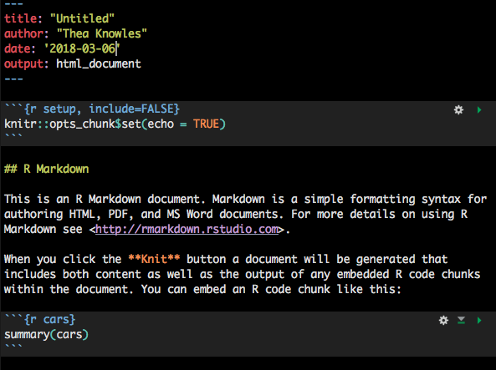
YAML Metadata
Chunk options
Text
R code chunks

Slide 2
