Slide 1
ELG 5255: Applied Machine Learning
Term Project
Group: 14
Name: Mohamed Bekheet Abdelall Mohamed
Name: Ali Amin El-Sayed Mahmoud El-Sherif
Name: Omar Ashraf Fathy Ibrahim
ID: 300327280
ID: 300327246
ID: 300327258

Slide 2
Problem’s overview

Slide 3



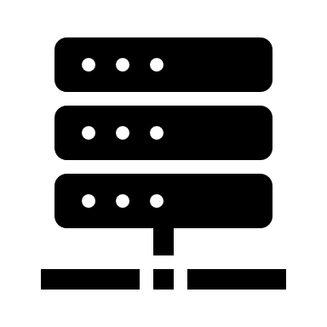
Problem’s overview
Switch ID
Port Number
Received packets
Received bytes
Sent bytes
Sent packets
Port alive duration (s)
Delta received packets
Delta received bytes
Delta sent bytes
Delta received packets
Delta port alive duration (s)
Connection Point
Total Load/Rate
Total Load/Latest
Unknown Load/Rate
Unknown Load/Latest
Latest bytes counter
Active Flow Entries
Packets Looked Up
Packets Matched
Network tracker
Multi Layer Perceptron
TCP-SYN Flood attacks
Port scan attacks
Flow Table Overflow attacks
Blackhole attacks
Traffic Diversion attacks
Predict the type of the traffic to the network whether it is normal traffic or one of the five possible attacks (predict the type of the attack).
Network

Slide 4
Flowchart

Slide 5
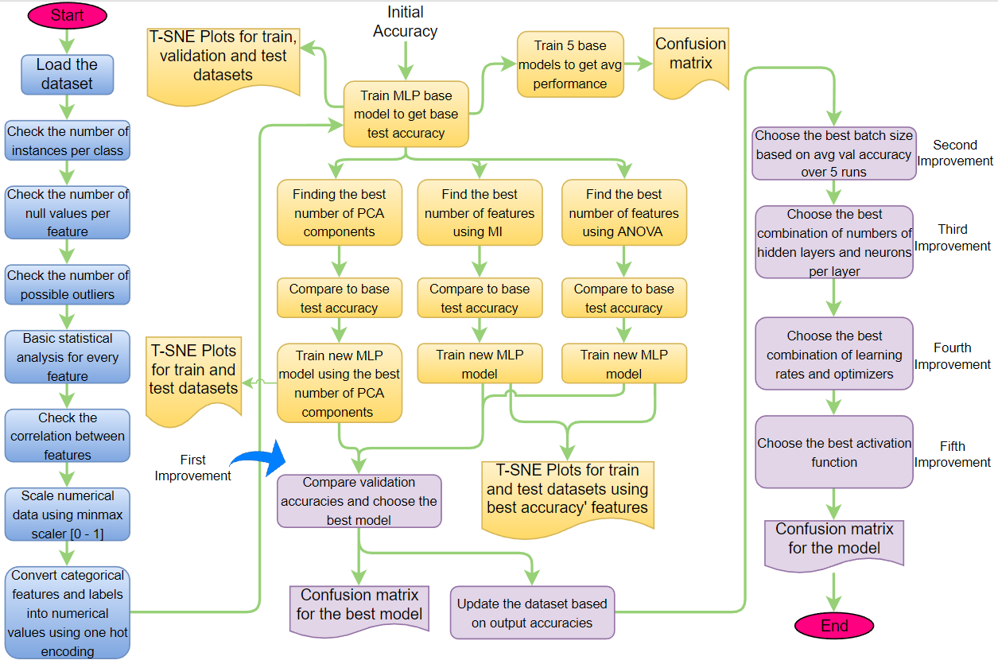

Slide 6
Dataset’s overview

Slide 7
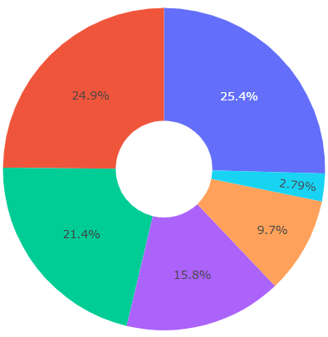
Number of instances per class
Class | Number of instances
PortScan | 666
TCP-SYN | 651
Blackhole | 561
Diversion | 414
Normal | 254
Overflow | 73

Slide 8
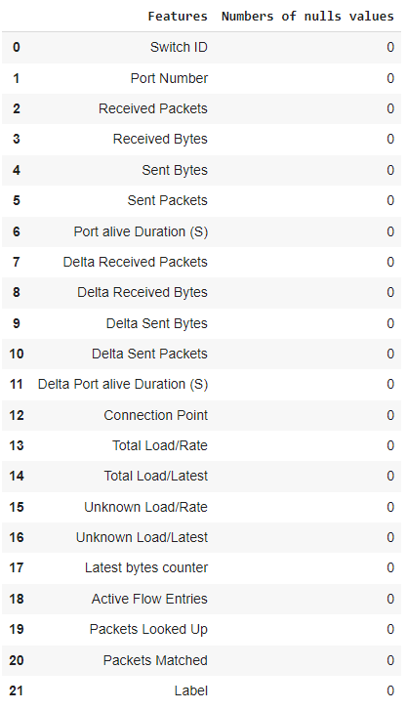
Number of null values

Slide 9
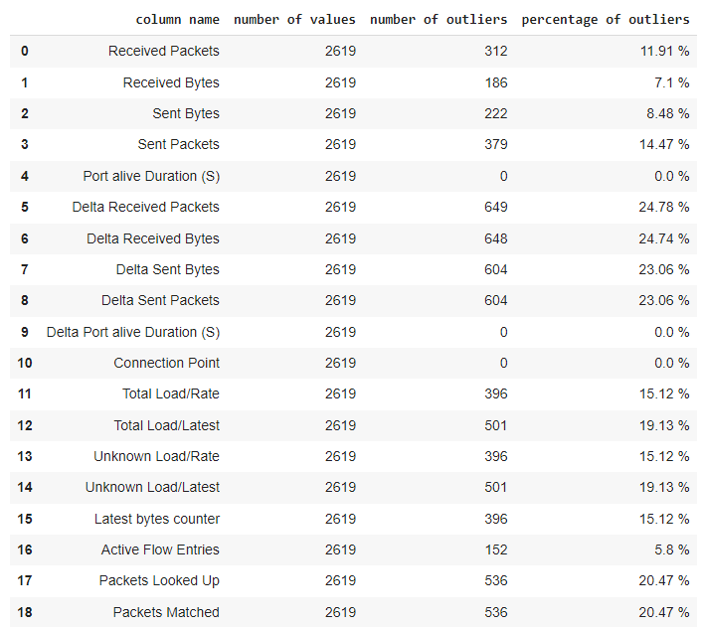
Number of possible outliers

Slide 10
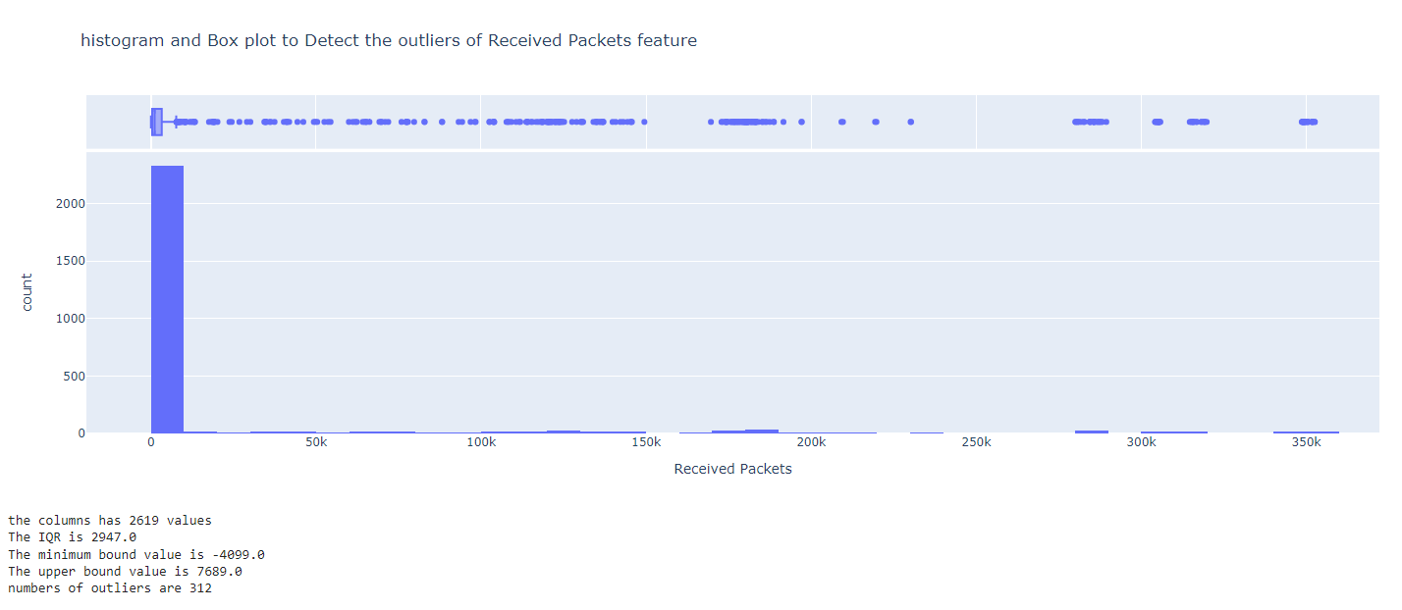
Outliers of received packets

Slide 11
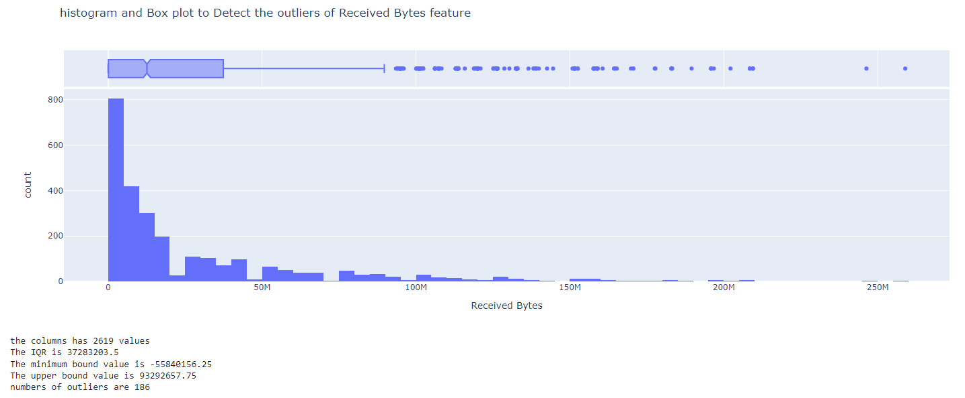
Outliers of received bytes

Slide 12
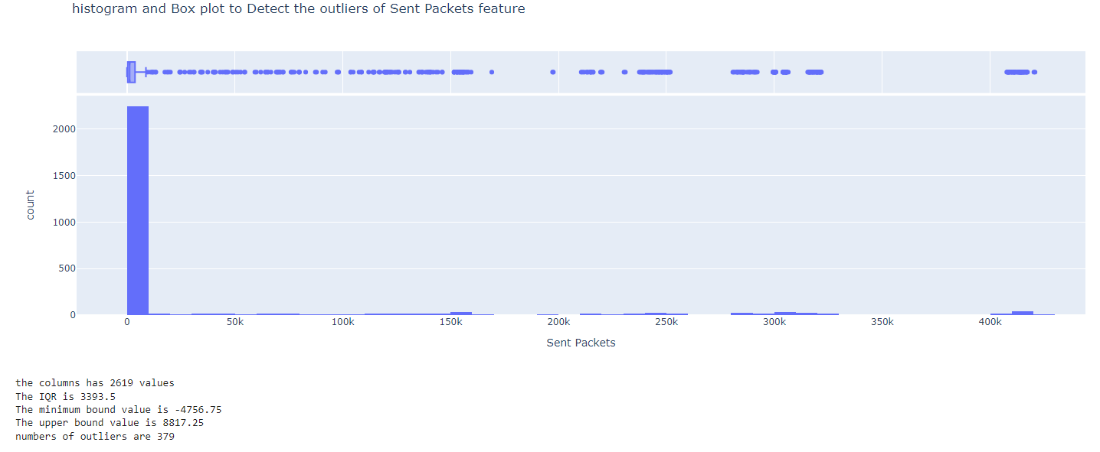
Outliers of sent packets

Slide 13
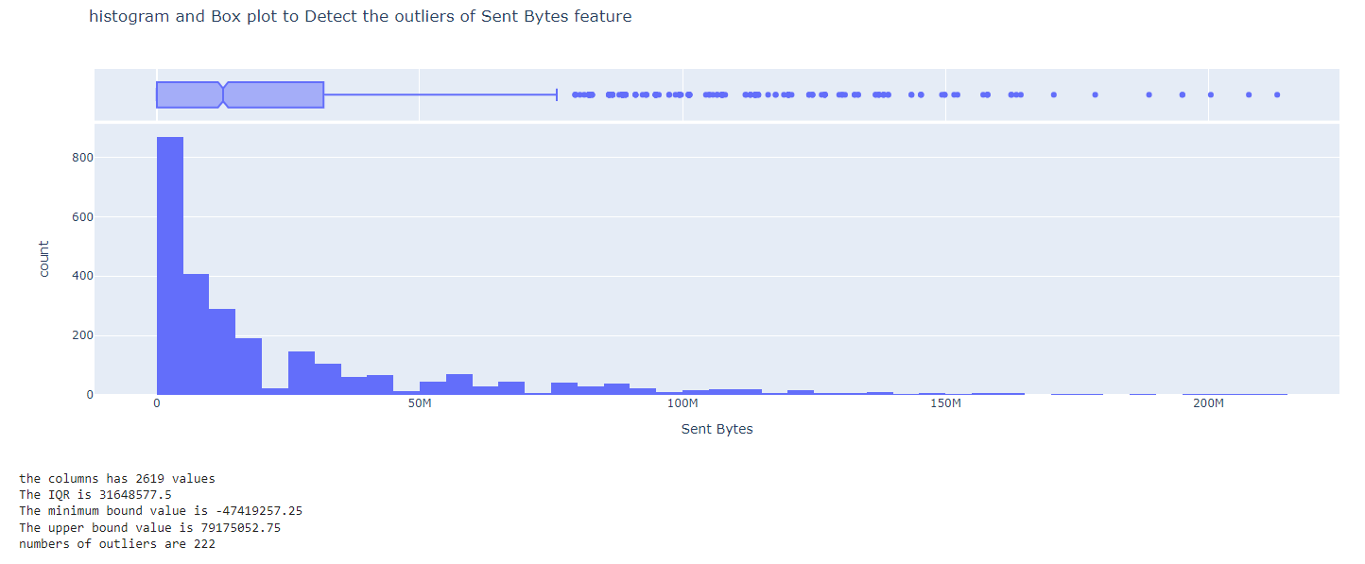
Outliers of sent bytes

Slide 14
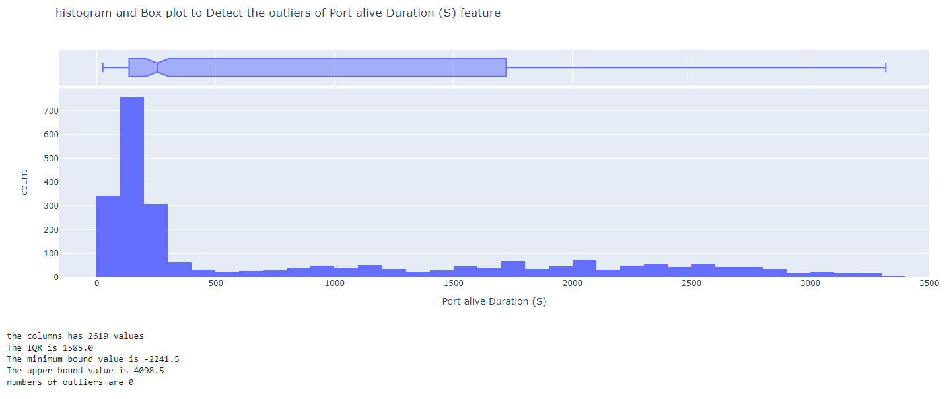
Outliers of port alive duration (S)

Slide 15
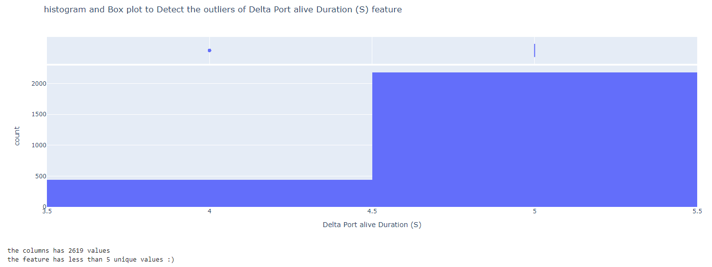
Outliers of delta port alive duration (S)

Slide 16
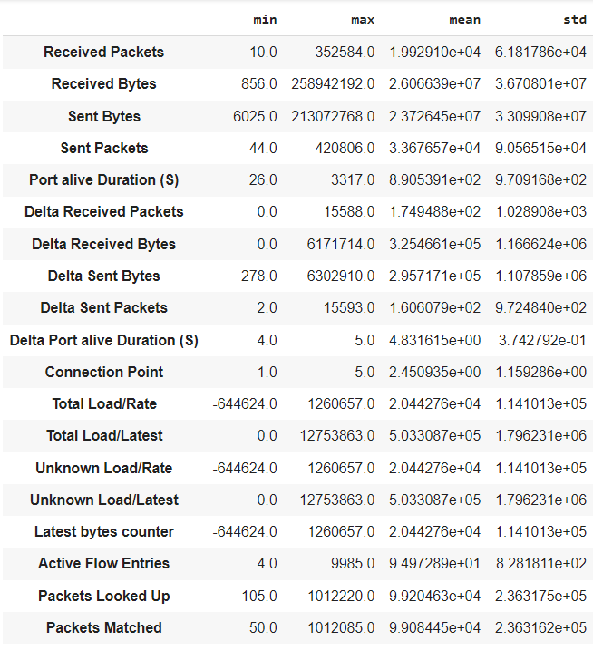
Basic statistical analysis

Slide 17
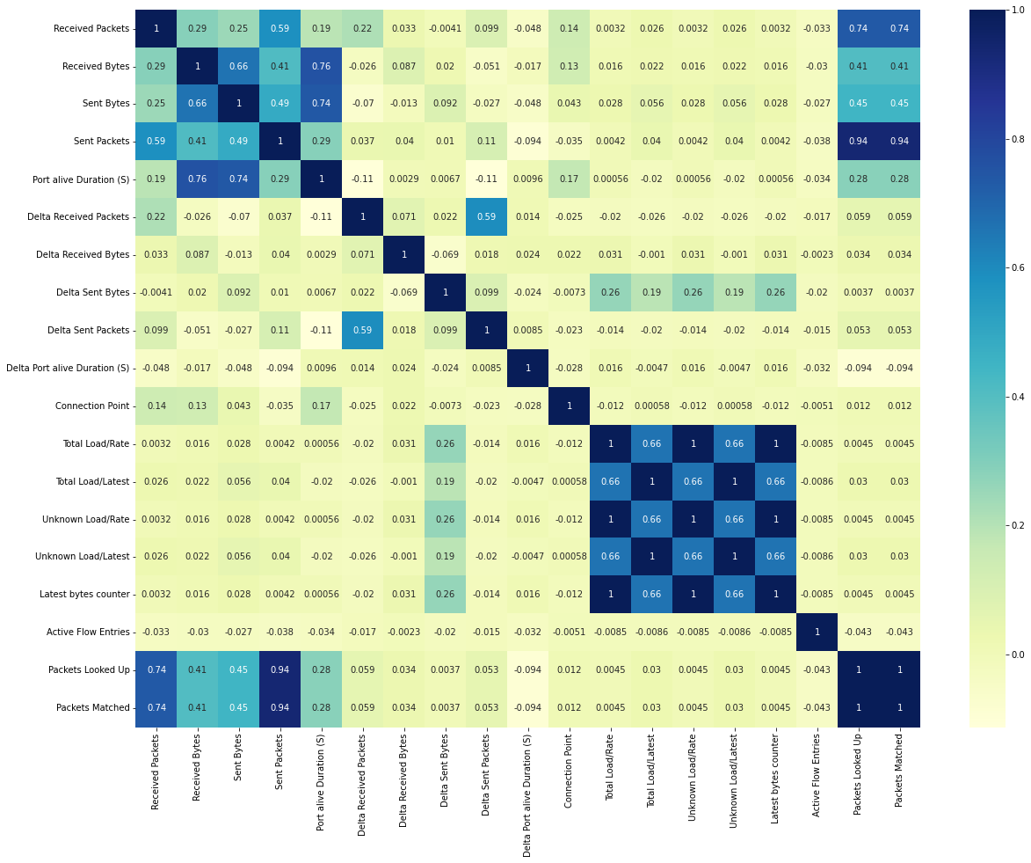
Correlation between features

Slide 18
Q1 Obtain the baseline performance

Slide 19
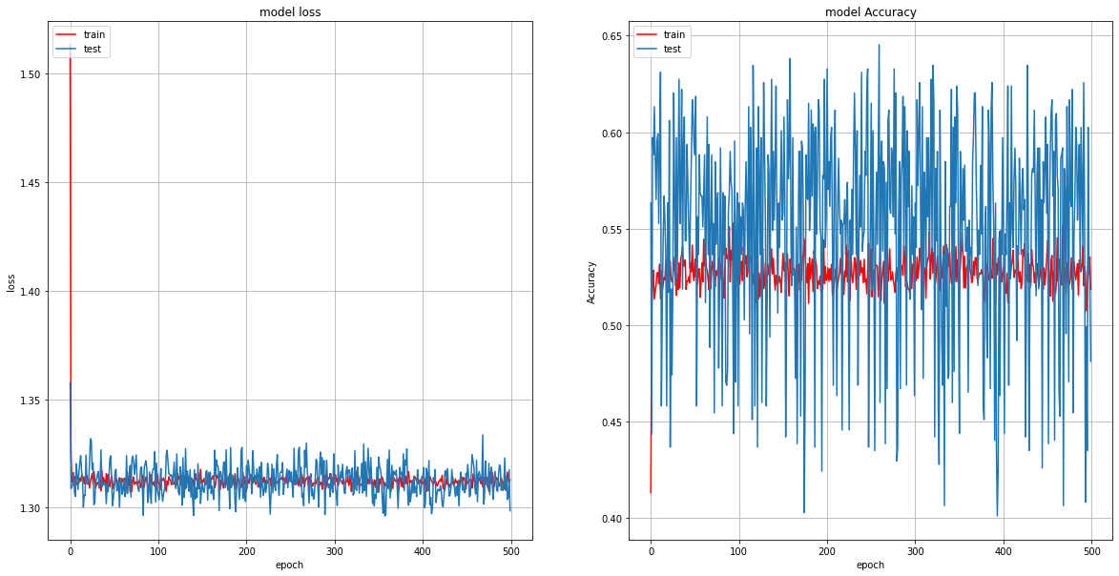
Plot the training and testing losses vs. the number of epochs

Slide 20
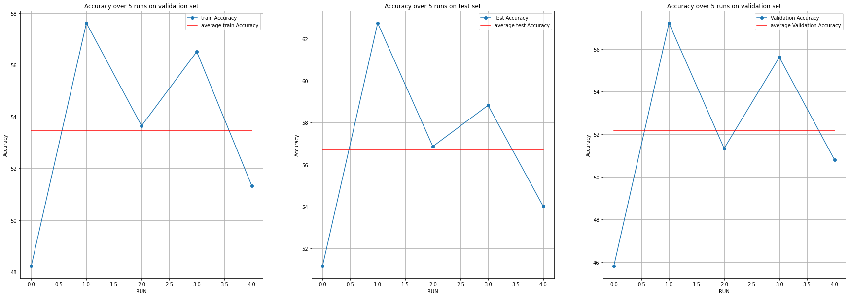
Run Baseline model over 5 Runs
Accuracy over 5 runs on train set
Max training acc | Max test acc | Min training acc | Min test acc | Avg training acc | Avg test acc
57.62% | 56.72% | 56.72% | 56.72% | 56.72% | 56.72%

Slide 21
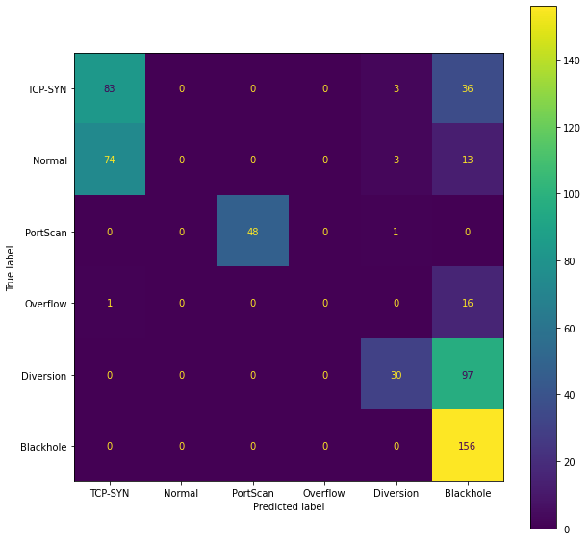
Confusion matrix based on the average test accuracy

Slide 22
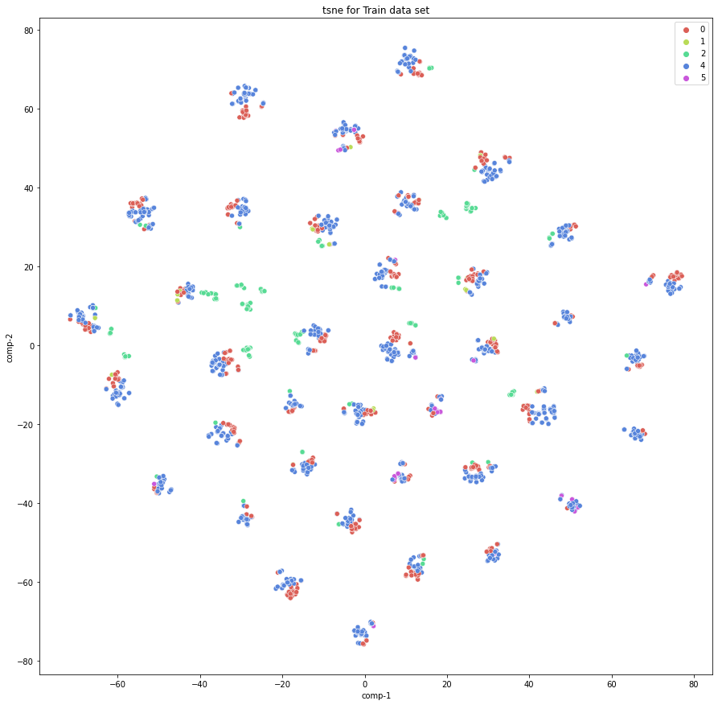
2D T-SNE for the training dataset

Slide 23
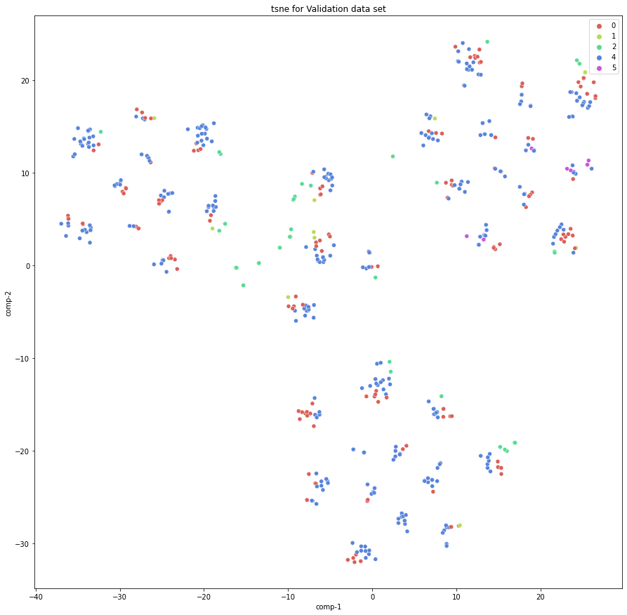
2D T-SNE for the validation dataset

Slide 24
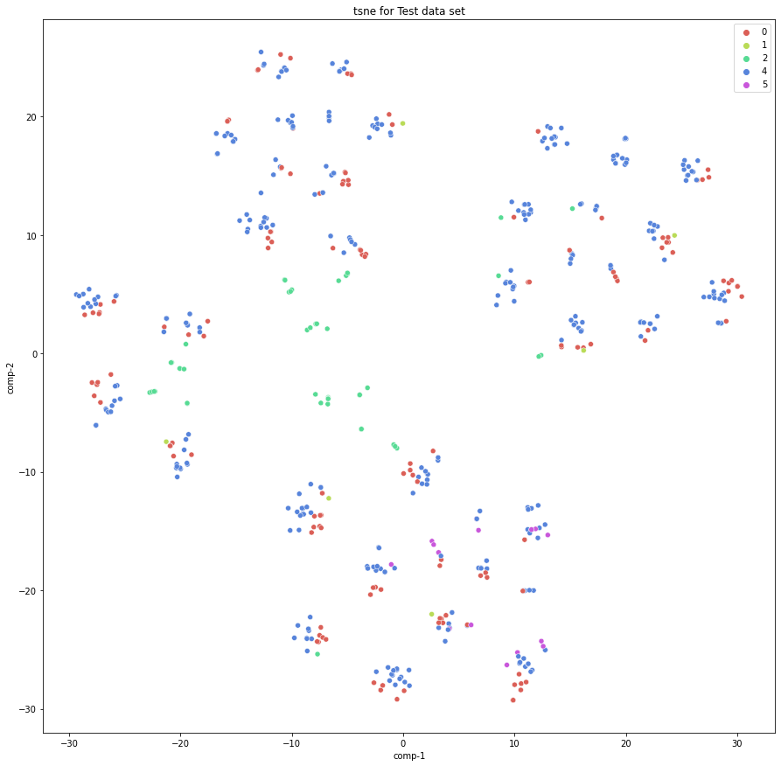
2D T-SNE for the test dataset

Slide 25
Q2 Compare dimensionality reduction to feature selection

Slide 26
Q2.1 Dimensionality Reduction

Slide 27
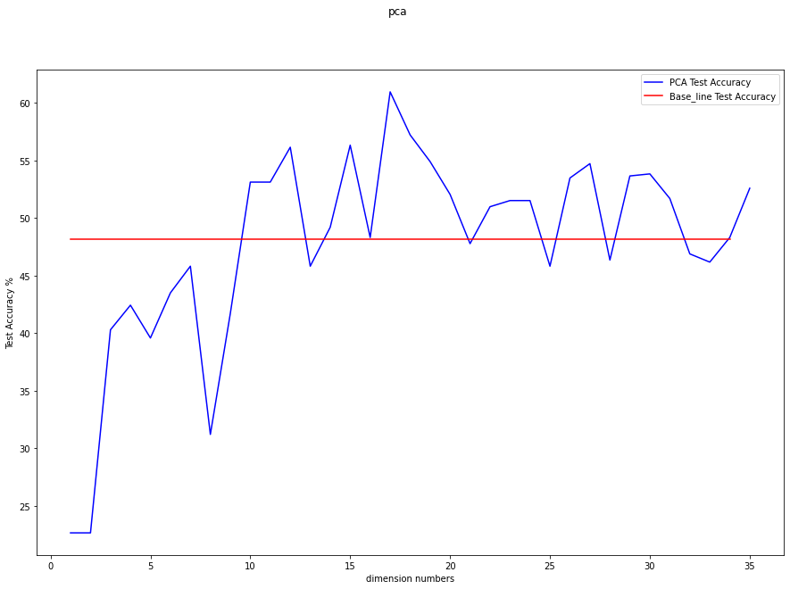
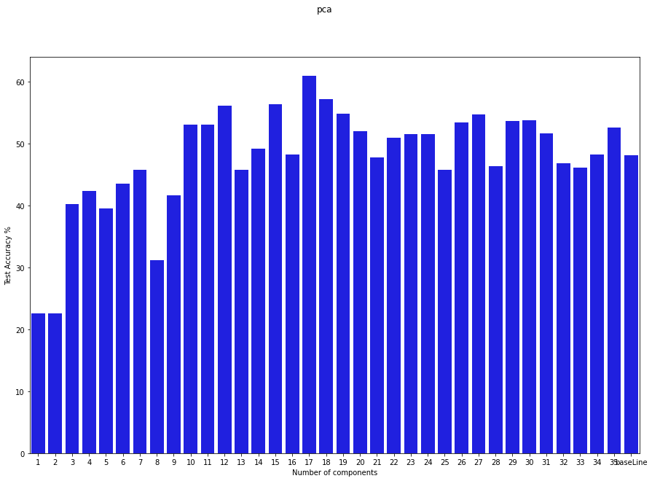
Applying PCA

Slide 28

Best PCA selection
The best number of features is:
17
with accuracy of test dataset:
60.96256971359253 %

Slide 29
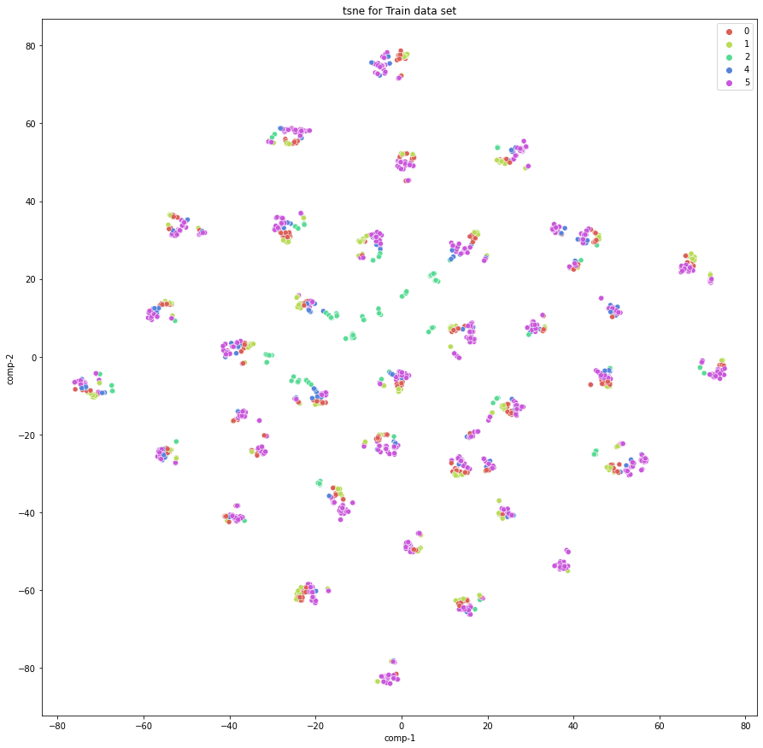
T-SNE plot after applying PCA on train dataset

Slide 30
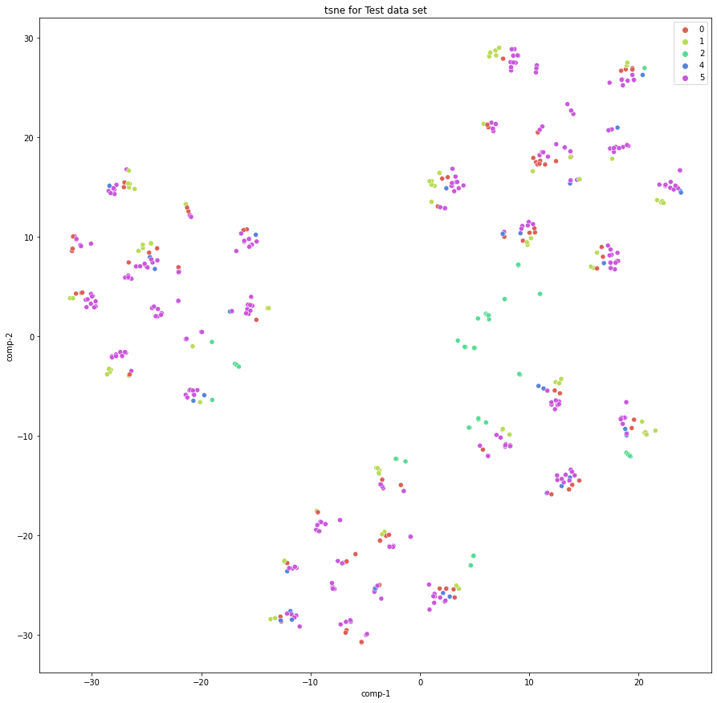
T-SNE plot after applying PCA on test dataset

Slide 31
Q2.2 Feature Selection
N.B: all runs were calibrated on 200 epochs

Slide 32
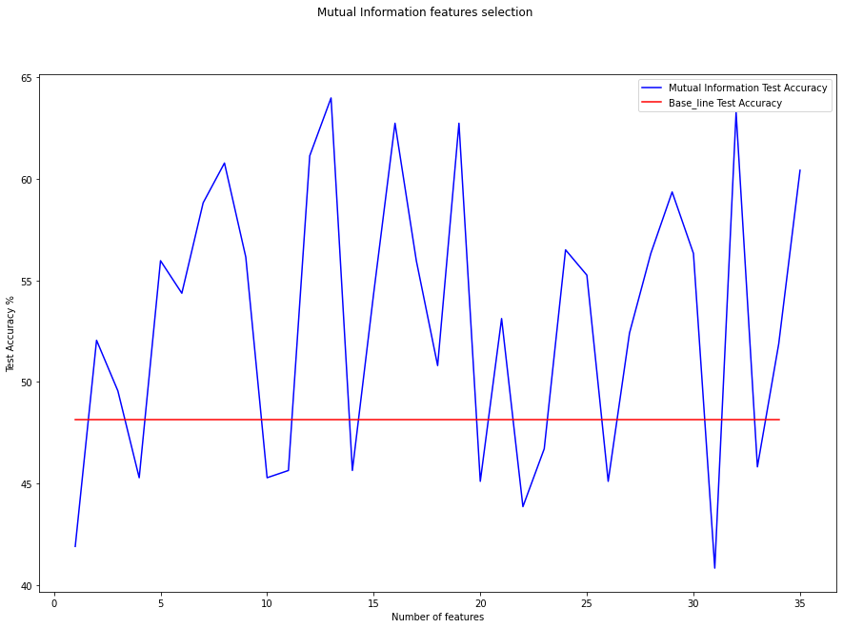
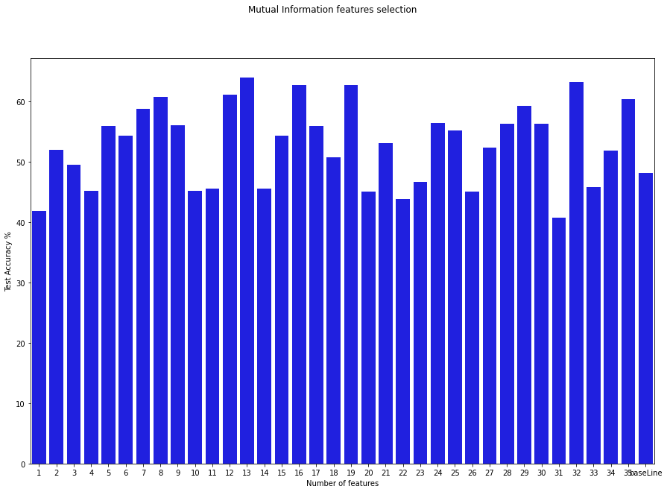
Mutual Information
Best number of features equals 13 with accuracy of 63.99286985397339 % For the test dataset

Slide 33
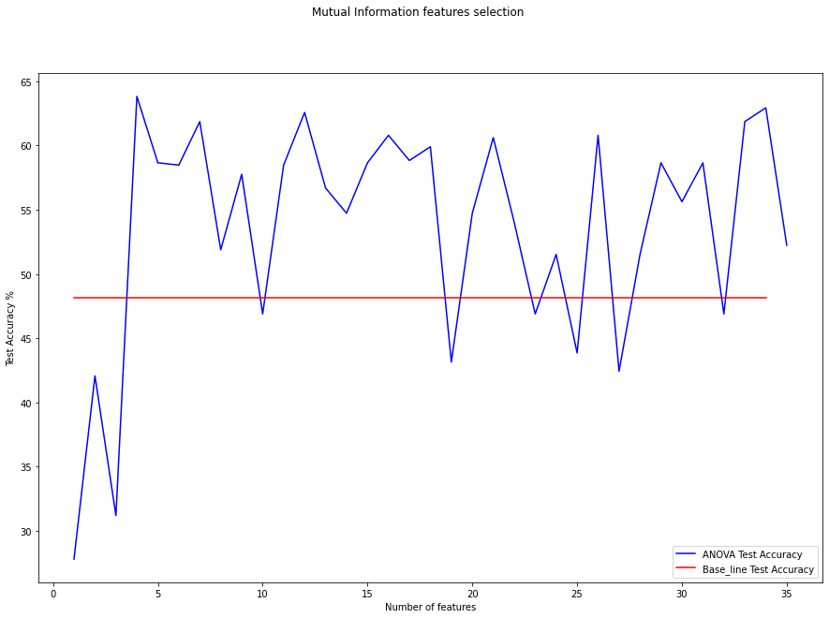
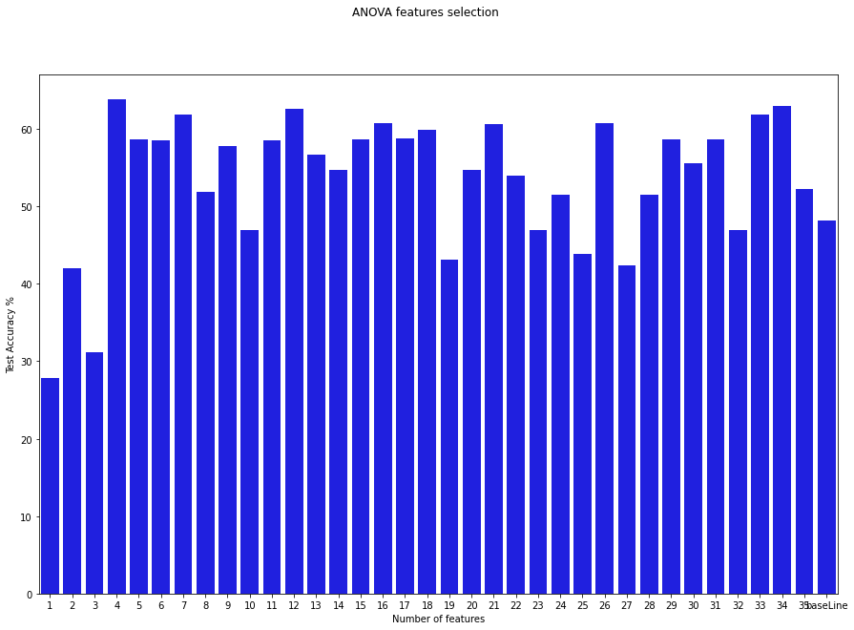
ANOVA
Best number of features equals 4 with accuracy of 63.814616203308105% For the test dataset

Slide 34
The best model: Mutual Information
The optimum number of features is:
13
And their indices are:
[4 17 18 2 3 1 0 7 6 16 14 5 12]
With accuracy of test dataset:
63.99286985397339 %

Slide 35
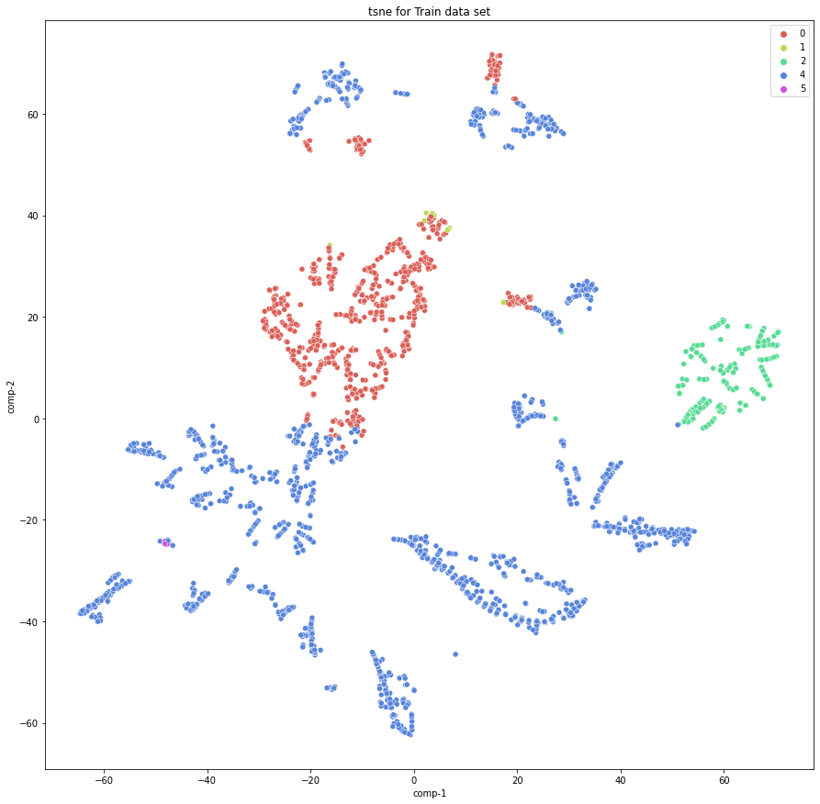
T-SNE plot after applying mutual information on train dataset

Slide 36
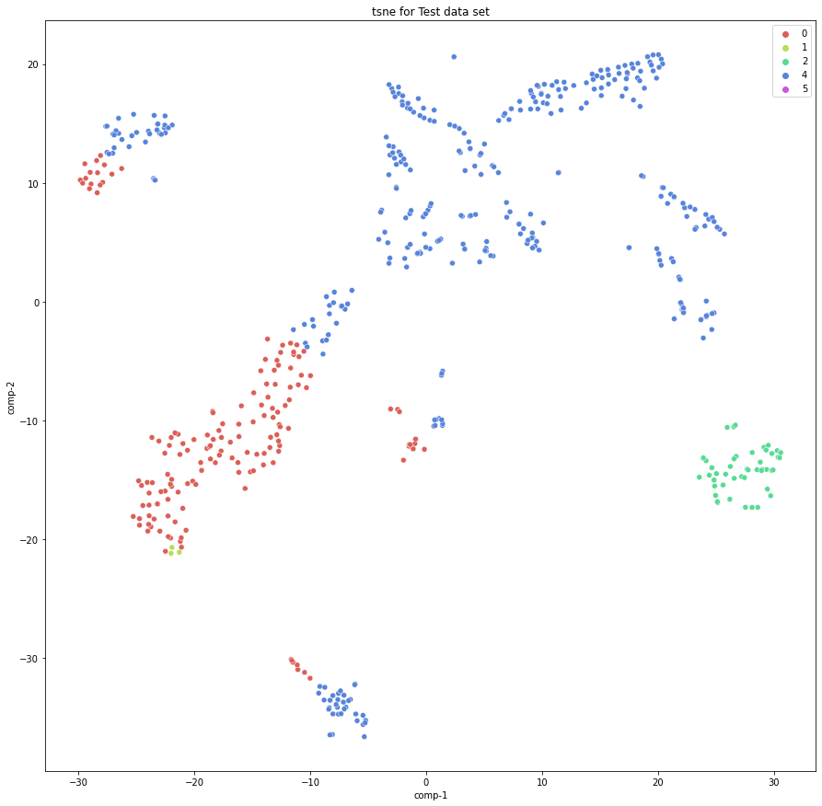
T-SNE plot after applying mutual information on test dataset

Slide 37
Comparison between models
PCA validation Accuracy
50.62388777732849
Mutual information validation Accuracy
51.69340372085571
ANOVA validation Accuracy
51.871657371520996

Slide 38
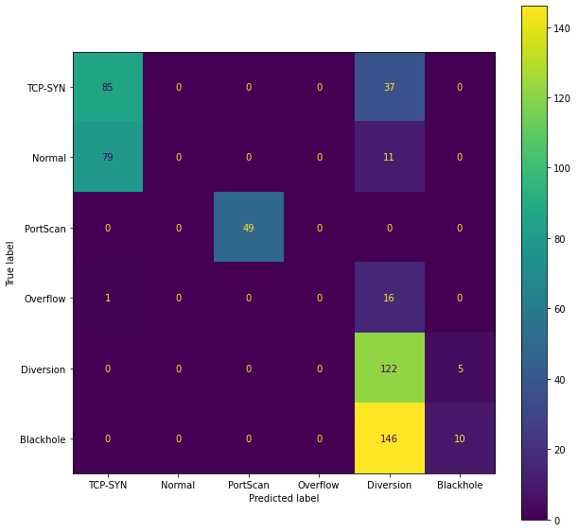
Confusion matrix (After training with ANOVA)

Slide 39
Q3 Vary the MLP parameters

Slide 40
Q3.1) Batch Size
Batch size= 32 |  |  |  |  |  | Batch size= 64 |  |  |  |  |  | Batch size= 128
Maximum train accuracy | Maximum test accuracy | Minimum train accuracy | Minimum test accuracy | Average train accuracy | Average test accuracy | Maximum train accuracy | Maximum test accuracy | Minimum train accuracy | Minimum test accuracy | Average train accuracy | Average test accuracy | Maximum train accuracy | Maximum test accuracy | Minimum train accuracy | Minimum test accuracy | Average train accuracy | Average test accuracy
62.7% | 64.88% | 62.01% | 64.17% | 62.4% | 64.49% | 62.7% | 64.71% | 61.86% | 64.53% | 62.2% | 64.6% | 62.73% | 65.06% | 62.24% | 64.35% | 62.44% | 64.6%
Despite 128 batch size showed highest average accuracies, 64 batch size were used in following questions as it showed high average validation accuracy of 63.814616% which is higher than that of 128 and equals to the one of 32.
N.B: all the numbers have been approximated to two decimal places.

Slide 41
Q3.2) Hidden layers / neuron layers
 | 1 hidden layer |  |  |  |  |  | 2 hidden layers
# of neurons for each layer | Max train acc | Max test acc | Min train acc | Min test acc | Avg train acc | Avg test acc | Max train acc | Max test acc | Min train acc | Min test acc | Avg train acc | Avg test acc
10 | 62.92% | 65.06% | 62.05% | 64.53% | 62.65% | 64.74% | 66.17% | 68.27% | 64.76% | 67.56% | 65.33% | 67.77%
20 | 65.37% | 66.84% | 63.04% | 64.88% | 63.60% | 65.42% | 68.23% | 71.30% | 67.54% | 69.88% | 67.85% | 70.48%
30 | 66.70% | 69.34% | 64.18% | 66.49% | 65.59% | 68.06% | 68.96% | 71.66% | 65.79% | 68.09% | 67.82% | 69.88%
40 | 67.12% | 69.88% | 65.60% | 67.56% | 66.69% | 69.20% | 69.26% | 71.84% | 67.96% | 69.34% | 68.46% | 70.23%
N.B: all the numbers have been approximated to two decimal places.

Slide 42
Q3.2) Hidden layers / neuron layers
 | 4 hidden layers |  |  |  |  |  | 8 hidden layers
# of neurons for each layer | Max train acc | Max test acc | Min train acc | Min test acc | Avg train acc | Avg test acc | Max train acc | Max test acc | Min train acc | Min test acc | Avg train acc | Avg test acc
10 | 67.66% | 69.70% | 65.94% | 68.45% | 67.09% | 69.27% | 69.26% | 71.66% | 66.13% | 68.63% | 67.80% | 70.02%
20 | 71.97% | 75.40% | 70.10% | 71.84% | 70.92% | 73.55% | 72.36% | 75.22% | 70.22% | 70.94% | 71.18% | 73.40%
30 | 72.28% | 75.94% | 70.14% | 71.84% | 70.77% | 73.44% | 72.36% | 75.40% | 69.30% | 68.63% | 70.52% | 72.51%
40 | 72.20% | 75.22% | 69.80% | 72.55% | 71.23% | 74.05% | 72.13% | 75.40% | 69.76% | 70.23% | 71.07% | 73.05%
N.B: all the numbers have been approximated to two decimal places.

Slide 43
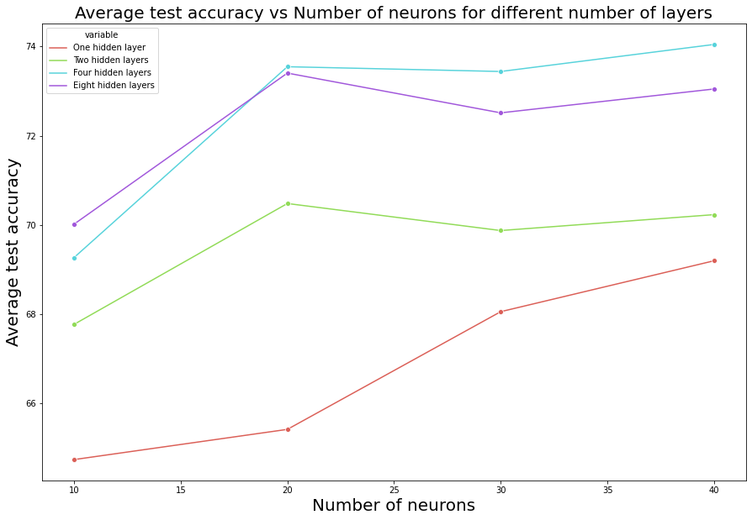
Q3.2) Hidden layers / neuron layers

Slide 44
Q3.3) Learning rate and different optimizers
 | Learning rate=0.1 |  |  |  |  |  | Learning rate=0.01 |  |  |  |  |  | Learning rate=0.001
optimizer | Max train acc | Max test acc | Min train acc | Min test acc | Avg train acc | Avg test acc | Max train acc | Max test acc | Min train acc | Min test acc | Avg train acc | Avg test acc | Max train acc | Max test acc | Min train acc | Min test acc | Avg train acc | Avg test acc
AdamW | 54.72% | 51.52% | 24.86% | 22.64% | 30.94% | 31.52% | 73.42% | 73.62% | 64.22% | 62.75% | 69.40% | 70.05% | 72.32% | 75.58% | 69.84% | 72.91% | 71.25% | 74.37%
SGD (momentum =0.1) | 72.16% | 76.47% | 66.70% | 68.27% | 70.27% | 73.44% | 69.57% | 71.84% | 68.31% | 70.05% | 69.11% | 71.41% | 62.28% | 64.53% | 25.43% | 22.64% | 39.93% | 39.00%
SGD (momentum =0.5) | 72.93% | 75.22% | 69.19% | 71.48% | 71.20% | 73.83% | 71.74% | 75.58% | 69.26% | 71.66% | 70.24% | 73.12% | 68.12% | 70.23% | 37.72% | 35.83% | 56.88% | 58.22%
SGD (momentum =0.9) | 71.74% | 74.51% | 67.24% | 70.23% | 69.58% | 72.01% | 72.28% | 75.94% | 69.53% | 71.84% | 70.68% | 73.40% | 69.45% | 71.84% | 67.20% | 68.81% | 68.51% | 70.41%
RMSprop | 67.12% | 69.70% | 49.79% | 47.24% | 60.23% | 61.85% | 76.79% | 77.01% | 74.26% | 72.55% | 75.44% | 75.37% | 73.20% | 74.87% | 71.55% | 72.01% | 72.40% | 73.44%
N.B: all the numbers have been approximated to two decimal places.

Slide 45
Q3.4) Activation functions
Relu |  |  |  |  |  | Leaky Relu
Max train acc | Max test acc | Min train acc | Min test acc | Avg train acc | Avg test acc | Max train acc | Max test acc | Min train acc | Min test acc | Avg train acc | Avg test acc
77.09% | 80.39% | 74.80% | 75.94% | 76.30% | 77.79% | 74.88% | 77.01% | 68.69% | 68.98% | 72.86% | 74.05%
Sigmoid |  |  |  |  |  | Tanh
Max train acc | Max test acc | Min train acc | Min test acc | Avg train acc | Avg test acc | Max train acc | Max test acc | Min train acc | Min test acc | Avg train acc | Avg test acc
73.31% | 77.01% | 69.72% | 71.66% | 71.92% | 74.01% | 76.21% | 77.18% | 73.50% | 72.73% | 75.17% | 75.12%
N.B: all the numbers have been approximated to two decimal places.

Slide 46
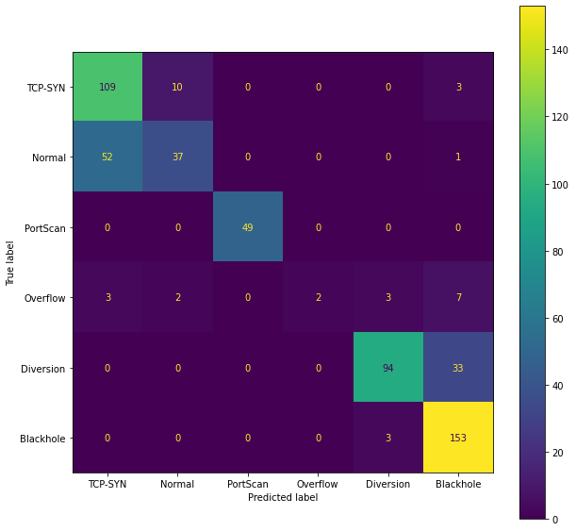
Q3.4) Activation functions
Confusion matrix of the model using RelU activation function on test dataset:

Slide 47
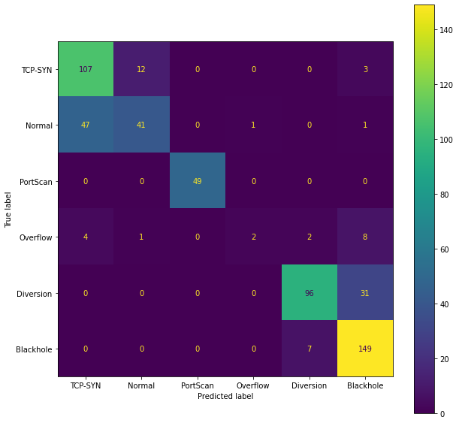
Q3.5) Bonus Question
Number of neurons 96 per layer was used Instead of 40.
It has achieved an average accuracy of 77.967914% on test dataset and the confusion matrix is as shown.

Slide 48
Conclusion

Slide 49
Conclusion
The base model (MLP with 1 hidden layer, 10 neurons, AdamW optimizer, batch size of one, and learning rate of 0.001) has achieved 56.72% average test accuracy.
ANOVA feature selection has achieved 63.81% test accuracy.
Batch size of 64 was used and achieved 64.6% average test accuracy.
Four hidden layers and 40 neurons per layer has achieved 74.05% average test accuracy.
RMSprop was used with learning rate of 0.01 achieved 75.37% average test accuracy.
While RelU activation function, the model has achieved 77.79% average test accuracy.
Increasing the number of neurons to be 96 neurons per layer has achieved 77.97% average test accuracy.
Using mutual information feature selection has decreased the overlapping between different classes as shown from the T-SNE plots.

