Slide 1
DTI5125
Group Assignment 4:
Chatbot using Google Dialogflow
Online and on-site courses institute
Group: 13

Slide 2
Table of contents
Introduction
Methodology
Ontology
System Configuration
Evaluation
System Output

Slide 3
Introduction
Question answering models are one of the most used applications in NLP. In this project a question answering model is being used based on an institution which offers courses and is named “Ischool”, allowing students whether to attend online on the platform or offline. Chatbot handling the study institute’s courses using Google Dialogflow tool for conversational AI virtual agents used in chatbots.

Slide 4
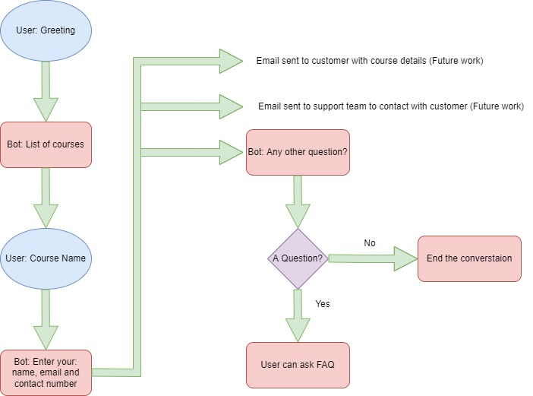
Methodology

Slide 5
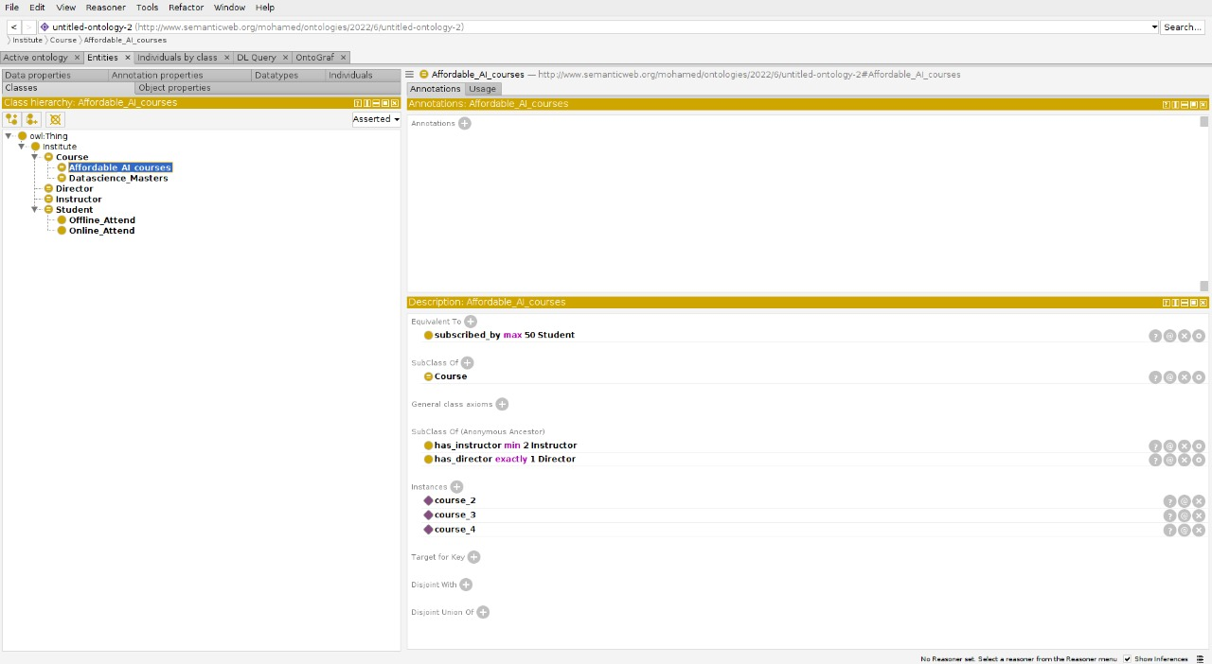
Ontology (Class Hierarchy)

Slide 6
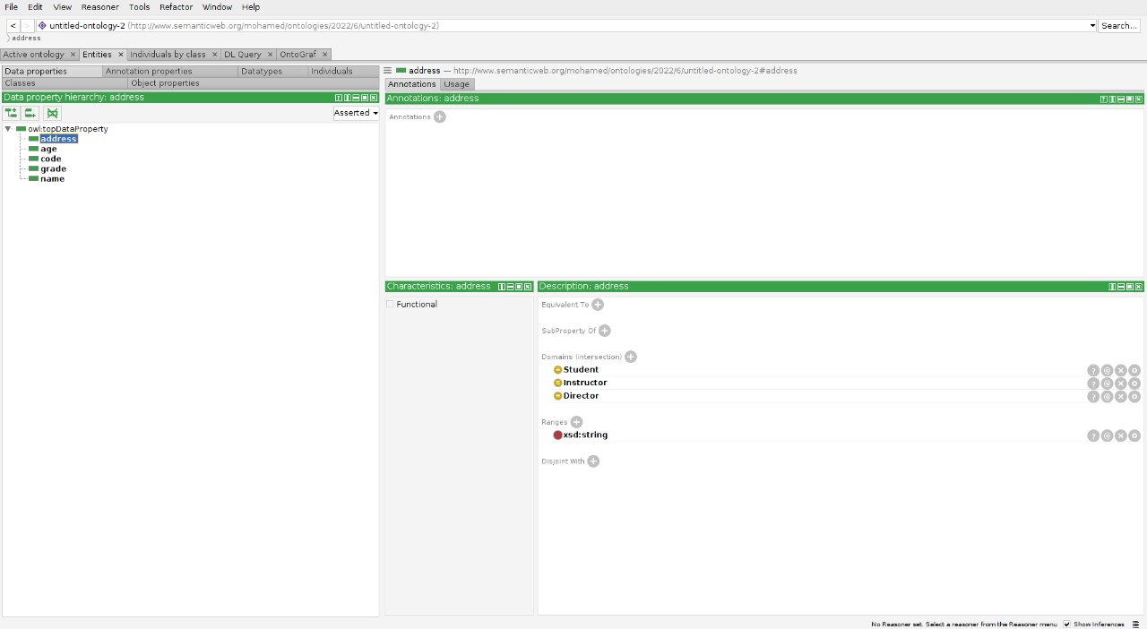
Ontology (Data Property Hierarchy)

Slide 7
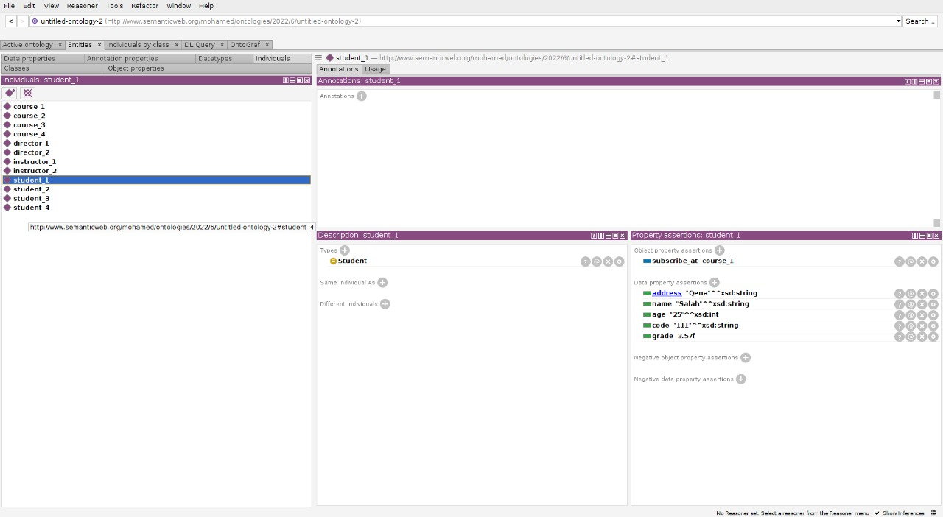
Ontology (Individuals)

Slide 8
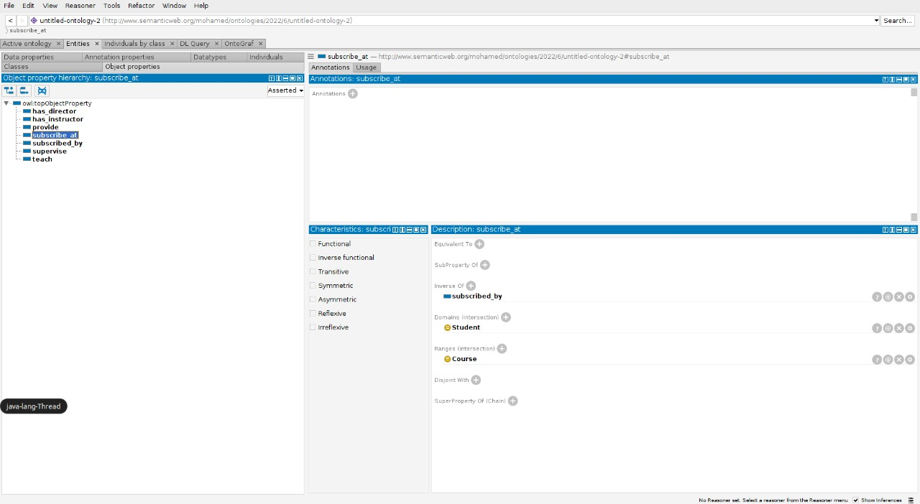
Ontology (Object Property)

Slide 9
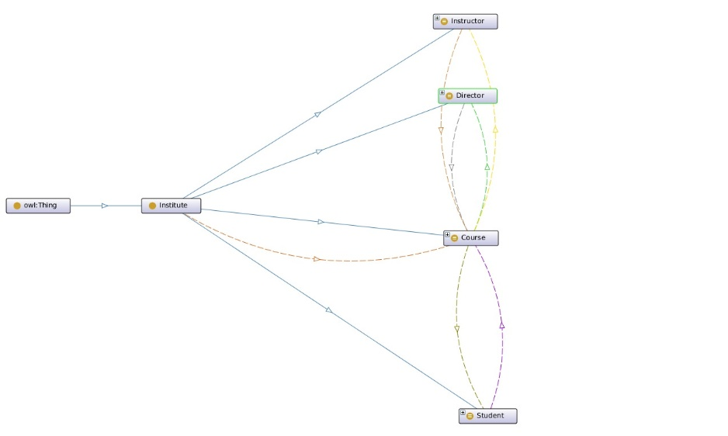
Ontology

Slide 10
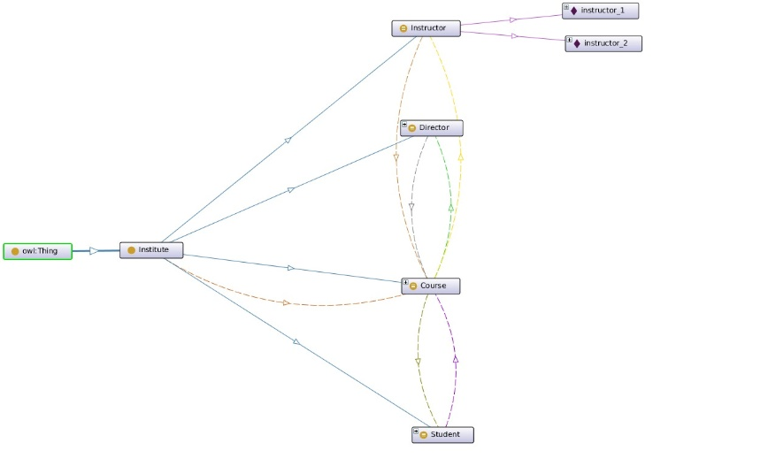
Ontology

Slide 11
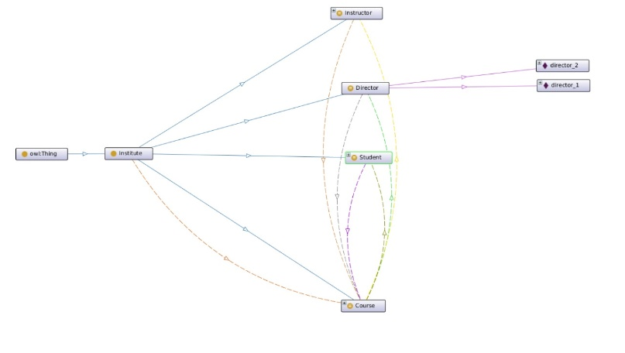
Ontology

Slide 12
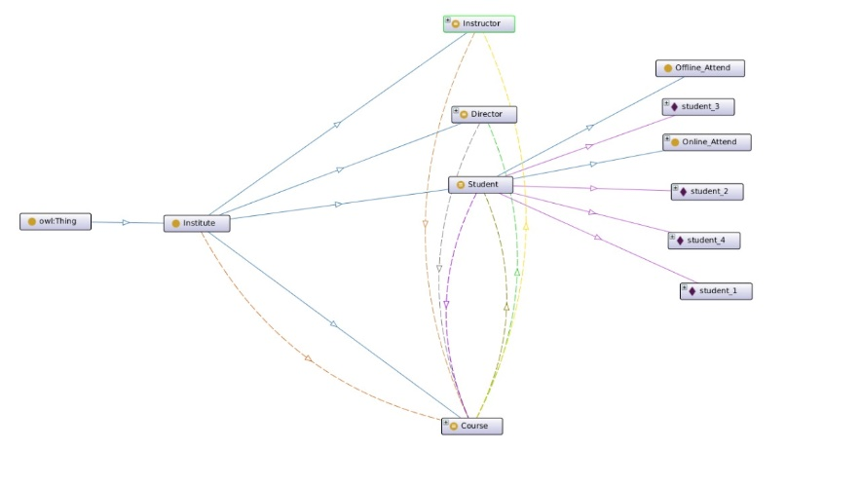
Ontology

Slide 13
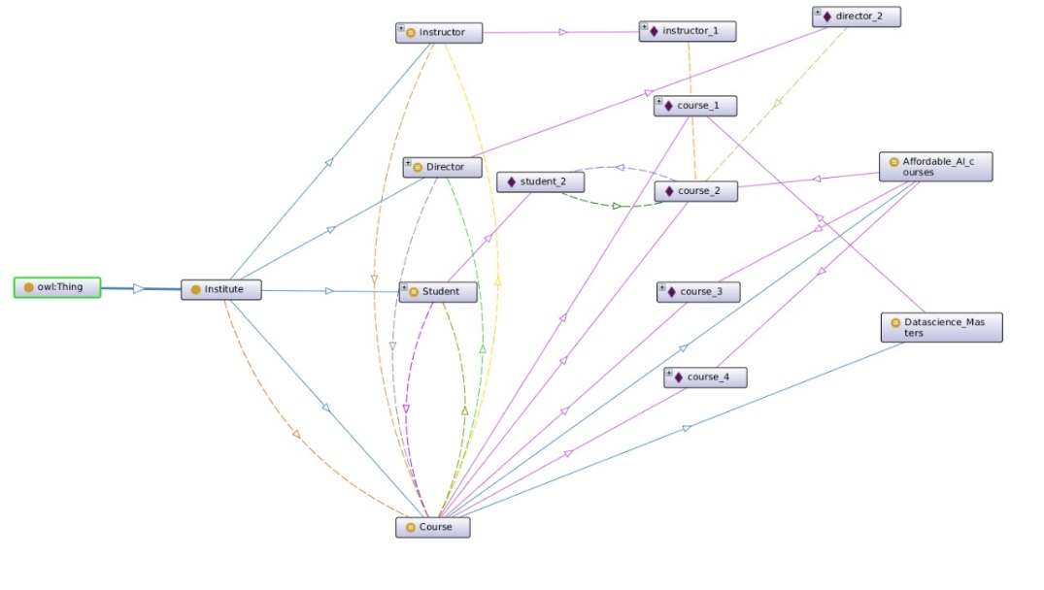
Ontology

Slide 14
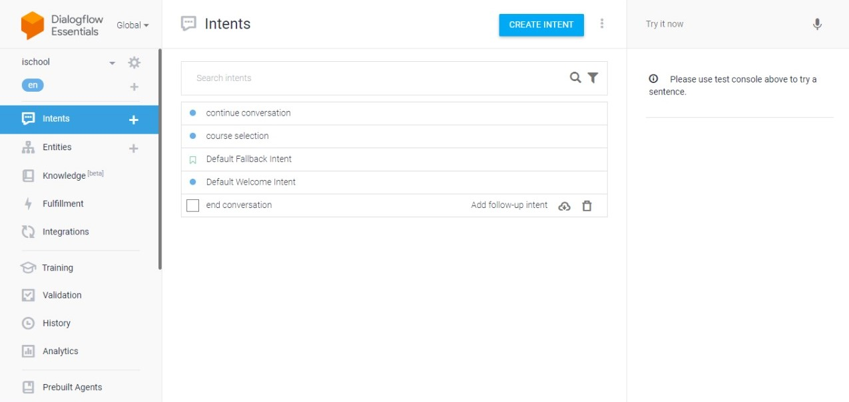
System Configuration (Intents)

Slide 15
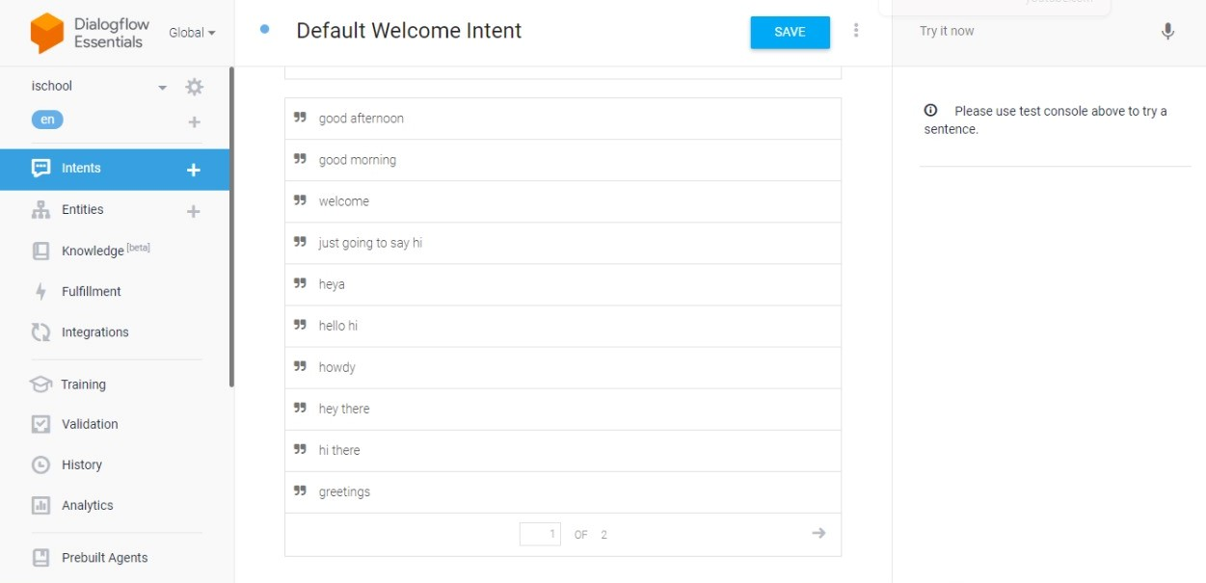
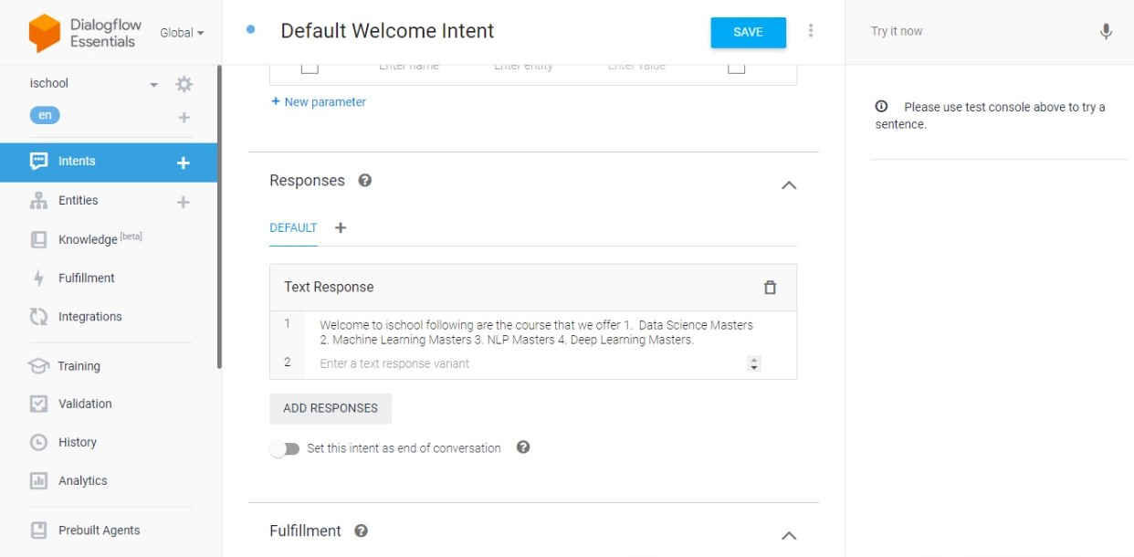
System Configuration (Welcome Intent)

Slide 16
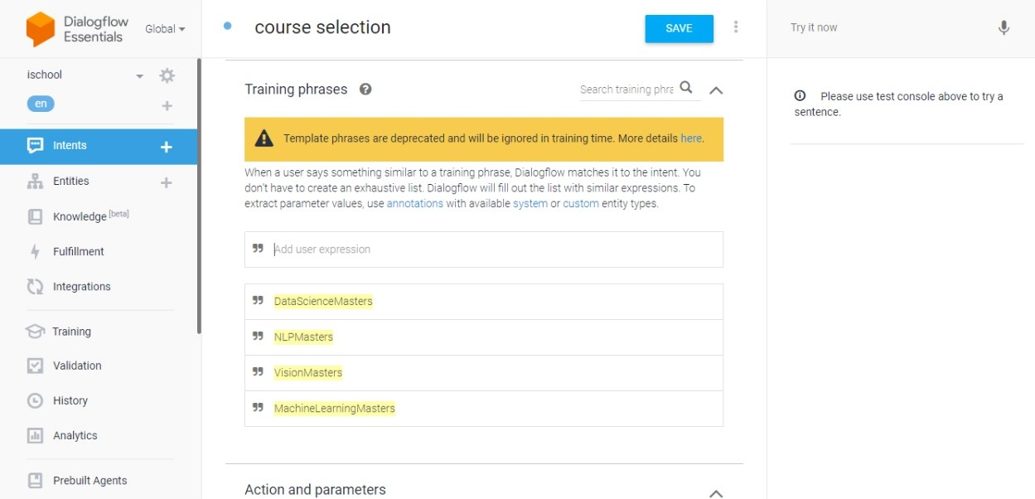
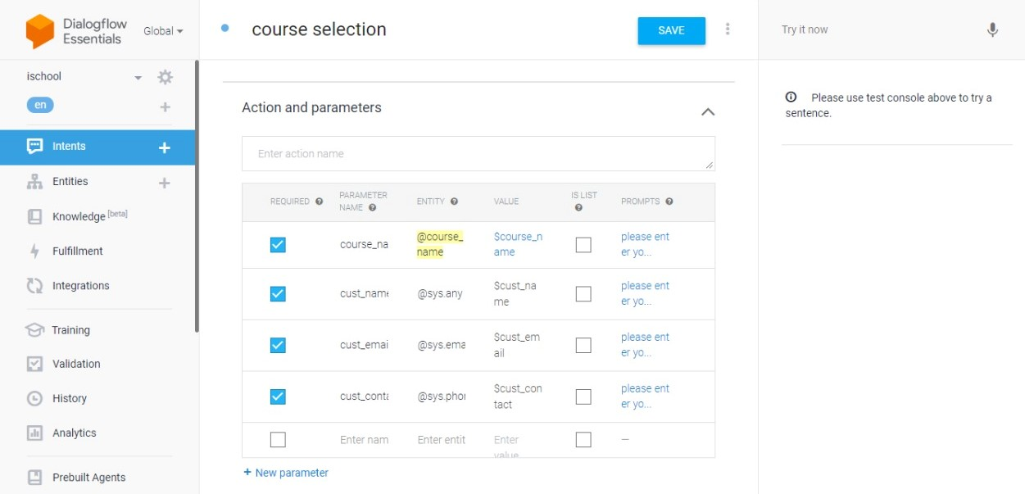
System Configuration (course selection1)

Slide 17
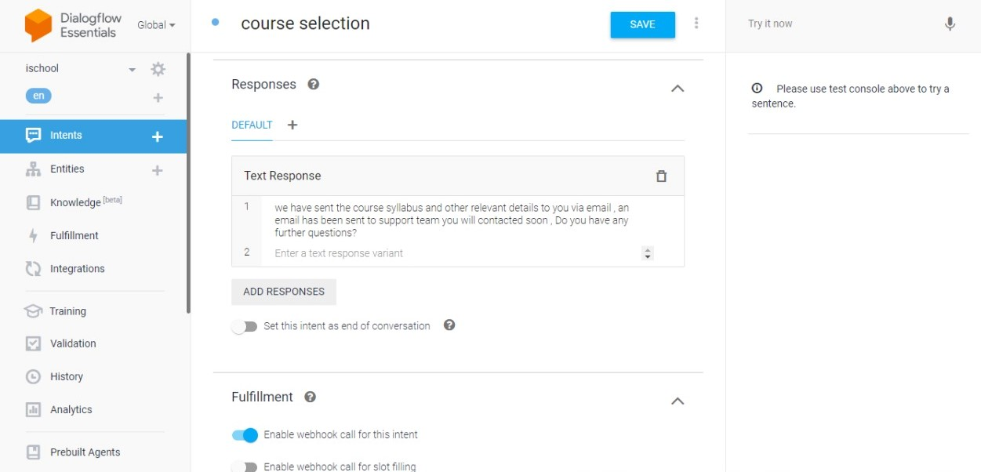
System Configuration (course selection2)

Slide 18
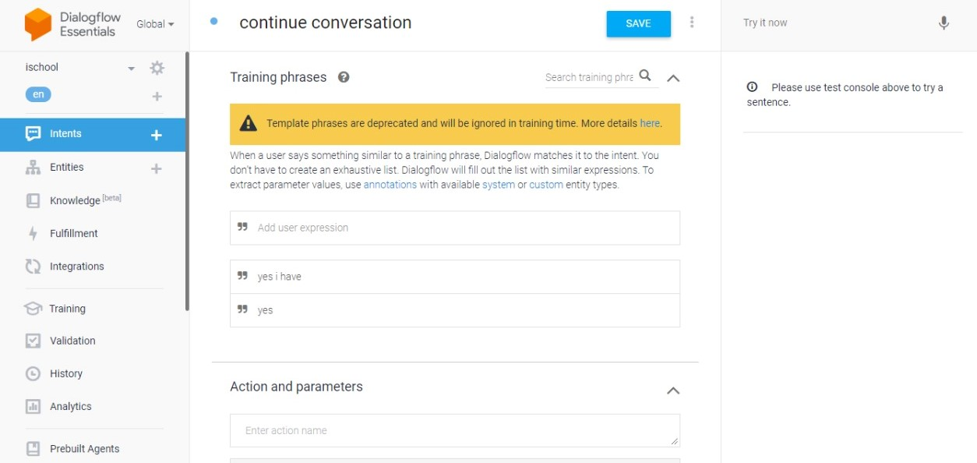
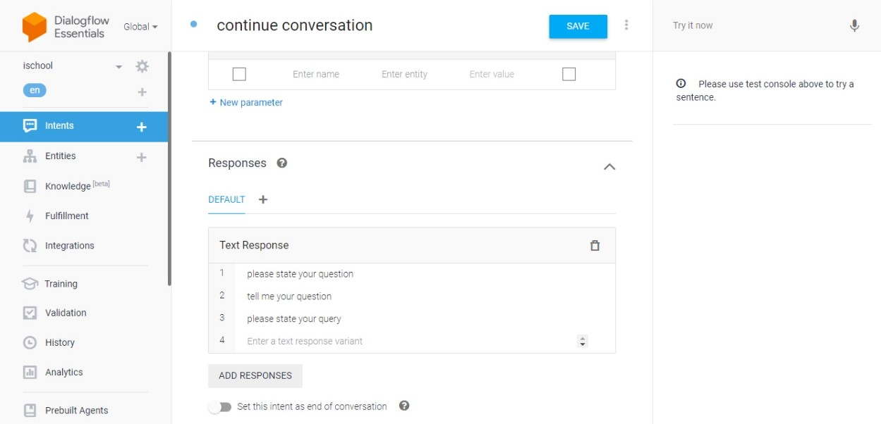
System Configuration (Continue Conversation)

Slide 19
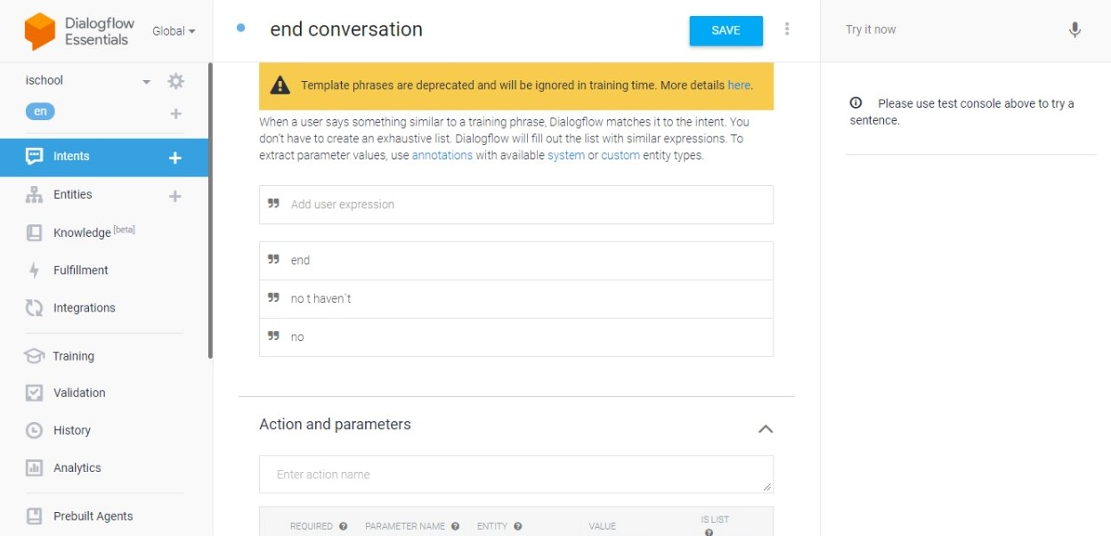
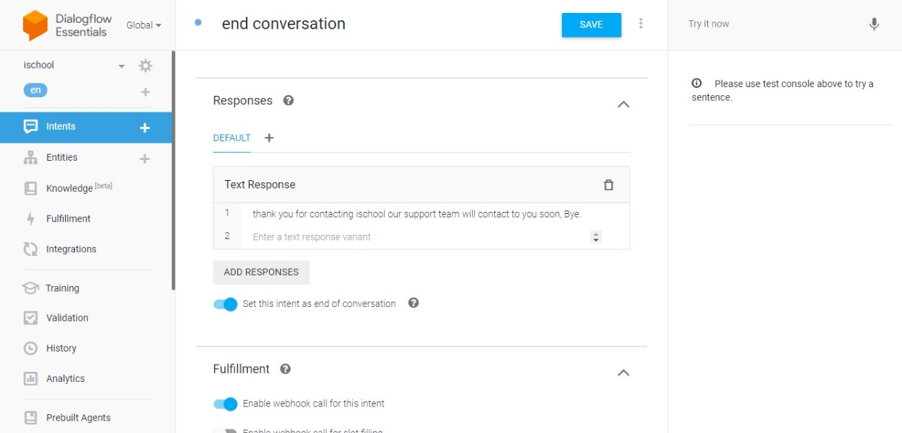
System Configuration (End Conversation)

Slide 20
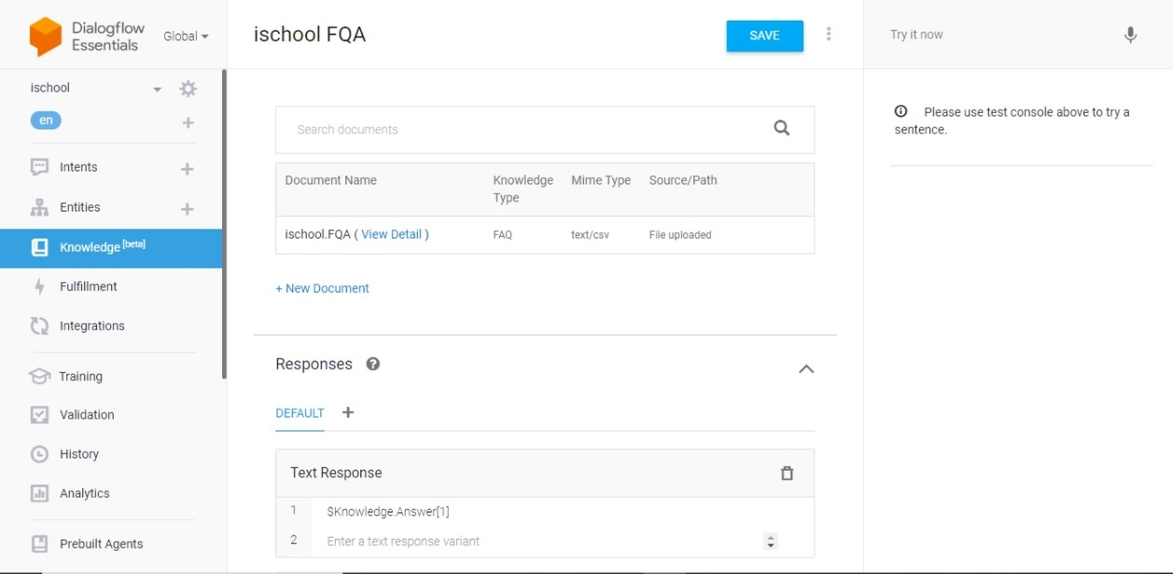
System Configuration (FAQ)

Slide 21
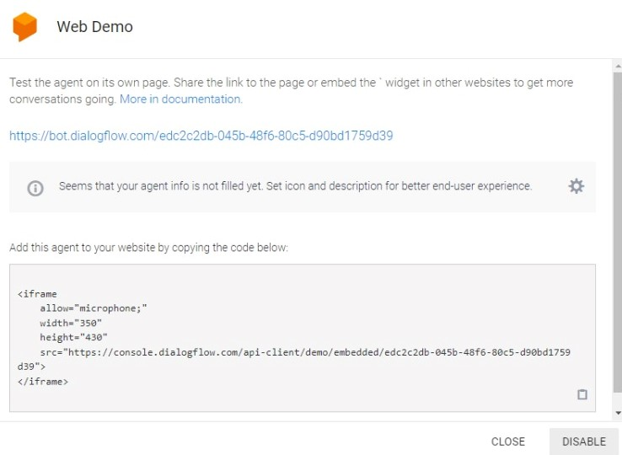
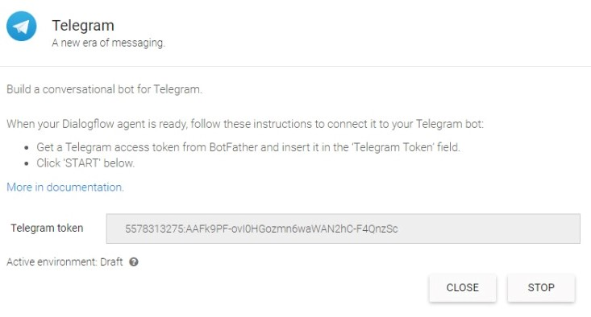
System Configuration (Telegram and Web Demo)

Slide 22
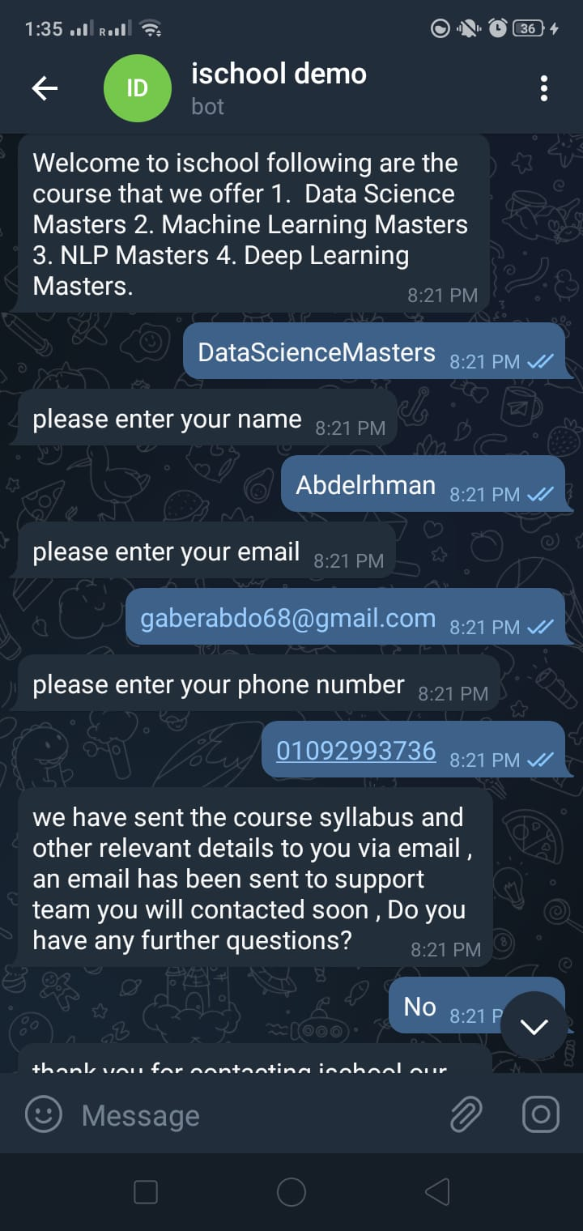
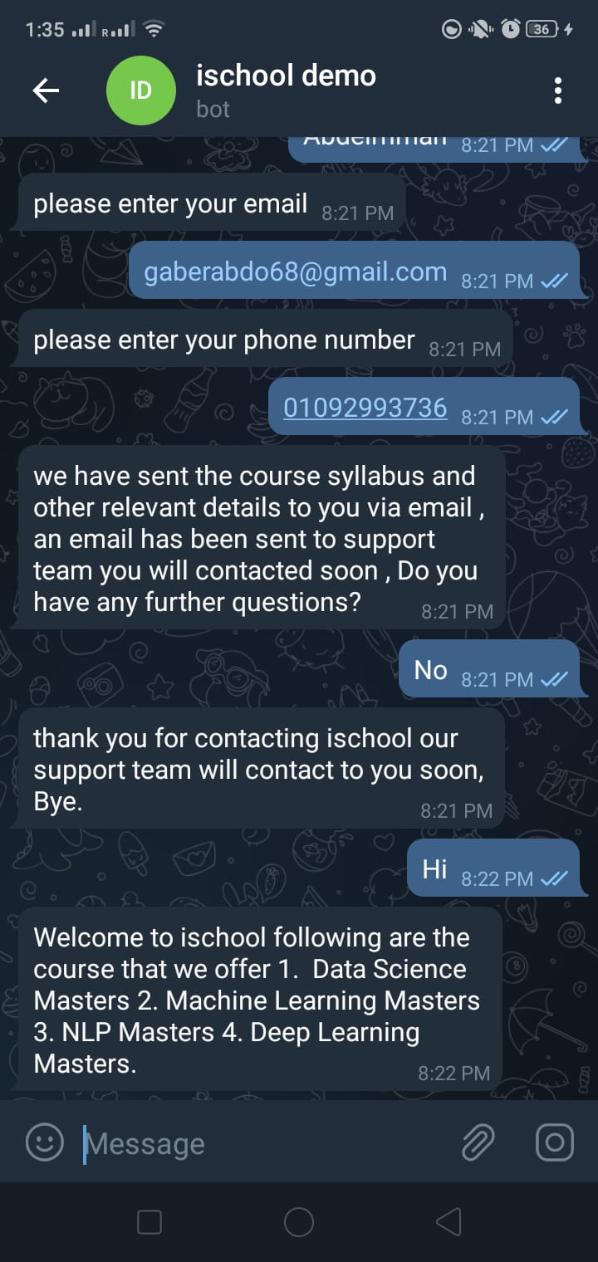
System Output

Slide 23
Evaluation
Chosen Types of Questions:
Welcoming like: hi, hello, good morning, welcome and good afternoon
Ending or thanking like: thanks, thank you, good-bye, see you later and bye.
Details about the services Like: price, instructor, date, and time of course.
Discounts
Content of course and technical questions.

Slide 24
Evaluation
Type | Q1 | Q2 | Q3 | Q4 | Q5 | TOTAL
Welcoming | 1 | 1 | 1 | 0 | 0 | 3
Ending or thanking | 0 | 0 | 0 | 0 | 0 | 0
Details about our service | 1 | 1 | 1 | 1 | 0 | 4
Discounts | 1 | 1 | 1 | 1 | 1 | 5
Content | 1 | 1 | 1 | 0 | 1 | 4

Slide 25
Evaluation
Faced Issues:
Welcome sentences
Ending phrases
E-mail addresses are not checked
Phone number validity
Asking a question in plural form
After knowing the weaknesses of the chatbot, it was retrained to avoid these mistakes.

Slide 26
Thank You

