Slide 1

DTI5125
Group Assignment 1: Text Classification Group: DSA_202101_13

Slide 2

we used some machine learning algorithms like Naive Bayes, Passive Aggressive, Decision Tree, and KNN(K-nearest neighbour)
we find the best model is LDA + random forest and used some of vectorization methodologies such as BOW (Bag Of Words), TF-IDF (term frequency-inverse document frequency) on word and bi-grame wise

Slide 3
Methodology Workflow
Choosing the dataset
Preprocessing
Feature Engineering
Data Augmentation
LDA with Error Analysis
Classification Modelling
LDA with Random Forest after data augmentation with error analysis

Slide 4
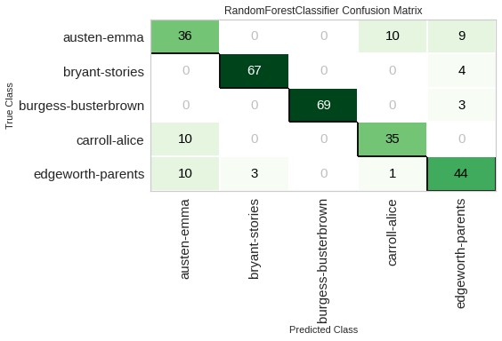
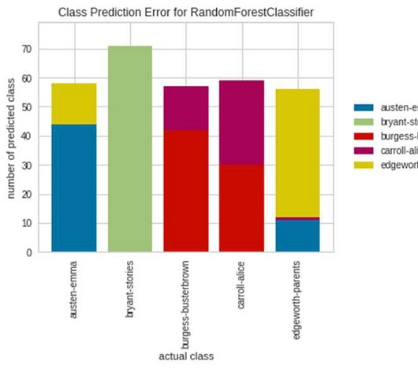
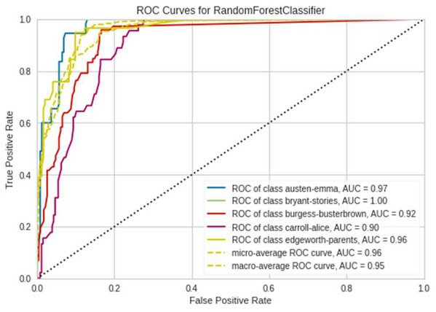
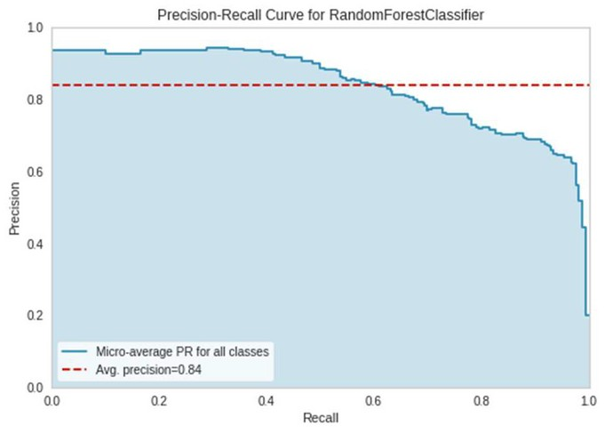
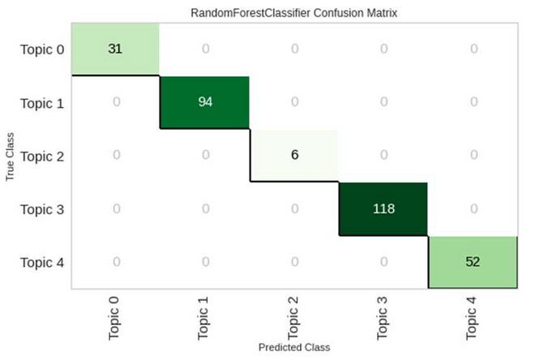
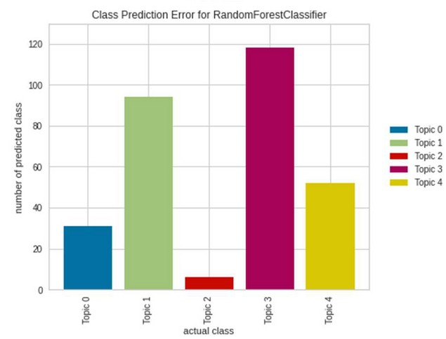
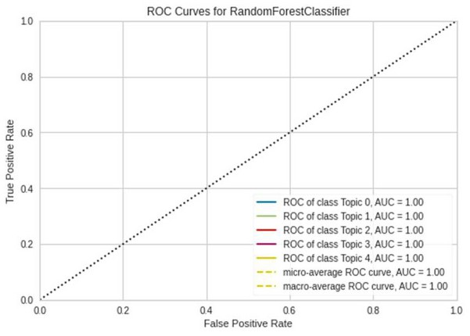
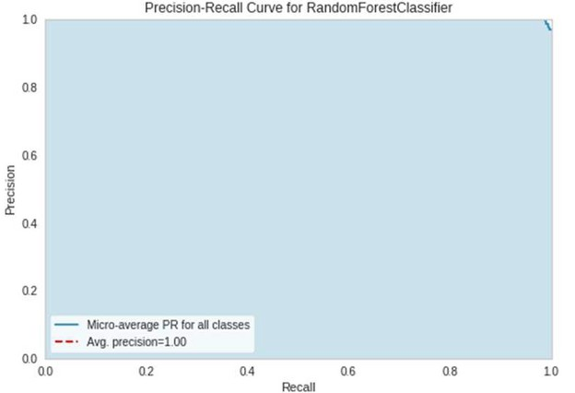
Evaluation before and after Augmentation
Confusion Matrix of
Class Prediction AUC-ROC for
Precision-Recall
the champion model ^{Error of the}
champion model in curve of the
champion model
each book
champion model

Slide 5
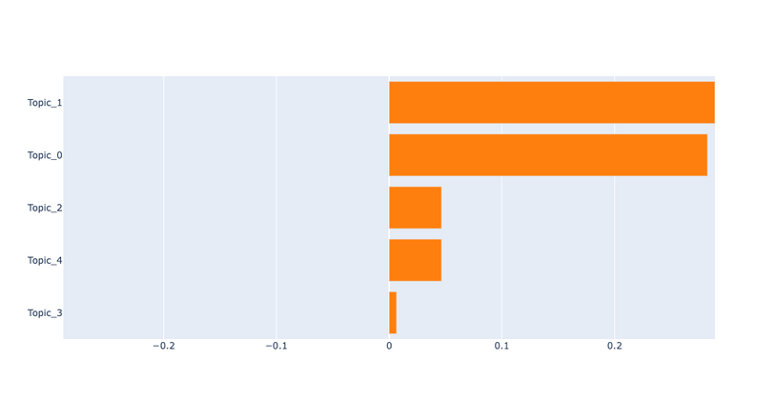
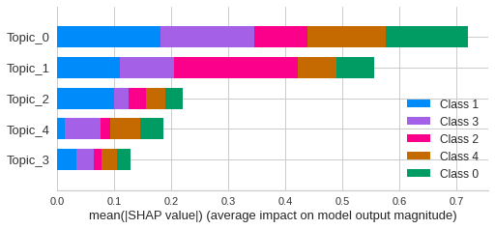
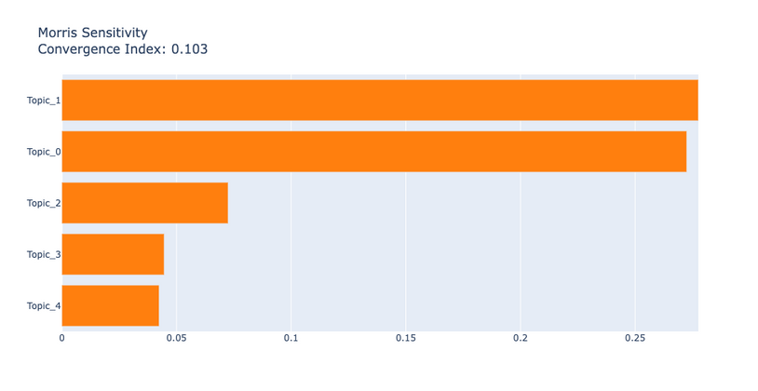
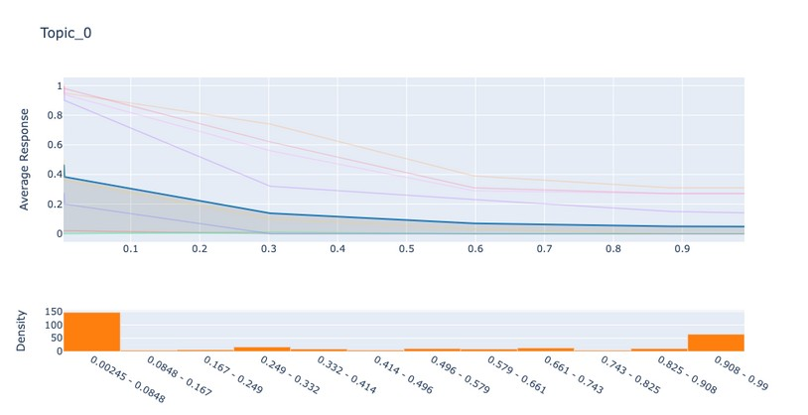
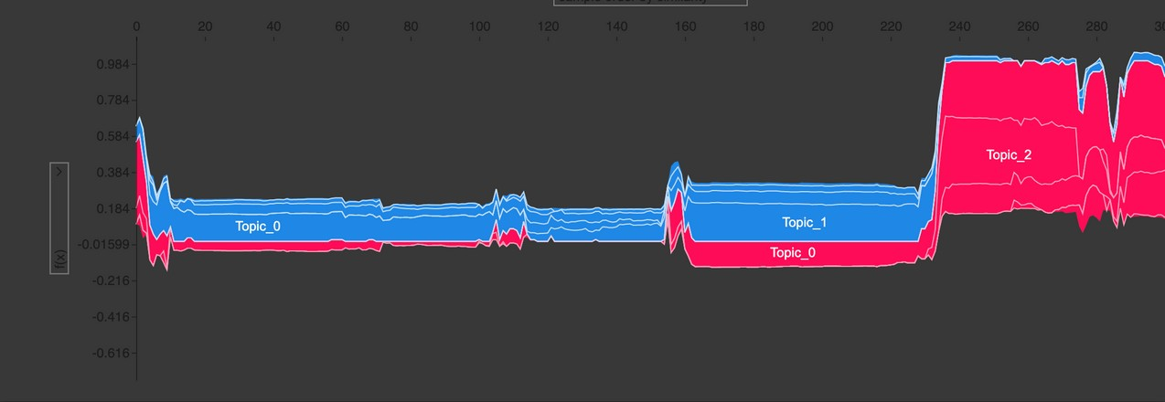
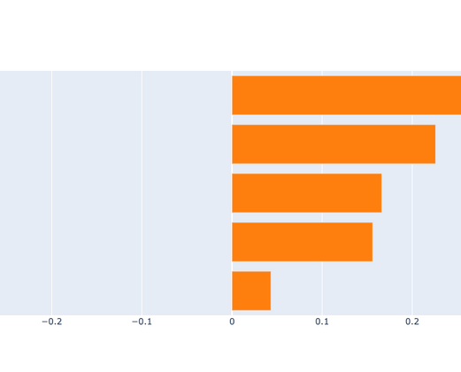
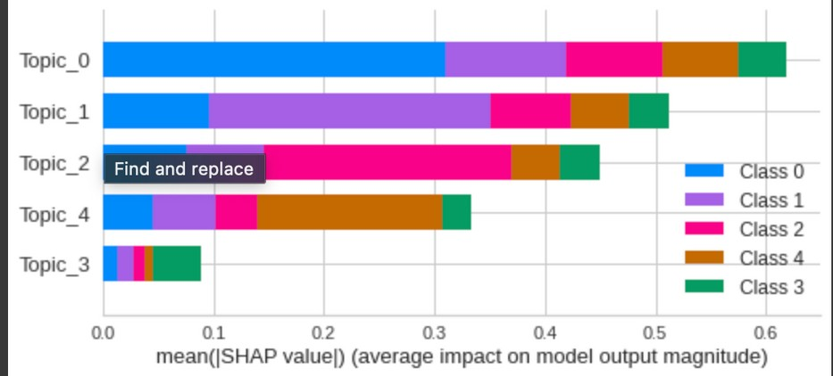
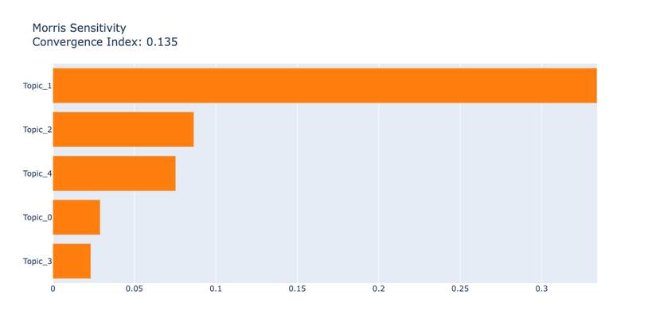
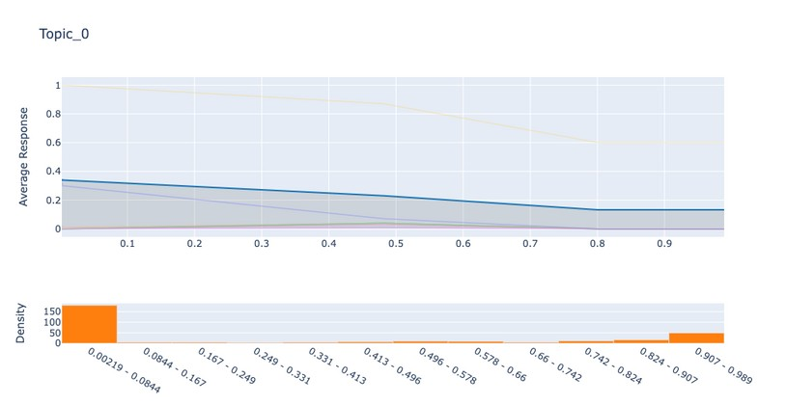
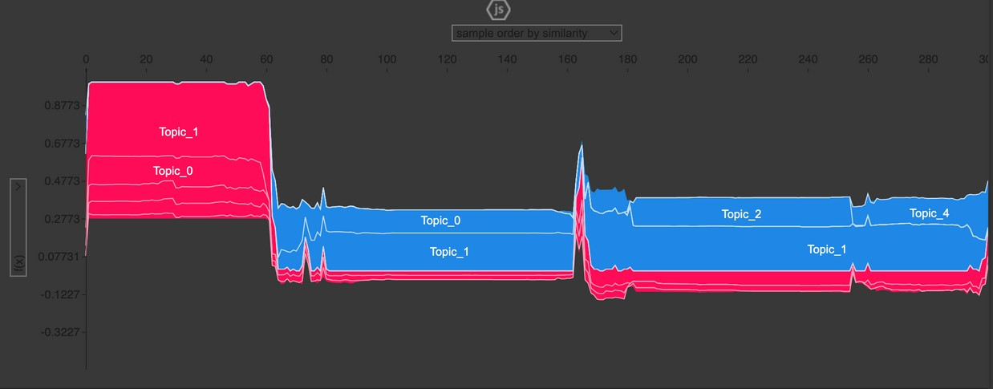
Error analysis before and after
Augmentation
Permutation Feature Importance
interpretion using summary plot
interpretion using Morris Sensitivity Analysis plot
interpretion using Partial dependence plots
interpretion using reason plot

