Slide 1

Presentation by :
Aman Kumar Singh | Member@amFOSS

Slide 2
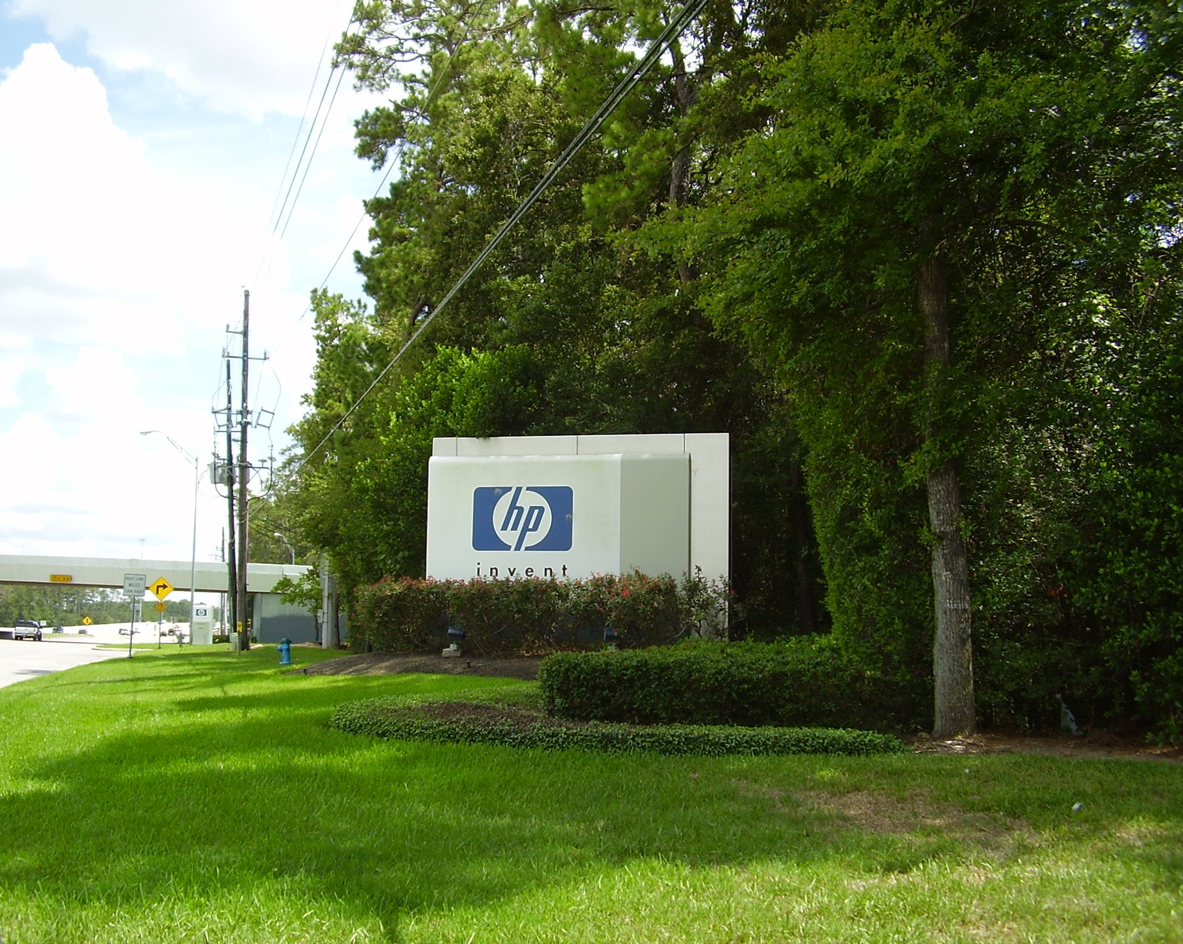
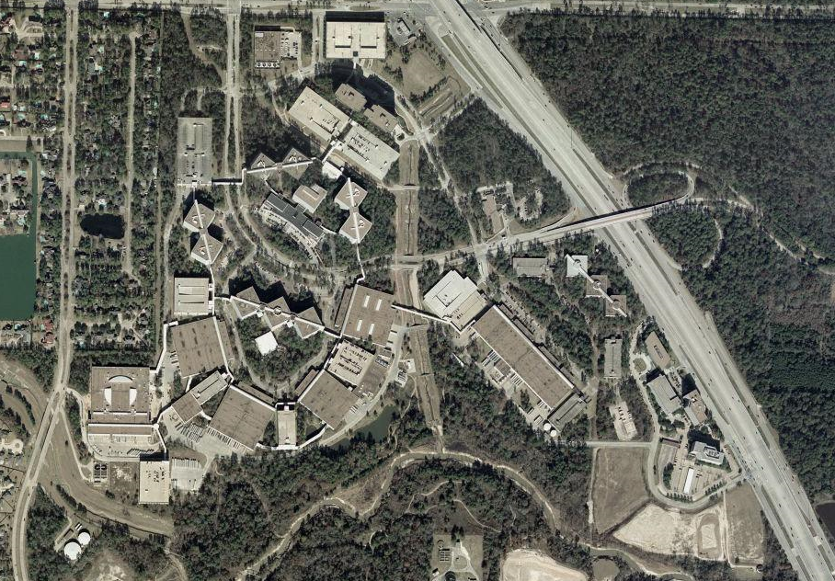
What is Compaq ?
Compaq was an American information technology company founded in 1982.
Compaq produced some of the first IBM PC compatible computers.
It rose to become the largest supplier of PC systems during the 1990s.
Besides that, it created to set records as a startup, highly regarded desktop PCs and servers.
Former Compaq headquarters, now the Hewlett-Packard United States campus

Slide 3
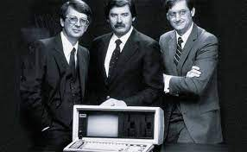
Brief History
Compaq was founded in February 1982 by Rod Canion, Jim Harris, and Bill Murto.
Unlike many startups, Compaq differentiated its offerings from the many other IBM clones by not focusing mainly on price, but instead concentrating on new features.
Founders: Rod Canion, Jim Harris and Bill Murto

Slide 4
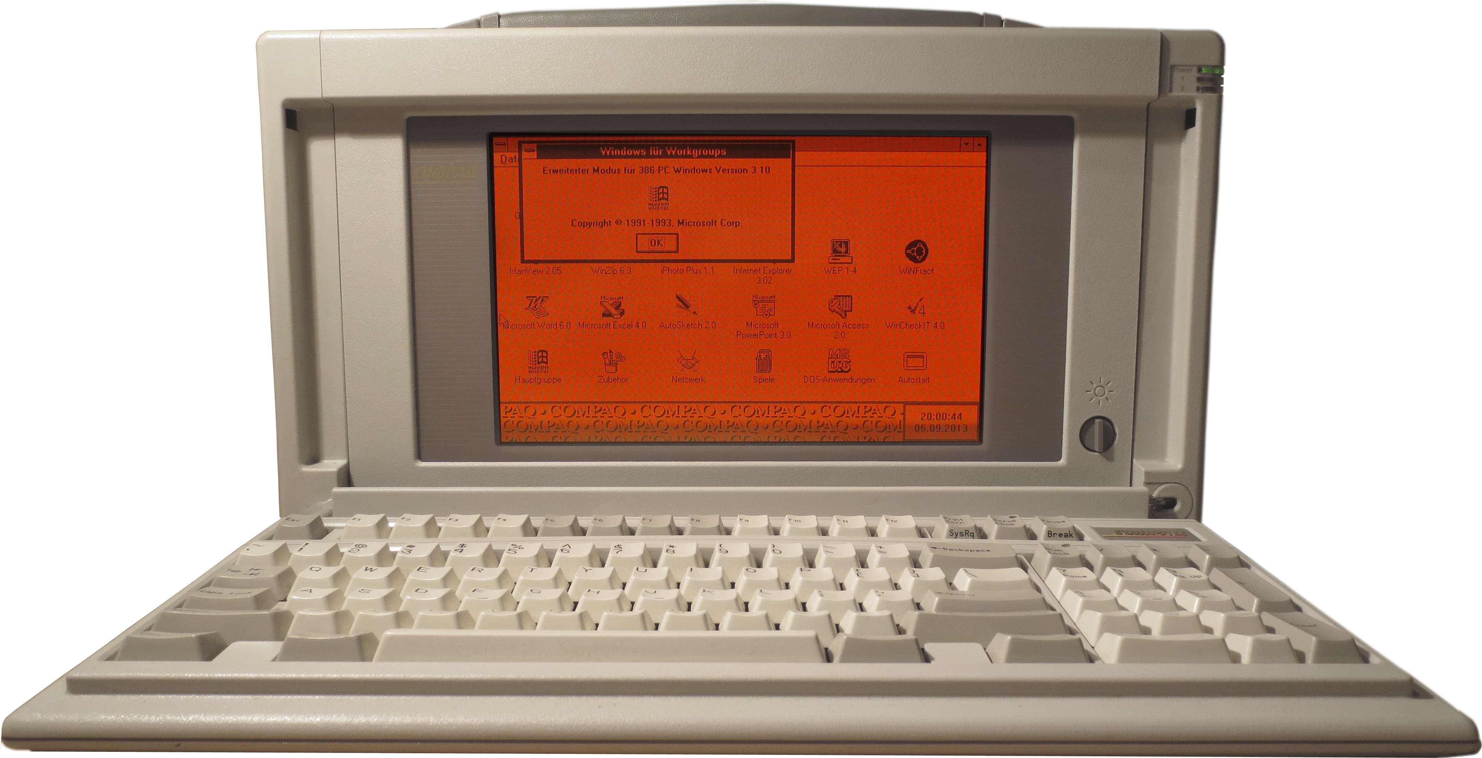
Successful Products
Compaq Portable (1982)
The debut Compaq machine an relatively inexpensive alternative to IBM's official Personal Computer.
It sold very well (over 50,000 units in its first year), setting the stage for Compaq's continued success.
Compaq Portable 386

Slide 5
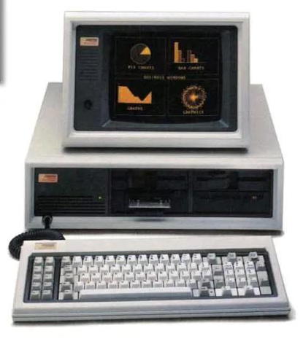
Successful Products
Compaq DeskPro (1984)
The firm dipped into the desktop PC clone market with the DeskPro.
With the top-of-the-line model included a 10MB hard drive, a 10MB removable tape drive, and 640K of RAM.
The DeskPro was well-received by critics in the increasingly crowded PC compatible market.
Compaq DeskPro

Slide 6
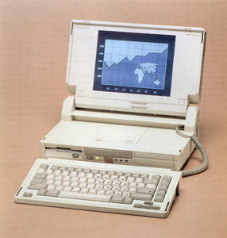
Successful Products
Compaq SLT/286 (1988)
Compaq shipped its first laptop computer, the SLT/286.
Compaq shipped the SLT/286, which was possibly the first laptop in the world to ship with a VGA resolution LCD screen (monochrome, 640 by 480).
Compaq was proud of its ever-shrinking portables.
Compaq SLT/286

Slide 7
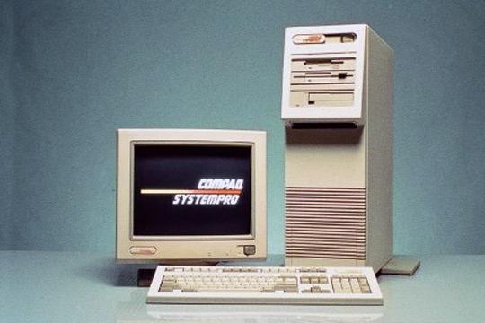
Successful Products
Compaq SystemPro (1989)
The SystemPro carried a hefty, mainframe-like price and shipped with capabilities practically unheard of in PC Space.
Over the next 13 years, Compaq continued its successful streak as one of the dominating PC clone makers.
Compaq SystemPro

Slide 8
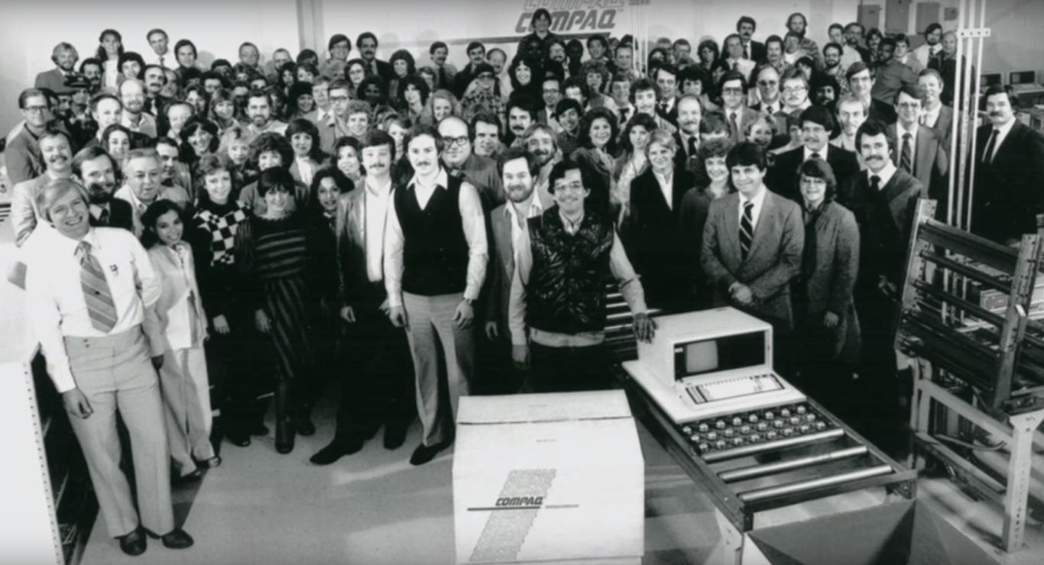
A major success
During its first year of sales, the company sold 53,000 PCs for sales of $111 million.
It reached the list of Fortune 500 companies (1986) faster than any organization before.
It was also the youngest company to reach $1 billion in annual sales (1987).
From the movie ‘Silicon Cowboys’

Slide 9

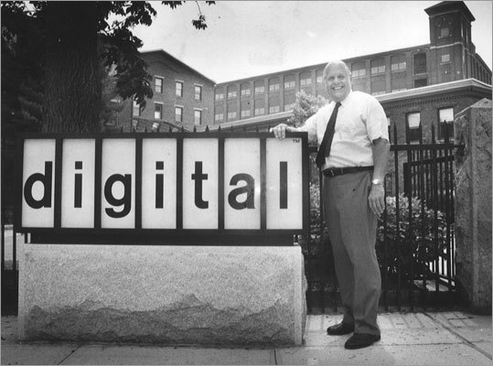
Fall of Compaq
Included 15 years at the top of the PC industry Compaq had a storied life, but in 2001 its fall came swiftly.
The early 1990s saw Canion ousted from the company.
The company acquired Tandem Computers and then acquired Digital Equipment Corporation (DEC) in 1998.
The merger with HP that provided the nail in the coffin for the already struggling company.
Rod Canion
Digital Equipment Corporation

Slide 10
Reasons
Acquisition of DEC.
Intel producing chipsets and motherboard, stabilizing the PC field.
Marketing efforts shifted from price to premium products.
Compaq's finances slowly started to unravel during dot-com bust.

Slide 11
THANK YOU
Any questions or feedback ?

