Slide 1
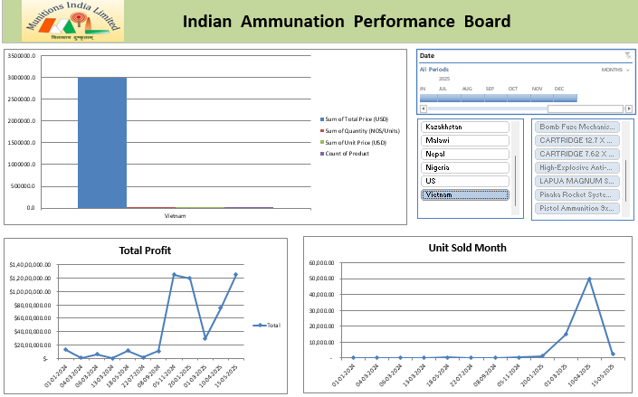
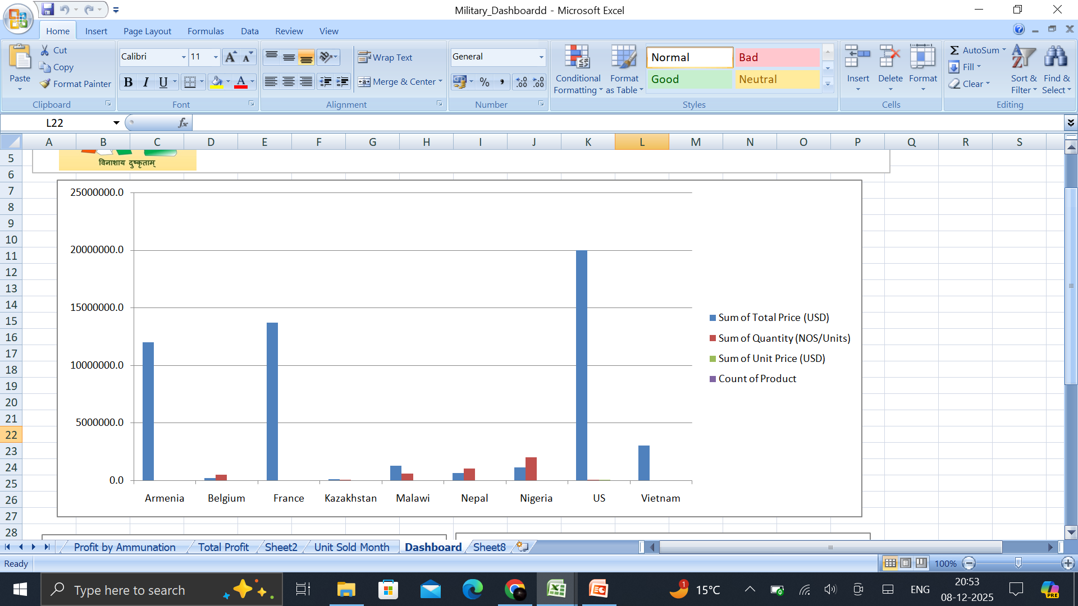
INDIAN AMMUNITION
Done by:-
Aman Prasad Bhagat
MCA Student

Slide 2
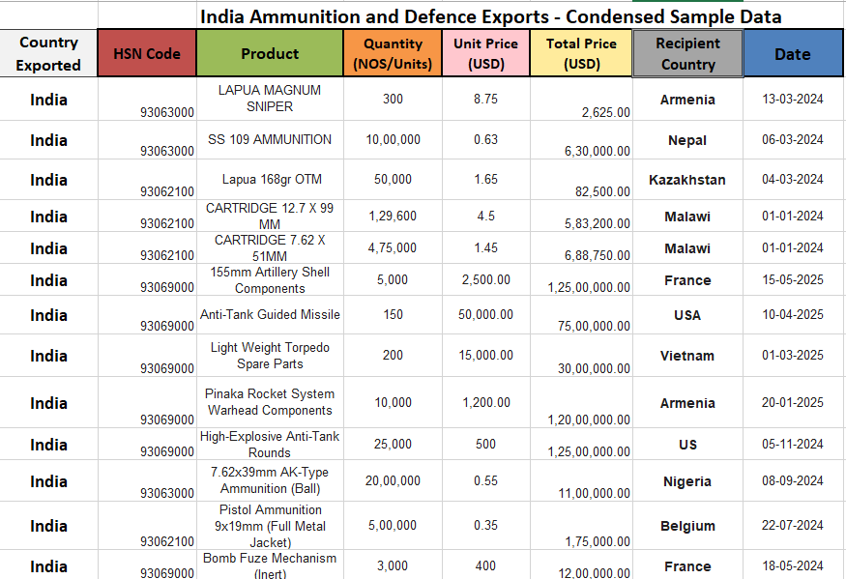
India Ammunition and Defense Exports - Condensed Sample Data

Slide 3
The primary Indian ammunition company is Munitions India Limited (MIL), a government-owned defense PSU under the Ministry of Defence, handling production, R&D for all ammo types (small, medium, high-calibre), and explosives, serving Indian forces and international clients. Other significant players include private sector firms like SSS Defence, Tata Group, Bharat Forge, and Premier Explosives, plus entities like Yantra India Limited (YIL), all contributing to India's growing self-reliance in defense manufacturing

Slide 4
Key Players:-
Munitions India Limited (MIL): India's largest manufacturer, spun off from the former Ordnance Factory Board, making everything from bullets to rockets, with 12 advanced factories.
SSS Defense: A private entity known for indigenous small arms and sniper rifles (Viper, Saber). Premier Explosives Limited: A publicly traded company involved in explosives and defense-related products.
Yantra India Limited (YIL): Another defense PSU focusing on various defense components, including artillery shells.
Private Sector Majors: Companies like Tata, Bharat Forge, and Mahindra Group are increasing their role in ammunition and defense systems.

Slide 5
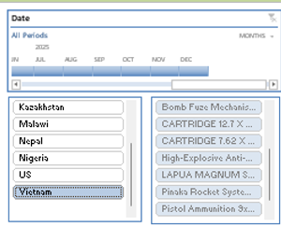
Slicer:-
Country Slicer:
This slicer lists countries such as:
Kazakhstan
Malawi
Nepal
Monthly Timeline: The date slicer lets users select specific months of thef year (e.g., June to December 2025). It helps analyze:-
Monthly production trends
Export quantity fluctuations
Ammunition Type Slicer:
The right-side slicer displays major ammunition categories, such as:
Bomb Fuuze Mechanisms
CARTRIDGE 12.7 mm
CARTRIDGE 7.62 mm
High-Explosive Anti-Tank Ammunition
LAPUA MAGNUM Sniper Rounds

Slide 6
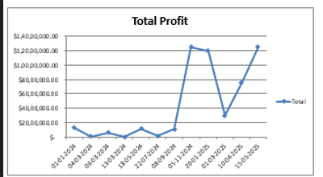
“Total Profit” Line Chart
The “Total Profit” chart shows how profit has changed over time from dated
01-01-2024 to 15-05-2025.
This line chart helps identify trends, growth patterns, sudden spikes, and drops in profit.
Steady Low Profit (Jan 2024 – Oct 2024)
From 01-01-2024 to 22-10-2024, the profit remains very low and almost flat.
✔Insight:
The business had slow performance during this period.
Profit levels were very small with no major growth.
This may indicate:
  low sales
  high expenses
  early-stage business
  seasonal demand changes

Slide 7
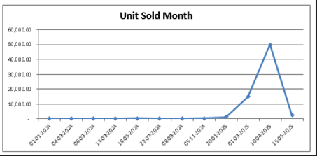
“Unit Sold Month” Line Chart
The chart shows the number of units sold each month from
01-01-2024 to 15-03-2025.
The line clearly highlights three major phases: low sales, sudden growth, and a sharp decline,
Extremely Low Sales (Jan 2024 – Jan 2025)
For almost one full year, from 01-01-2024 to 20-01-2025, the units sold remain flat and close to zero.
✔ Insight:
Very few units were sold during this period.
This indicates:
low market demand
new product still gaining recognition
limited marketing

Slide 8


