Slide 1
Northwind sales analytics
Business Insights & Performance Analysis | 1994-1996

Slide 2
Overview
The objective of this report is to design and develop a visually compelling, interactive, and user-centric Power BI dashboard that effectively communicates key performance indicators (KPIs) for Northwind Traders.
This report is intended to:
Deliver actionable insights into customer behavior, sales performance, inventory dynamics, and employee productivity
Consolidate data from multiple relational tables into a unified analytical model
Enable stakeholders to explore data dynamically using filters, slicers, and drill-through capabilities
Support strategic and operational decision-making through data-driven insights
The ultimate goal is to enhance how Northwind Traders interprets and leverages its data, strengthening its competitive position in the wholesale specialty foods market.

Slide 3
Expected Business Impact
The implementation of this analytics dashboard is expected to:
Improve visibility into revenue trends and sales drivers
Identify high-value customers and profitable product categories
Monitor employee performance and sales contribution
Track inventory levels and reorder risks
Evaluate shipping efficiency and operational performance
By centralizing performance metrics into an interactive BI solution, the organization can shift from reactive reporting to proactive decision-making.

Slide 4
Dataset Description
The Northwind database contains transactional sales data for a fictional company, Northwind Traders, which specializes in importing and exporting specialty food products globally.
The dataset represents a typical relational business structure and is ideal for performing:
Sales trend analysis
Customer segmentation
Product performance evaluation
Supply chain and shipping analysis
Employee performance tracking

Slide 5
Data Model Overview
The dataset follows a relational schema where transactional data is connected through primary and foreign keys. The central fact table is Orders, Products, supported by multiple dimension tables.
Table Descriptions -
1. Customers Table - Purpose: Enables customer segmentation, regional sales analysis, and revenue concentration analysis.
2. Employees Table - Purpose: Supports sales performance tracking and employee productivity analysis.
3. Orders Table - Purpose: Enables order trend analysis, shipping performance evaluation, and revenue timeline tracking.
4. Order Details Table (Fact Table) - Purpose: Serves as the primary fact table for calculating total revenue, discounts, and sales volume.
5. Products Table - Purpose: Supports product performance analysis and inventory management insights.
6. Suppliers Table - Purpose: Enables supplier-level analysis and procurement evaluation.
7. Shippers Table - Purpose: Used to analyze delivery performance and freight cost impact.
8. Categories Table - Purpose: Enables category-level sales and profitability analysis.

Slide 6
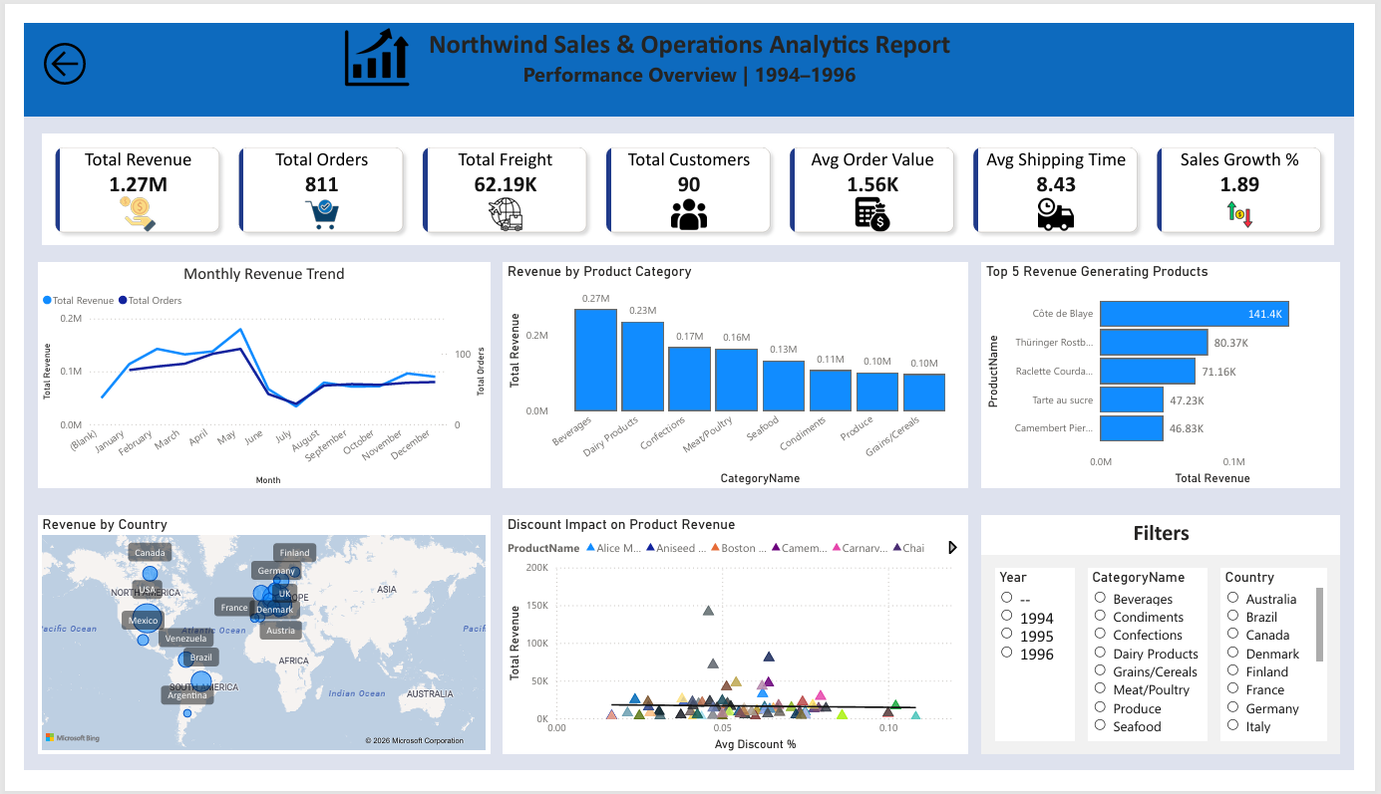
Sales Analysis
This dashboard section provides a comprehensive view of overall revenue performance, order trends, and category contribution. It highlights total sales, average order value, sales growth over time, and top-performing products. The visualizations help identify revenue drivers, seasonal patterns, and areas of high profitability to support strategic sales planning.

Slide 7
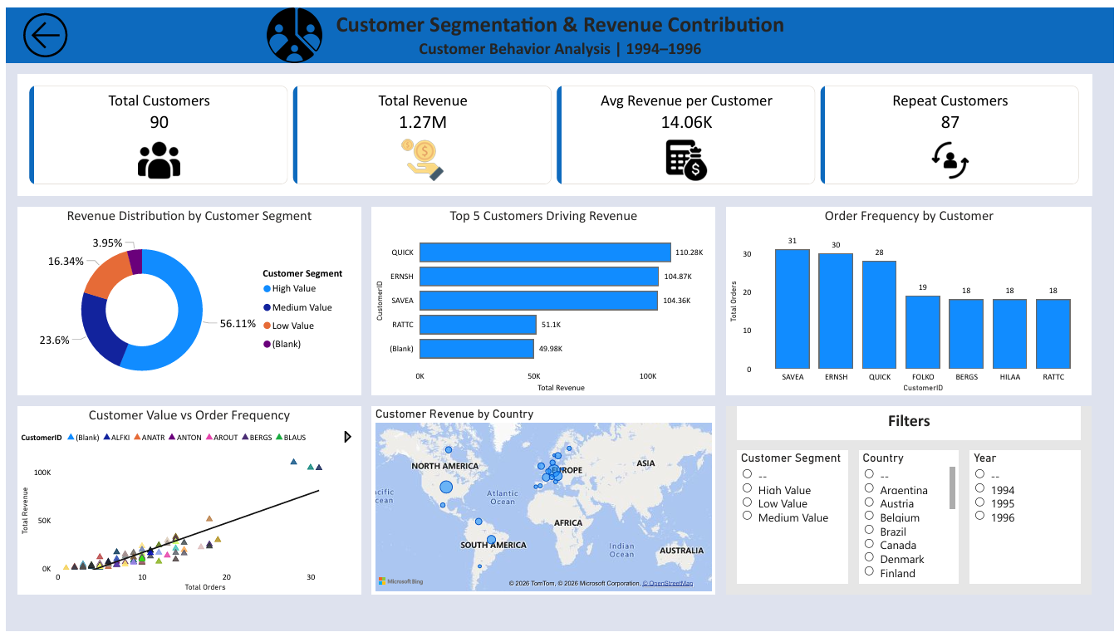
Customer Segmentation Analysis
This section analyzes customer purchasing behavior, geographic distribution, and revenue contribution. It identifies high-value customers, repeat purchasing patterns, and regional performance differences. These insights support customer segmentation, targeted marketing strategies, and long-term relationship management.

Slide 8
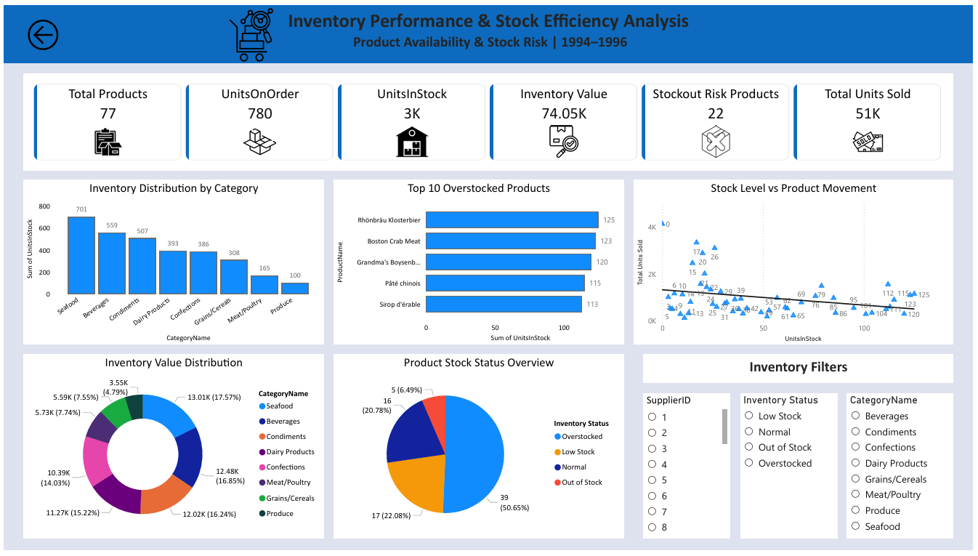
Inventory Performance Analysis
The inventory dashboard monitors product availability, stock levels, reorder status, and discontinued items. It helps identify slow-moving products, stock shortages, and demand trends. This analysis enables better inventory planning, reduces stock-out risks, and improves supply chain efficiency.

Slide 9
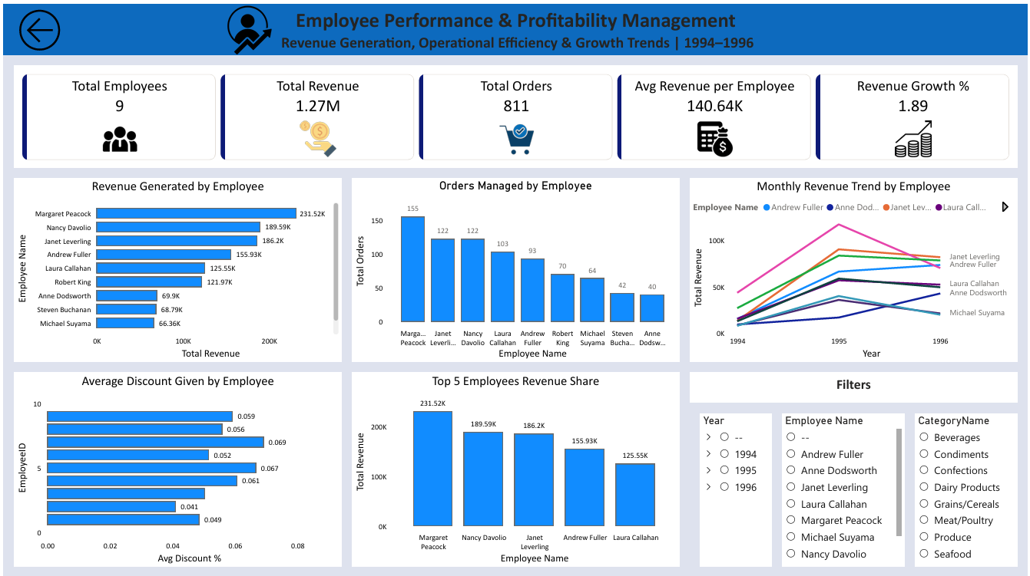
Employee Performance Analysis
This section evaluates employee sales performance, order handling efficiency, and revenue contribution. It compares individual performance metrics and highlights top-performing sales representatives. These insights assist management in performance evaluation, incentive planning, and resource allocation.

Slide 10
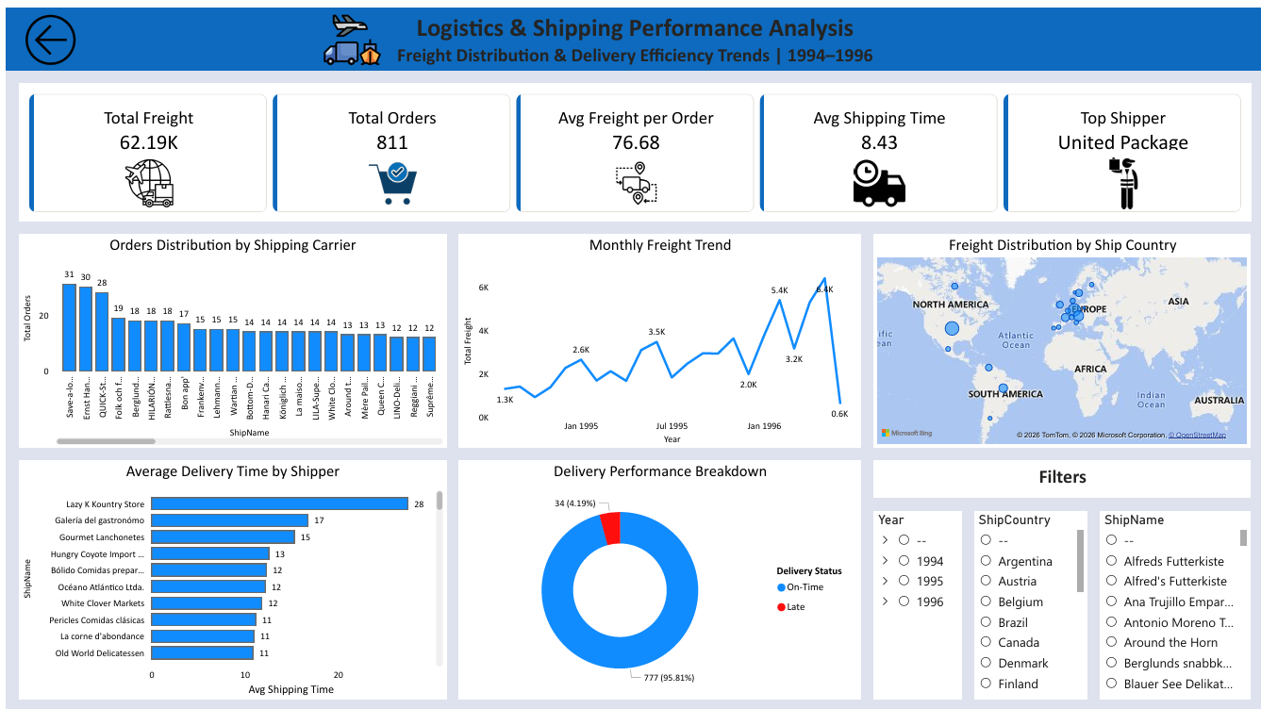
Shipping Analysis
The shipping dashboard examines delivery timelines, freight costs, and shipper performance. It assesses on-time versus delayed deliveries and analyzes the operational impact of shipping expenses. This helps optimize logistics processes and improve customer satisfaction.

Slide 11
Strategic Recommendations
• Focus on high-margin product categories • Strengthen relationships with high-value
customers
• Optimize discount strategy to protect margins • Improve shipping efficiency using
best-performing carriers
• Use dashboard for continuous performance monitoring

Slide 12
Thank You

