Slide 1
Veggie Marketplace
Andrew Fulton

Slide 2
The Problem
Global Pandemic
  Travel discouraged
  Panic buying
  Disrupted supply chains
  More time at home
  More people growing vegetables

Slide 3
The Future
Reduce emissions from transport
Food security
Supporting locals
Promote healthier diets

Slide 4
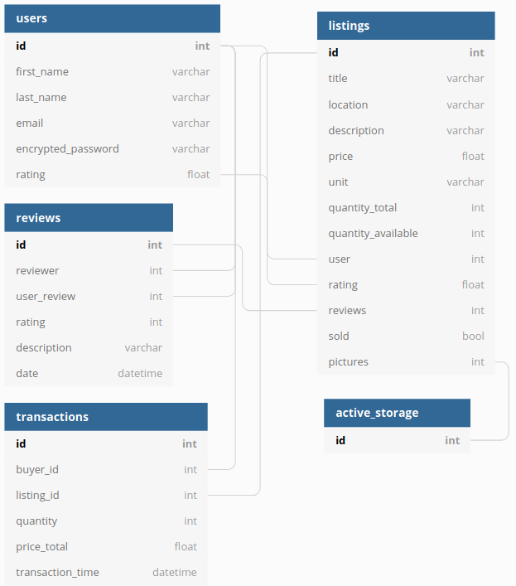
ERD

Slide 5
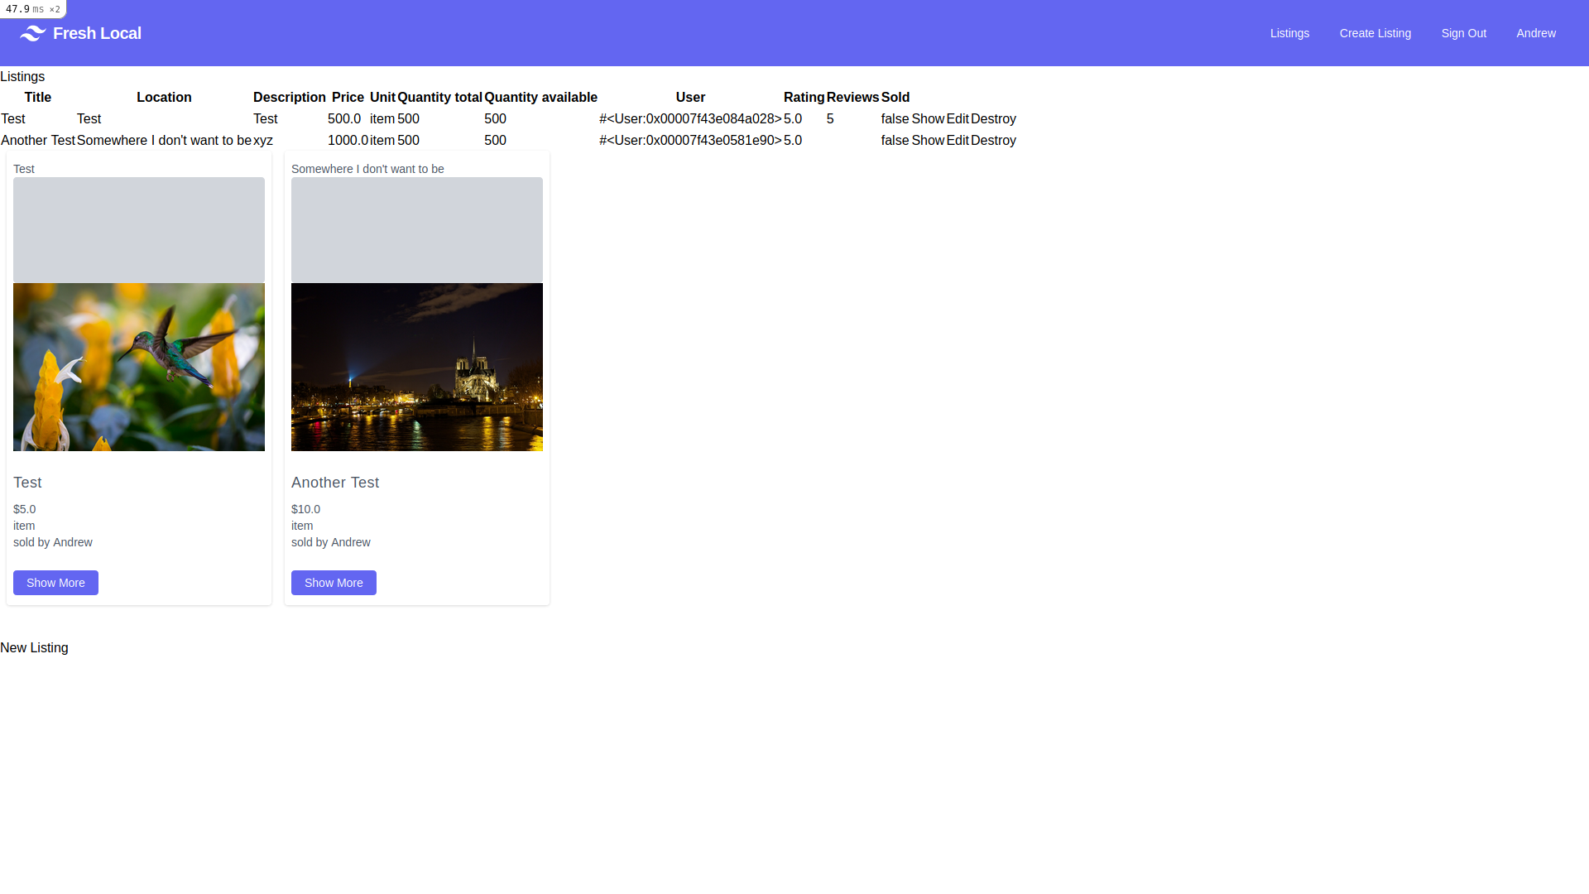
Listings

Slide 6
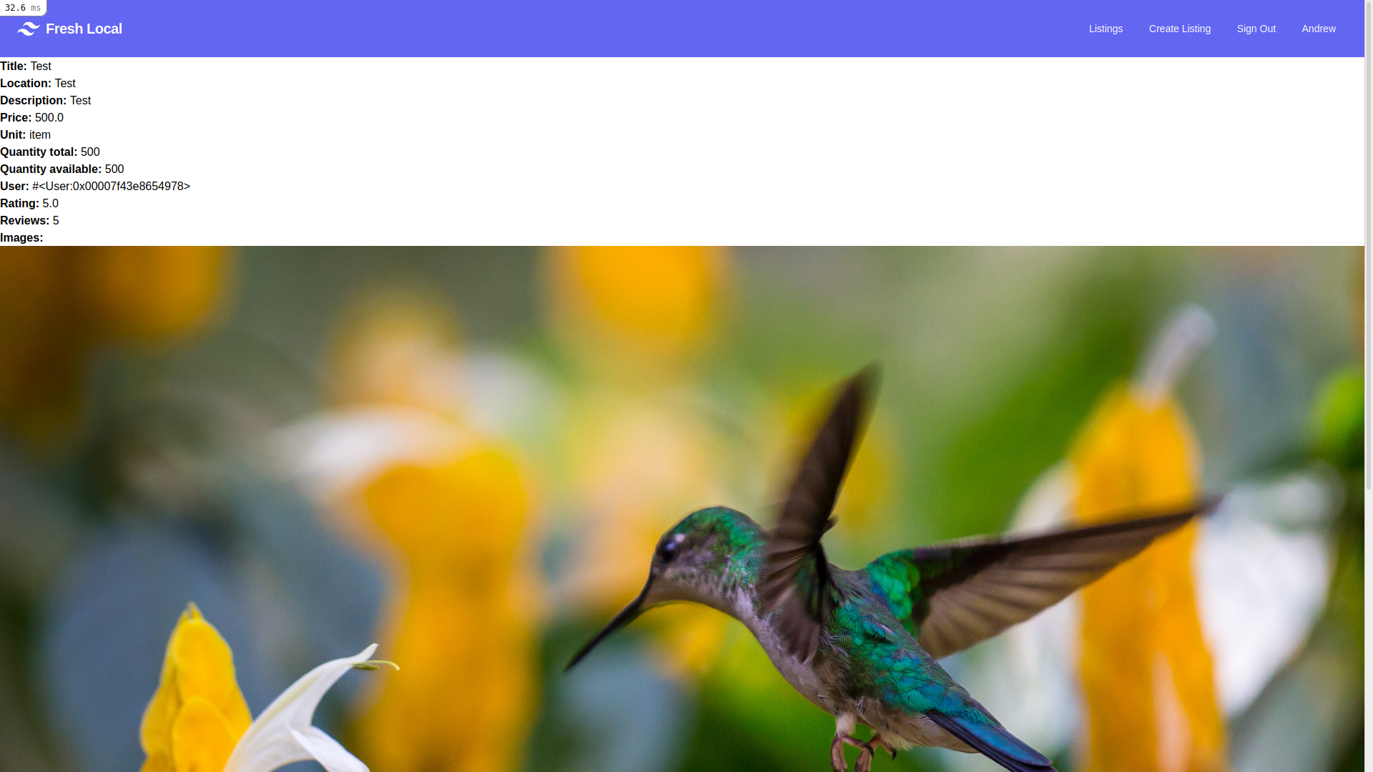
Listing

Slide 7
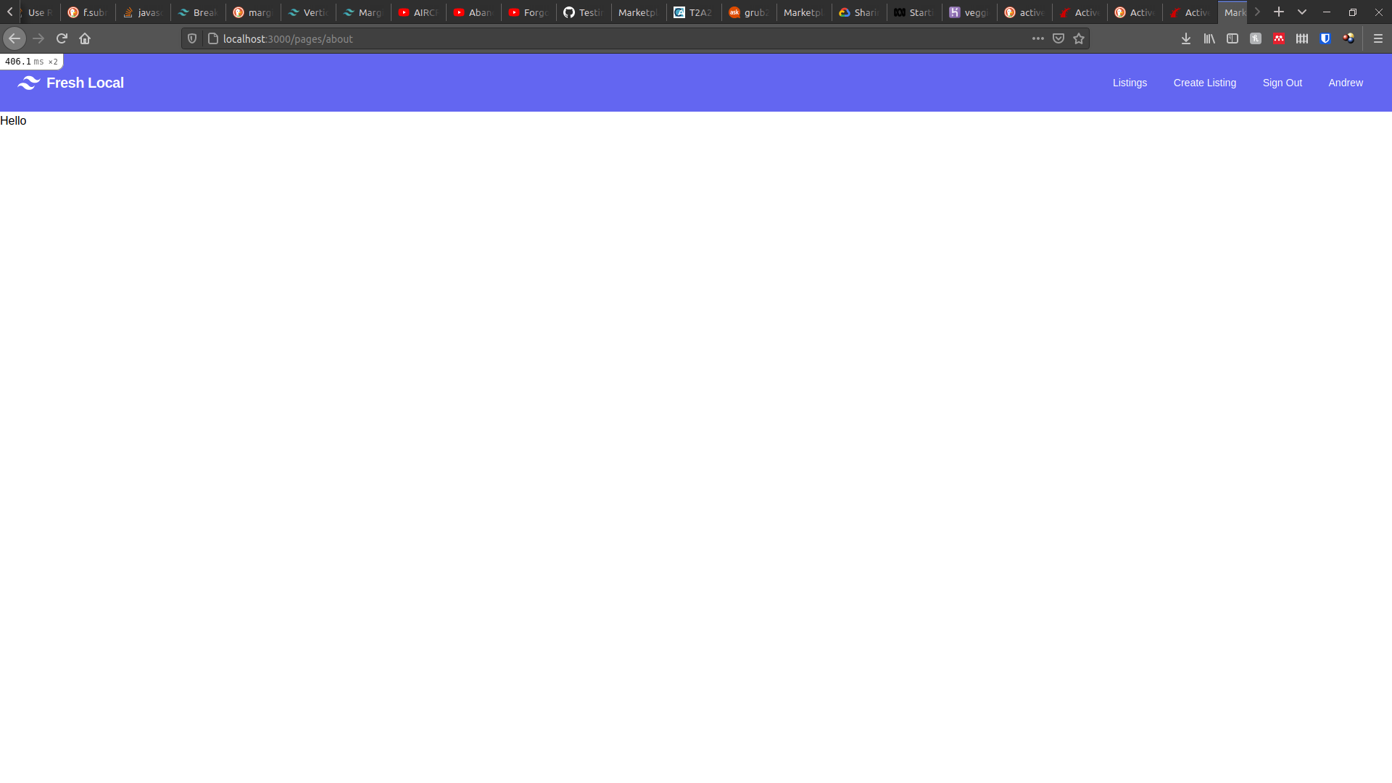
About

Slide 8
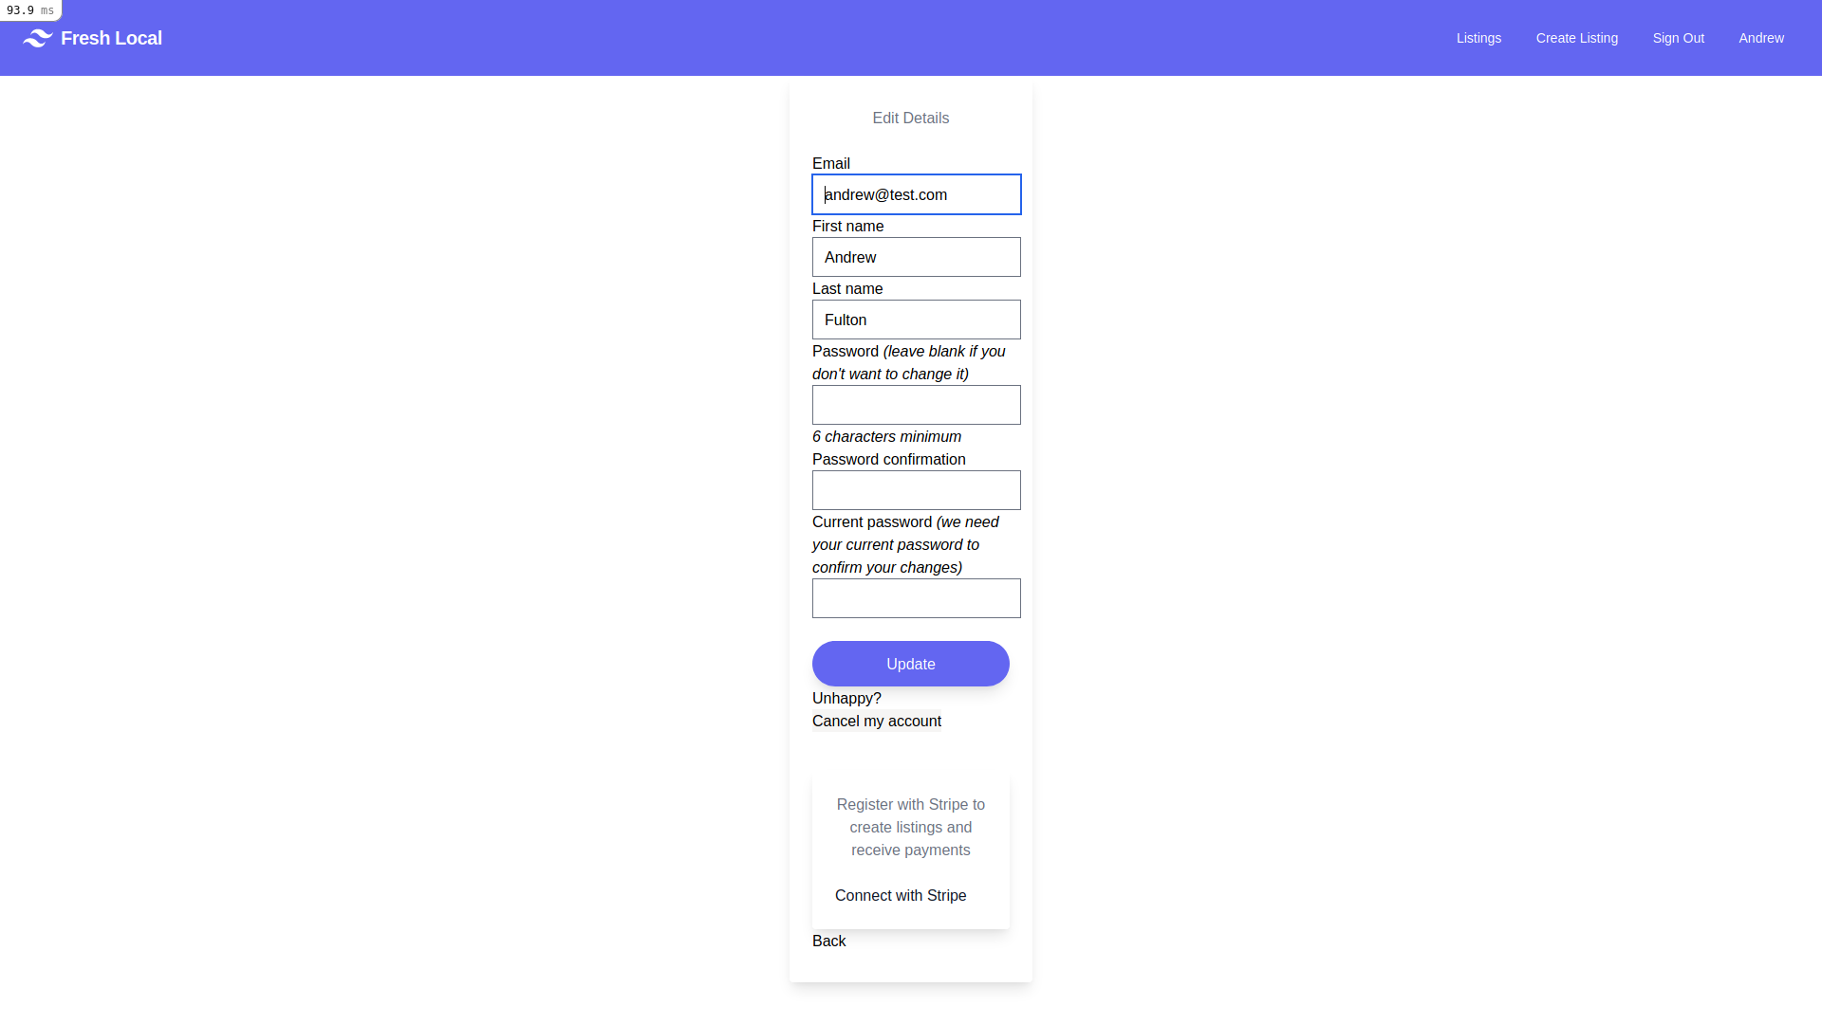
User Details

Slide 9
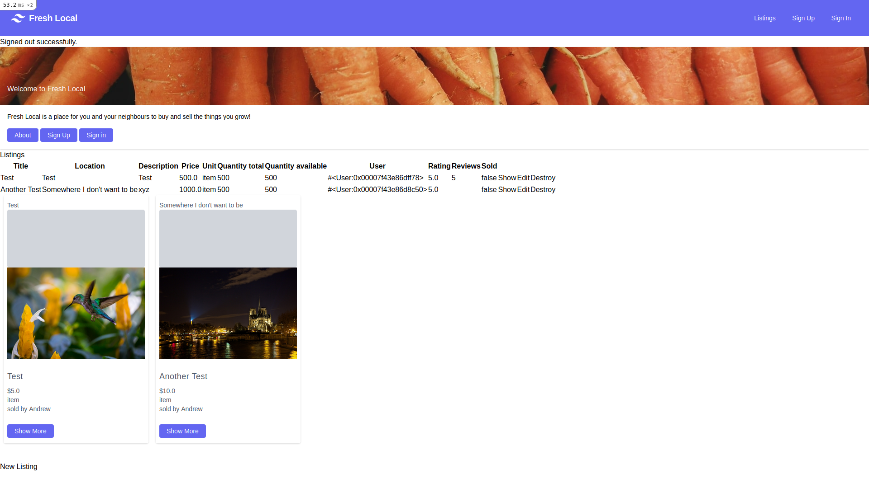
Welcome Banner

