Slide 1
Daily Task Tracker
Andrew Fulton

Slide 2

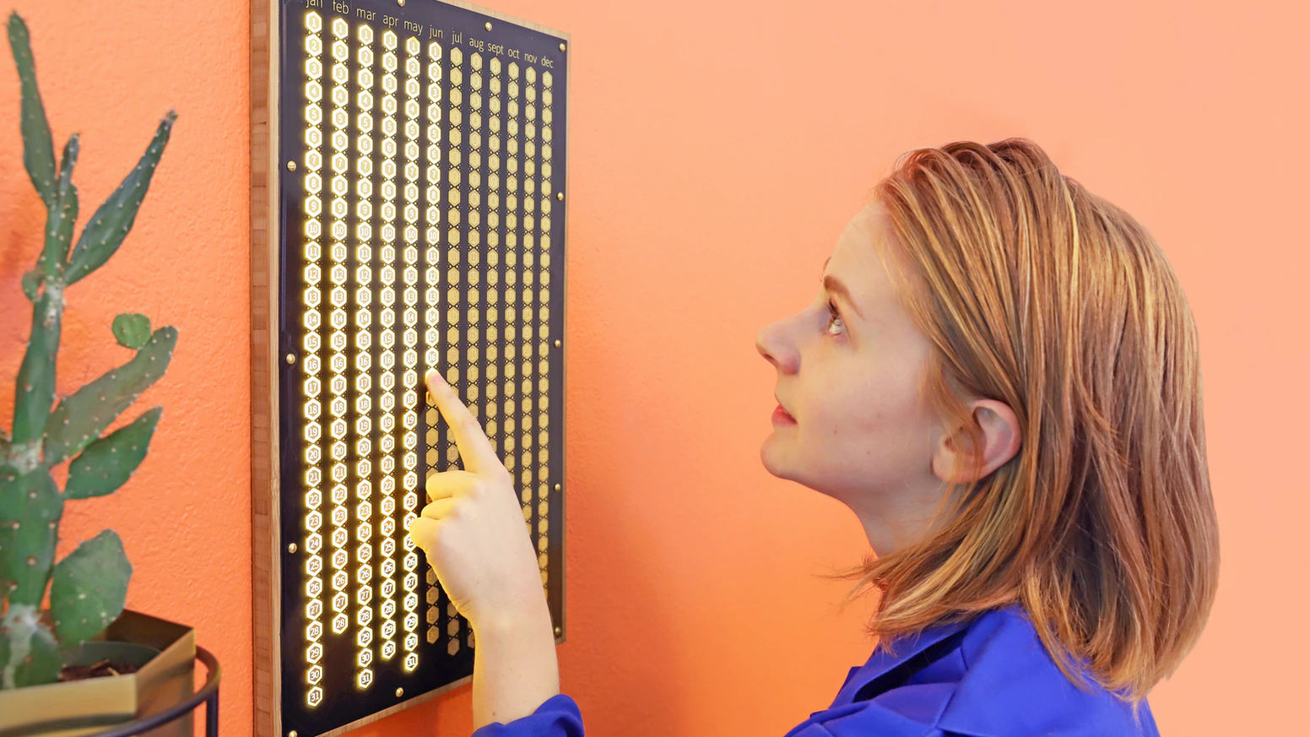
Purpose and Scope
Track tasks you want to do every day
Break habits or create new ones
Giertz, S., 2019, The Every Day Calendar, Kickstarter [online] available at: https://www.kickstarter.com/projects/simonegiertz/the-every-day-calendar/description

Slide 3
Features
Create new tasks to track
Track existing tasks
Delete existing tasks
See task progress visually

Slide 4
Create New Task
Take input and make it lower case
Substitute spaces with ‘_’ and add .txt extension
Check the txt directory for a matching filename
Create a text file with the task name

Slide 5
Track an Existing Task
List text files and make them more human readable
Take input to select task
If user input relates to a task ask if they completed it today or a different day
Take either today’s date from the system or a user inputted date provided it was before today
Check file for an array and if the date already exists
Add the date to the text file and return to menu

Slide 6
Delete an Existing Task
List text files and make them more human readable
Take input to select task
If the input matches a filename, ask user for confirmation
Delete the text file and return to menu

Slide 7
View Task Progress
List text files and make them more human readable
Take input to select task
Convert file contents to an array
Filter out but don’t delete entries not from this year
For each time in a month, print an asterisk
Display how many days the task was completed

Slide 8
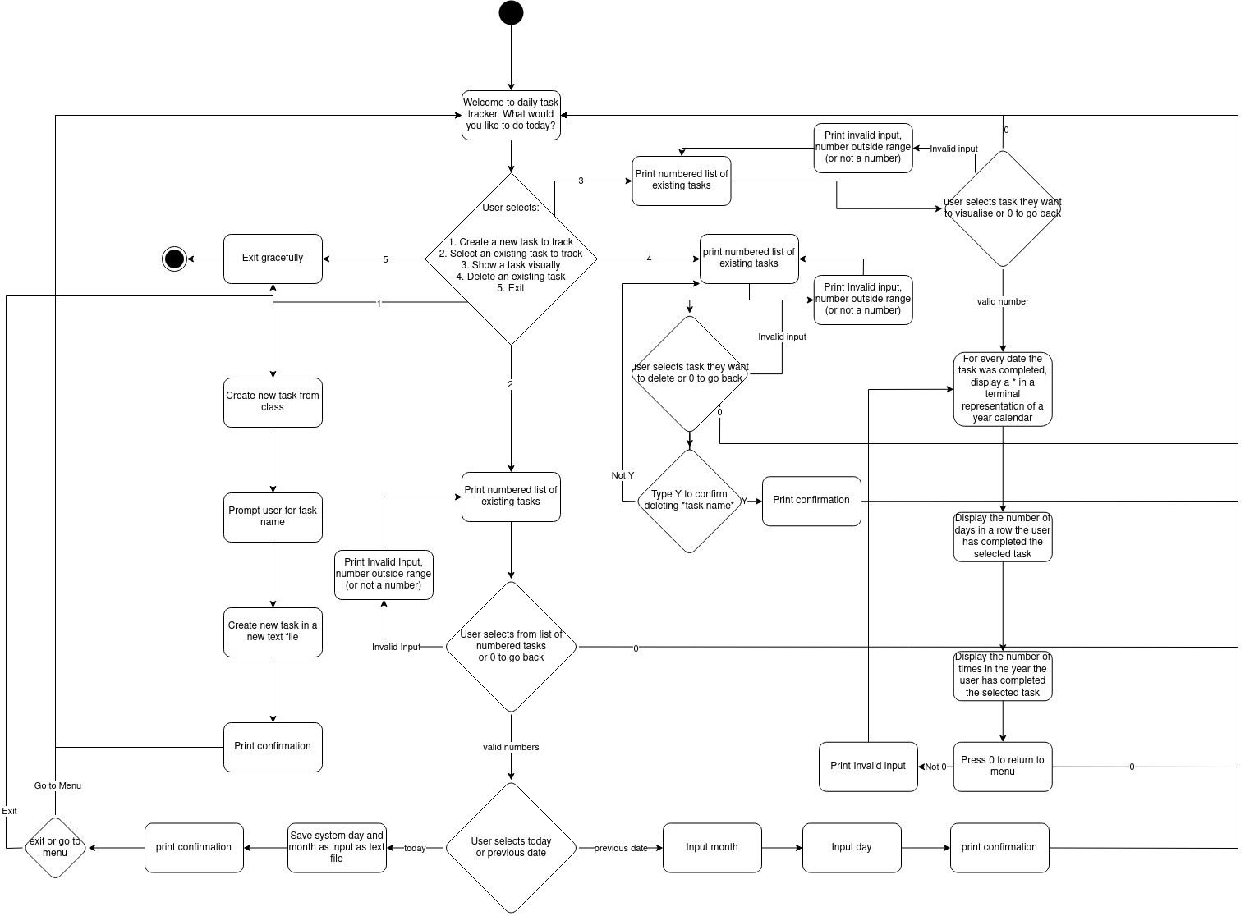

Slide 9
Walkthrough

Slide 10
Development and Build
Revision of modules, methods, classes
Threw it all out
Trello
Testing
Ethical Issues
Next Steps

