Slide 1
Agent-Based Modeling of Emotion-Driven Societies
: Extending Sugarscape with Agent-Zero
: A Mid-Term Progress Presentation
Ankit Mishra
Indian Institute Of Space Science And Technology

Slide 2
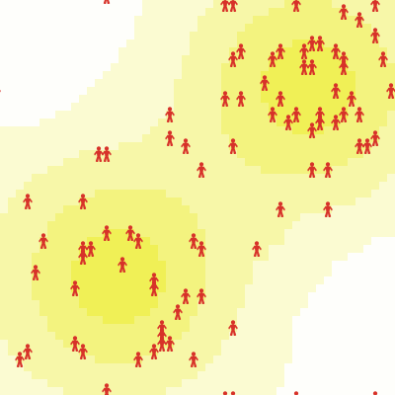
Introduction
What is Sugarscape?
What is Agent_Zero?
Why integrate emotions into Sugarscape?
Current focus: Modeling fear, expanding to other emotions later
Overall goal: Understanding emotional decision-making in societies

Slide 3
Background & Motivation
Why Sugarscape?
Originally designed to model resource distribution, trade, and social dynamics.
Agents move, consume sugar, reproduce, and die → simulates a simple economy.
Why Agent_Zero?
Classical agent models rely purely on rational decision-making.
Agent_Zero introduces neurocognitive and emotional factors in decision-making.
Real societies are influenced by fear, anger, cooperation, trust, etc.
Why Merge the Two?
Societies don’t function purely on logic; emotions shape economic and social behaviors.
Modeling fear-based decision-making first → expands to other emotions later.
Helps explore how emotional agents react to resource scarcity, inequality, and conflicts.

Slide 4
Implementation Approach
Overview of the Model
Emotions in agents ( Fear Modeling )
Mathematical/Formal Representation
Challenges & Considerations

Slide 5
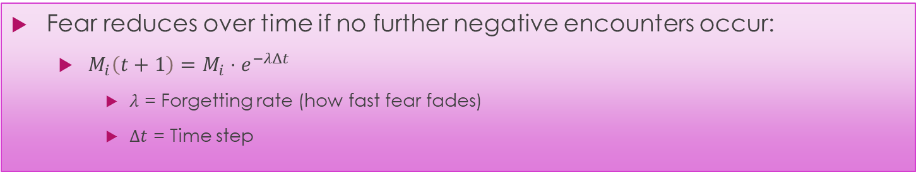
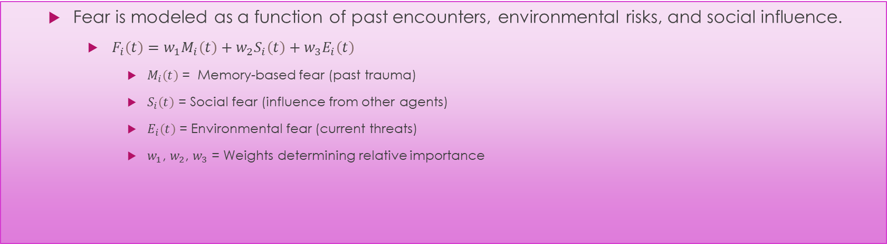
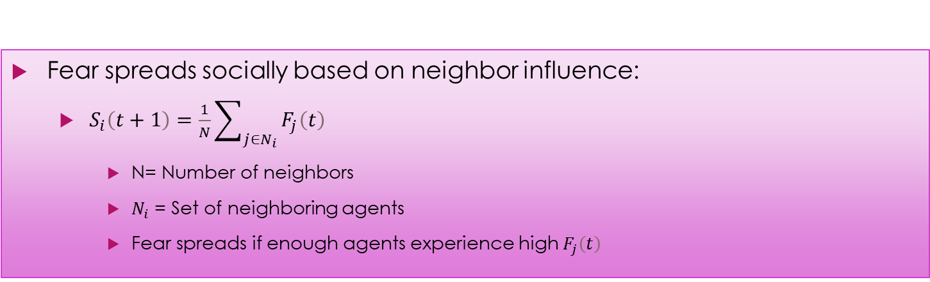
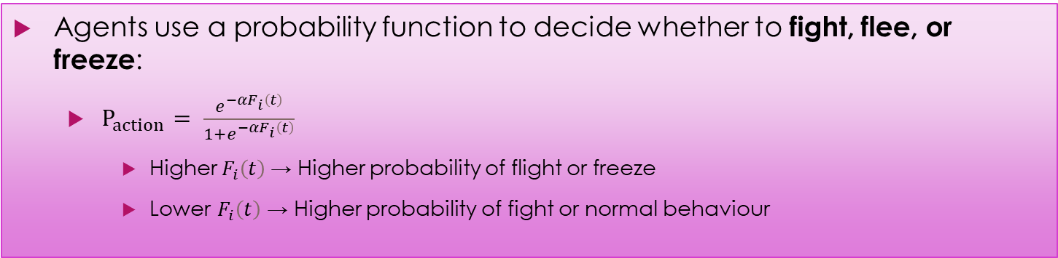
Fear-Based Decision Making
Formalizing Fear in Agents
Fear is modeled as a function of past encounters, environmental risks, and social influence.
$F_{i}\left(t\right)=w_{1}M_{i}\left(t\right)+w_{2}S_{i}\left(t\right)+w_{3}E_{i}\left(t\right)$
$M_{i}\left(t\right)$ = Memory-based fear (past trauma)
$S_{i}\left(t\right)$ = Social fear (influence from other agents)
$E_{i}\left(t\right)$ = Environmental fear (current threats)
$w_{1}$, $w_{2}$, $w_{3}$ = Weights determining relative importance
Memory Decay in Fear Response
Fear reduces over time if no further negative encounters occur:
$M_{i}\left(t+1\right)=M_{i}⋅ⅇ^{−λΔt}$
$λ$ = Forgetting rate (how fast fear fades)
$Δt$ = Time step
Decision-Making Under Fear
Agents use a probability function to decide whether to fight, flee, or freeze:
$P_{action}= \frac{e^{−αF_{i}\left(t\right)}}{1+e^{−αF_{i}\left(t\right)}}$
Higher $F_{i}\left(t\right)$→ Higher probability of flight or freeze
Lower $F_{i}\left(t\right)$ → Higher probability of fight or normal behaviour
Fear Diffusion in Agent Society
Fear spreads socially based on neighbor influence:
$S_{i}\left(t+1\right)=\frac{1}{N}\sum_{j∈N_{i}}{F_{j}\left(t\right)}$
N= Number of neighbors
$N_{i}$ = Set of neighboring agents
Fear spreads if enough agents experience high $F_{j}\left(t\right)$

Slide 6
Environmental & Social Factors
Agent’s surroundings (food availability, threats)
Neighboring agents' emotions (fear spread)
Compute Fear Function F(t)
Fear is updated using:
Memory Decay Equation
Social Influence Equation
Environmental Stimuli
Decision Algorithms
Agent’s past experiences (memory)
Movement Decision → Moves if fear crosses a threshold
Resource Gathering → Collects sugar based on fear & need
Social Influence → Adjusts fear if neighbors are fearful
Agent’s Final Action
Moves to a new position OR stays
Collects resources
Updates emotional state

Slide 7
Algorithms Used in the Model
Algorithm | What It Does | Where Used?
Fear Update Function | Computes an agent's fear based on environment, memory, and peers | Updates emotional state each step
Movement Decision Rule | Agents move probabilistically based on their fear level | Determines agent relocation
Resource Gathering | Agents decide how much sugar to consume/store | Affects survival & economic behavior
Social Influence Model | Agents observe neighbors' fear & adjust their own | Models peer effects on decision-making
Memory Decay Function | Fear memory fades over time (exponential decay) | Long-term adaptation in behavior

Slide 8
Simulation Results – Emergent Behaviors
Agent Responses Under Fear: Bullet points summarizing key behaviors observed
Graphs & Heatmaps: Show patterns of movement, clustering, or behavioral changes
Comparison: How agents behave with and without the fear model
Key Takeaways: Brief points on what the results suggest

Slide 9
Broader Implications & Future Work
Why This Matters? (Real-world relevance)
Expanding Beyond Fear (Introducing other emotions)
Future Improvements (Next steps in refining the model)

Slide 10
Conclusion & Key Takeaways
What We Have Achieved So Far (Summarizing progress)
Key Insights from the Model (Main findings)
Future Directions & Impact (Final thoughts)

