Slide 1

ByteMind - Fake Review Detector
Restoring Trust in Online Shopping with AI
HACKATHON: AWS AI FOR BHARAT
Team: ByteMind (Solo) | Developer: Ankit Kumar Yadav
University: Galgotias University, BCA (Honours with Research) in AI/ML
Notes:
1

Slide 2

The E-commerce Trust Crisis
Online shopping relies heavily on customer reviews, but a significant problem undermines this trust:
Prevalence: 30-40% of online reviews are estimated to be fake.
Financial Impact: This translates to an estimated $152 billion in annual consumer losses globally.
Credibility Erosion: Both consumers and legitimate businesses suffer from this deception.
Pain Points:
Consumers are misled, making poor purchasing decisions.
Authentic businesses lose credibility and sales.
Manual detection is impossible due to the sheer volume of reviews.
Notes:
2

Slide 3





ByteMind: Our AI-Powered Solution
ByteMind leverages advanced AI to combat review fraud, ensuring a more trustworthy online shopping experience.
AI-Powered Detection
Real-Time Analysis
AWS Serverless Architecture
Utilizes sophisticated pattern recognition and Natural Language Processing (NLP) to identify fraudulent reviews.
Delivers near-instantaneous results, processing reviews with less than 100ms response time.
Built on a robust, scalable, and cost-effective cloud infrastructure.
High Accuracy
Easy Integration
Achieves over 80% accuracy in classifying reviews as fake or genuine.
Provides a RESTful API for seamless integration into any e-commerce platform.
Notes:
3

Slide 4

ByteMind: How It Works
User Submits
API Gateway
AI Lambda
Pattern Analysis
Our streamlined, serverless architecture ensures efficient and rapid fake review detection.
Notes:
4

Slide 5

Technology Stack & AWS Services
Cloud Infrastructure (AWS):
AWS Lambda: Serverless compute for automatic scaling and execution.
API Gateway: Manages all incoming RESTful API requests.
CloudWatch: Provides comprehensive monitoring and logging for operational insights.
ByteMind is engineered for performance, scalability, and reliability, leveraging leading technologies and AWS cloud services.
Benefits: Highly cost-effective, infinitely scalable, and ensures 99.9% uptime.
Backend:
Python 3.12
AI/ML Core:
Natural Language Processing (NLP)
Pattern Recognition Algorithms
Regex Analysis
Notes:
5

Slide 6
AI Detection Methodology: Pattern Analysis
ByteMind identifies fake reviews by analyzing a diverse set of linguistic and structural patterns, indicative of deceptive intent.
Excessive Punctuation
Repeated Superlatives
Urgency Language
E.g., "Amazing!!!! Highly recommend!!"
E.g., "Best best product ever."
E.g., "Buy now! Limited time offer!"
Generic Praise
Exaggerated Ratings
Marketing Buzzwords
E.g., "Highly recommend, best ever."
E.g., "5 stars!!!! A masterpiece!"
E.g., "Top quality, unbeatable price."
Suspiciously Perfect
Reviews with no complaints or constructive feedback.
Each detected pattern contributes to a weighted score, culminating in a confidence score (0-100%) and a classification: FAKE vs. GENUINE.
Notes:
6

Slide 7
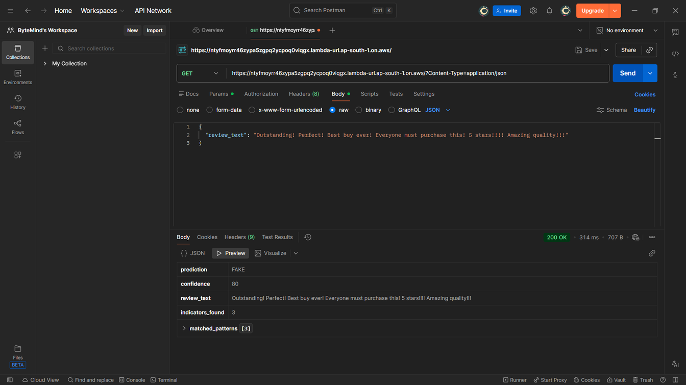
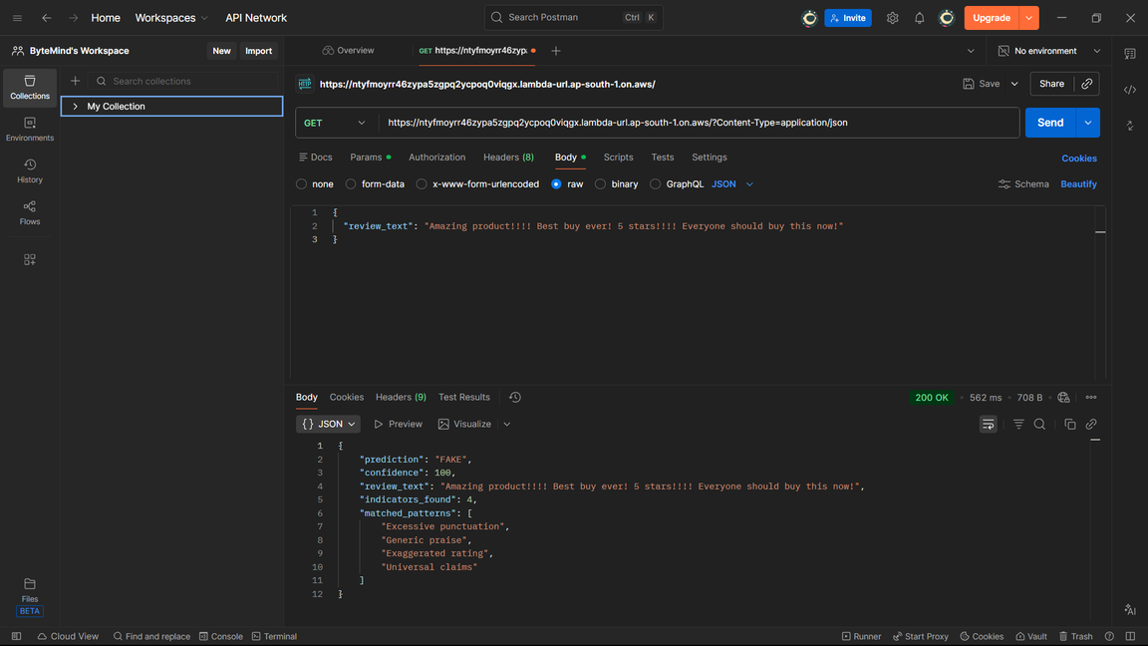
Live Demo: ByteMind API in Action
Witness ByteMind's real-time detection capabilities through Postman API calls.
Genuine Review Detection
Fake Review Detection
Notes:
7

Slide 8
Performance & Real-World Impact
80-85%
<100ms
1000+
$0.20
Accuracy
Response Time
Requests/Second
Cost per Million Requests
High detection rate for identifying fraudulent reviews.
Blazing-fast analysis for real-time applications.
Massive scalability to handle peak e-commerce traffic.
Extremely cost-effective, leveraging AWS serverless efficiency.
99.9%
Uptime
Guaranteed by AWS SLA for continuous operation.
Real-World Applications:
E-commerce Platforms: Amazon, Flipkart, and others for maintaining product integrity.
Review Aggregators: Yelp, TripAdvisor to enhance review credibility.
Consumer Protection Agencies: Tools for identifying and combating deceptive practices.
Business Reputation Management: Helping brands safeguard their online image.
Notes:
8

Slide 9

Current Status & Roadmap
Phase 1: Completed
Production-ready API deployed on AWS.
Real-time detection fully functional.
Pattern-based AI model implemented, tested, and validated.
1
2
Phase 2: Coming Soon 🚀
User-friendly web interface (in development).
Chrome extension for real-time browser detection.
Enhanced ML models (e.g., BERT integration).
Multi-language support (Hindi, regional Indian languages).
Mobile application for on-the-go analysis.
Our journey continues with an ambitious roadmap to expand ByteMind's reach and capabilities.
Notes:
9

Slide 10
Impact & Future Vision
Empowering Consumers: Enables informed purchasing decisions for Indian shoppers.
Protecting Businesses: Safeguards small businesses from the damaging effects of review fraud.
Building Trust: Strengthens the digital commerce ecosystem across India.
Scalable Solution: Ready for pan-India deployment and global expansion.
Future Vision:
To seamlessly integrate ByteMind with major e-commerce platforms, fostering a universally trustworthy online shopping environment across India and beyond.
Developer: Ankit Kumar Yadav | Team: ByteMind | University: Galgotias University
Status: API Live and Available for Testing!
Thank You! Questions?
Notes:
10

