Slide 1
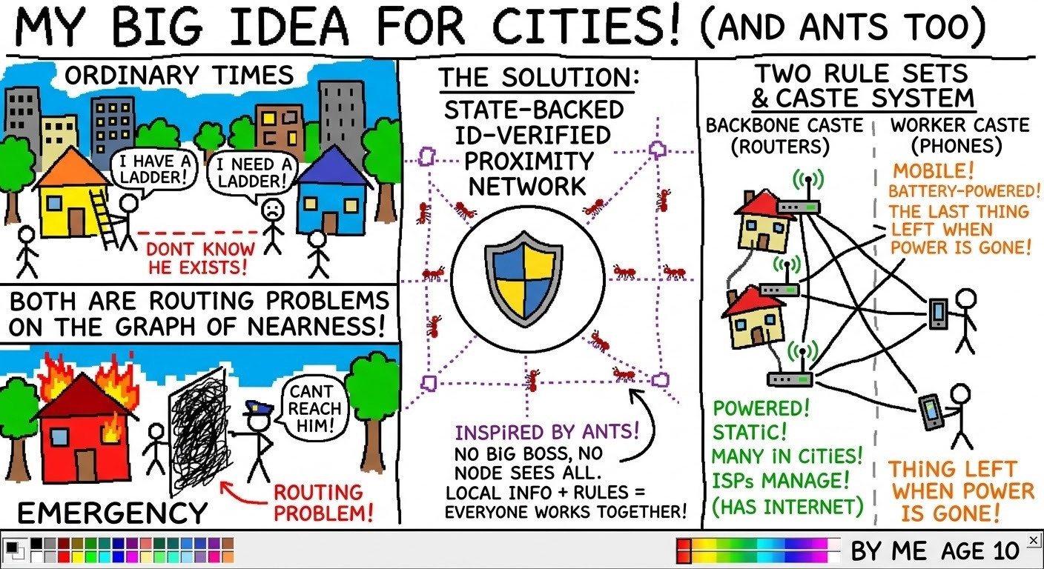
HACKYEAH 2026 · OPEN TASK: SMART CITY
Pomóc
The network that is already there
A dual-use civic mesh: neighbourhood sharing on an ordinary Tuesday, resilient communication on the day the network goes dark.
Team: Apexlab
Members: Vargha Csongor Csaba · Magyar Dániel · Fábi Tamás

Slide 2


THE PROBLEM
Two failures, one root cause
On an ordinary day
On the bad day
Resources sit idle. Nobody nearby knows they exist.
Help sits unreachable. The mobile network is the first thing to fail.
~13 min
~80 m
a drill is used in its whole lifetime
between a cardiac arrest and the AED on the wall
The city already owns what it needs. It is in the wrong pocket.

Slide 3


THE IDEA
One network, one identity, two rule sets
Peace mode
Emergency mode
Borrow a drill, get sour cream next door, hand over a parking spot
Reach is hop-limited (default ~3 hops, configurable): local by protocol, not by policy
Free by default; a fee only when a lender asks one for a loan
Signed official alerts, “I am OK” check-ins, life-critical requests
No operator network needed: home routers mesh over Wi-Fi, phones relay over Bluetooth LE
Fees off, priorities on, store-and-forward on
Runs on what the city already has: phones and ISP routers. Routers are the Wi-Fi mesh backbone, phones the Bluetooth edge.

Slide 4
TARGET SCENARIO · VISION, NOT IN THE SIM
The AED, in ~90 seconds
1
2
3
4
Ola sends a signed LIFE_CRITICAL request with her location attached.
The mesh knows a registered AED ~40 m from Marek.
Everyone else sees the request is taken.
Marek runs it over.
It floods the mesh at top priority, pre-empting everything else.
He is the nearest capable responder and accepts with one tap.
The mesh guides Marek to the AED, then to Ola.
One person moves, the messages did the rest.
Messages travel hop by hop. The object travels with one person.

Slide 5
EMERGENCY MODE
Three levels, one signed declaration
 | L1 Disruption | L2 Disaster | L3 Security
Cause | cell outage, cable cut, cyberattack | flood, storm, blackout | armed attack, hybrid threat
Entered by | automatic (no backhaul) or local authority | local authority declaration | local authority declaration
Router portal | read + check-in | read + check-in + request | read only
Citizen requests | emergency requests: life-critical, safety, “I am OK” | emergency requests: life-critical, safety, “I am OK” | life-critical, safety, “I am OK”; casualty reports sealed to the authorities
Citizen info | on | on | off (rumour control), phones go quiet
Jamming the cells can force L1 at most. Everything above it needs a signature. Portal inputs are aggregated once a minute per router, so the mesh load is bounded by routers, not attackers.

Slide 6
PEACE MODE
Resource sharing within a few hops
Request → neighbours within the hop limit see it → first accepted match closes it
Shared-ownership amortisation: a tool lent for small fees pays itself back
Registered static resources: public AEDs, shelters, water points pinned to the map
Daily OK (opt-in senior care): no phone use for hours or a detected fall → the phone asks “Are you OK?” → the people the senior chose → only then nearest neighbours and 112
Local questions and answers: is the pharmacy open, who has a spare car seat, is the playground flooded
Guard rails: rate limits per identity, reputation, quiet hours, category mutes
Why it matters for the bad day: the app is already installed, the identities already issued, the graph already known
Example request
Cordless drill, Sunday afternoon
2 PLN fee
3 hops
expires 2 h
Matched by Marek, 2 hops away, in ~4 minutes.
No shop trip, no delivery van, one drill working instead of two idle ones.

Slide 7
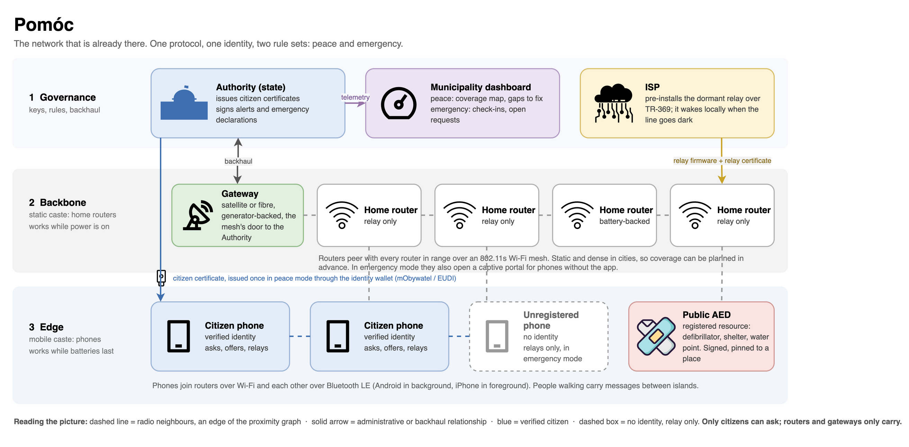
ARCHITECTURE
How the pieces fit together

Slide 8
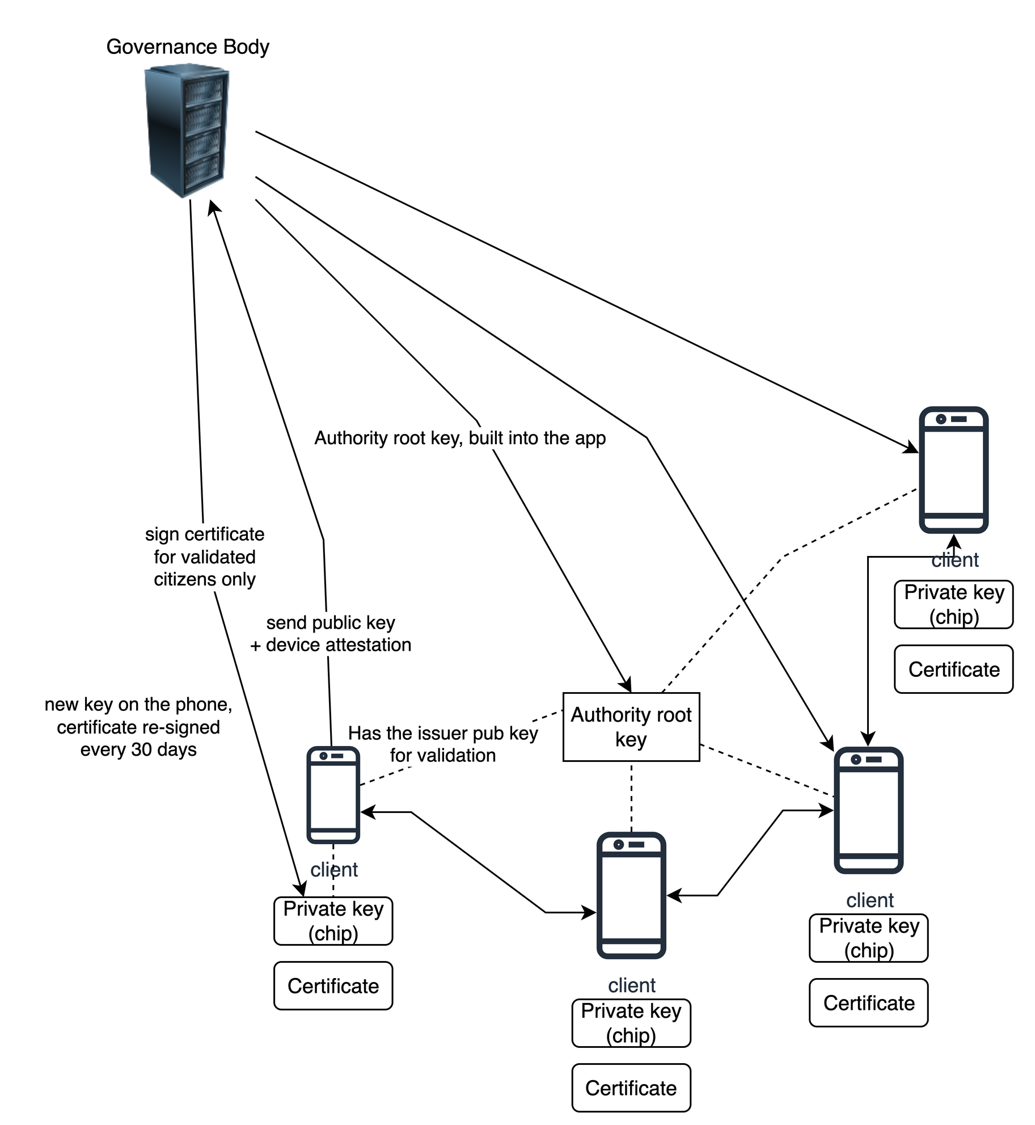
TRUST
Verified people, verifiable offline
Register once through the national identity wallet (mObywatel / EUDI). The key is born in the phone's secure chip and never leaves it; the Authority verifies the person and the device, then signs a citizen certificate.
Every message is signed. Any node verifies it with the Authority root key already in the app. No network needed.
Routers hold relay certificates: they carry, they can never ask. A cryptographic rule, not a policy.
Pseudonymous on the wire. ~30-day keys: the phone makes a new one and the Authority re-signs it, through the mesh when the internet is gone.
Forged alerts die. Local authorities sign declarations for their area with keys under the Authority root; alerts are signed too. Anything unverifiable is dropped at the first hop.

Slide 9
WHAT WE BUILT AT HACKYEAH
A simulation of the protocol on a city graph
Kraków district, static router layer plus mobile phone layer, in one interactive one-pager. Deterministic, playable step by step:
Honest scope
Built: the protocol simulation (modes, levels, flooding, hop limits, TTL, de-duplication, store-and-forward, degradation)
Not simulated: cryptography (a trust flag stands in), topology gossip, rate limits, AED registry and guidance, casualty reports, router portal, Daily OK. Timers are compressed for the demo
Not built: router firmware, identity integration, Authority services
Vision, not in the sim: coverage planning. Phone density shifts by district and over time; the city sees where Pomóc is thin and responds with relay nodes, campaigns or incentives
1
Peace request + match
2
Flooding: hop limit, TTL, dedup
3
Cells down → L1, router backbone
4
Power down → phone-only, store-and-forward
5
L2 west, L3 east: regional declarations
6
Forged request rejected
Live metrics: reach, delivery per class, hops, latency. Set device counts and radio range and see how coverage changes with fewer nodes.
Pomóc is a vision; the simulation is the argument.

Slide 10
WHY IT IS BELIEVABLE
Every piece has been tried. Nobody has combined them.
00000JAPAN and Comcast already flip existing home and public Wi-Fi open in disasters, by remote config
EUDI wallets are mandatory EU-wide: Pomóc would plug into mObywatel in Poland, DÁP in Hungary, any national wallet
Alert RCB is moving into mObywatel; Pomóc is its offline continuation when the cells are down
Japan's Relay-by-Smartphone has tested phone-to-phone message relaying since 2011
Peerby: ~80% of neighbourhood requests filled within ~30 minutes
Standard parts: 802.11s router mesh (OpenWrt), BLE / Wi-Fi Aware, TR-369, PKI with secure-element keys
The point
The first 24 hours. After an attack or disaster, authorities and emergency services need time to respond. Pomóc keeps a communication platform alive in that gap.
Aim: fewer casualties. Life-critical requests, casualty reports with voluntarily shared position, and verified official alerts keep moving without cells or power.
Already in every pocket. Almost no new hardware, no new identity scheme: phones, home routers, a few battery-backed relays and the national EUDI wallet.
No ISP payment. Government-legalised, nonprofit software. ISPs are not paid. The only cost is the gateway servers the governance has to maintain anyway as communication hubs.
Next: open protocol spec · pilot in one district with one ISP · battery-backed relay placement from the coverage model. Concept, research, docs, simulation and this deck were made with AI assistance (Claude Code; title illustration generated with Gemini); the team stands behind all of it.

