Slide 1
HACKYEAH 2026 · OPEN TASK: SMART CITY
Pomóc
The network that is already there
A dual-use civic mesh: neighbourhood resource sharing on an ordinary day, resilient emergency communication when mobile networks and power fail. Same identity, same protocol, same phones and home routers.
home router (static)
phone (mobile)
Notes:
Open with the contrast: the same city, two very different days. Pomóc is the route between a need and a resource.

Slide 2


Cities hold the resources and lose the route to them
An ordinary Tuesday
The day the network goes dark
resources idle because nobody nearby knows
help is nearby but unreachable
Tools, parking spots and skills sit unused next to people who need them
Every small need becomes a trip to a shop
Neighbourhood platforms are centralised and have no reason to work offline
Official warnings (Alert RCB) ride on cellular networks and fail with the cells
Consumer mesh apps are installed after the crisis starts and carry no identity
A stranger's request cannot be verified, so nobody can safely act on it
Both are routing problems on the same graph: who is physically near whom.

Slide 3


One network, one identity, two rule sets
 | Peace mode (default) | Emergency mode
Purpose | Waste reduction, local utilisation | Resilient communication, life-critical routing
Messages | Lend, borrow, give, sell, information | Life-critical, safety, official alerts, “I am OK” check-ins
Payments | Optional micro-payments or credits | Disabled
Reach | Hop-limited: default 3, max 6 | 6 to 15 hops by level, store-and-forward
Transport | Peers over mesh, internet only to authorities | Router mesh, then phone-only mesh
Trigger | Default | Backhaul loss (L1) or signed declaration
Routers: backbone
Static, powered, dense in cities, already remotely managed by ISPs. Relay only.
Phones: workers
Mobile and battery-powered: the only thing left when the power goes. Ask, offer, relay.
Why the state: only a state can verify identity, enable ISP relays and sign declarations everyone accepts.
Inspired by an ant colony: no node sees the whole, each acts on local information, coordination emerges.
Notes:
Emphasise: the state is the operator. That is what makes identity, router capability and emergency legitimacy possible.

Slide 4
When the network dies, the crowd keeps routing
0 Everything up
1 Cells down, power up
2 Power down
3 Gateways bridge
Peace mode. Mesh runs in parallel.
Router backbone carries traffic; captive portal for phones without the app.
Phone-only mesh for hours. People walking carry messages between islands.
Satellite or generator-backed sites link islands to the Authority.
Scenario (illustrative): cardiac arrest, the nearest public AED is 4 hops away
1
2
3
4
5
Ola's phone sends a signed LIFE_CRITICAL request at top priority
Mesh floods it with de-duplication, pre-empting every other class
The citizen nearest the registered AED accepts: “fetching AED”
Per-hop instructions move the AED hand to hand along the found path
Assumed outcome: AED arrives in about 90 s, against about 6 min for staff on site
The network routes the message, the crowd routes the object.
Notes:
90 s vs 6 min are scenario numbers from our AED walkthrough, not measurements.

Slide 5
Emergency policy is a signed, regional preset
 | L1 Disruption | L2 Disaster | L3 Security
Typical cause | Cell outage, cable cut, cyberattack | Flood, storm, long blackout | Terror, war, hybrid attack
Entered by | Local automation or declaration | Declaration only | Declaration only
Router portal | Read + check-in, aggregated | + structured request, flagged unverified | Read only, one-way
Citizen classes | Life-critical, safety, check-in, info, free give | Same as L1 | Life-critical, safety, check-in. Info off
Hop limit | 10 | 15 | 6
Phone topology gossip | On | On | Off
Radio emission | Normal | Normal | Reduced duty cycle
Built to resist abuse
Jamming gains nothing. Local automation reaches L1 at most; L2 and L3 need an Authority signature.
Mesh load is bounded. A router emits at most one signed PORTAL_SUMMARY per minute, so load scales with routers, not attackers.
L3 is stricter. Citizen INFO off stops rumours; phone gossip off hides where people are.
Declarations are regional (one district at L3, the rest at L2). Downgrades need a signed all-clear or expiry; L3 always steps down through L1.

Slide 6



Peacetime is why it is installed before the crisis
Everyday value
A reason to keep it
Value for the city
Borrow a drill, get sour cream from a neighbour, hand over a parking spot
Hop limit 3 keeps it hyperlocal by protocol
Optional credits: a tool pays itself back through community use
Verified neighbours make lending to strangers safe
Bounded notifications: quiet hours, mutes, hop caps
AED, EpiPen and insulin requests work in peace too
Peerby reports about 80% of requests filled within 30 minutes
Predictable graph: coverage gaps, articulation points, percolation threshold
Shows where battery-backed relays or gateways belong
Open data per district: transactions, waste avoided
Same identity, same graph, same protocol: the peacetime habit becomes the emergency capability.
Notes:
Peerby figure is from published coverage of Peerby (see prior-art.md). Adoption at disaster time is too late: Bridgefy spikes only after the crisis starts.

Slide 7
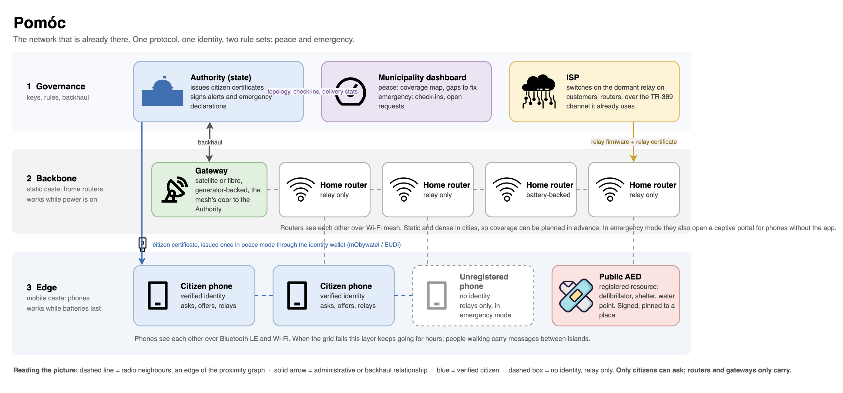
Architecture: citizens ask, routers and gateways carry

Slide 8
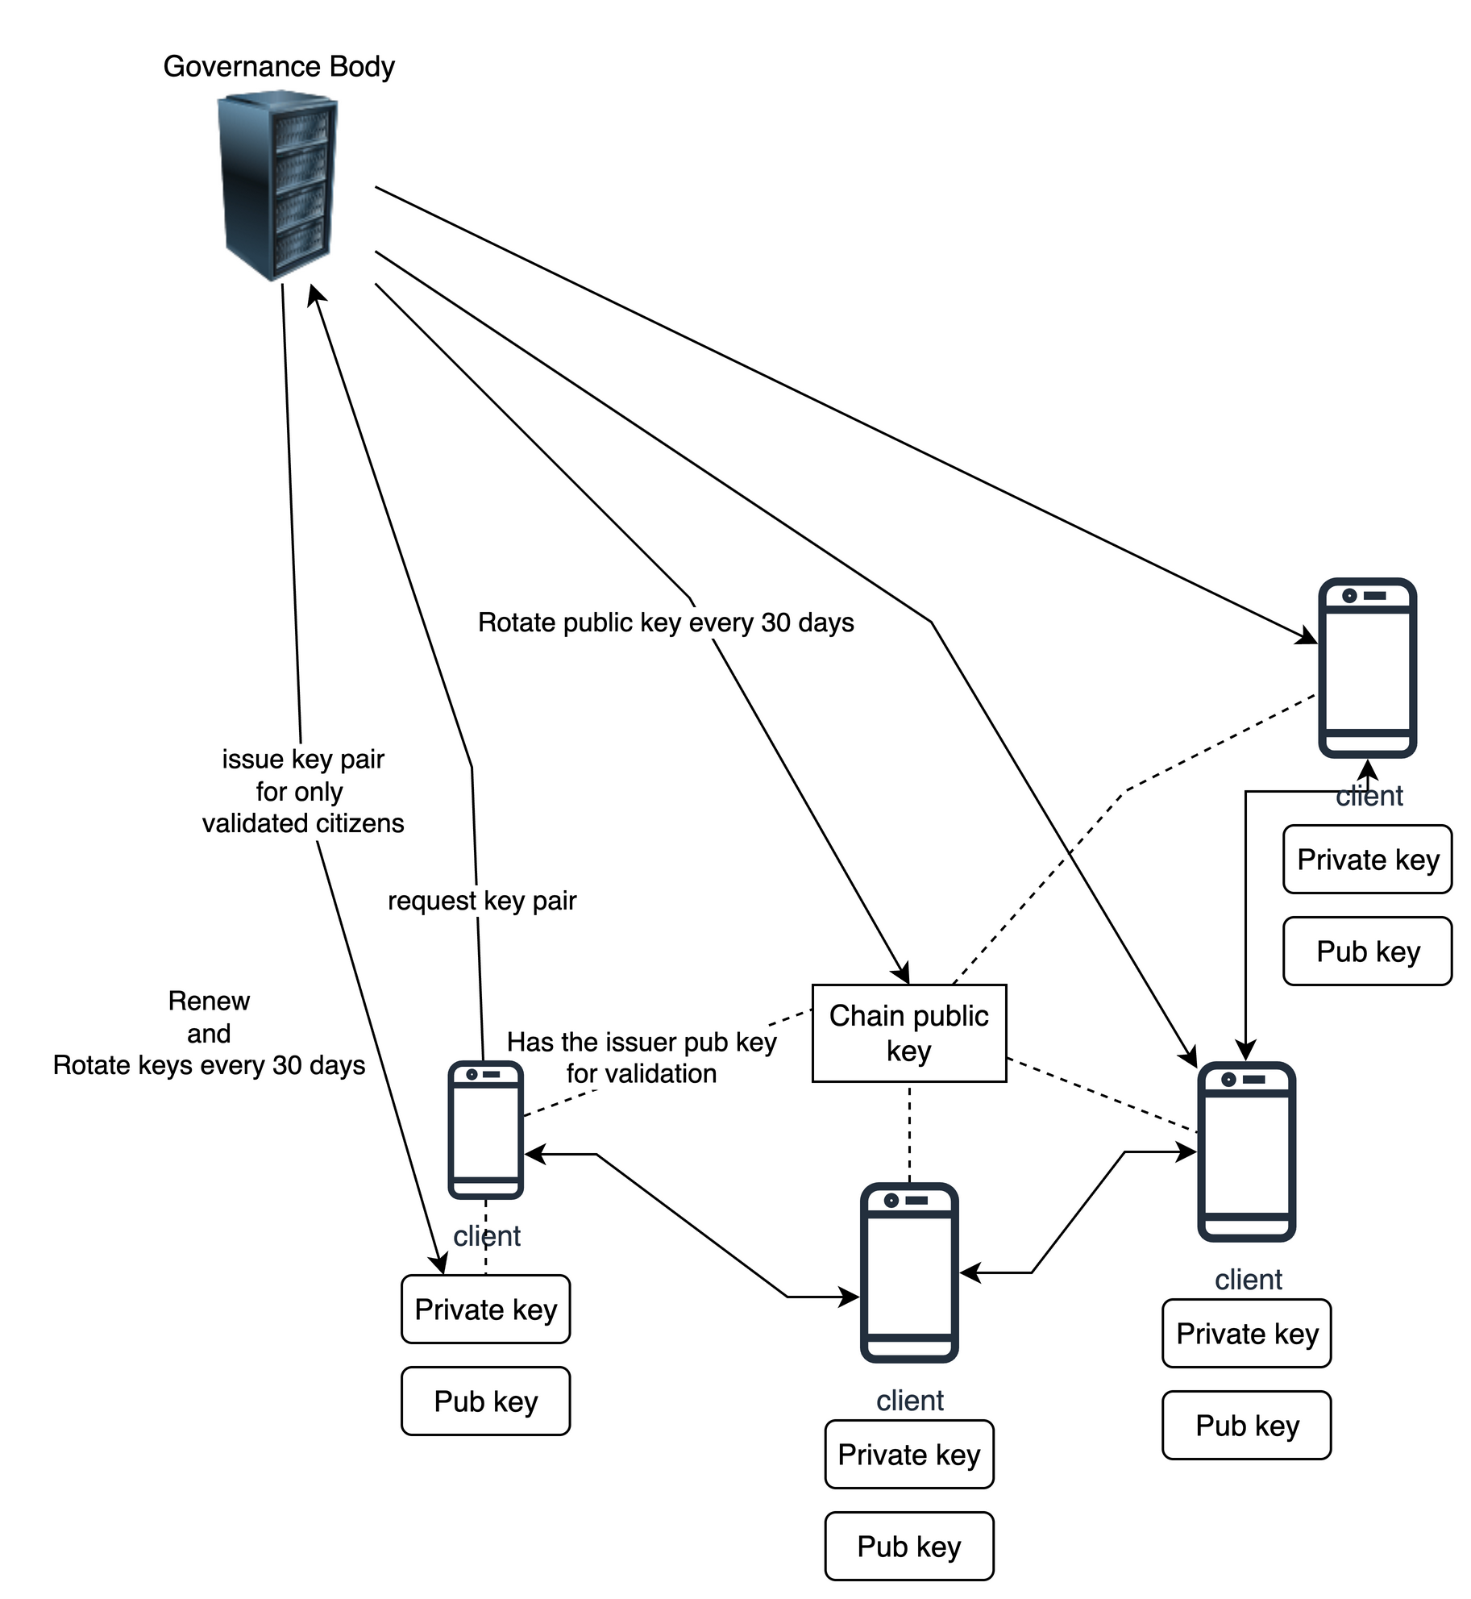
Trust model: verify anything, offline
Issuer-generated keys. The Authority HSM issues key pair and certificate after wallet-verified registration, wrapped to the phone's secure element.
Offline verification. Any node checks any message against the Authority root key embedded in the app. No network round trip.
“Routers cannot act” is cryptographic. Relay certificates grant forwarding only; a request signed by one is dropped everywhere.
Forged alerts die. Declarations and alerts use separate Authority keys; unverifiable ones are dropped by every node.
Short-lived. Target 30-day keys renewed silently, over the mesh when offline; target 90-day emergency grace so an outage never locks anyone out.
Honest trade-off. The Authority could impersonate citizens. Bounded by no key retention, k-of-n escrow, dual-control HSMs and a public transparency log.
Illustrative key flow; keys live in the phone secure element.

Slide 9
Technical feasibility: every block has a precedent
Block | What we rely on | Closest precedent
Router relay | ISP remote management (TR-069 / TR-369) on OpenWrt, prplOS, RDK-B | 00000JAPAN since 2014; Comcast opened 141k to 261k hotspots before hurricanes
Phone mesh | BLE and Wi-Fi Aware / Direct; messages sized for one BLE advertisement (target 240 B) | Relay-by-Smartphone (Tohoku), Bridgefy 12M+ users, bitchat
Offline trust | ed25519 signatures, certificate chain against embedded root, secure-element keys | Standard PKI, HSMs, Android Keystore / iOS Secure Enclave
Identity | National identity wallet: mObywatel, EUDI wallet | Alert RCB, announced move into mObywatel (2025)
Alerts | CAP payload so existing origination tools feed the mesh | Regulatory basis: EECC Article 110 warning systems
Hard parts and mitigations
OS background limits: permissions requested in peace; app must earn its place
Battery: adaptive duty cycle, target 8 h from 50%
Flooding: signed, rate-limited, portal aggregated
Privacy: pseudonyms, hop distance not GPS, L3 gossip off
Consent: published regulation, customer opt-out, relay isolated from home LAN
Residual risk: iOS background BLE limits, ISP and regulator uptake, trust in a single issuer
Design target (NFR-RES-07), not yet measured: with 20% router participation, an official alert reaches 95% of connected nodes within 5 minutes (cells down, power up).

Slide 10
Dual use is not new; the combination is
 | Consumer mesh apps | LoRa meshes | Hotspot opening | Street-light paper | Peerby | Pomóc
Works without backhaul | Yes | Yes | No | Partly | No | Yes
Works without grid power | Yes | Battery | No | No | No | Yes (phones)
Uses deployed hardware | Phones | No | Yes | No | n/a | Phones + routers
Verified identity | No | No | No | No | Platform | State, offline
Reason to install pre-crisis | No | No | n/a | Yes | Yes | Yes
Alerts verifiable offline | No | No | No | No | No | Yes
Proposed path to pilot
1
Simulation
protocol, both modes, coverage view
2
District pilot
one ISP, volunteers, a drill declaration
3
Regulation + wallet
mObywatel module, open specification
Dual use is not new: Meuser et al. 2019 (street lights) and Peerby show it. To our knowledge, nothing combines state identity, a router + phone backbone and offline-verifiable alerts. Hotspot opening: 00000JAPAN, Xfinity.
Scope and disclosure. Done: concept, requirements and diagrams (prepared 3 Oct). Not built: code, simulation or demo; the protocol simulation is planned. Concept, research, documentation and this deck were developed with AI assistance (Claude Code); the team answers for all of it. Sources: docs/prior-art.md in the repository; Meuser et al. 2019 (arXiv 1908.10233); Comcast press releases 2022 and 2023; 00000JAPAN (SoftBank, Access Network); Peerby (TechCrunch 2013); Bridgefy; Alert RCB / mObywatel announcements 2025.

