Slide 1
Filesystem

Slide 2
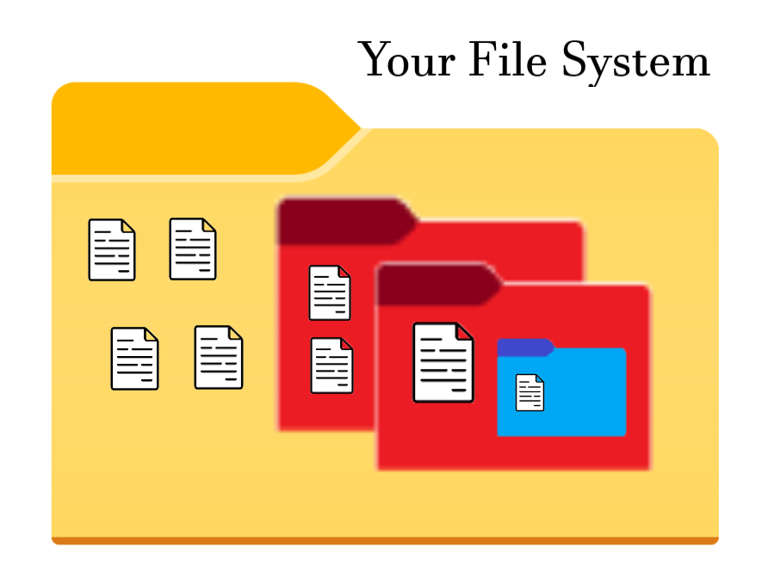
This is your file system on your computer.
You can think of it as basically one giant folder that can hold multiple nested files and folders.

Slide 3
Terms you should understand:
Folder: A folder is a container. It can contain multiples files and folders. Folders are also known as directories.
File: A file is a general document. It contains content and data such as text files, word documents, pictures, binaries, etc.

Slide 4
The outermost folder which contains everything else is called the “root” folder.
There is only one “root” folder in your filesystem even among different users using the same computer.
Beyond that, there is nothing else. Nothing but the void…
The root folder is the starting point for all files on a computer and also contains necessary folders and files for the operating system to run, boot up, etc.
Root is also represented with the “/” (slash) symbol.
I AM ROOT

Slide 5
To navigate your system, understand that your filesystem is arranged in a tree structure.
First, we start with root. The starting point of all files and folders.
Root

Slide 6
Root
These are folders within the root folder. There are many more of course.
Users
Program Files
temp

Slide 7
The Users folder has two folders within it.
The Program Files folder has three.
The temp folder is empty.
And then those next level of folders can have more folder and files in them, and so on.
If you flip the diagram upside down, it forms a tree shape.
Root
Users
Program Files
temp
Public
misteruser
Python
MySQL
Windows

Slide 8
Root
You want to run your hello world.py Python file. Where is it located? What is the filepath?
Users
Program Files
temp
Hello world.py
Public
misteruser
Python
MySQL
Windows

Slide 9
Start here!
Start at root and follow the path to the file.
Root
Users
Misteruser
Hello world.py (File)
Root
Users
Program Files
temp
So the file path is:
/Users/misteruser/hello world.py
Hello world.py
Public
misteruser
Python
MySQL
Windows

Slide 10
Start here!
Terminology:
Path: Path describes the location of a file or folder. Each folder we step through is separated by a “/” (slash) symbol.
There are two types of path we can describe. Absolute path and relative path.
Root
Users
Program Files
temp
Hello world.py
Public
misteruser
Python
MySQL
Windows

Slide 11
Absolute path:
Absolute means the full path, so it must start at root. Root is represented with a “/” (slash) symbol at the start of the path.
/Users/misteruser/hello world.py
Start here!
Root
Users
Program Files
temp
Public
Hello world.py
Python
MySQL
misteruser
Windows
Root
Start here!
Relative path:
Relative means in relation or depending on your current location in the filesystem and that will be the starting point. Since it does not start at root, the initial “/” (slash) is omitted.
misteruser/hello world.py
Users
Program Files
temp
Hello world.py
Public
misteruser
Python
MySQL
Windows

Slide 12
You will also see “.” (periods) and “..” (double periods) in paths.
A single period is short way of representing the current directory we are working in.
A double period is a short way of representing the previous directory.
What is the directory of this single period in this path?
./misterusers/hello world.py
What is the directory of this double period in this path?
../Users/misterusers/hello world.py
Root
Users
Program Files
temp
Public
Hello world.py
Python
MySQL
misteruser
Windows

Slide 13
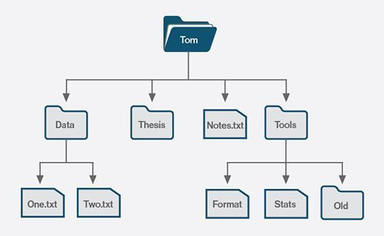
As long as you are aware of where you are in your file system, you will never be lost.
Name and organize your files and folders appropriately. Make logical groups. Use consistent naming conventions. Look up advice and common tips and tricks.

