Slide 1
SQL

Slide 2
What is SQL?
SQL stands for Structured Query Language.
Programming language used to manage data stored in relational databases.
MySQL, MS Access, SQL Server, Oracle, Sybase, Informix, Postgres etc.
Developed in 1970s by IBM computer scientists.

Slide 3
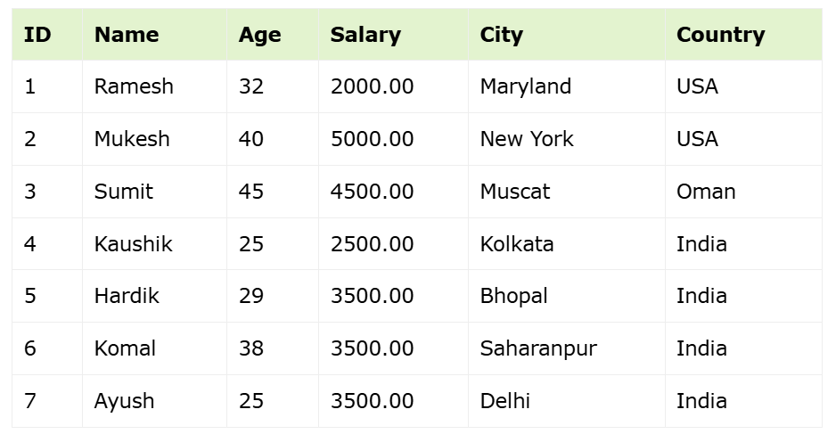
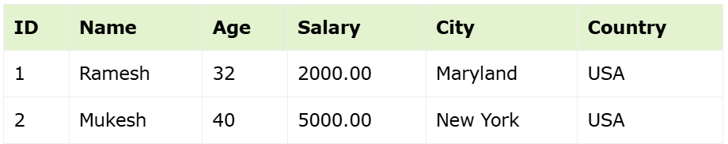
SQL Example
Customers Table
SELECT * FROM CUSTOMERS WHERE country = 'USA';

Slide 4
DML (Data Manipulation Language)
Adding, deleting, modifying data in a database.
SELECT – Retrieves record(s) from one or more tables*
INSERT – Creates new record(s)
UPDATE – Modifies existing record(s)
DELETE – Deletes record(s)
CRUD (Create, Read, Update, Delete)

Slide 5
DDL (Data Definition Language)
Create and modify the structure of database objects (tables, views, schemas, indexes etc.)
CREATE – Creates a new table, view, or other object in the database.
ALTER – Modifies an existing database object, such as a table.
DROP - Deletes an entire table, view, or other objects in the database.
TRUNCATE – Deletes all the data in the table.
SELECT – Retrieves record(s) from one or more tables*

Slide 6
DCL (Data Control Language)
Control access to data stored in a database.
GRANT – Gives a privilege to user
REVOKE – Takes back privileges granted from user

Slide 7
Why SQL?
Database systems are responsible for the storage and management of data for many software applications.
Uber’s database system is estimated to be over 100 petabytes. (1 petabyte = 1024 terabytes, 100 petabytes can hold approx. 20 billion images)
YouTube sends and receive approx. 440,000 TB of data per day.
Database systems implement search algorithms, performance enhancements, and other features useful for navigating large data.
Database systems allows us to organize and visualize our data.
Not really a prerequisite for AI, but a basic understanding is important for anyone learning AI.
Average salary of database administrator with less than 1 year experience is $108,500* (7 years, $142,959)
Career Paths: Database Administrator (DBA), Database Developer, Database Tester, Data Scientist, ETL Developer, Database Migration Expert, Cloud Database Expert etc.

Slide 8
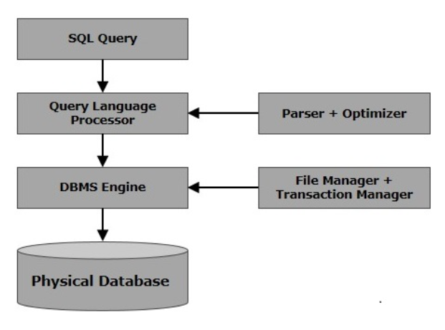

Slide 9
RDBMS
Relational Database Management System
Database management system based on the relational model by E. F. Codd in 1970.
MS SQL Server, IBM DB2, Oracle, MySQL, Microsoft Access

Slide 10
Table
Database object that stores data in tabular format (columns and rows)

Slide 11
Field
Columns
Attributes or specific information for every record in the table

Slide 12
Record
Rows
A record represents one data object or one entity

Slide 13
NULL
A value in a field that appears to be blank
Field has no value
Not the same as zero or an empty string with spaces

Slide 14
Constraints
Rules enforced on data columns or table
Limit the type of data
Ensure accuracy and reliability
Examples
NOT NULL
DEFAULT
UNIQUE
PRIMARY
FOREIGN
CHECK
INDEX

Slide 15
Data Integrity
Entity Integrity – No duplicate rows in a table
Domain Integrity – Enforce valid entries by restricting type, format, range of values

