Slide 1
SQL
Work in progress…

Slide 2
What is SQL?
SQL stands for Structured Query Language.
It is the programming language used to manage data stored in relational databases.
MySQL, MS Access, SQL Server, Oracle, Sybase, Informix, Postgres etc.
Developed in 1970s by IBM computer scientists.

Slide 3
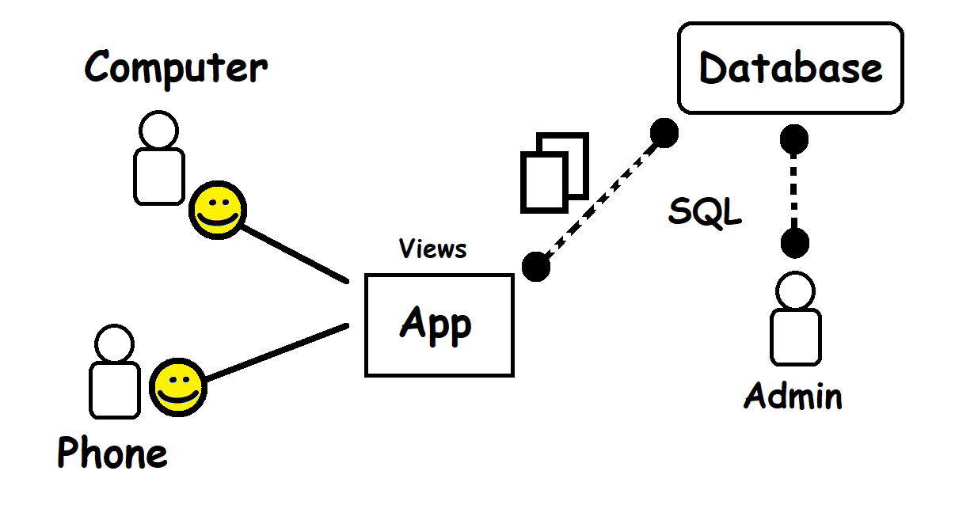

Slide 4
Why SQL?
Database systems are responsible for the storage and management of data for many software applications.
Uber’s database system is estimated to be over 100 petabytes. (1 petabyte = 1024 terabytes, 100 petabytes can hold approx. 20 billion images)
YouTube sends and receive approx. 440,000 TB of data per day.
Database systems implement search algorithms, performance enhancements, and other features useful for navigating large data.
Flexibility – DDL shared between DBMS
Consistency – Data remains consistent
Redundancy – Reduced
Optimized Performance – Memory usage, storage costs, processing speed
Compatability – to other technologies
Scalability – adapting to load
Database systems allows us to organize and visualize our data.
Not really a prerequisite for AI, but a basic understanding is important for anyone learning AI.
Average salary of database administrator with less than 1 year experience is $108,500* (7 years, $142,959)
Career Paths: Database Administrator (DBA), Database Developer, Database Tester, Data Scientist, ETL Developer, Database Migration Expert, Cloud Database Expert etc.

Slide 5
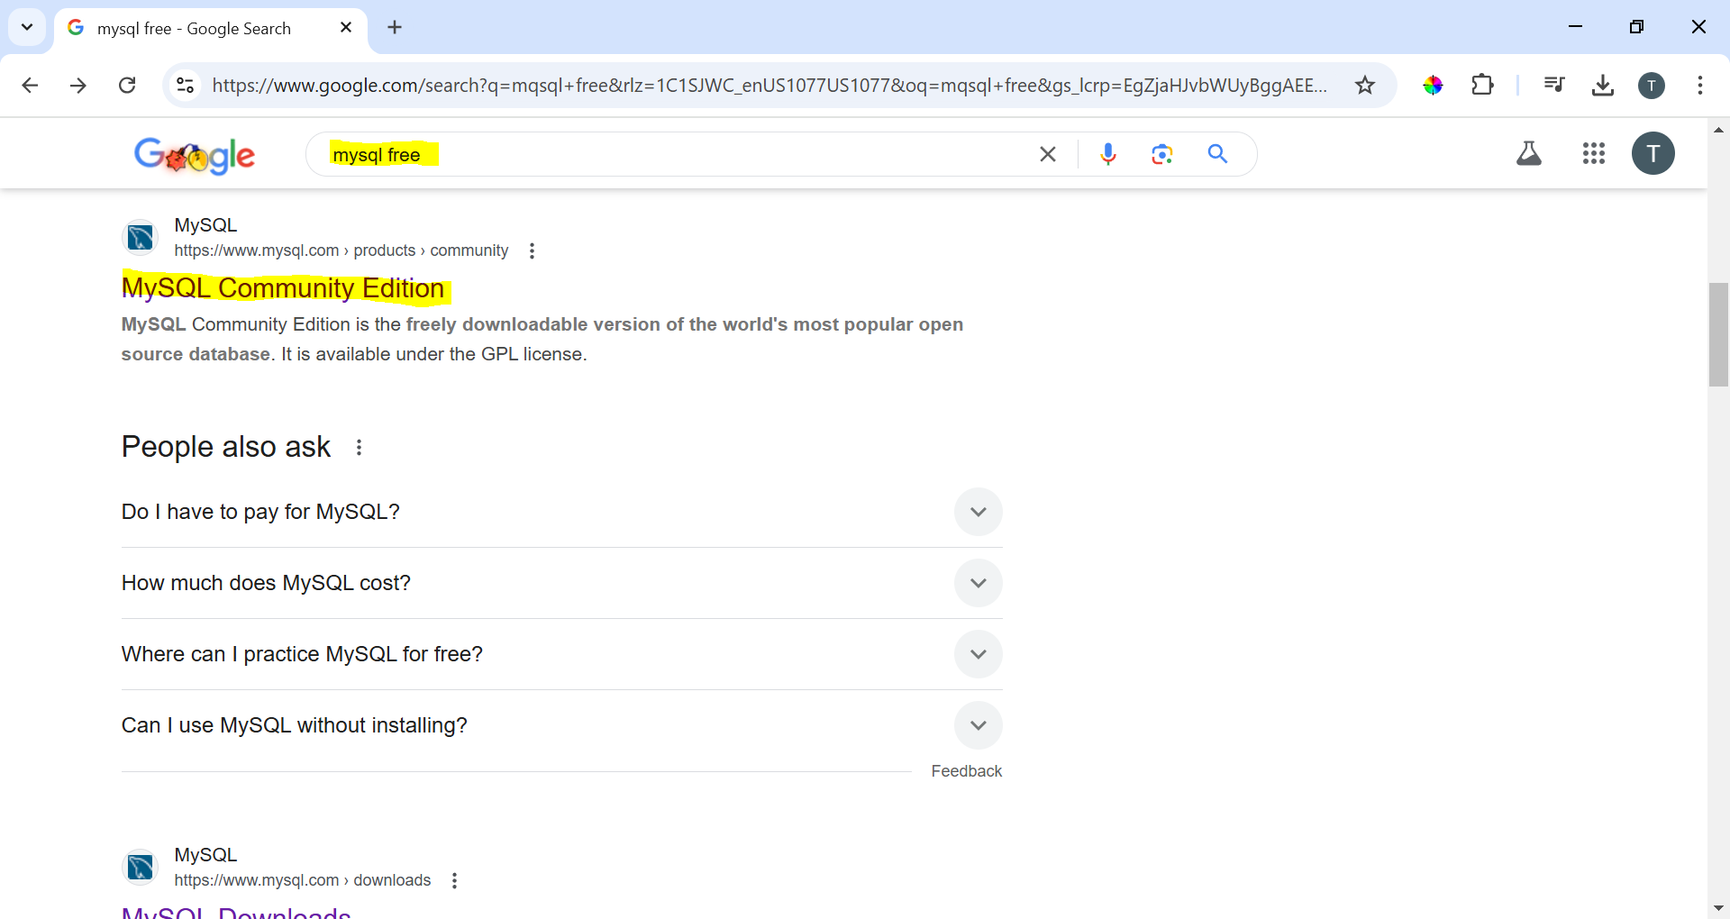
Installation
Look for free stuff first…

Slide 6
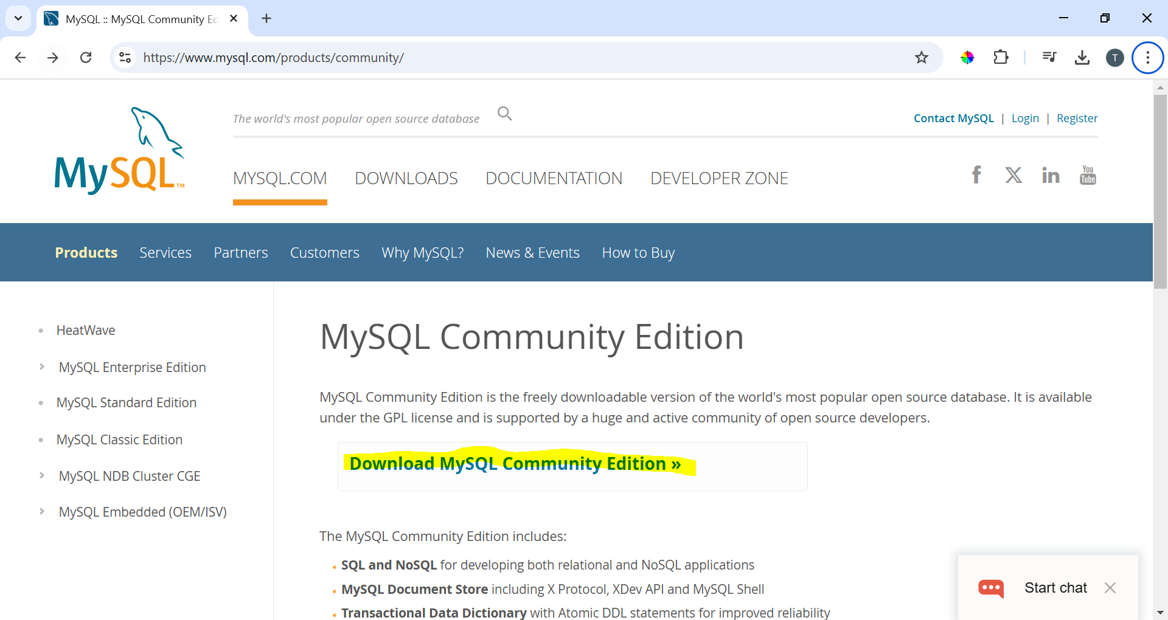
Installation

Slide 7
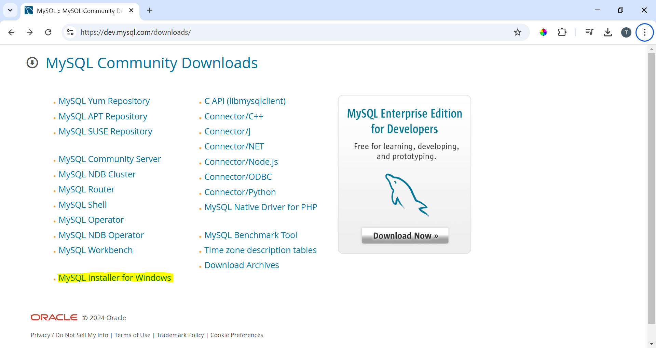
Installation

Slide 8
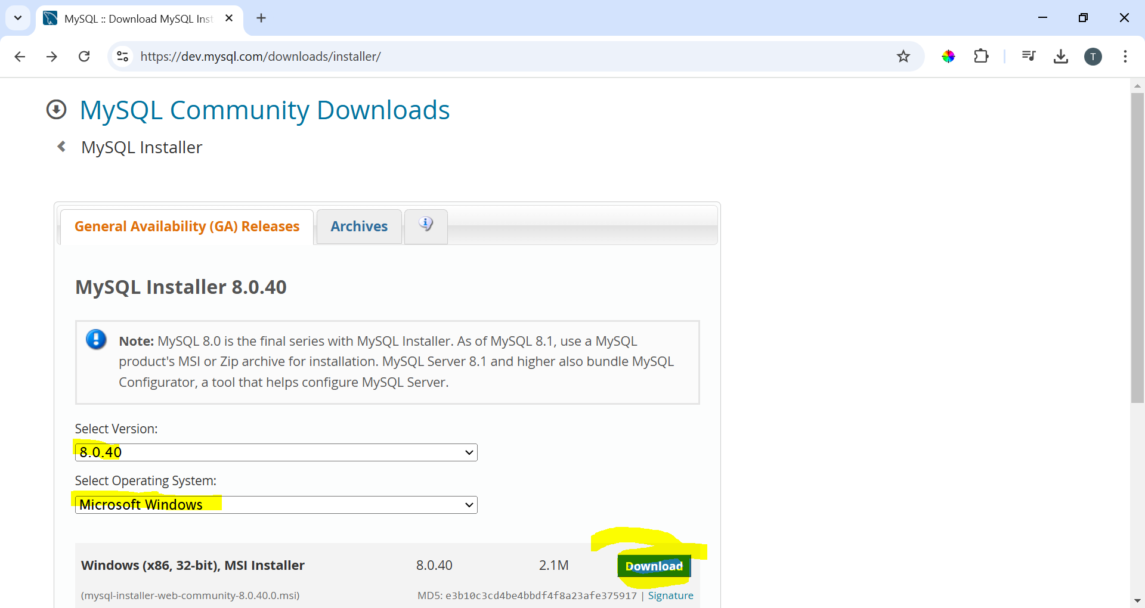
Installation

Slide 9
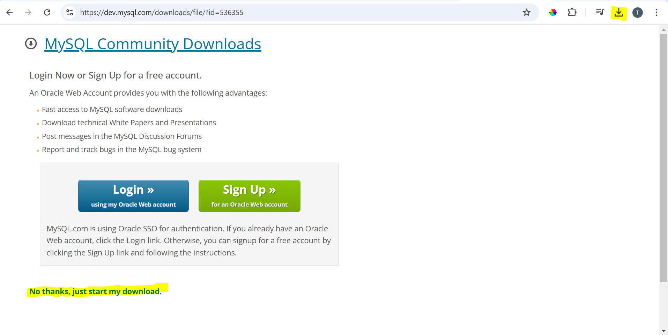
Installation

Slide 10
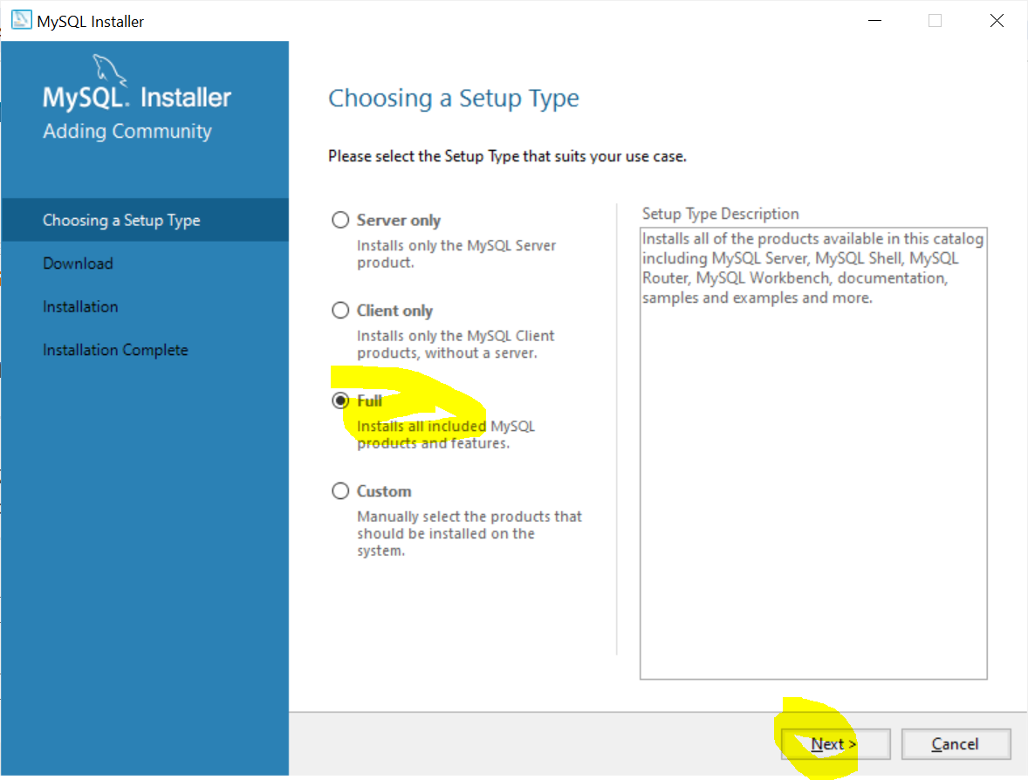
Installation

Slide 11
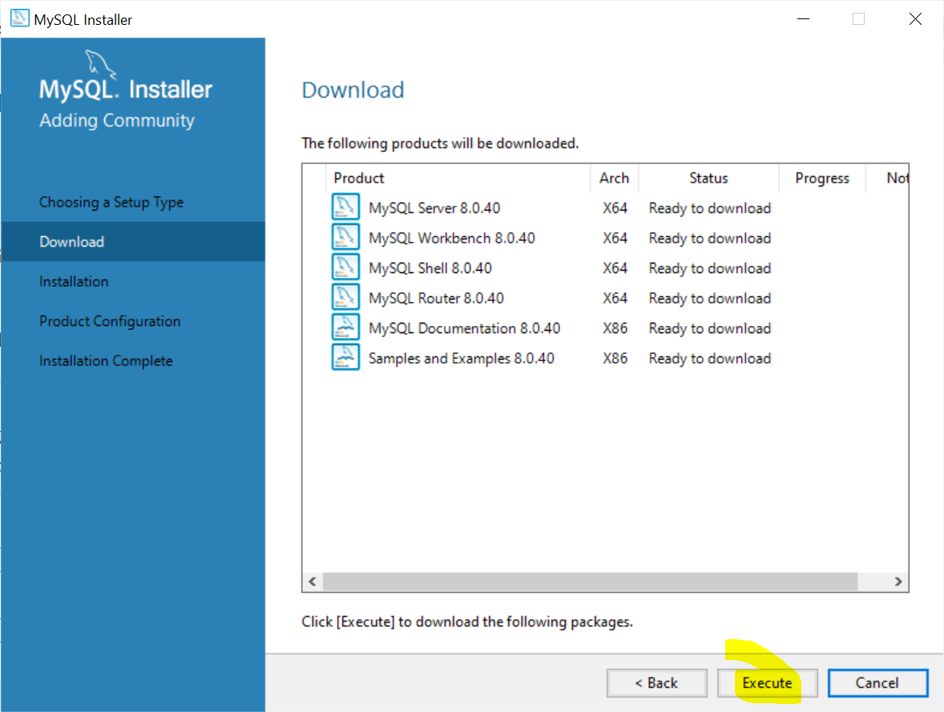
Installation

Slide 12
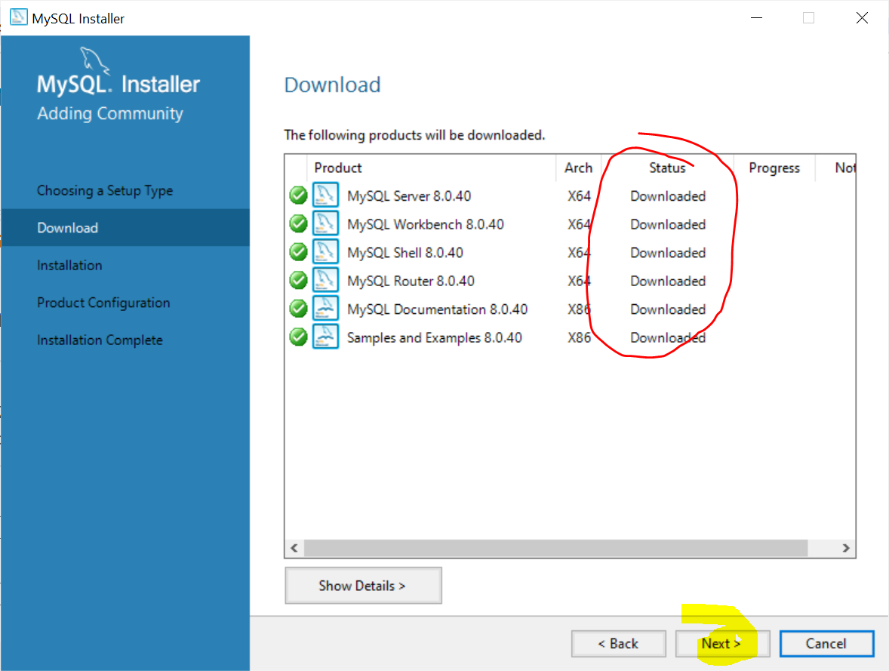
Installation

Slide 13
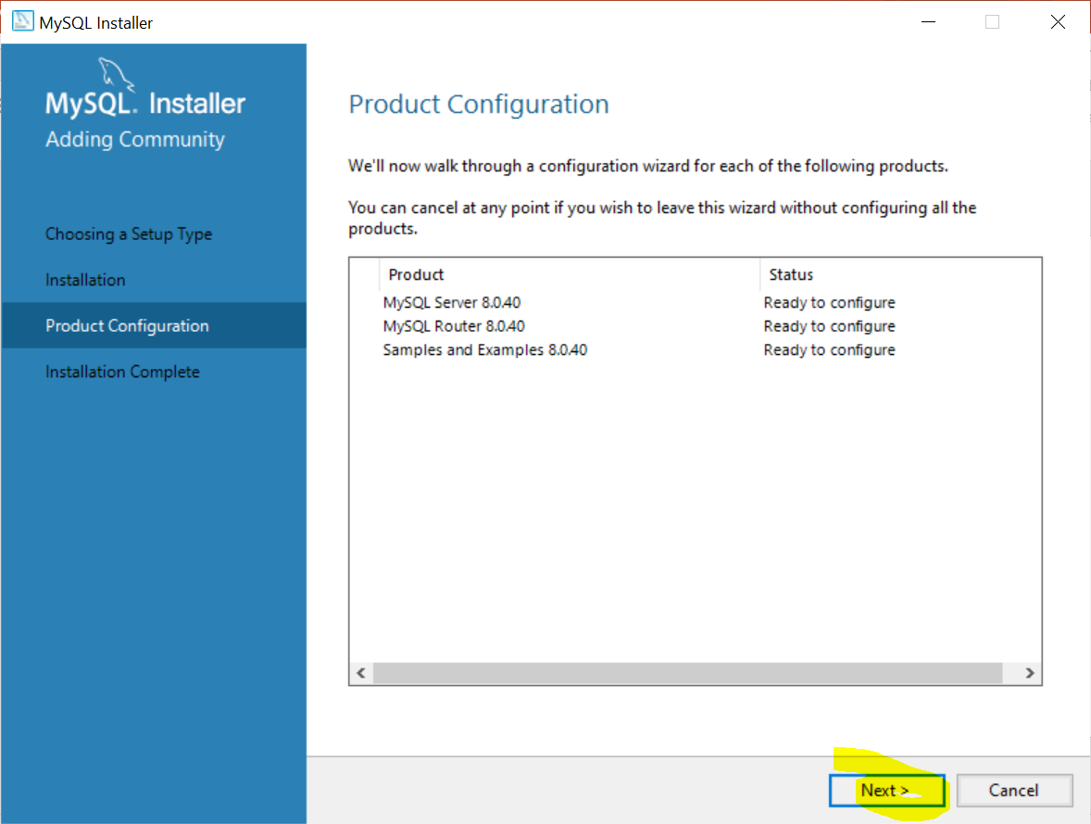
Installation

Slide 14
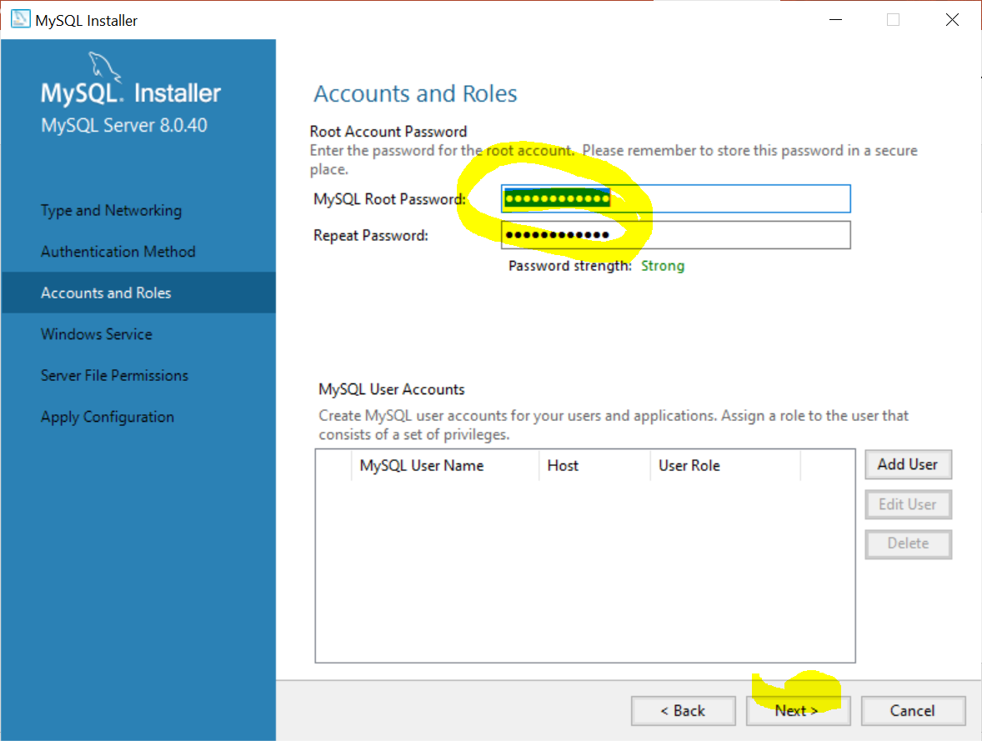
Installation
Keep clicking next/execute until you get to this page. Do not worry about the advanced settings.
This step is important!
Set the password for the root user. You can set an easy password to remember. In real life, this account is the most powerful account having the permission to do anything to the database and therefore the most dangerous and must be secured with a stronger password that needs to be written down somewhere.
Keep hitting next…

Slide 15
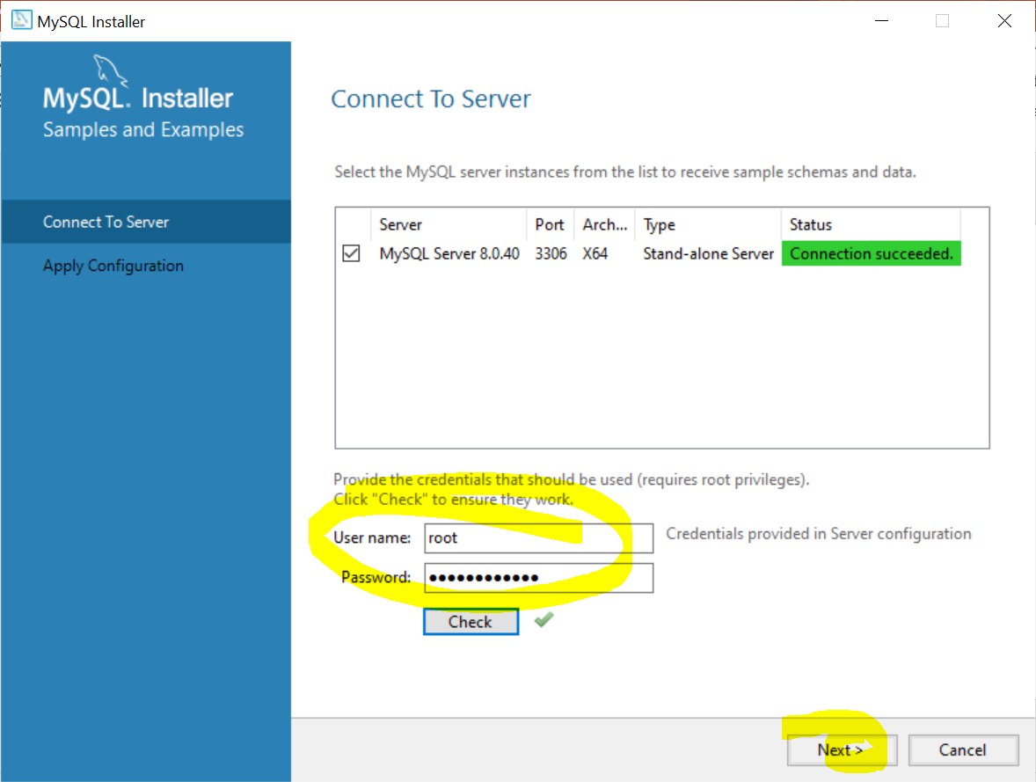
Installation
Test your root password here to continue.
Note the root user is called “root”.
So the username is “root” and the password is whatever you entered.
Keep hitting next…

Slide 16
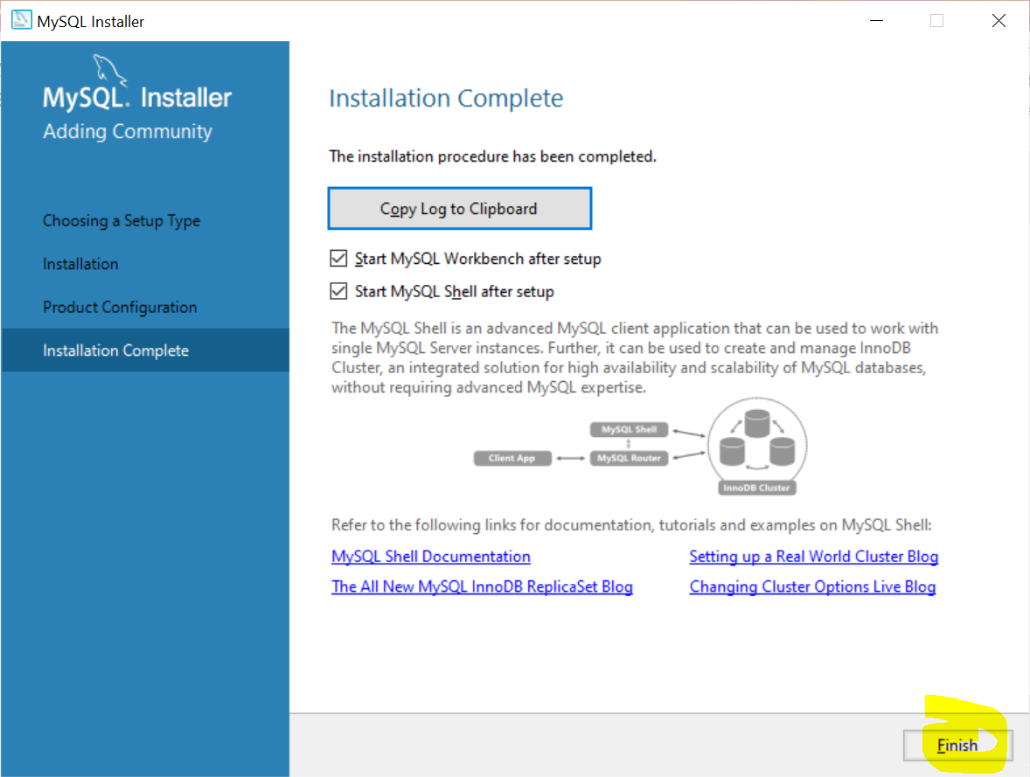
Installation
Congrats! Installation Complete!
Click finish.

Slide 17

Getting Started
MySQL has a graphical user interface called MySQL Workbench where users can visually use the system.
I will be using the command line to type out all my commands to the system.
Benefits:
Learn SQL by typing
Learn how to use command line
I have not used MySQL in years, but I can still use the command line for anything
Enter the root password.

Slide 18
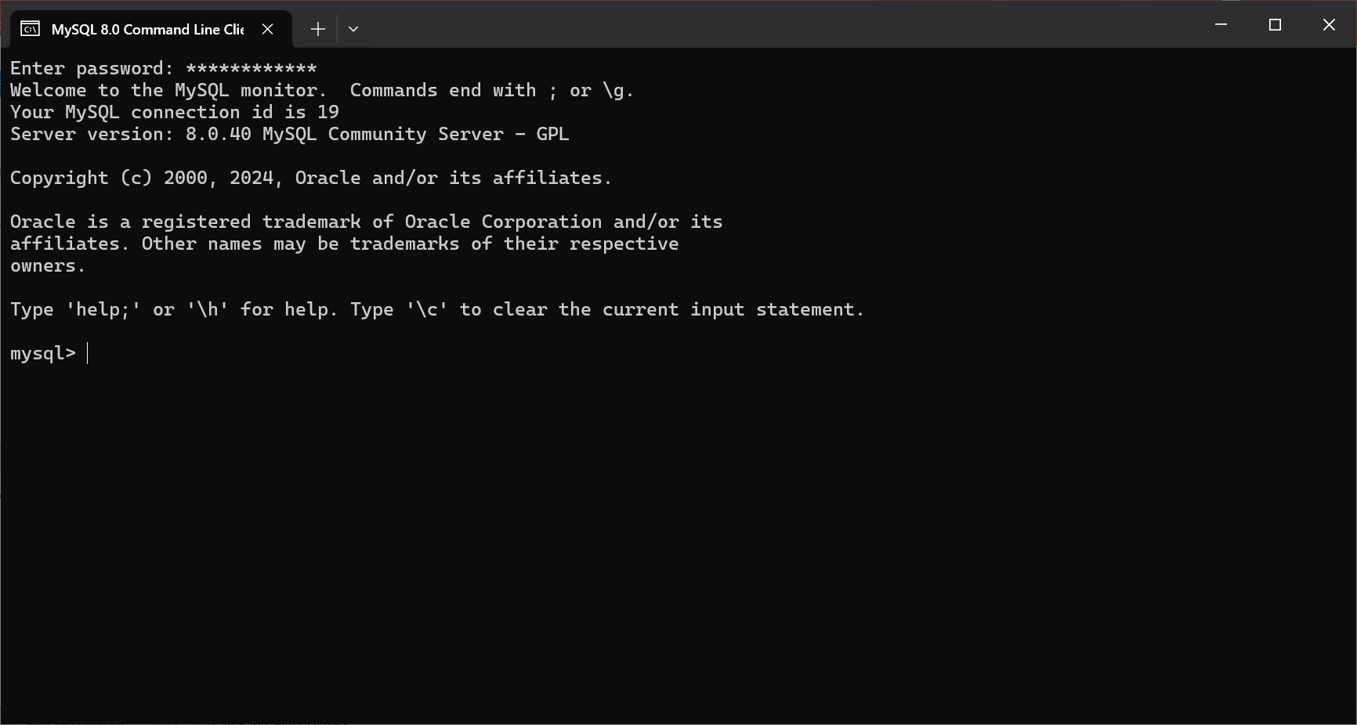
Getting Started
After logging in, MySQL will be ready to use.

Slide 19
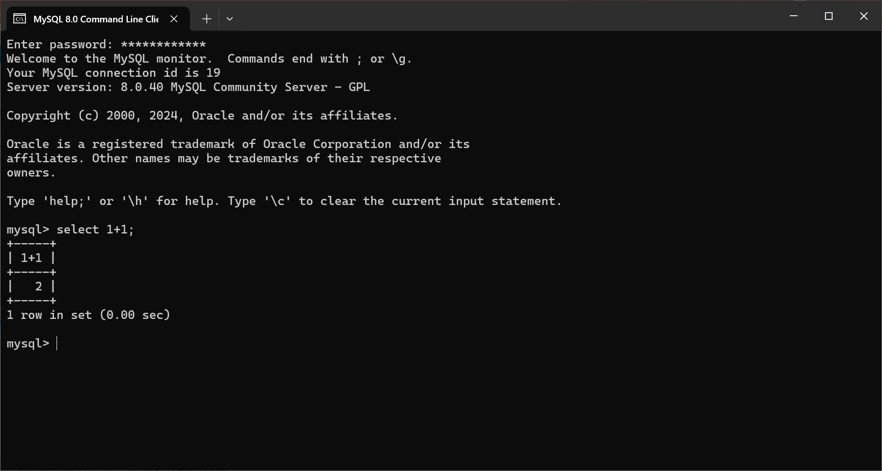
Getting Started
Testing that the server is working with a simple select statement…

Slide 20
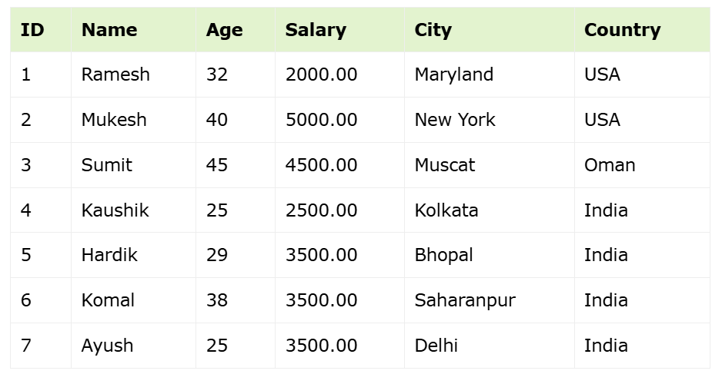
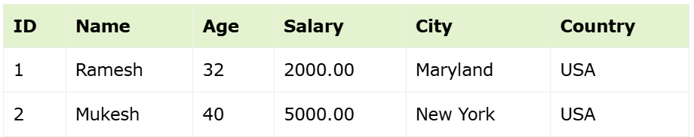
SQL Example
Customers Table
SELECT * FROM CUSTOMERS WHERE country = 'USA';

Slide 21
Terminology
Table - Database object that stores data in tabular format (columns and rows)
Columns/Field – Attributes or specific information for every record/row in the table
Row/Record – Data, one row, one entity

Slide 22
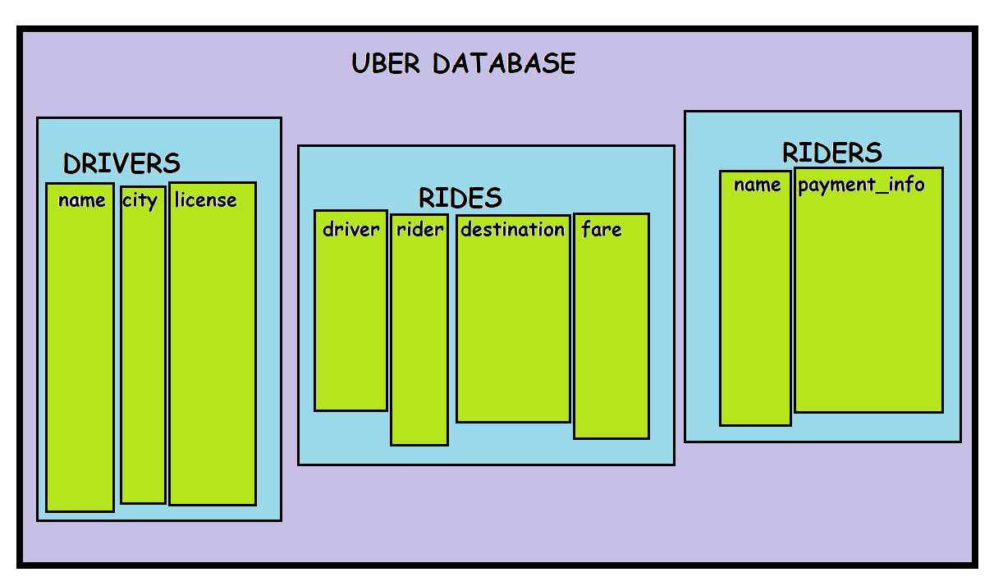

Slide 23
DML (Data Manipulation Language)
Adding, deleting, modifying data in a database.
SELECT – Retrieves record(s) from one or more tables*
INSERT – Creates new record(s)
UPDATE – Modifies existing record(s)
DELETE – Deletes record(s)
CRUD (Create, Read, Update, Delete)

Slide 24
DDL (Data Definition Language)
Create and modify the structure of database objects (tables, views, schemas, indexes etc.)
CREATE – Creates a new table, view, or other object in the database.
ALTER – Modifies an existing database object, such as a table.
DROP - Deletes an entire table, view, or other objects in the database.
TRUNCATE – Deletes all the data in the table.
SELECT – Retrieves record(s) from one or more tables*

Slide 25
DCL (Data Control Language)
Control access to data stored in a database.
GRANT – Gives a privilege to user
REVOKE – Takes back privileges granted from user

Slide 26
Syntax
Case insensitive
SELECT = select
End statements with semi-colon;

Slide 27
Create table
CREATE TABLE CUSTOMERS (
ID INT AUTO_INCREMENT,
NAME VARCHAR(20) NOT NULL,
AGE INT NOT NULL,
CITY CHAR (25),
SALARY DECIMAL (18, 2),
PRIMARY KEY (ID)
);

Slide 28
Insert data
INSERT INTO CUSTOMERS
(ID,NAME,AGE,CITY,SALARY)
VALUES
(1, 'Ramesh', 32, 'Ahmedabad', 2000.00 ),
(2, 'Khilan', 25, 'Delhi', 1500.00 ),
(3, 'Kaushik', 23, 'Kota', 2000.00 ),
(4, 'Chaitali', 25, 'Mumbai', 6500.00 ),
(5, 'Hardik', 27, 'Bhopal', 8500.00 ),
(6, 'Komal', 22, 'Hyderabad', 4500.00 ),
(7, 'Muffy', 24, 'Indore', 10000.00 );

Slide 29
Reading Data
SELECT {columns|computation=display/view} FROM {table_name};
SELECT * = SELECT ALL
SELECT
SELECT ID, NAME, ADDRESS FROM CUSTOMERS;
SELECT * from CUSTOMERS;
SELECT ID AS Identity_Document FROM CUSTOMERS;
SELECT 46475*453;

Slide 30
WHERE
=
!=
Select * From CUSTOMERS Where AGE > 23;
<
>=
<=
AND
OR
NOT
IN

Slide 31
WHERE / AND, OR
AND
0
0
0
1
OR
0
1
1
1
Variable 1 | Variable 2 | AND | OR
0 | 0 | 0 | 0
0 | 1 | 0 | 1
1 | 0 | 0 | 1
1 | 1 | 1 | 1
SELECT * FROM CUSTOMERS WHERE ADDRESS = "Hyderabad" AND AGE = 22;
SELECT 1 AND 0, 0 AND 1, 0 AND 0, 0 AND NULL;
SELECT 1 AND 1;
SELECT 1 AND NULL, NULL AND NULL;
SELECT * FROM CUSTOMERS WHERE NAME LIKE 'k%' AND AGE >= 22 AND SALARY < 3742;

Slide 32
OR
SELECT 1 OR 1, 1 OR 0, 0 OR 1;
SELECT 0 OR 0;
SELECT 1 OR NULL, 0 OR NULL, NULL or NULL;
SELECT * FROM CUSTOMERS WHERE SALARY > 5000 OR ADDRESS = "Hyderabad";
SELECT * FROM CUSTOMERS WHERE NAME LIKE '%k' OR SALARY > 5000 OR AGE < 25;

Slide 33
IN
SELECT * FROM CUSTOMERS WHERE NAME IN ('Khilan', 'Hardik', 'Muffy’);
UPDATE CUSTOMERS SET AGE = 30 WHERE AGE IN (25, 27);

Slide 34
GROUP BY
SELECT AGE, COUNT(Name) FROM CUSTOMERS GROUP BY AGE;
SELECT AGE, AVG(SALARY) AS AVG_SALARY FROM CUSTOMERS GROUP BY AGE HAVING AVG(salary) > 8000;

Slide 35
CREATE DATABASE database_name;
USE database_name;
DROP DATABASE database_name;
CREATE TABLE table_name (
Column_name_1 data_type,
Column_name_2 data_type,
PRIMARY KEY (column_name_1, …)
);
INSERT INTO table_name(column_1,…) VALUES(value_1,…);
SELECT column_1 FROM table_name;
UPDATE table_name SET column_1 = value_1, … WHERE condition;
DELETE FROM table_name WHERE condition;
DROP TABLE table_name;
TRUNCATE TABLE table_name;
ALTER TABLE table_name {ADD|DROP|MODIFY} column_name {data type};
ALTER TABLE table_name RENAME TO new_table_name;
SELECT DISTINCT column FROM table_name;
WHERE AND OR OPERATORS column IN (values, ‘string’, 008), BETween val1 AND val2 LIKE ( PATTERN)
ORDERY BY
GROUP BY, Having
SELECT COUNT(column)
CREATE INDEX name ON TABLE
DROP INDEX name ON TABLE

Slide 36
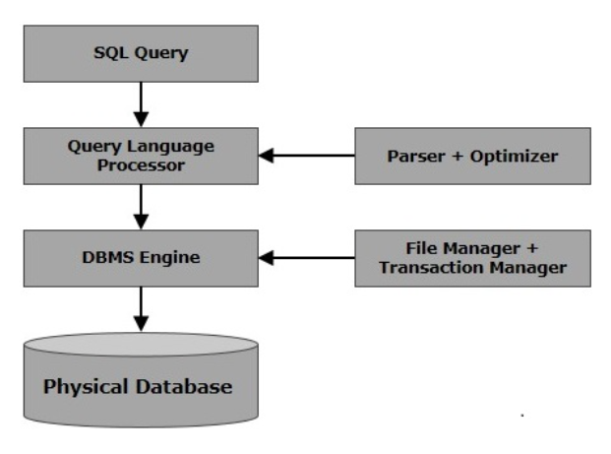

Slide 37
RDBMS
Relational Database Management System
Database management system based on the relational model by E. F. Codd in 1970.
MS SQL Server, IBM DB2, Oracle, MySQL, Microsoft Access

Slide 38
NULL
A value in a field that appears to be blank
Field has no value
Not the same as zero or an empty string with spaces

Slide 39
Constraints
Rules enforced on data columns or table
Limit the type of data
Ensure accuracy and reliability
Examples
NOT NULL
DEFAULT
UNIQUE
PRIMARY
FOREIGN
CHECK
INDEX

Slide 40
Data Integrity
Entity Integrity – No duplicate rows in a table
Domain Integrity – Enforce valid entries by restricting type, format, range of values

Slide 41
Normalization
Normalization is the process of structuring and organizing data in a relational database. As a result, this reduces redundancy and improves data integrity.
What is redundancy?
Redundancy is when the same data is stored in multiple locations within a database or storage system.
Why is redundancy bad?
Increased storage space, potential data inconsistencies when updating, added complexity, higher risk of error in maintenance.
What is data integrity?
Data integrity is the process of ensuring that data is accurate, complete, consistent, and valid throughout its lifecycle.
Why is data integrity important?
Builds trust with people; customers and stakeholders, prevents data breaches and loss, ensures reliable and trustworthy data.

Slide 42

Normalization / Normal Forms
In short, managing lots of data can get messy real quick. We don’t want any bad side effects when we are working with data such as broken links between data when things are being deleted, incomplete updates to duplicate data locations, or inconsistencies when entering data. These type of side effects are also known as anomalies. To combat such anomalies, a database developer can and should apply “Normal Forms” which was first proposed by Edgar F. Codd.
These normal forms are similar to rules, techniques, or steps we can apply to solve each problem. Applying one form means the previous sub forms should be be applied as well. For example, to use Third Normal Form, we use First and Second Normal Form first.

Slide 43
Normalization / Normal Forms
 | Abbreviation | Name | Year
0 | UNF | Unnormalized Form | 1970
1 | 1NF | First Normal Form | 1970
2 | 2NF | Second Normal Form | 1971
3 | 3NF | Third Normal Form | 1971
4 | EKNF | Elementary Key Normal Form | 1982
5 | BCNF | Boyce-Codd Normal Form | 1974
6 | 4NF | Fourth Normal Form | 1977
7 | ETNF | Essential Tuple Normal Form | 2012
8 | 5NF | Fifth Normal Form | 1979
9 | DKNF | Domain-Key Normal Form | 1981
10 | 6NF | Sixth Normal Form | 2003
In most cases, developers only go up to 3NF
It’s not necessary to apply all forms.
Forms beyond 4NF are mainly academic as the problems they solve rarely occur.

Slide 44
Normalization / First Normal Form
First Normal Form: Each field contains a single value. A field may not contain a set of values or a nested record. A field may not contain relations or composite values.
In the following Book table, the Subject field is made up of a composite value (3 individual values). This is a potential point of error. What kind of problems can we encounter in a real life scenario?
Title | Author | Price | Subject | Pages | Publisher
Beginning MySQL Database Design and Optimization | Chad Russell | 49.99 | MySQL, Database, Design | 520 | Apress
What if you had to insert 100 books into this table and each book belonged anywhere in the range of 1-3 subjects? How many distinct subjects do we have? How many books do we have in the “MySQL” subject? Can we be sure that there are no typos when entering the subject data? Is “MySQL” always spelled “MySQL”? Or can it be “mysql”?

Slide 45
Normalization / First Normal Form / Solution
To apply the first normal form, the Subject field is extracted into its own table.
Book
Title | Author | Price | Pages | Publisher
Beginning MySQL Database Design and Optimization | Chad Russell | 49.99 | 520 | Apress
Subject
Title | Subject
Beginning MySQL Database Design and Optimization | MySQL
Beginning MySQL Database Design and Optimization | Database
Beginning MySQL Database Design and Optimization | Design
What are the benefits of arranging data like this?

Slide 46
Normalization / Second Normal Form
To apply the first normal form, the Subject field is extracted into its own table.
Book
Title | Author | Price | Pages | Publisher
Beginning MySQL Database Design and Optimization | Chad Russell | 49.99 | 520 | Apress
Subject
Title | Subject
Beginning MySQL Database Design and Optimization | MySQL
Beginning MySQL Database Design and Optimization | Database
Beginning MySQL Database Design and Optimization | Design
What are the benefits of arranging data like this?

Slide 47
Normalization / Third Normal Form
To apply the first normal form, the Subject field is extracted into its own table.
Book
Title | Author | Price | Pages | Publisher
Beginning MySQL Database Design and Optimization | Chad Russell | 49.99 | 520 | Apress
Subject
Title | Subject
Beginning MySQL Database Design and Optimization | MySQL
Beginning MySQL Database Design and Optimization | Database
Beginning MySQL Database Design and Optimization | Design
What are the benefits of arranging data like this?

Slide 48
Work in progress…
A common scenario is a company wanting to sell their products online so they will need to store data about their products and customers in a database.
Products
id
Name
Price
Customers
Id
Name
Customer_cart
cart_id
Customer_id
Cart_Product
cart_product_id
Product_id
Quantity
price
We will create two tables Product and Customer.
Product
Customer
We will add another entity called Cart
Cart

Slide 49
id | name | dept | price | created | modified
55555 | Pizza | Food | 10.00 | 12/14 9:37 AM | 12/14…
55556 | Soda | Beverage | 2.00 | 12/1 | 12/12..
55557 |  |  |  | 12/09 8:22 AM | 12/09…
55558 |  |  |  | 11/22 8:20 AM | 11/22…
55559 |  |  |  |  | 11/22..
55560 |  |  |  |  | 11/01..
shoes
Shirt
Pants
toy

