Slide 1

Generative Forecasting with Joint Probability Models
A Framework that redefines how we predict the behavior of complex, chaotic dynamical systems.
Probabilistic Machine Learning For Mechanics(Deep Generative Models) Course Project
Abhishek R Reddy
2025AMA2244
Notes:
My name is Abhishek R Reddy, and my presentation topic is Generative Forecasting with Joint Probability Models.
This project is part of the course Probabilistic Machine Learning for Mechanics, under the topic of Deep Generative Models.
The main idea of this work is to study a forecasting framework for complex and chaotic dynamical systems.

Slide 2
Generative Forecasting using Joint Probability Models
Contents
What is Chaotic Dynamical Systems?
Concepts related to Chaotic Dynamical System
Generative Forecasting with Conditional Probability
Generative Forecasting using Joint Probability Models
Uncertainty quantification from joint samples
Wasserstein drift (a UQ Metric)
Extension to Joint Generative Framework
Conditional Joint Models.
Latent optimal control
Evaluation of framework on Lorenz-63 model
Generating the Data for Training
NADE Implementation to Forecast Lorenz System
Testing Methodology
Distribution adherence test
Estimation UQ metrics
Implementation of Conditional Joint Model
Notes:
My topic is Generative Forecasting using Joint Probability Models.
In this presentation, I will first give a brief introduction to chaotic dynamical systems and the important concepts related to them. Then I will move to generative forecasting. First, I will discuss the usual conditional probability approach. Then I will explain the main idea of this work, which is forecasting using joint probability models.
Next, I will discuss how uncertainty can be estimated from joint samples. I will also explain the Wasserstein drift metric, which is used to measure distribution mismatch.
After that, I will briefly cover possible extensions of the joint generative framework, including conditional joint models and latent optimal control.
Finally, I will present the evaluation of the framework on the Lorenz-63 model. This includes data generation, NADE implementation, testing methodology, distribution adherence test, uncertainty quantification metrics, and implementation of the conditional joint model.
So overall, the presentation moves from the basic forecasting problem to the joint probability modelling approach and finally to its evaluation on Lorenz-63.

Slide 3
Chaotic Dynamical System
A chaotic dynamical system is a system that is extremely sensitive to its initial conditions.
Because of this extreme sensitivity, even tiny changes at the start will accumulate over time and lead to completely different outcomes.
Examples:
Atmosphere
Convection (Lorenz System)
Fluid Turbulence
Nonlinear Vibrations in Structures
Celestial Mechanics etc.,

Slide 4
Concepts related to Chaotic Dynamical System
Determinism (Non-Randomness): | A chaotic system is not random. It is governed by strict physical laws. If we start with exactly the same initial conditions, you would get the same result. However, it is impossible to obtain the real-world values with infinite precision.
Non-Linearity | Chaos cannot exist in linear systems. Non-linear terms must exist in governing equations.
Phase Space | Phase space is a mathematical space where all possible states of a dynamical system are represented.
Attractor | An attractor is a set of states in phase space toward which a dynamical system evolves over time. It often settles into a specific "shape" in phase space. In chaotic systems, attractors are strange attractors.

Slide 5
Example of a Strange Attractor
Edward Lorenz developed the system as a simplified mathematical model for atmospheric convection.
The model describes how three key properties of this system change over time:
x is proportional to the intensity of the convection (the rate of fluid flow).
y is proportional to the temperature difference between the rising and falling air currents.
z is proportional to the distortion of the vertical temperature profile from a linear one.
Lorenz attractor

Slide 6

Generative Forecasting with Conditional Probability
Forecasting using patterns in a timed sequence of data (past) to estimate the probability of future events. is
Predicts the next state by looking only at the sequence of past observations.
The model approximates the Conditional PDF, using historical observations as constraints to sample the next state.
Timed Sequence of Data
Update Parameters
Monday
Tuesday
Wednesday
Thursday
Friday
Saturday
Sunday
Monday
Tuesday
Wednesday
Thursday
Friday
Saturday
P(Wed)
Min NLL
Sampling
P(Sun)
Data
Training
Sampling
Notes:
In the usual forecasting approach, the model predicts the future state by looking at the past sequence of observations.
Mathematically, we try to estimate the probability of the next state, $x_{t}$, conditioned on previous states such as $x_{t−Δt}$, $x_{t−2Δt}$, and so on.
So instead of giving only one fixed prediction, the model learns a conditional probability distribution. From this distribution, we can sample possible future states.
In the example shown here, we can think of the data as a time sequence from Monday to Saturday. During training, the model learns patterns from the sequence and updates its parameters by minimizing the negative log likelihood.
After training, if we give the model the recent past observations, such as Friday and Saturday, it can sample the likely next state, which is Sunday.
The main point is that this method predicts the future only based on the given past sequence. This is useful, but it depends strongly on the conditioning history.

Slide 7



Generative Forecasting using Joint Probability Models
can be written using Product Rule of Probability as:
Instead of learning a one-way 'rule' to predict the future, we train the model to understand the overall patterns of short time windows (sequences).
Deep Generative Model
Adjacent time steps
Monday Tuesday Wednesday
Temporal Time Window : 3 ( Hyperparameter)
Thursday | Friday | Saturday
Ground Turth
Generative Model provide us with samples
Friday | Saturday | Sunday
Tuesday Wednesday
Thursday
Training
Friday | Saturday | Sunday
Wednesday
Thursday
Friday
Friday | Saturday | Sunday
Sampling
Friday | Saturday | Sunday
Best Match
Predicted Forecast
Thursday
Friday
Saturday
Friday | Saturday | Sunday
Day 1 Day 2 Day 3
Data
Friday | Saturday | Sunday
Notes:
Now I will explain the main idea of generative forecasting using joint probability models.
In the conditional approach, we usually model the probability of the future state given the past states. But using the product rule of probability, this conditional probability can also be written as a ratio of two joint probability distributions.
So instead of directly learning only the conditional rule, this method learns the joint distribution of short time windows.
For example, instead of learning only “Friday and Saturday give Sunday,” the model learns the overall pattern of adjacent time steps such as Thursday, Friday, Saturday, or Friday, Saturday, Sunday.
During training, the data is divided into short temporal windows. Here, the temporal window length is taken as 3. The generative model learns the probability distribution of these three-step sequences.
After training, the model generates many possible samples. During sampling, we compare the known past part, for example Friday and Saturday, with the generated samples. The sample whose past part matches best is selected, and its next value is taken as the forecast for Sunday.
So the key idea is: the model does not directly predict the future using only one conditional rule. Instead, it learns the joint structure of short trajectories and then extracts the future by matching the known past.
This makes the framework useful for generative forecasting, because it can produce multiple possible future states and also help in uncertainty quantification.

Slide 8
Generative Forecasting using Joint Probability Models
Uncertainty quantification from joint samples
In chaotic systems, the model will eventually lose track of the truth, and we need some metrics tell us exactly when and why that is happening without us needing to know the actual future.
"Top-k" Selection
Thursday | Friday | Saturday
Ground Turth
K-nearest Ensemble
Generative Model provide us with samples
Friday | Saturday | Sunday
2nd Best Match
Friday | Saturday | Sunday
2
Friday | Saturday | Sunday
Sampling
Friday | Saturday | Sunday
Best Match
i=1
Point Forecast
Friday | Saturday | Sunday
Day 1 Day 2 Day 2
Kth Best Match
Friday | Saturday | Sunday
K
t-2Δt
t-Δt
t
Notes:
In chaotic systems, the forecast will eventually lose track of the true trajectory. So we need a way to understand when the forecast becomes uncertain and why, even when the actual future is not available.
Here, the model first generates many joint samples. Each sample contains the past time steps and the possible future state.
Then we compare the known past part, like Friday and Saturday, with the generated samples. Based on this comparison, we select the top-k nearest samples. These are the samples whose past values are closest to the observed history.
From these selected samples, the future part is used to form an ensemble forecast. The best matching sample can be used as the point forecast, while the full top-k set gives a k-nearest ensemble.
If the selected future samples are very close to each other, uncertainty is low. But if they are widely spread, uncertainty is high. So this method gives both the forecast and an estimate of uncertainty from the generated joint samples.

Slide 9
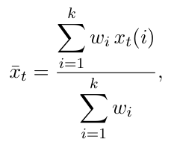
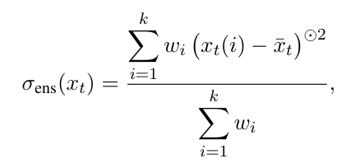
Generative Forecasting using Joint Probability Models
Ensemble Variance: (On Predicted Forecast)
First, we need calculate the weighted average of the all the predicted forecasts (sunday) from the k-nearest ensemble.
wi is the optional importance weights
Then we can calculate the ensemble variance.
High Variance Indicates the Model is Uncertain.

Slide 10
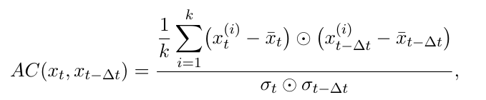


Generative Forecasting using Joint Probability Models
2. Autocorrelation : (Between Predicted Forecast and the Previous State)
Autocorrelation measures how much the state at time t (e.g., Sunday) depends linearly on the state at time t-Δt
: Empirical Means at t and t-Δt respectively
: Standard deviations at t and t-Δt respectively
If AC is close to 1: This means the system has strong momentum and changes slowly relative to time. If AC is close to 0: This means the system is highly volatile or is being dominated by random noise.

Slide 11

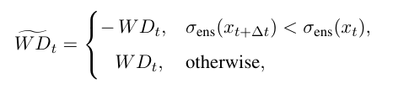



Wasserstein Drift
Wasserstein Drift measures the model's self-consistency by tracking how much overlapping predictions for the exact same time step diverge.
This provides an early warning signal for forecast failure without needing actual ground truth data.
-- estimated in practice using a Sinkhorn-regularized optimal transport solver.
A higher score means the overlapping predictions are drifting apart, indicating the model is getting confused.
The signed version of the Wasserstein distance using
changes in ensemble variance:
The cumulative Wasserstein :
Thursday | Friday | Saturday
Ground Turth
Friday | Saturday | Sunday
Friday | Saturday | Sunday
Generated to predict SUNDAY
Friday | Saturday | Sunday
Friday | Saturday | Sunday
$$\hat{p_{t}}$$
Friday | Saturday | Sunday
Friday | Saturday | Sunday
Saturday | Sunday | Monday
Saturday | Sunday | Monday
Generated to predict MONDAY
Saturday | Sunday | Monday
Saturday | Sunday | Monday
Saturday | Sunday | Monday
Saturday | Sunday | Monday
$$\hat{p_{t−Δt}}$$
Notes:
Now I will explain the Wasserstein Drift metric.
The main idea is to check whether the model gives consistent predictions for the same future time when we approach it from overlapping time windows.
For example, one set of samples may predict Sunday using Friday and Saturday. Another overlapping set may also contain predictions for Sunday while predicting Monday. Ideally, both predictions for Sunday should be similar.
Wasserstein Drift measures how much these overlapping predictions differ. If the drift is small, the model is self-consistent. If the drift is large, it means the predictions are moving apart, and the model may be losing reliability.
This is useful because it gives an early warning of forecast failure without needing the actual ground truth future.
In practice, the Wasserstein distance is estimated using an optimal transport solver. A signed version can also be used by checking whether the ensemble variance is increasing or decreasing.
Finally, the cumulative Wasserstein Drift adds this drift over time, so we can track how prediction inconsistency grows as the forecast horizon increases.

Slide 12
Extension to Joint Generative Framework
Conditional Joint Models.
The existing baseline conditional models use past data to predict only the single next time step.
This extension to the joint generative framework, conditional joint models takes past data into the model to generate a full overlapping time window and then selects the generated window that best matches our known recent past.
In this case, the framework uses the observed history twice in this extension
Explicitly: Input as a conditional
Implicitly: During sieving - the picking the best forecast
Notes:
Now I will explain an extension of the joint generative framework called conditional joint models.
In the baseline conditional model, the past data is used only to predict the single next time step. But in the conditional joint model, the past data is used to generate a complete overlapping time window.
So instead of generating only one future point, the model generates a short sequence that includes both the recent past and the future state.
Here, the observed history is used in two ways. First, it is used explicitly as a condition to the model. Second, it is used implicitly during sieving, where we select the generated window that best matches the known recent past.
This improves the forecasting process because the model uses past information while generating the sample, and again while selecting the best forecast.
So the key point is: conditional joint models combine conditional forecasting with the joint window-based approach. This helps the model generate more consistent and better-matched future predictions.

Slide 13
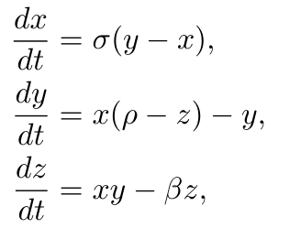
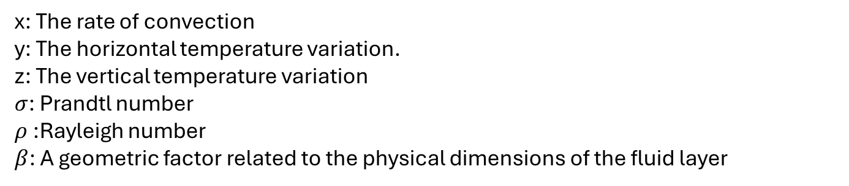
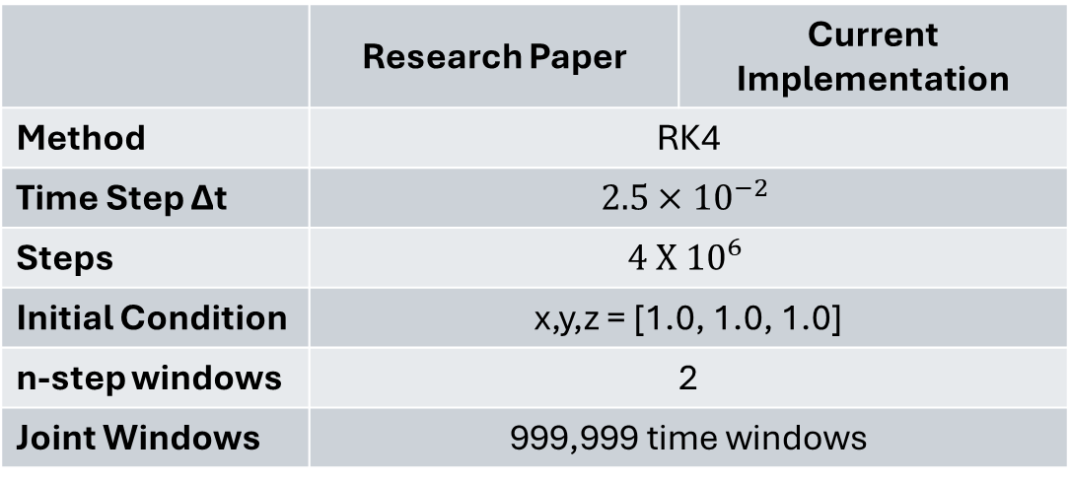
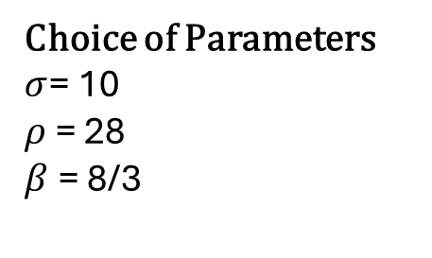
Lorenz-63 model
x: The rate of convection
y: The horizontal temperature variation.
z: The vertical temperature variation
$σ$: Prandtl number
$ρ$ :Rayleigh number
$β$: A geometric factor related to the physical dimensions of the fluid layer
Generating the Data for Training
 | Research Paper | Current Implementation
Method | RK4
Time Step Δt | $$2.5×{10}^{−2}$$
Steps | $$4 X {10}^{6}$$
Initial Condition | x,y,z = [1.0, 1.0, 1.0]
n-step windows | 2
Joint Windows | 999,999 time windows
Choice of Parameters
$σ$= 10 $ρ$ = 28
$β$ = 8/3

Slide 14
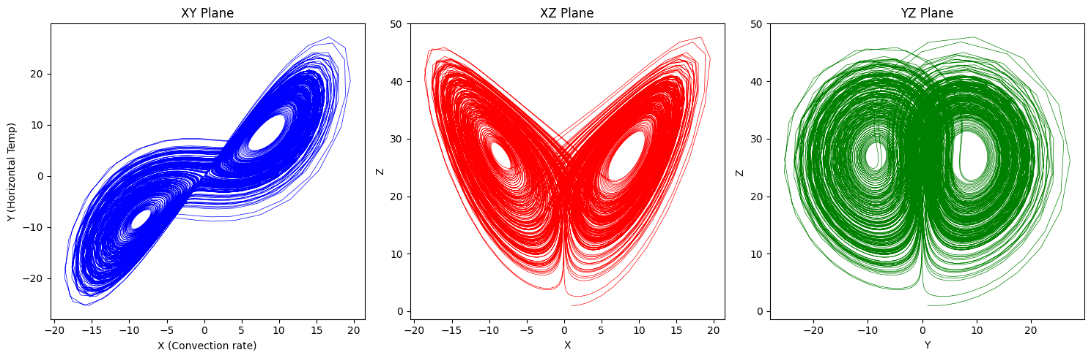
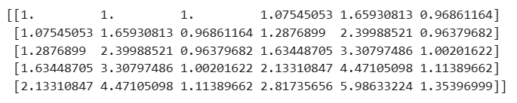
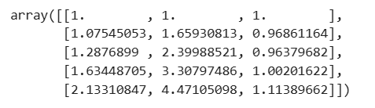
Lorenz-63 model
Trajectory
Joint Windows

Slide 15
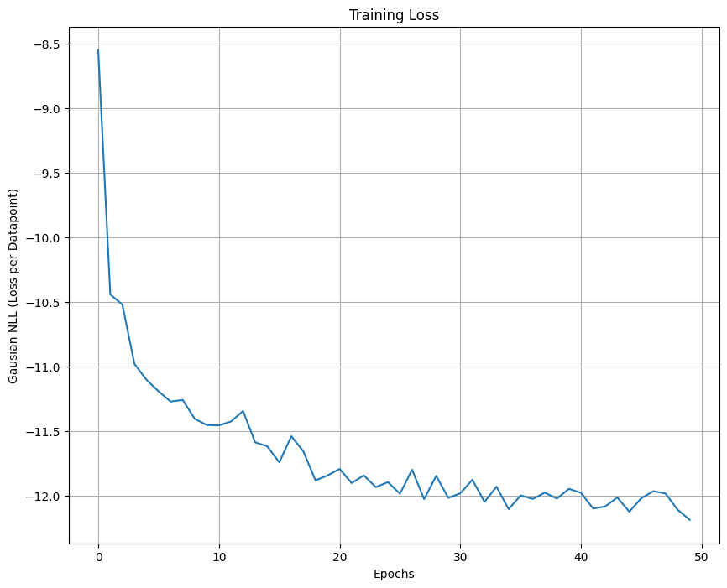
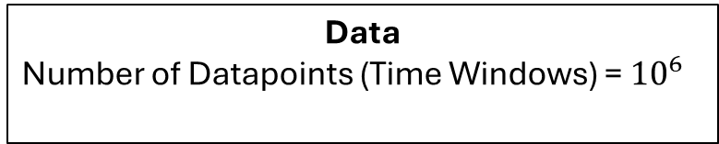
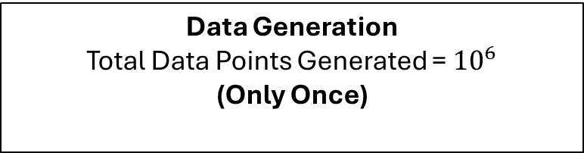
NADE Implementation to Forecast Lorenz System
Data
Number of Datapoints (Time Windows) = ${10}^{6}$
NADE Architecture
Hidden Layer Dimension = 1000
Training
Batch Size = 500
Loss Function: Gaussian Negative Log Likelihood
Adam Optimizer with Learning Rate = 0.001
Epochs = 50
Data Generation
Total Data Points Generated = ${10}^{6}$
(Only Once)

Slide 16
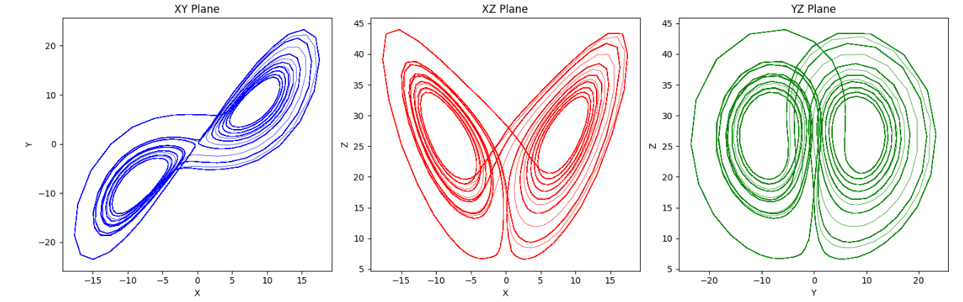
NADE Implementation to Forecast Lorenz System
Trained on (${10}^{6})$ time steps and forecasted from (${10}^{6}+1)$ for 50000 steps

Slide 17


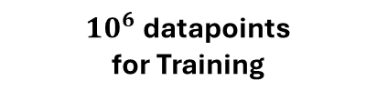
Testing
For testing, we consider 500 unseen initial conditions drawn uniformly forming nonoverlapping trajectories.
Each initial state is forecasted for 400 steps.
Total Generated 4 x ${10}^{6}$ timesteps/datapoints (Not randomized)
${10}^{6}$ datapoints for Training
3 x ${10}^{6}$
400 Steps
400 Steps
400 Steps
1
2
500
Initial Condition
AE
Model
Forecasted 400 Steps
Mean absolute error (MAE) across an ensemble of 500 test initial conditions drawn from the attractor but not used for training.

Slide 18
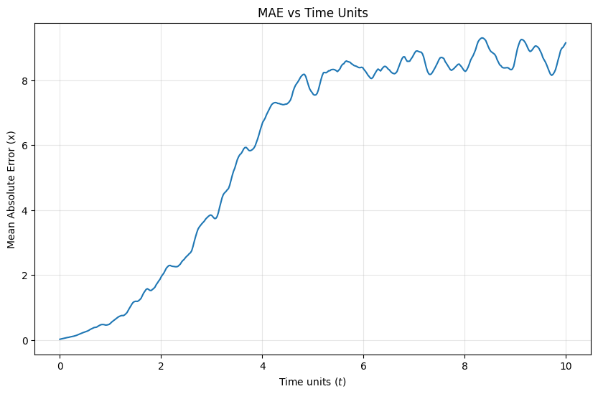
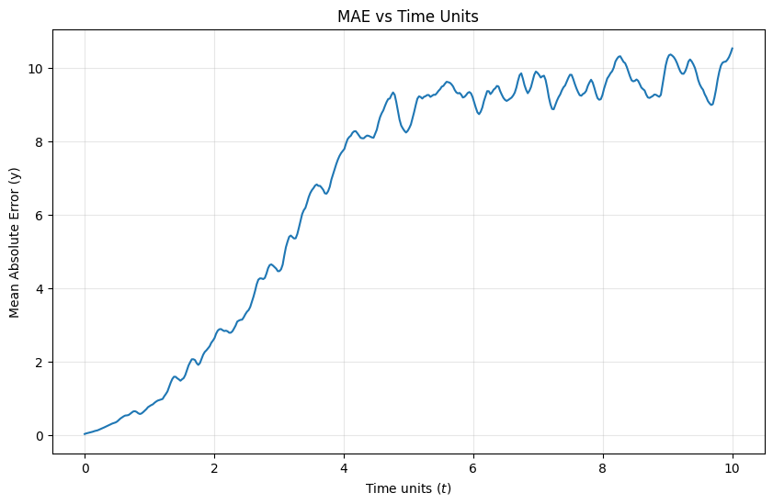
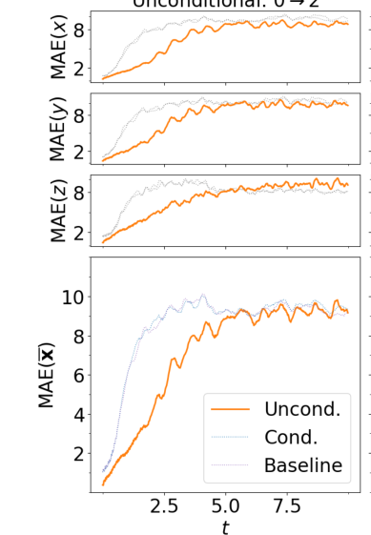
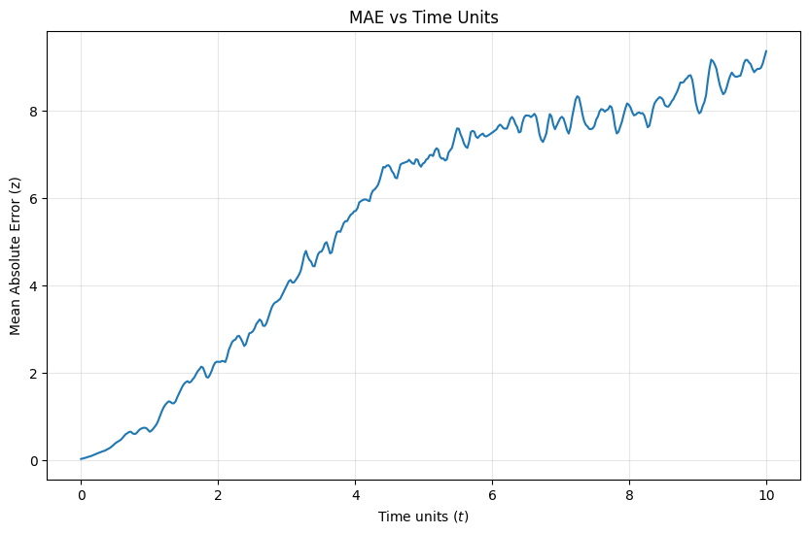
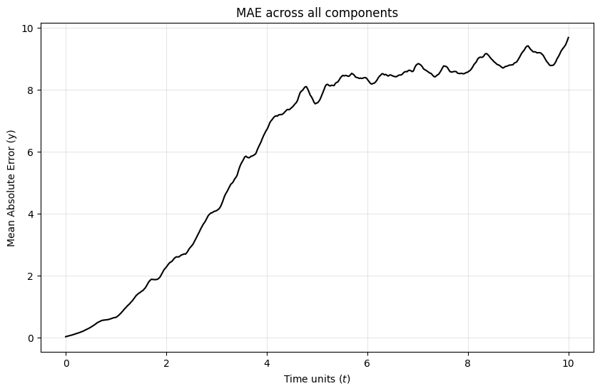
Testing
Research Paper Plots

Slide 19
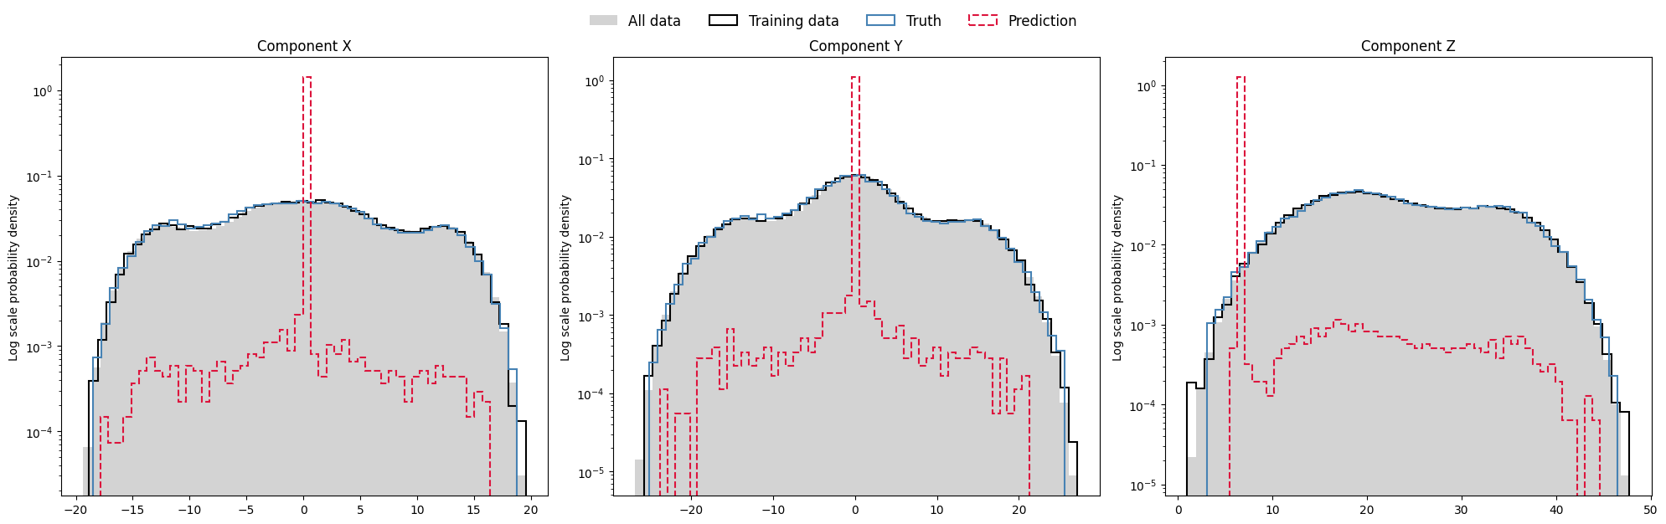
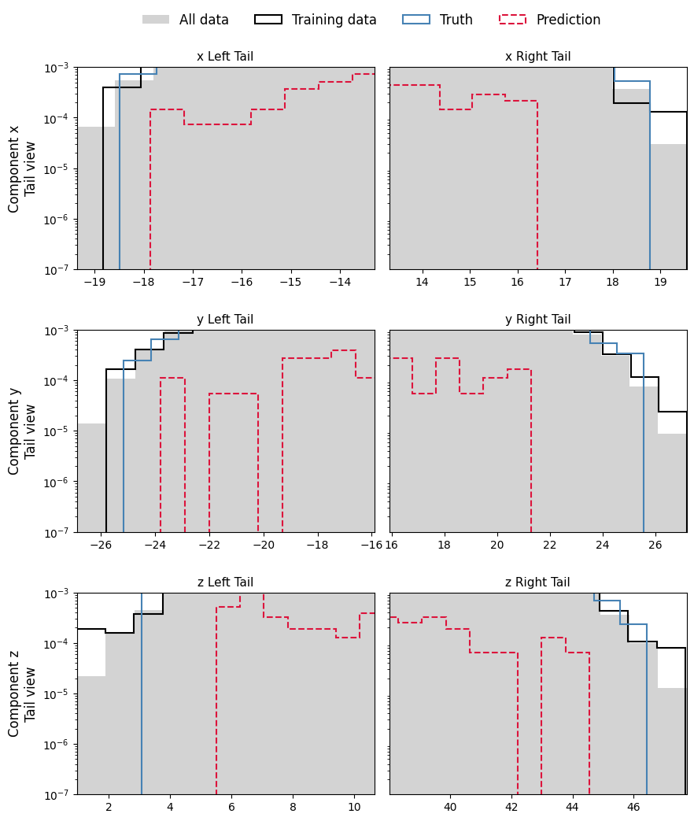
Distribution adherence test
NADE was trained with 40000-time windows.
Forecasted for 20000 steps from 40000 to 60000.
Notes:
Now I will explain the distribution adherence test.
The aim of this test is to check whether the generated forecasts follow the same statistical distribution as the true Lorenz-63 system.
Here, the NADE model was trained using 40,000 time windows. After training, forecasting was done for 20,000 steps, from step 40,000 to 60,000.
In the plots, the grey region represents all data, the black curve represents training data, the blue curve represents the true test data, and the red dashed curve represents the predicted forecast distribution.
For a good generative forecast, the red predicted distribution should approximately follow the true distribution. It does not need to match every point exactly, but the overall shape and range should be similar.
From these plots, we can see that the prediction captures some parts of the distribution, but there are also mismatches, especially near the tails. This means the model has learned the general behavior, but it is still not perfectly distribution-adherent.
So the main takeaway is: this test checks whether the forecast is statistically realistic, not just whether one trajectory is accurate.

Slide 20
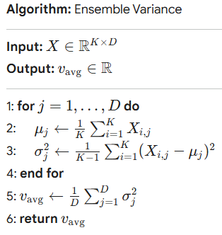
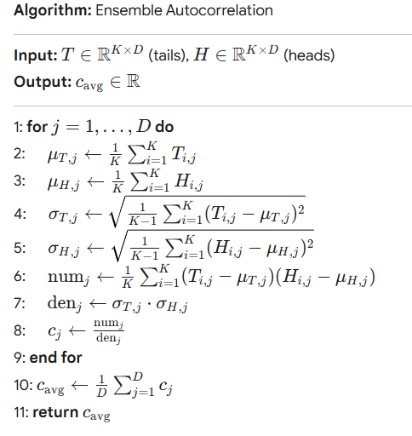
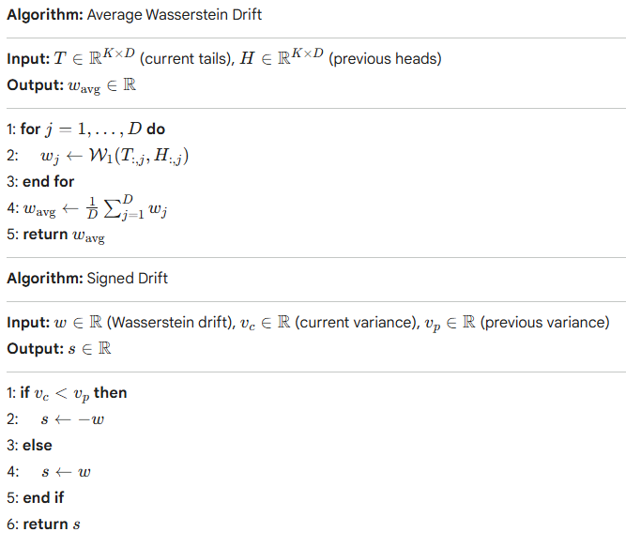
Estimation UQ metrics
NADE was trained with 1e6 time windows.
For testing, we consider 500 unseen initial conditions drawn uniformly forming nonoverlapping trajectories. Each initial state is forecasted for 400 steps.

Slide 21
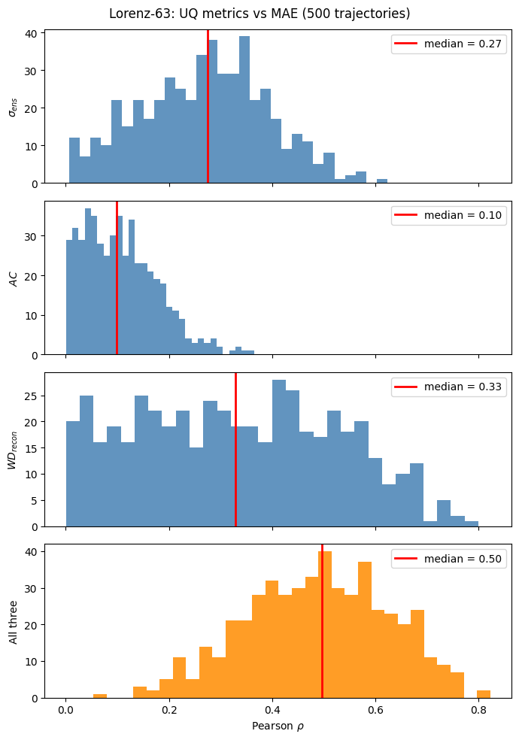

Estimation UQ metrics
Ensemble Variance, Autocorrelation and Wasserstein Drift has been calculated for 500X400 grid.
From Ground Truth MAE is also calculated for this 500X400 grid.
Performed linear regression on the 500 X 400 grid to map UQ metrics directly to the Mean Absolute Error (MAE).
Applied linear regression to model MAE (response variable) using the three UQ metrics (regressors).
Configured four regression models per trajectory: one for each individual metric, and one multiple regression combining all three.
Extracted the Pearson correlation coefficient per trajectory.
Notes:
Now I will explain the estimation of uncertainty quantification metrics.
For each forecast trajectory, three UQ metrics were calculated: ensemble variance, autocorrelation, and Wasserstein drift. Along with these, the mean absolute error, or MAE, was calculated using the ground truth.
The idea is to check whether these UQ metrics can indicate forecast error. So, linear regression was performed to map the UQ metrics to the MAE.
Four regression models were used for each trajectory. Three models used each UQ metric separately, and one multiple regression model used all three metrics together.
After that, the Pearson correlation coefficient was calculated. This tells us how strongly the estimated uncertainty is related to the actual forecast error.
From the histograms, individual metrics show some correlation with MAE, but the correlation is not very high. The combined model using all three metrics gives a better median correlation, around 0.50.
So the main takeaway is: a single uncertainty metric may not fully explain the forecast error, but combining multiple UQ metrics gives a better estimate of forecast reliability.

Slide 22
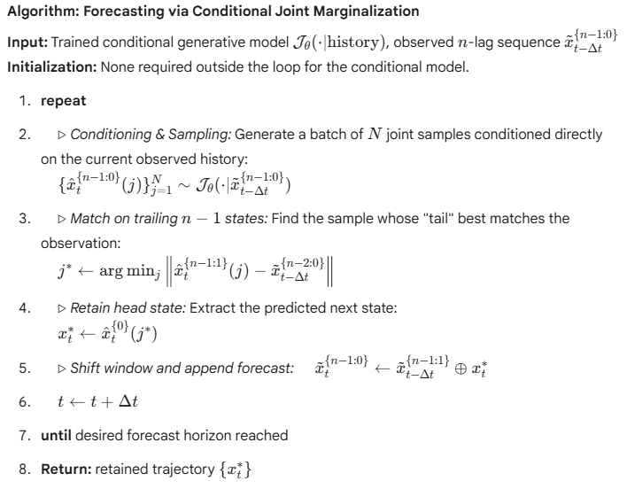
Implementation of Conditional Joint Model
Data
Number of Datapoints (Time Windows) = ${10}^{6}$
NADE Architecture
Hidden Layer Dimension = 1000
Training
Batch Size = 500
Loss Function: Gaussian Negative Log Likelihood
Adam Optimizer with Learning Rate = 0.001
Epochs = 50
Data Generation
Total Data Points Generated = 1000 per forecast step
Notes:
Now I will explain the implementation of the conditional joint model.
For the experiment, the dataset contains ${10}^{6}$time windows. The NADE architecture uses a hidden layer dimension of 1000.
During training, we used a batch size of 500, Gaussian negative log likelihood as the loss function, and the Adam optimizer with a learning rate of 0.001. The model was trained for 50 epochs.
For forecasting, at each forecast step, the conditional generative model generates 1000 joint samples conditioned on the observed history.
Then, from these samples, we compare the trailing past states with the actual observed past. The sample whose past part matches best is selected.
After selecting the best sample, the head state is retained as the predicted next state. Then the time window is shifted forward, and the predicted state is appended for the next forecasting step.
So the main idea is: the conditional joint model first generates multiple possible future windows using the observed history, then selects the best matching window to produce the final forecast.

Slide 23
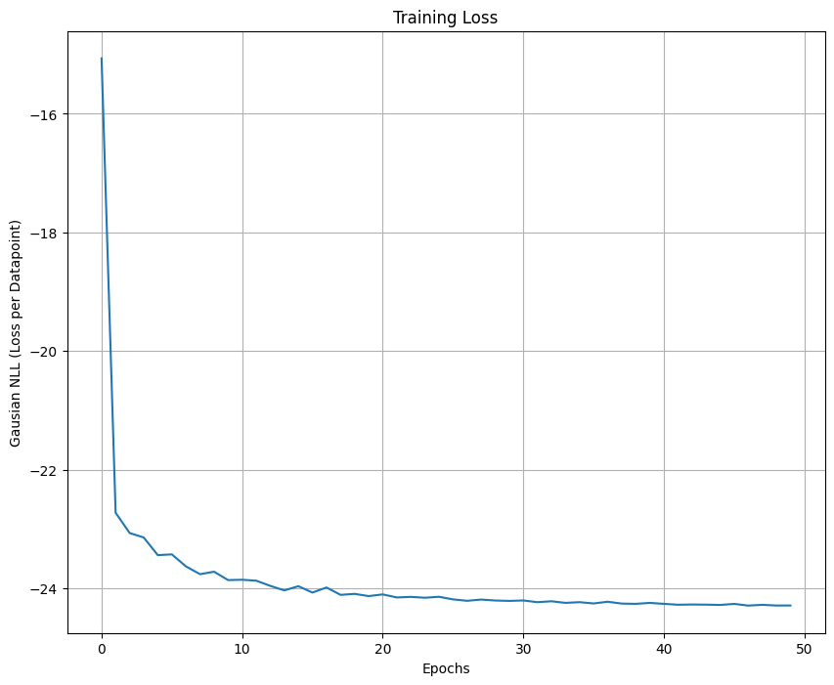
Implementation of Conditional Joint Model

Slide 24
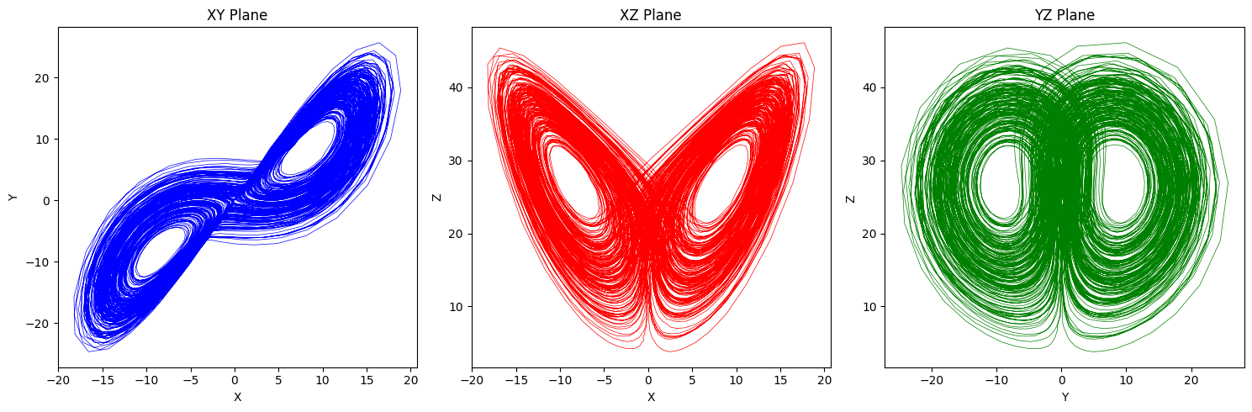
Implementation of Conditional Joint Model
Unconditional Joint Generative Model
Conditional Joint Generative Model

Slide 25
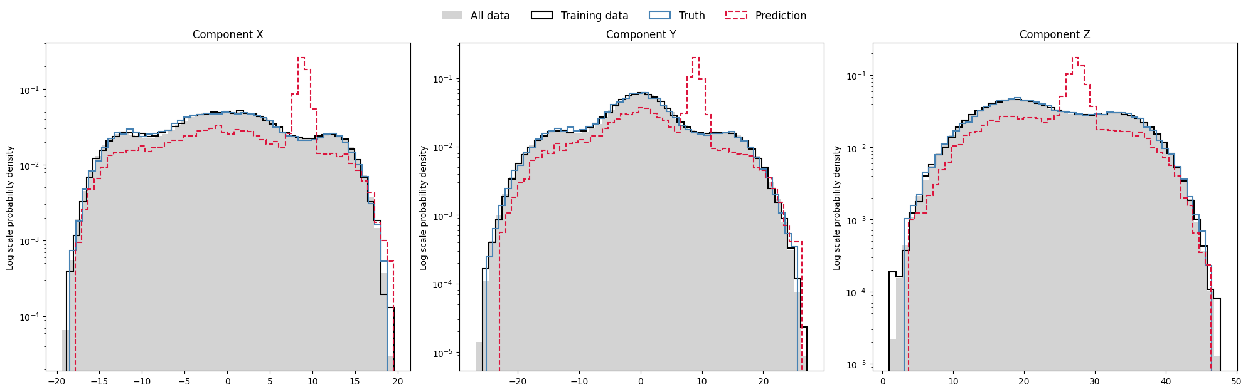
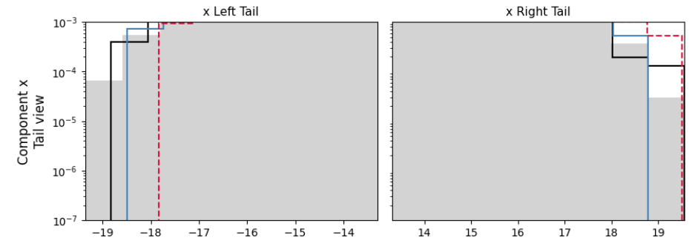
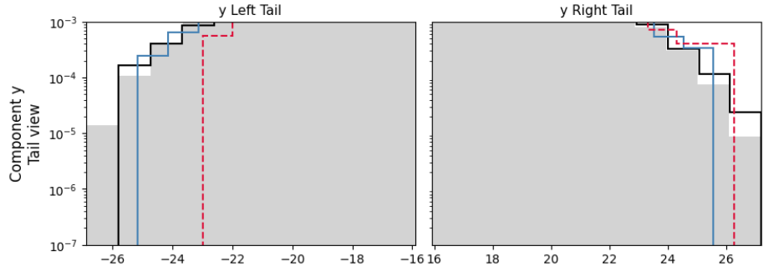
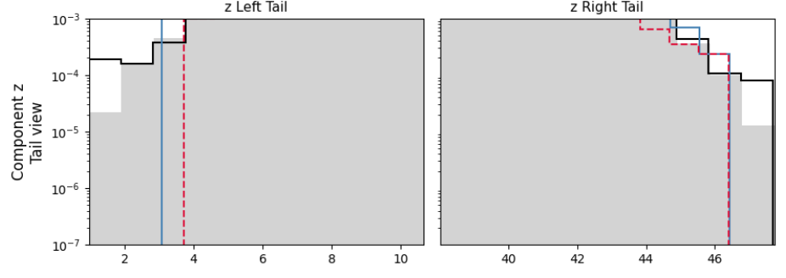
Distribution adherence test
Notes:
Now I will show the distribution adherence test for the conditional joint model.
The purpose of this test is to check whether the predicted samples follow the same statistical distribution as the true Lorenz-63 data.
In these plots, the grey region represents the overall data distribution, the black curve represents the training data, the blue curve represents the true test data, and the red dashed curve represents the prediction.
For a good model, the red dashed prediction should closely follow the blue and black curves. Here, we can see that the predicted distribution matches the true distribution much better than before, especially in the main regions of the $x$, $y$, and $z$components.
There are still some small deviations and peaks, especially around certain values, but overall the prediction captures the shape and range of the Lorenz attractor distribution reasonably well.
The tail plots also show that the model is able to cover the extreme regions better, although some mismatch is still present near the boundaries.

Slide 26
Future Work
• Increase the complexity of the NADE architecture and evaluate its performance.
• Implement the model for the KS equation.
• Extend the implementation to high-dimensional datasets such as ERA5.
Notes:
Finally, I will discuss the future work.
First, the NADE architecture can be made more complex and its performance can be evaluated. This may help the model capture more complicated nonlinear patterns in chaotic systems.
Second, the same framework can be implemented for the Kuramoto–Sivashinsky equation, or KS equation. This will help test the method on a more challenging spatio-temporal chaotic system.
Third, the framework can be extended to high-dimensional datasets such as ERA5. This is important because real weather and climate data are much more complex than low-dimensional systems like Lorenz-63.
So overall, the future direction is to move from simple chaotic systems toward more realistic and high-dimensional forecasting problems.

Slide 27
Thank You

