Slide 1
Metaverse
By \ Ismail Ahmed

Slide 2



Whoami
An enthusiastic developer who aim to improve, generate & solve problems about cybersecurity to provide the privacy and security for organizations & individuals all over the WORLD !
https://www.linkedin.com/in/engismail2020/
https://github.com/thearrival

Slide 3

What’s the Metaverse ?

Slide 4
Introduction
The metaverse will be “a fully functional economy... Where people & corporations will be able to develop, invest, own and sell” Things .
The metaverse is expected to become a far more developed space in the future.
Metaverse technology has increasingly become the most popular in the IT world & every investor desires a piece of it.

Slide 5
The Seven Layers of the Metaverse
Infrastructure
5G, WiFi 6, Cloud, GPU, Materials
Human interface
Mobile, Smart Glasses, Voice, Wearables, Neural
Decentralization
Edge Computing, AI agents Microservices, Blockchain
Spatial Computing
3D Engines, VR/AR/XR, Multitasking UI, Geospatial Mapping
Creator economy
Design Tools, Asset Markets, Workflow, Commerce
Discovery
Ad Networks, Social, Stores, Ratings, Agents
Experience
Games, Social, Esports, shopping

Slide 6
What can Metaverse slove?
Lack of personal touch
Time zone Differences
Hardware issues
Low individual visibility
Scarce true real-time interactions
Software Issue

Slide 7
What do we need to run Metaverse Project
To establish any project concerning Metaverse you’ll be require to relay on three main cores :-
Interoperability, Presence and Standardization.

Slide 8
“They are digital world, services devices, , websites, etc.
The internet is a wide set of protocols, technology, tubes and language, plus access devices and content and communication experience atop them. Metaverse will be too ! ”

Slide 9
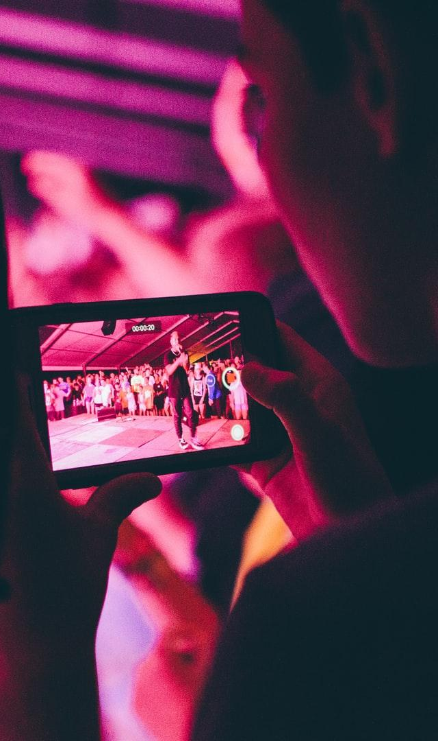
I sincerely appreciate your attention !

