Slide 1
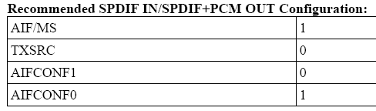
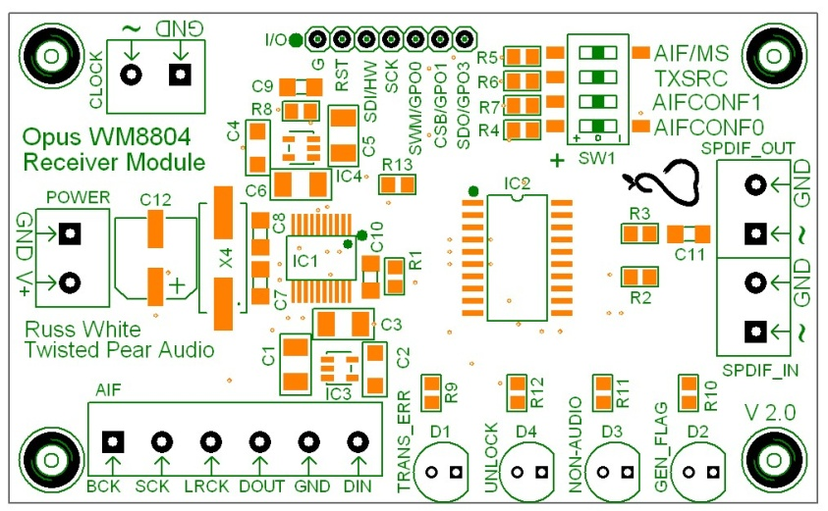

+ = 1
= 0
O = open
7.5VDC
SPDIF in
To Metronome

Slide 2
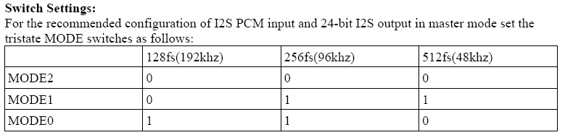
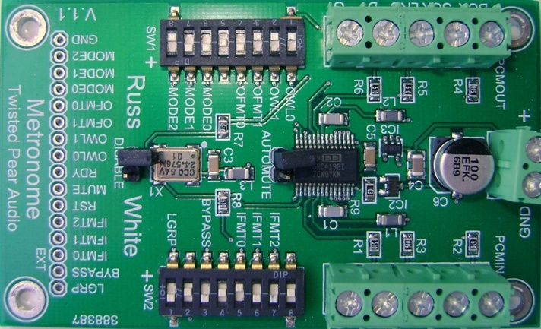
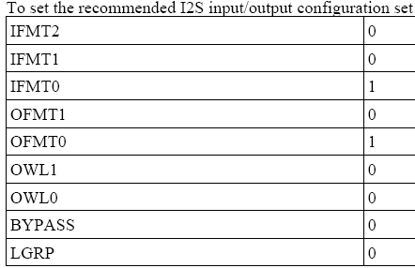

To OPUS
+ = 1
= 0
O = open
G D LRC SCK BCK
7.5VDC
G D LRC SCK BCK
From OPUS Receiver

Slide 3
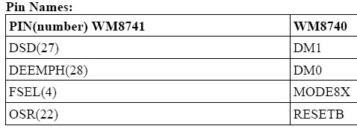
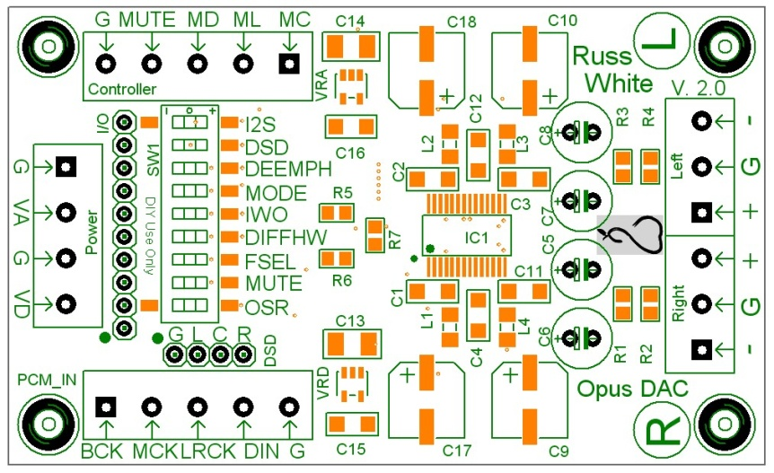
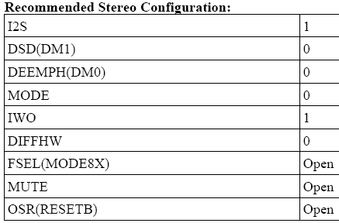

Replace C5-8 with jumpers
+ = 1
= 0
O = open
2 x 7.5 VDC
To IVY
From metronome

Slide 4
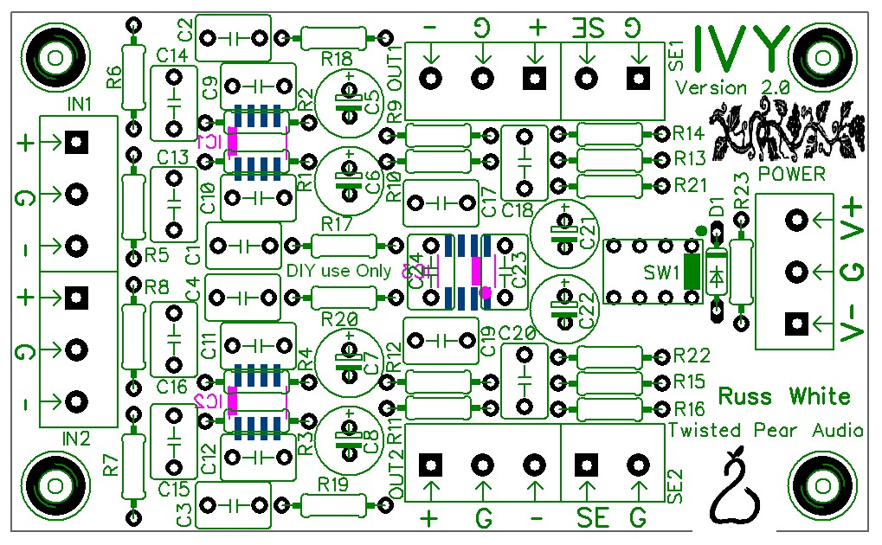
+/- 15 VDC
From Opus
For 2Vrms output
C1-4 1nf
R17-20 Jumper
R1-4 2K
R5-8 2K
C13-16 Omit

Slide 5
