Slide 1


O-Cloud - (Online storage system)

Slide 2

Presented By:
Abhishek Gupta
Adarsh Pandey
Anuj Arora
Aryan Varshney
Shivam Sharma
Yogesh Sharma
mentored by:
Ms. Kriti Bansal

Slide 3

introduction
Cloud storage is a model of computer data storage in which the digital data is stored in over the cloud.
The physical storage spans multiple servers (sometimes in multiple locations), and the physical environment is typically owned and managed by a hosting company. These cloud storage providers are responsible for keeping the data available and accessible, and the physical environment protected and running. People and organizations buy storage capacity from the providers to store user, organization, or application data.

Slide 4

PROBLEM STATEMENT
Chance of Data Loss.
Offline storage mediums are costly.
Carrying Of External Storage Devices.
Maintenance of Storage Device.

Slide 5
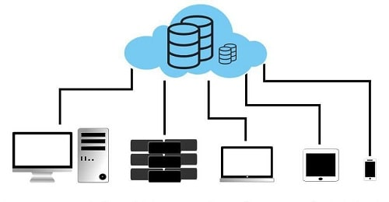
Objectives
To provide cloud-based data security.
To improve cloud-based file management.
To implement efficient file retrievals.
To make a cost effective storage system.

Slide 6

Modules
Admin - have access of all the data and user profiles.
User - have access to his/her profile and data only.

Slide 7

Sub Modules (ADMIN)
DASHBOARD
USER DETAILS
CONTACT US
ISSUES
DELETE USER

Slide 8

Sub Modules (USER)
UPLOAD FILE
VIEW/DOWNLOAD FILE
DELETE FILE
PROFILE
CHANGE PASSWORD

Slide 9

Purpose Of The Project
Save Expenditure.
Save Time.
Data Safety.
Ease in data sharing.

Slide 10

advantages
Data Security is concerned.
Accessibility over any place.
Immediate access in seconds of time.
Data Recovery is much easy.

Slide 11

Software Requirements
Operating System: Any Operating System. Application Server : XAMPP (Apache). Front-End: HTML5, CSS3. Back-End: JavaScript ,PHP. Database: Mysql CLOUD Database Connectivity : PhpMyAdmin.
Hardware Requirements
Processor: Intel Celeron (Minimum Version)
RAM: 512 MB
Hard Disk: 20 GB(Windows Installation + Sever Installation)

Slide 12
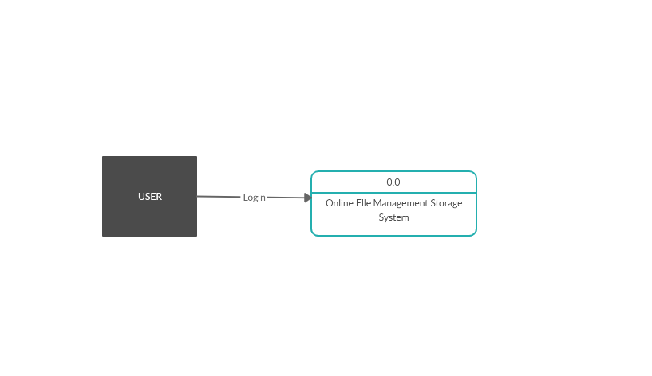
Data Flow Diagram
LEVEL 0

Slide 13
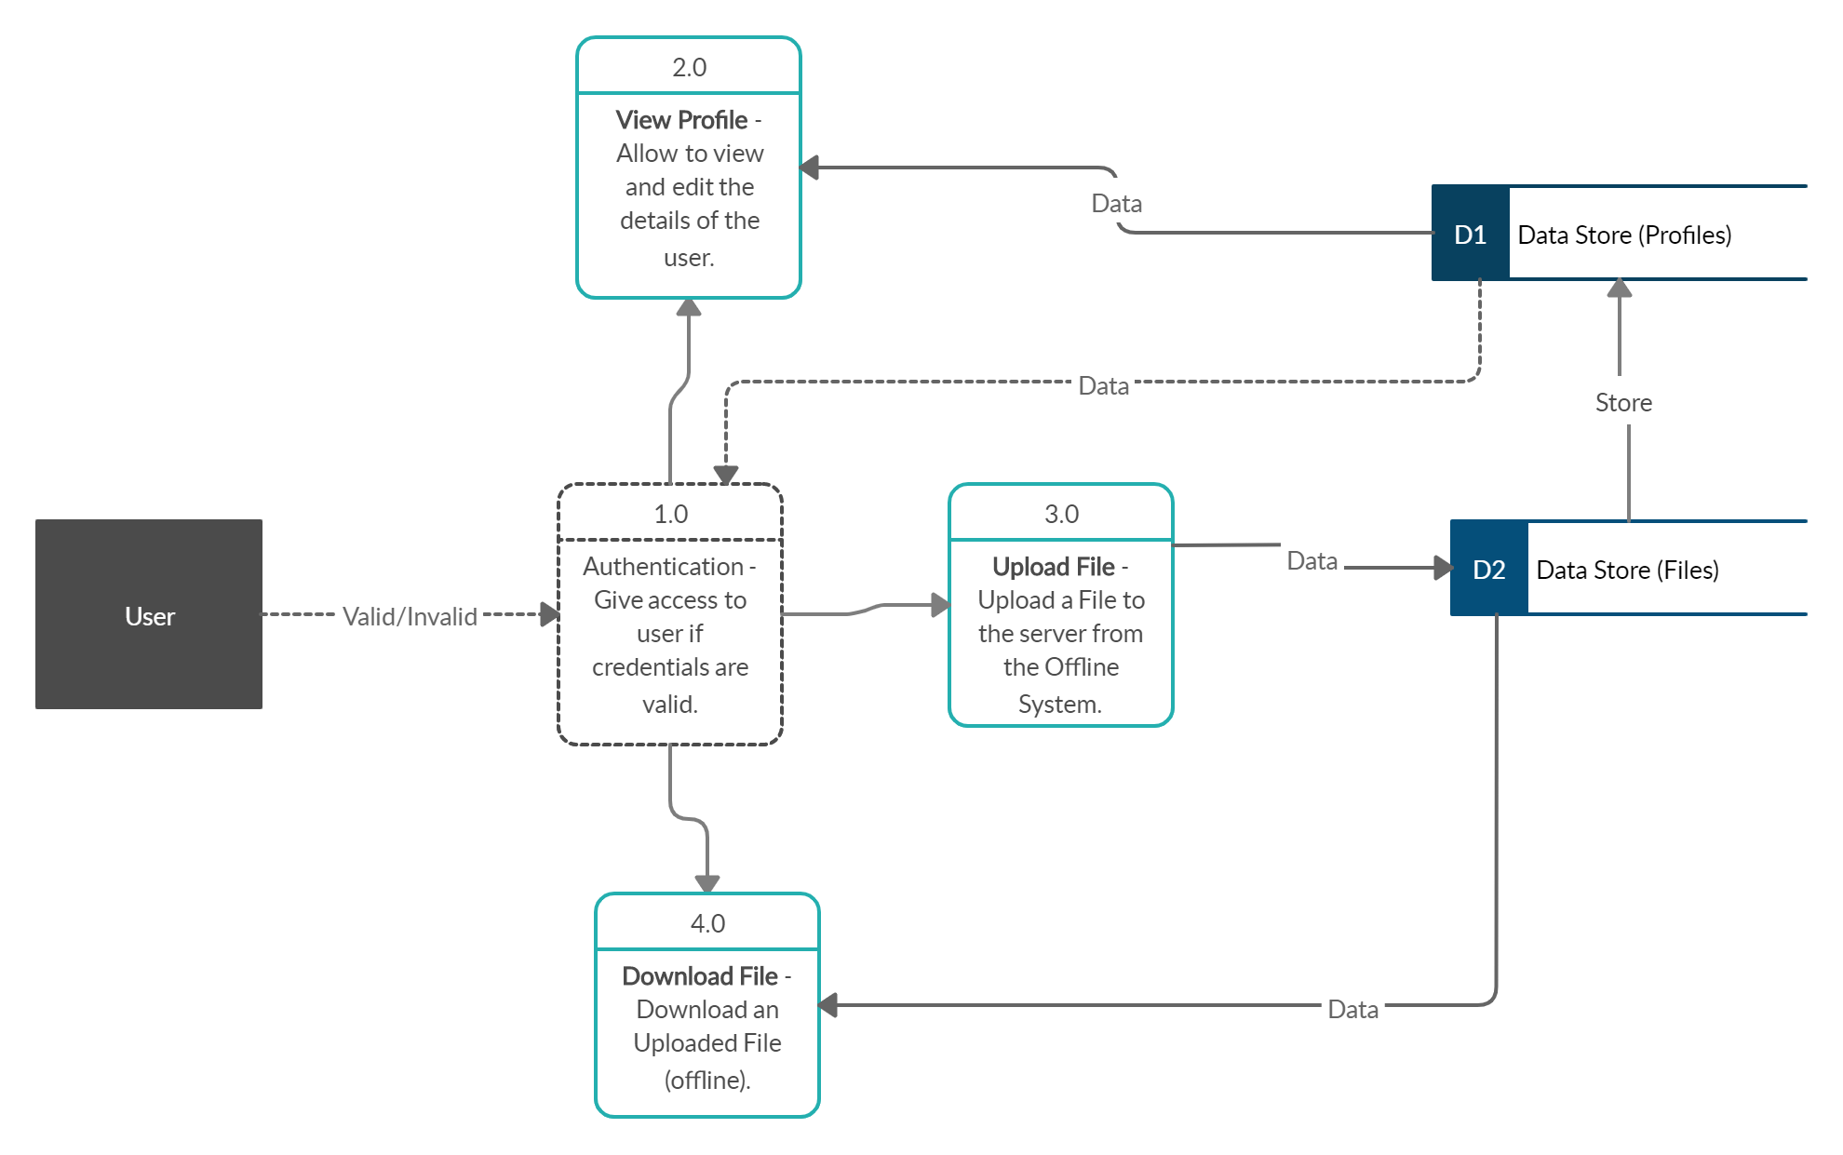
Data Flow Diagram
LEVEL 1

Slide 14
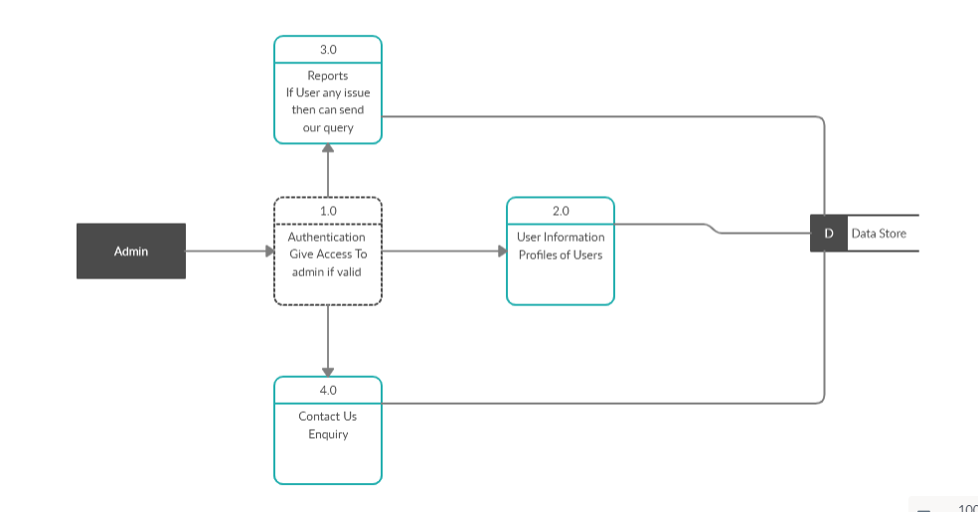
Data Flow Diagram

Slide 15
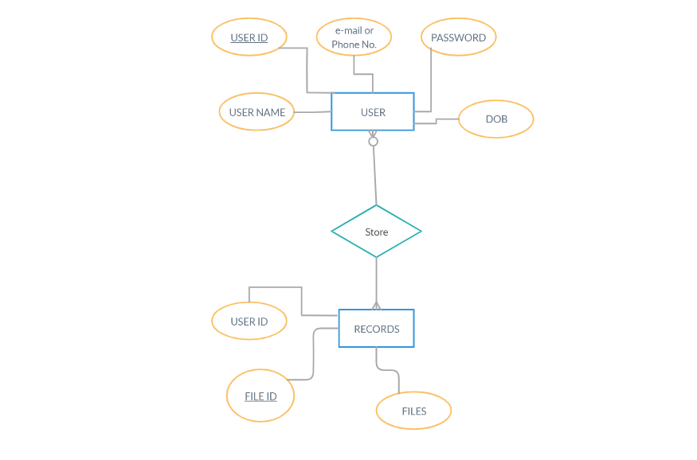
ER Diagram

Slide 16
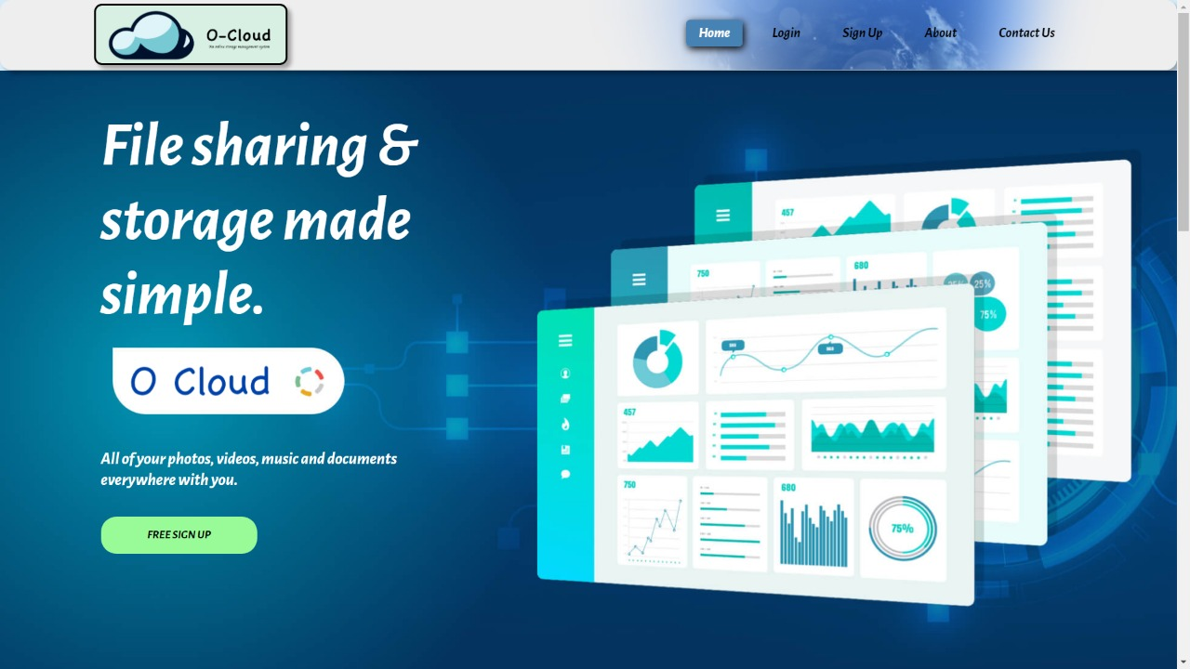
O-CLOUD HOME

Slide 17
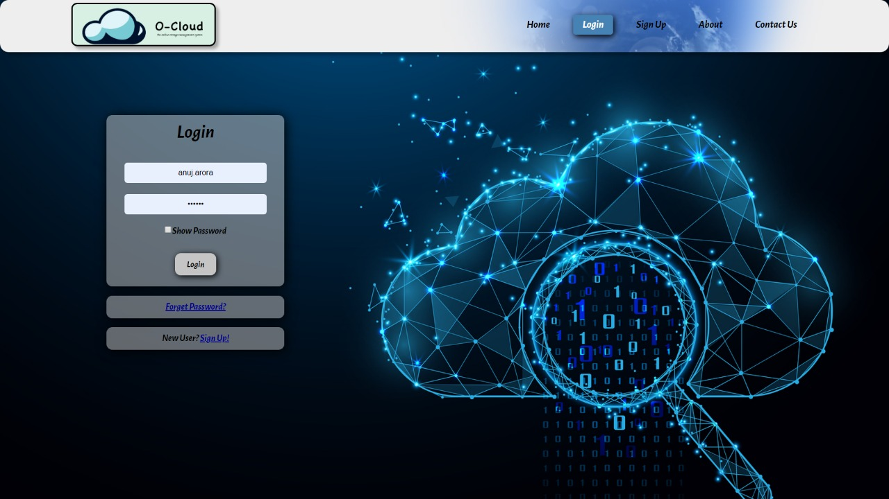
USER LOGIN

Slide 18
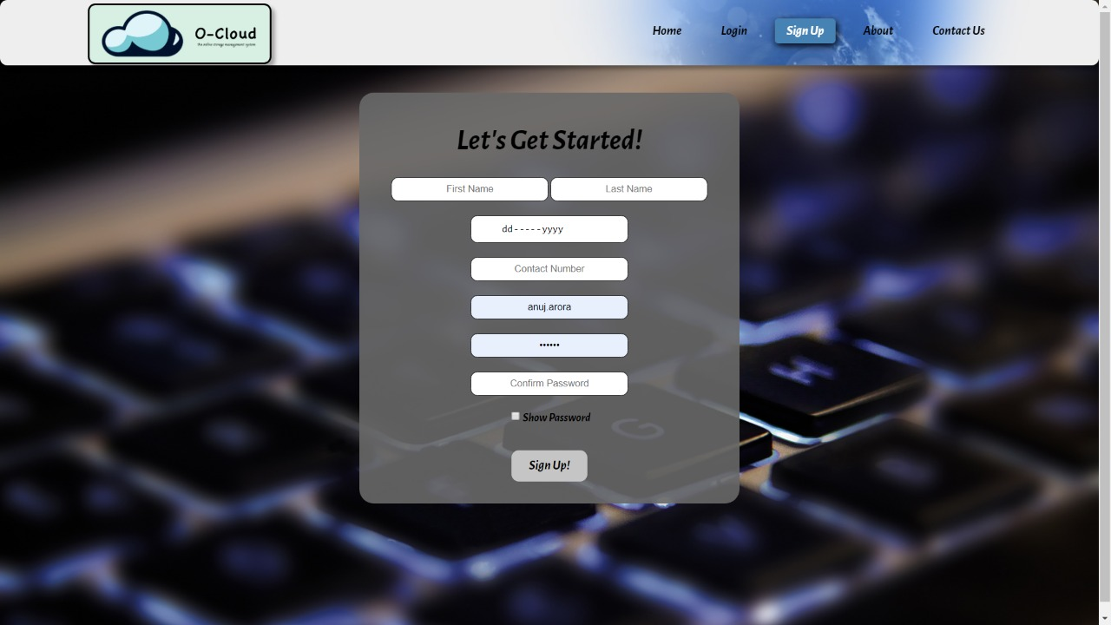
SIGN UP

Slide 19
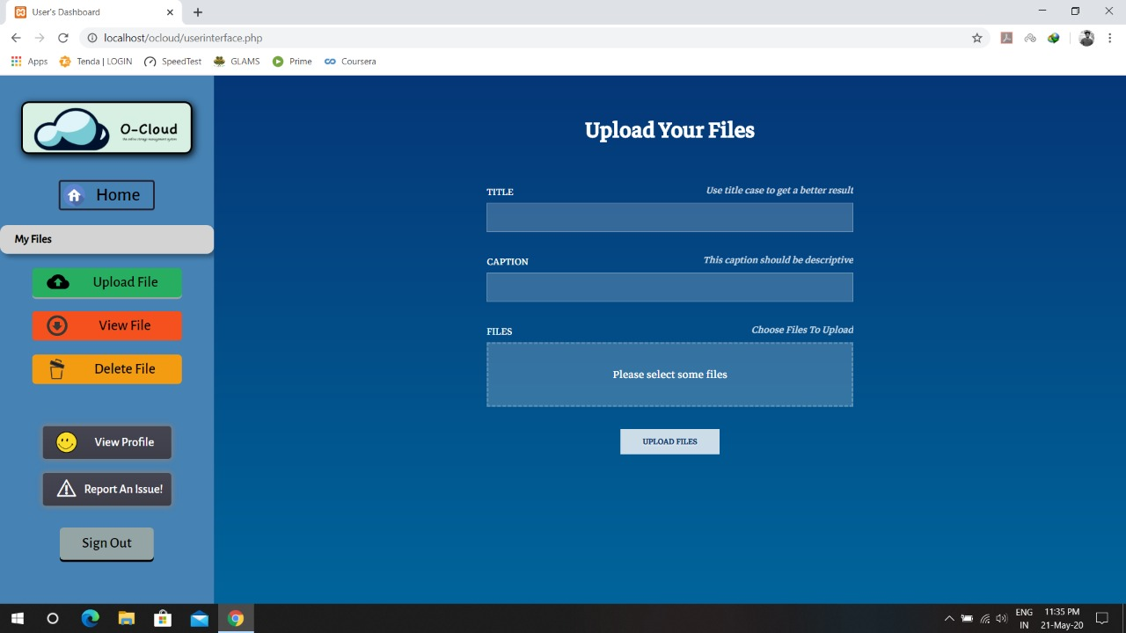
UPLOAD FILES

Slide 20
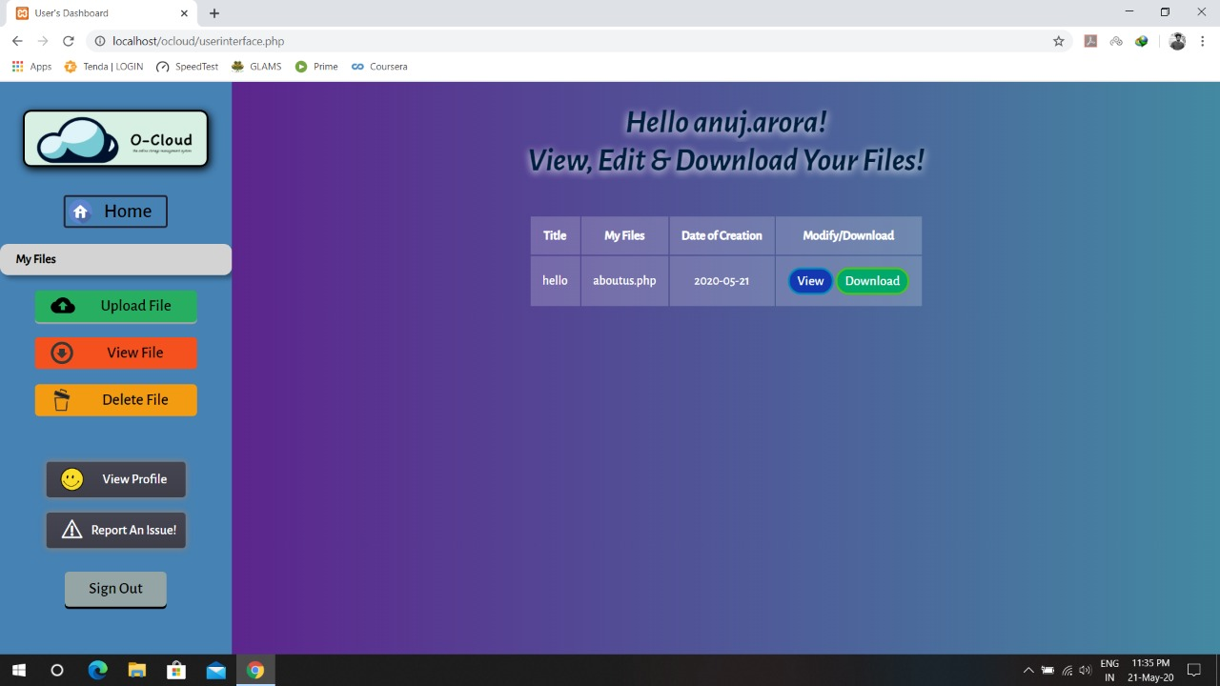
VIEW & DOWNLOAD FILES

Slide 21

Thank You

