Slide 1

Hotel Booking Cancellation Analysis
A data-driven investigation into the factors driving reservation cancellations — and how hotels can recover lost revenue.
PREPARED BY: MOHAMMAD ASAD

Slide 2

The Business Problem
The Challenge
Project Objectives
City and resort hotels are experiencing persistently high booking cancellation rates, directly reducing revenue and room utilization. Understanding the root causes is essential to reversing this trend.
Identify key variables influencing reservation cancellations
Deliver data-driven recommendations for pricing and operations
Support marketing and channel strategy decisions
Increase occupancy and overall revenue generation

Slide 3

Assumptions & Research Questions
Core Assumptions
No major external events between 2015–2017 skew the dataset
Cancelled rooms remain vacant for the booked period
Booking cancellations are a primary driver of revenue loss
Hotels are not currently applying the proposed solutions
Research Questions
Which variables most strongly predict reservation cancellations?
How can hotels reduce cancellation rates operationally?
How can pricing and promotional strategies be improved?

Slide 4


Hypotheses & Expected Recommendations
Price Sensitivity
Lead Time Effect
Higher room rates correlate with increased cancellation probability as guests seek cheaper alternatives.
Longer booking windows and waiting lists increase the likelihood of guests changing plans.
Channel Concentration
Revenue Recovery
Offline travel agents contribute a large share of bookings, introducing higher cancellation risk.
Understanding these factors enables targeted interventions to improve occupancy and revenue.
Expected Actions: Dynamic pricing, flexible cancellation policies, loyalty programs, and agent performance monitoring.

Slide 5
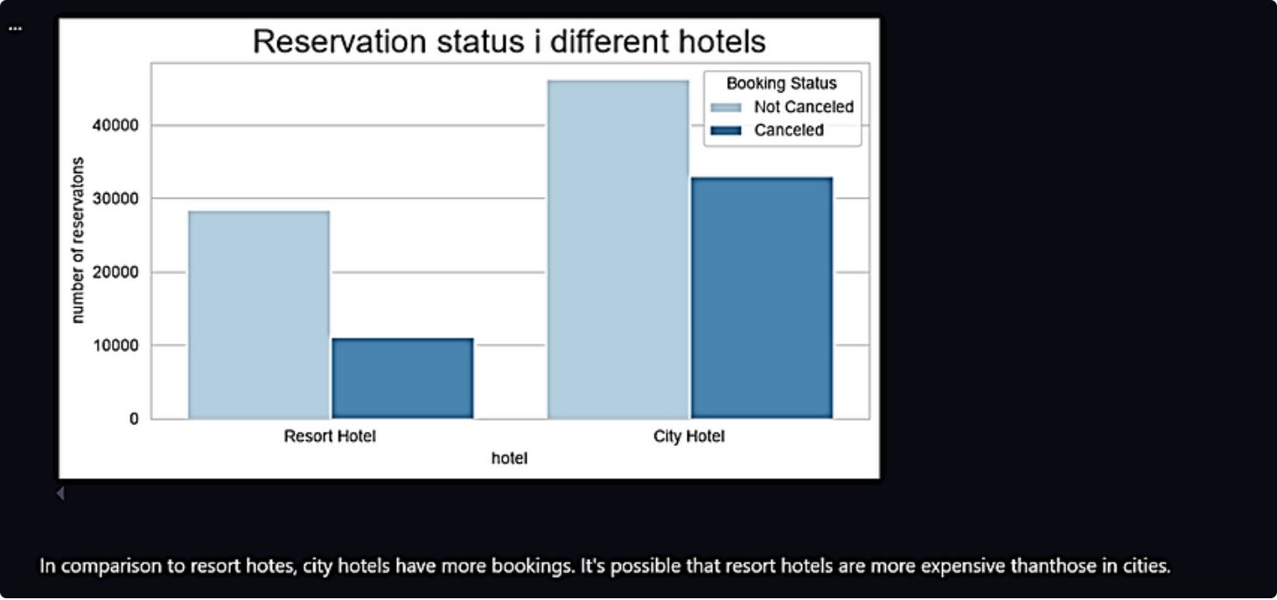
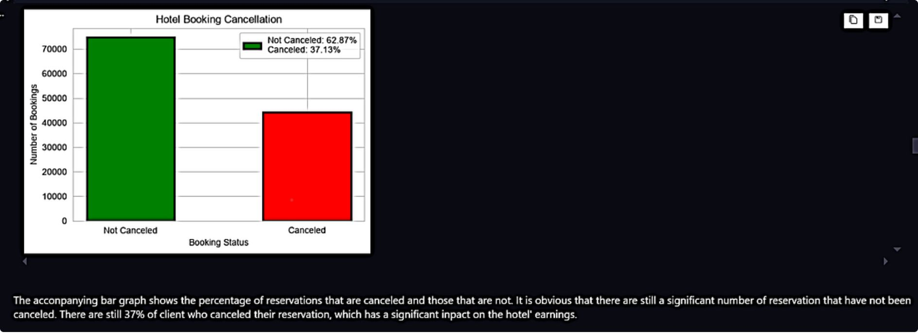
Booking Trends: City vs. Resort Hotels
The following visualizations compare booking volumes and cancellation patterns across city and resort hotel segments, revealing distinct behavioral differences that inform targeted strategy.

Slide 6
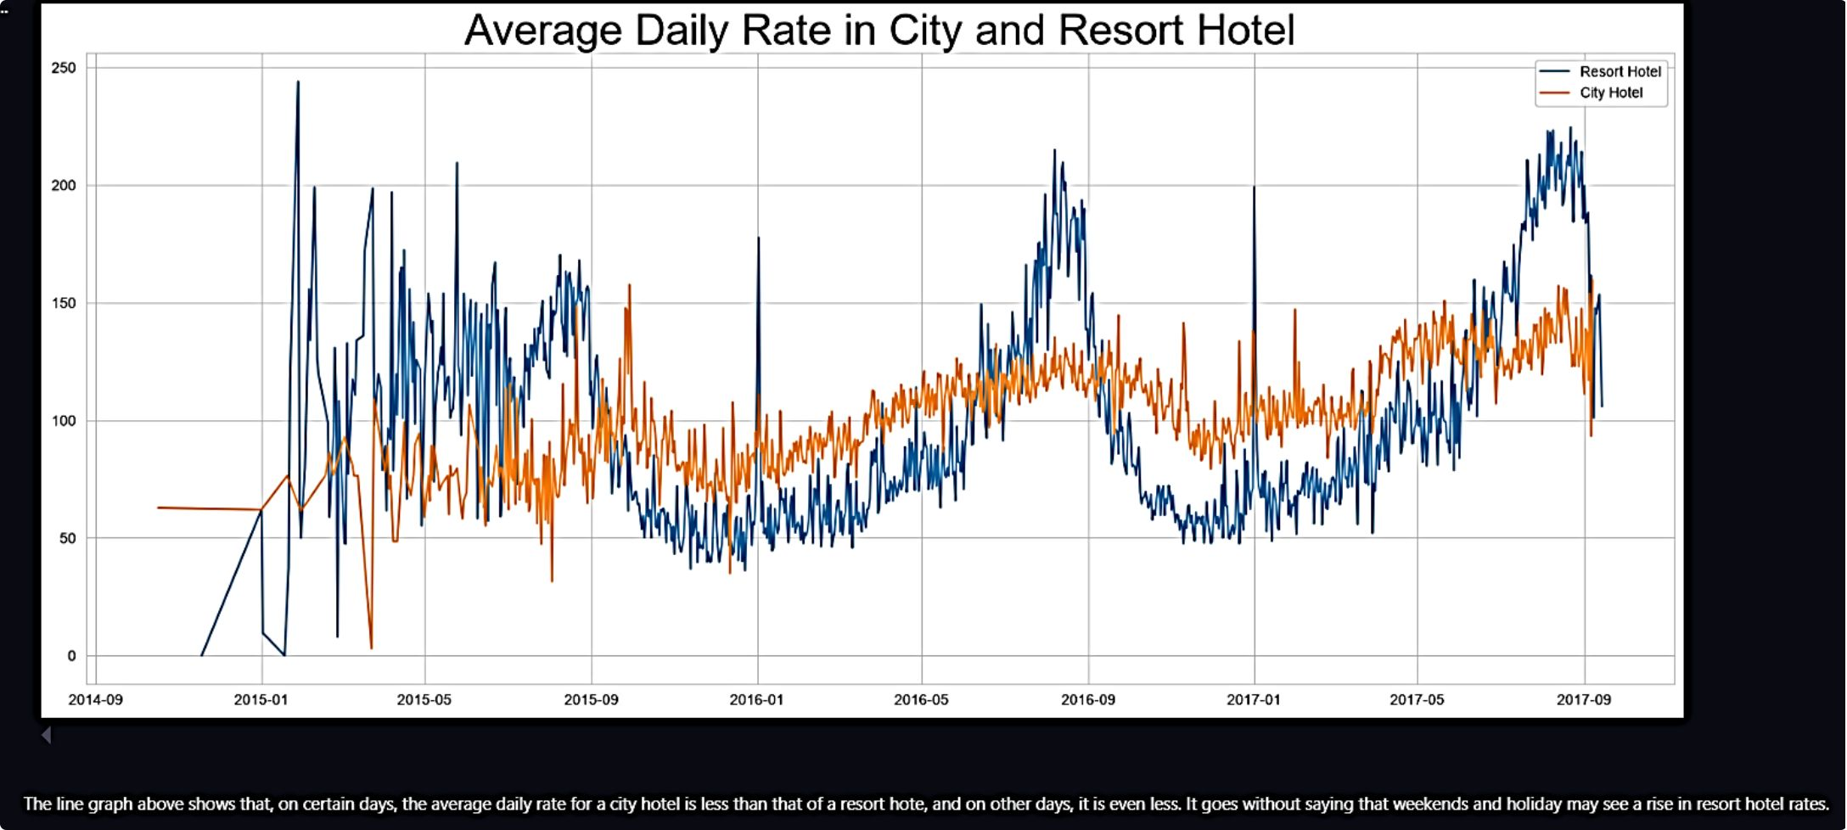
Cancellation Rate Analysis
This visualization breaks down cancellation rates by key booking attributes, highlighting which guest segments and reservation types carry the highest risk of cancellation.

Slide 7
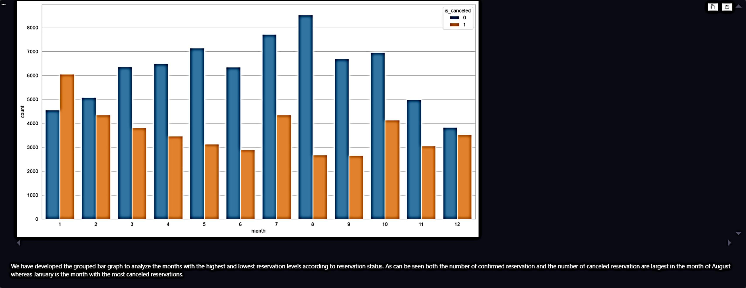
Booking Channel & Agent Performance
Offline travel agents dominate booking volume but also carry elevated cancellation rates. Shifting mix toward direct bookings and loyalty channels can reduce exposure to third-party volatility.

Slide 8
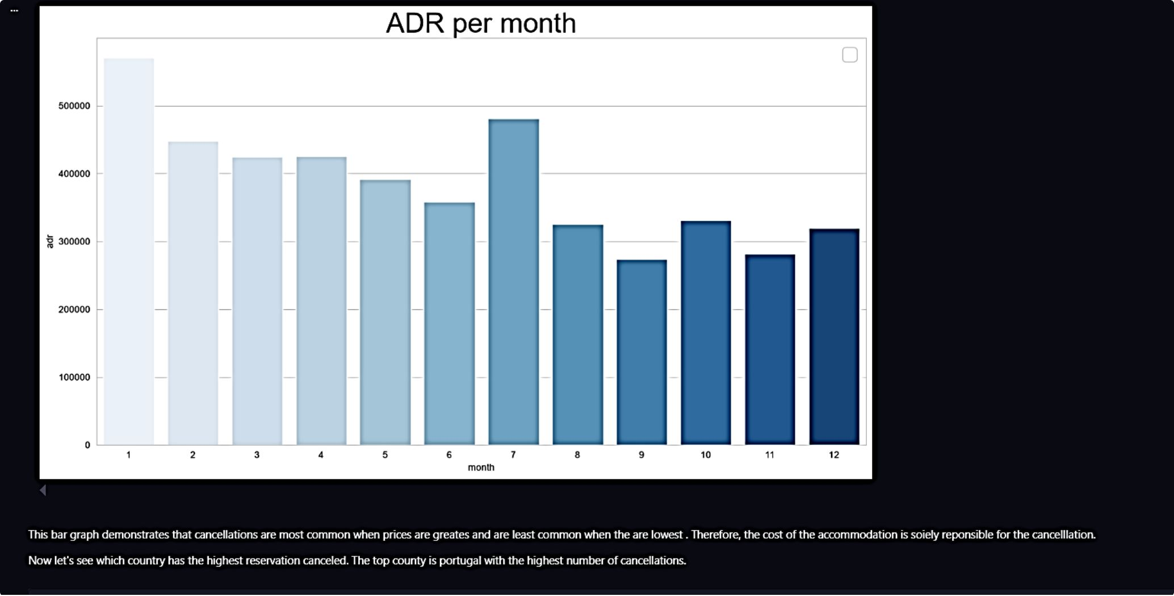

Seasonal Cancellation Patterns
Key Seasonal Insight
Cancellations peak sharply in January, likely driven by post-holiday budget adjustments and travel plan revisions. This window represents the highest-risk period for revenue loss.
January campaigns with targeted discounts or flexible rebooking options can convert at-risk reservations into confirmed stays.

Slide 9
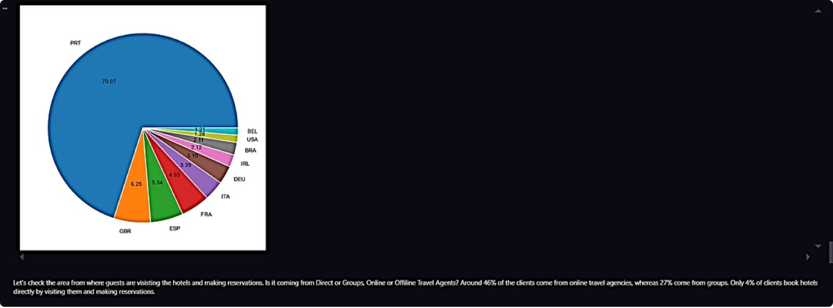
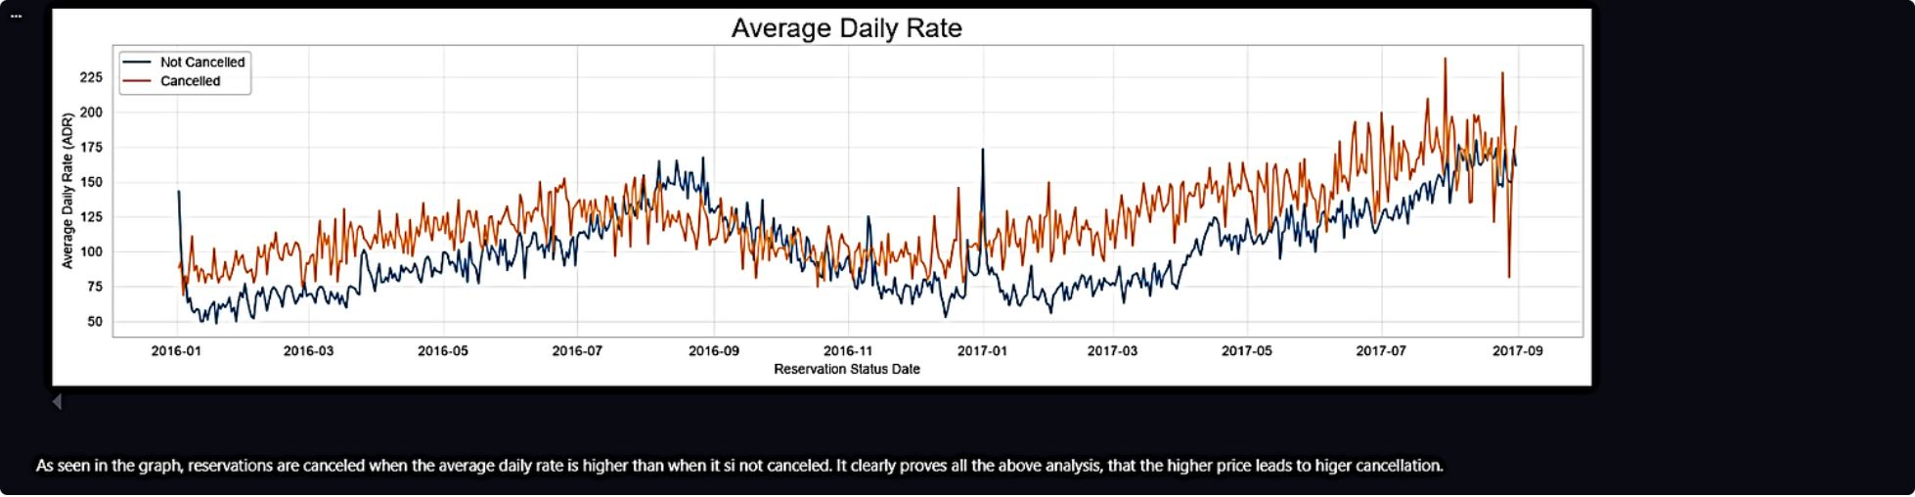
Additional Analytical Findings
These additional visualizations further validate the relationship between pricing, lead time, and cancellation probability — reinforcing the case for dynamic, data-informed revenue management strategies.

Slide 10

Strategic Recommendations
Dynamic Pricing
Lower rates in high-cancellation periods and locations. Offer weekend and holiday discounts, especially at resort hotels.
January Campaign
Launch targeted promotions in January — the highest-cancellation month — with incentives to lock in bookings early.
Service Quality
Invest in hotel quality and guest experience, particularly in Portugal, to reduce cancellations driven by dissatisfaction.
Loyalty Programs
Strengthen direct booking channels through loyalty incentives, reducing reliance on high-cancellation offline agents.

