Slide 1
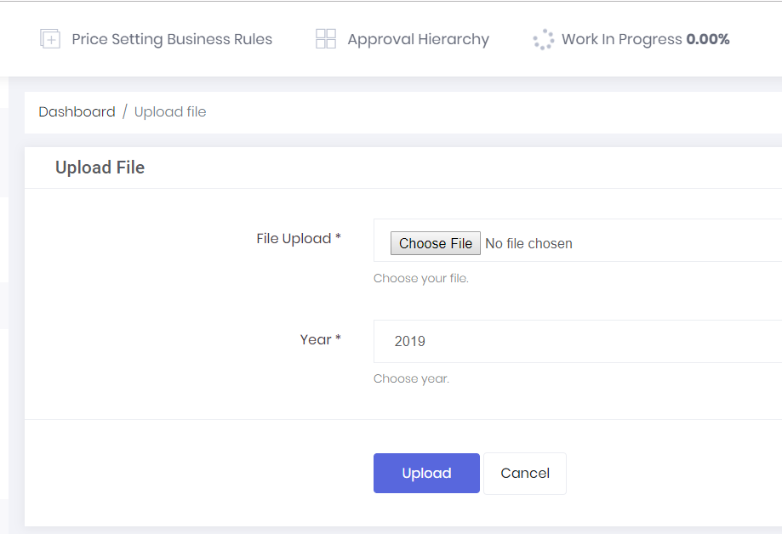
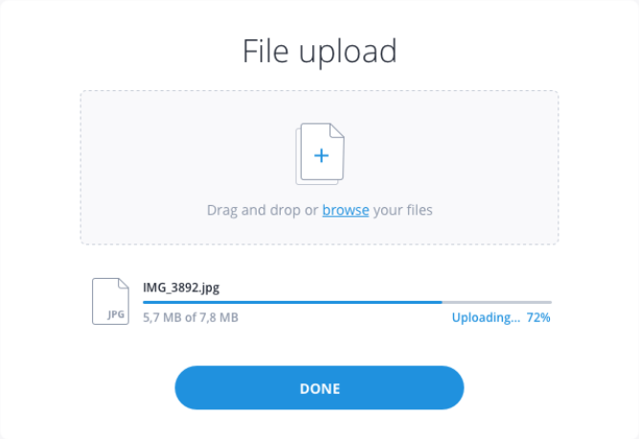
Upload New Data: UI/UX
I tried to upload a new file for 2018. There is already 2018 data existing, but I did not get a message saying that existing file will be overridden. If data for the year exists, a message should be displayed as follows: “You already have pricing data for 2018. Uploading a new file will delete existing data and any analysis done on that data. Are you sure you want to proceed?”
The file upload with dummy data took me 2 minutes. I would like to get a sense for how long it will take by file size.
Since the file uploads take some time, could we please add a message above the File Upload text, in red, saying: “File uploads could take a few minutes depending on the file size. Please do not refresh or close the tool once you start uploading.”
Change the text on the header as follows:
Dashboard / Upload File → Dashboard / Upload Pricing Data
Upload File → “Upload Annual Pricing Data For Analysis & Price Setting”
Once the file upload starts there is a small lag in the “Work in Progress” text to appear up on the top. The file upload happens and then nothing for a few seconds and the Work in Progress appears. Could we please fix that?
The Work In Progress message is easy to miss as it is on the top, least expected. Could we please move it to be in the same space and with a bar like in the image attached right above the buttons?
What font type and size are we using? How much flexibility do we have to change this across the tool? I feel like the one we are using is not necessarily best suited for numbers!

Slide 2
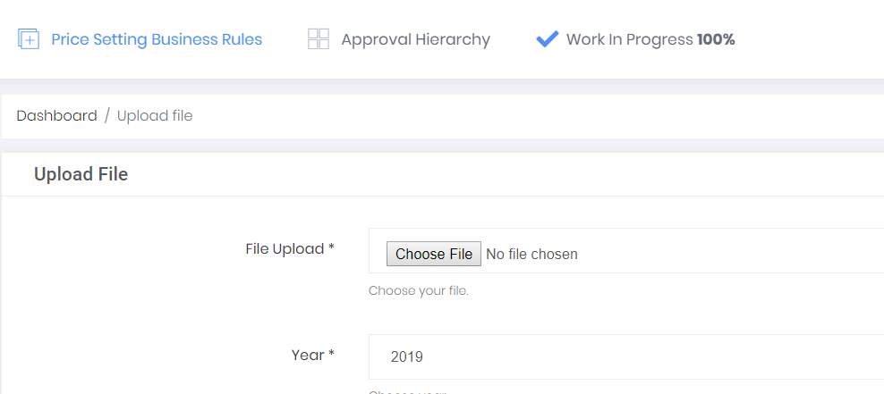
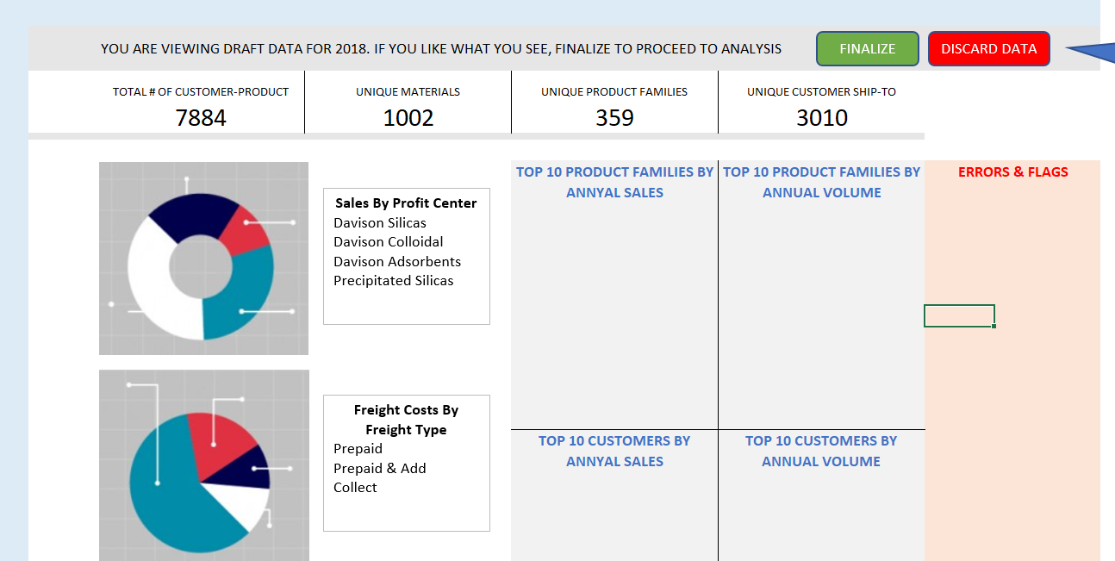
Upload New Data: Navigation
Once the file is uploaded, the text just says “Work In Progress 100%” and does nothing else. Could we please change navigation to as follows (already described in the requirements spreadsheet)?
Once the file is uploaded 100% automatically navigate to the dashboard page for that data
Provide a message saying (slight modification from screenshot): “YOU ARE VIEWING DRAFT DATA FOR 2018. IF YOU HAVE UPLOADED THIS IN ERROR, PLEASE DELETE THE DATA AND TRY AGAIN.”
Provide options: Finalize / Discard and Reload
Upon clicking Discard and Reload, delete data just loaded and navigate back to Upload File page
Upon clicking Finalize, the message disappears and the page stays on the dashboard

Slide 3
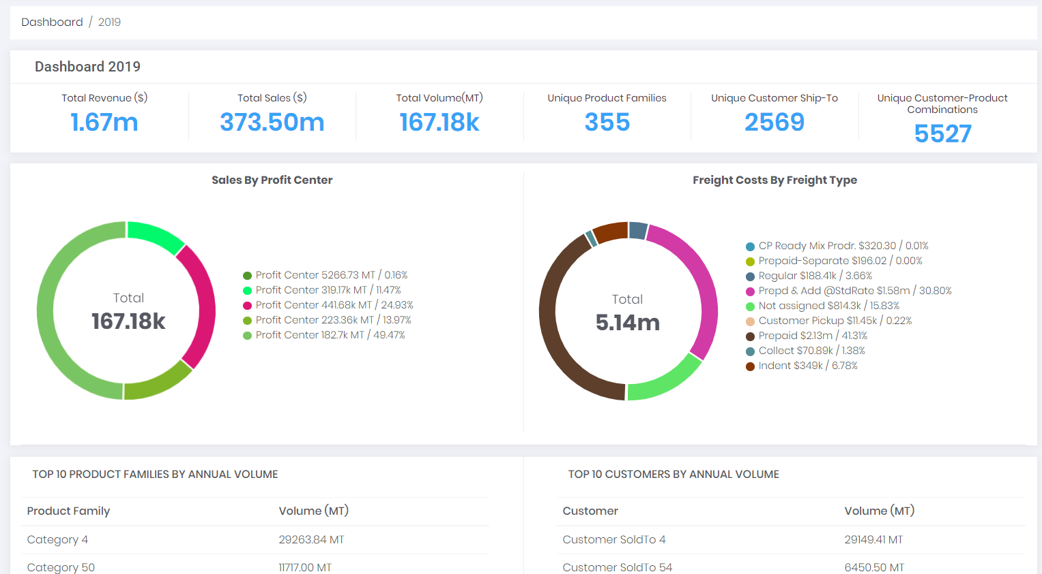
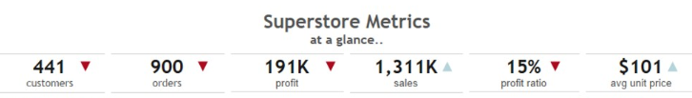

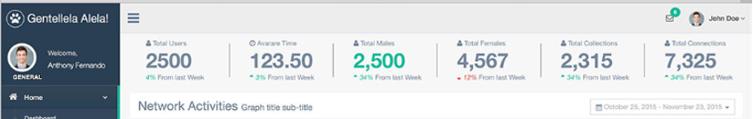
Dashboard: UI/UX
I like some of the changes you made on this page, but it still feels like a lot of white space and I have to scroll to get to more data. I think the UI/UX could do with some tweaking. Specifically my issues are as follows:
Summary numbers in header:
Dashboard 2019 is repeated 2 times. Please remove one of them so that the whole page moves up by a little
In the summary the numbers are all not aligned vertically, because of the spill of text to the second line. Look at images 1, 2, 3 and 4 for ideas. One has text below, one has text not wrapping, one has small tables with numbers always right justified, one has very clear separators and the numbers always with comma etc. They are all easier on the eyes
Use all uppercase for the text in the header: TOTAL SALES instead of Total Sales
Use capital letters for Million (M), thousands (K) etc. Use commas in large numbers (e.g. it should be 5,527). Do not include decimal places in the header
Are these numbers real? What is Total Revenue and Total Sales? Can we have just Total Sales? So we have Total Sales, Total Volume, Unique Product Families, Unique Customer Ship-Tos, Unique Customer-Product Combinations
1
2
3
4

Slide 4
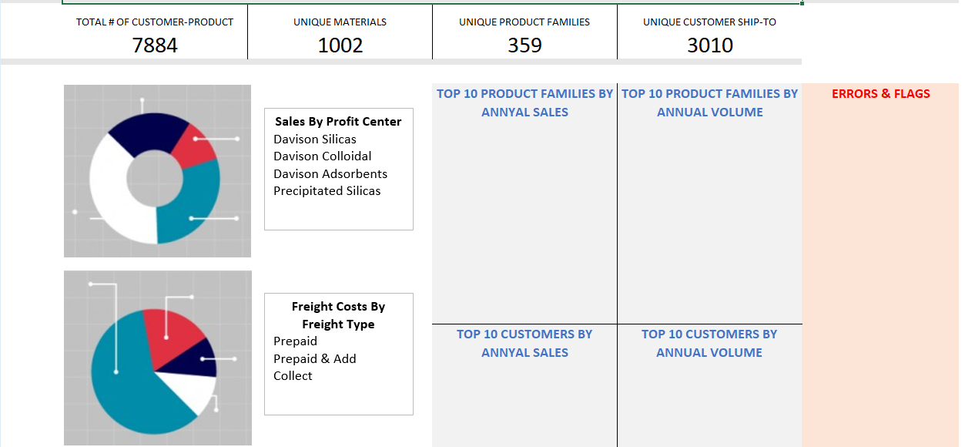
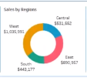
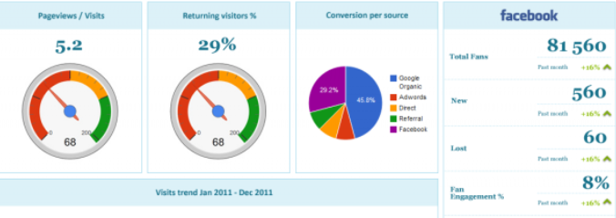
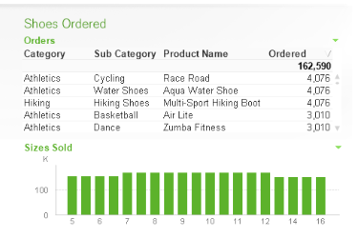
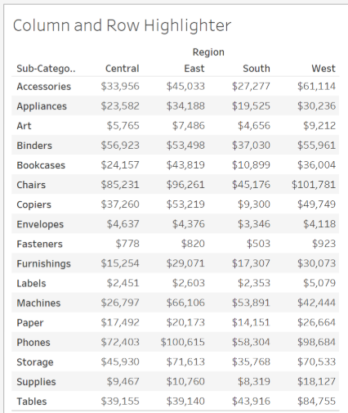
Dashboard: UI/UX (continued)
1
Fit more into the visible space above page-break:
Image 1 on the right is what I had in the requirements spreadsheet – it has all the information on one page
Most analysis websites that I looked at online do not have much scrolling as all important information is above the fold. I would like all the information to be above the fold at 100% font size for the dashboard
In the modules with charts, instead of listing all the text on the side, could we do something like the pie chart in image 2 and reduce the total space it takes?
Ideally I would like to have both the charts next to one another (like in image 3) or one below the other (like in image 1) taking up much lesser space, so that the 4 lists can be on the right hand side like in image 1, with extra space for errors / other messages
The lists have to be tighter both vertically and horizontally, like in image 4. This way they will also fit next to the pie charts like in image 1
It might also be easy for reading if can have light colors for alternate rows like in image 5
The headers for each of the modules are not consistent: Mixed case vs Upper case; left justified vs center, bolded vs not-bolded. Could we have the header titles be all consistent, left justified, bolded and slightly larger font than the data
2
3
4
5

Slide 5
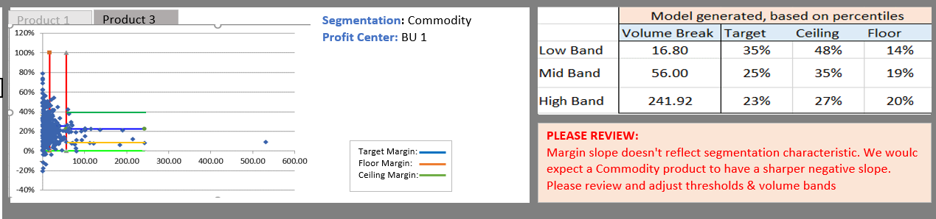
Product Scatterplot: Missing critical functionality (1 of 2)
C
D
A
F
B
E
Product Scatterplot:
Display of the volume breaks (vertical bars one for Low Volume and one for Mid Volume) on the scatterplot
Display of the margin thresholds (horizontal bars 3 for each of the volume breaks) on the scatterplot. These are visual representations of what is in the table
Being able to display multiple scatterplots (at least 2) as different tabs (see image above with Product 1 and Product 3 tabs)
Displaying the details about the product (based on underlying data)
Displaying the legend information (hide / unhide legend so that it is not always there, but can be accessed)
Getting the calculations correct for all the numbers (please refer to spreadsheet, ask questions if you don’t understand, but all those 12 values are extremely important)
For now, I am not focusing on the Customer Scatterplots and Histograms functionality until we get the Product Scatterplot & Pocket Margin waterfall data, calculations and display right.

Slide 6
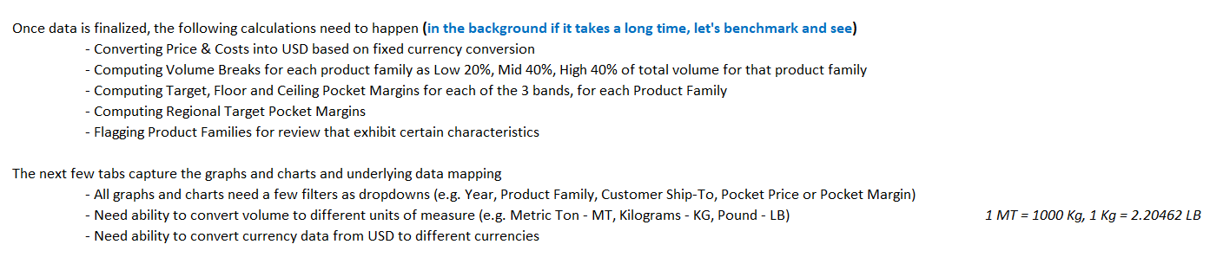
Product Scatterplot: Missing critical functionality (2 of 2)
More Missing Functionality – Needs more discussion:
I think a whole tab with additional functionality in the specifications spreadsheet has been missed by the team. It is called the Calculations>> tab. No questions have been raised on this and none of this functionality has been built
Some of them have been covered in the earlier slide regarding Volume Breaks and Pocket Margin thresholds but there are some that are missing completely
This needs further discussion!

Slide 7
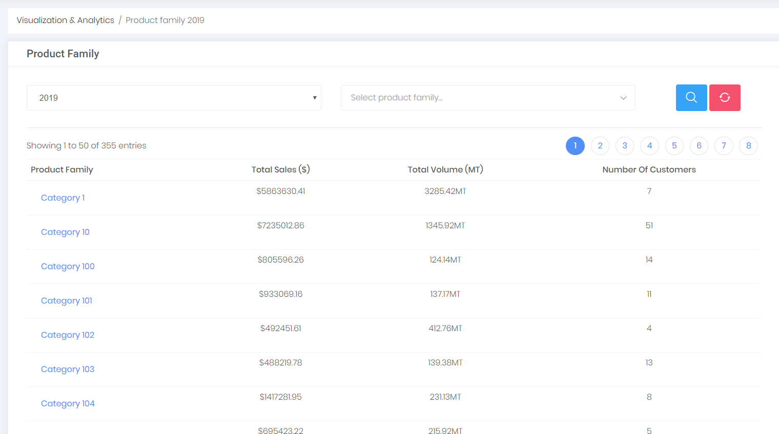
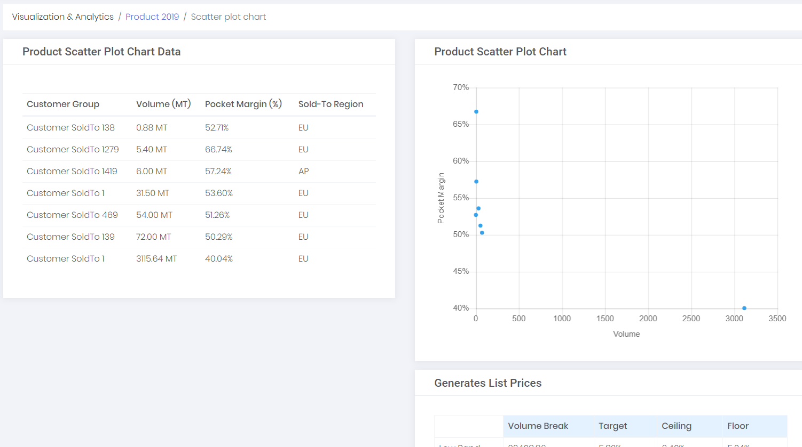
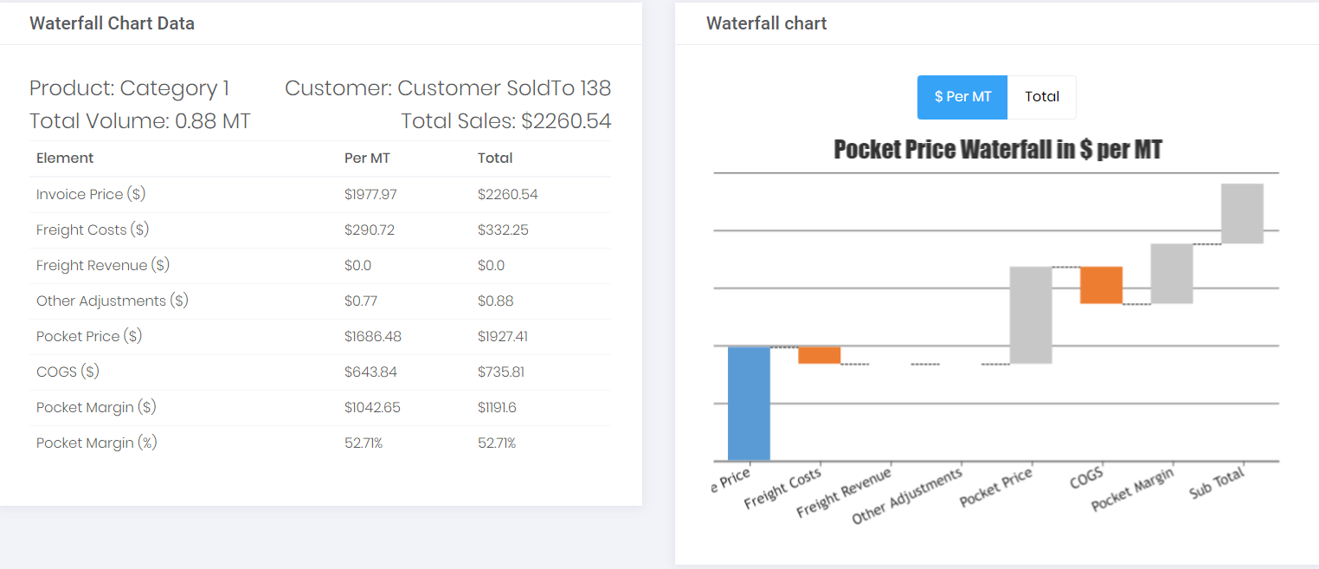
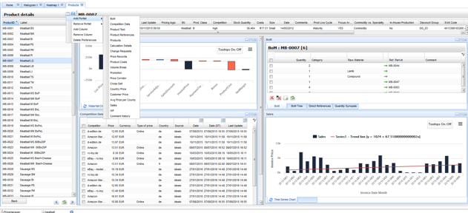
Product Scatterplot: Missing consolidated flow (critical)
1a
1b
1c
We talked about this in the past as well and this is how it is in the specifications spreadsheet:
The idea of the Product Scatterplot flow is to be able to show the list of Product Families on the leftmost pane (image 1a in our tool, similar to Product Details table in image 2), the scatterplot and the list of customers in the scatterplot (image 1b in our tool that is the equivalent to the chart and the table below it in image 2) and individual product waterfall (image 1c from our tool that is the same as the rightmost pane in image 2) all in one page.
In the beginning we decided to just get all the building blocks for each of the charts (scatterplot, waterfall etc) just in place and then look at the flow.
The question is: Are there any limitations (memory, space, design constraints) that prevent us from fitting all the 3 in one page like image 2?
2

Slide 8
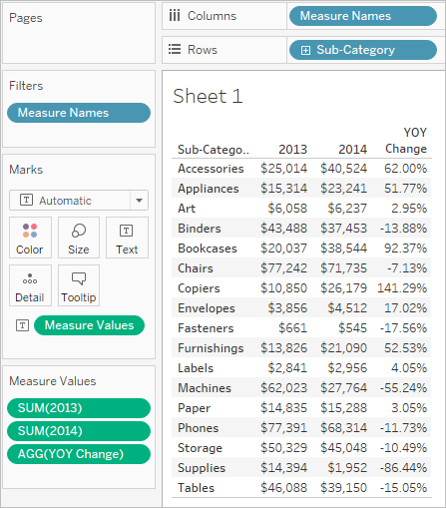
Product Scatterplot: UI/UX
1
Extra white space
Extra white space
Too much space between rows
Too much space between columns
2
Same feedback as the main pages. Too much of white space and too much of scrolling. Numbers not right justified. Font not right for numbers
Get rid of the second header that repeats Product Family
Can we get to the same crispness as image 2 where all the columns are close enough and rows don’t have much space in between?
In the table, if there is a bigger number that needs more space the columns should automatically space out
If there is a longer text that needs more space the text should wrap

Slide 9
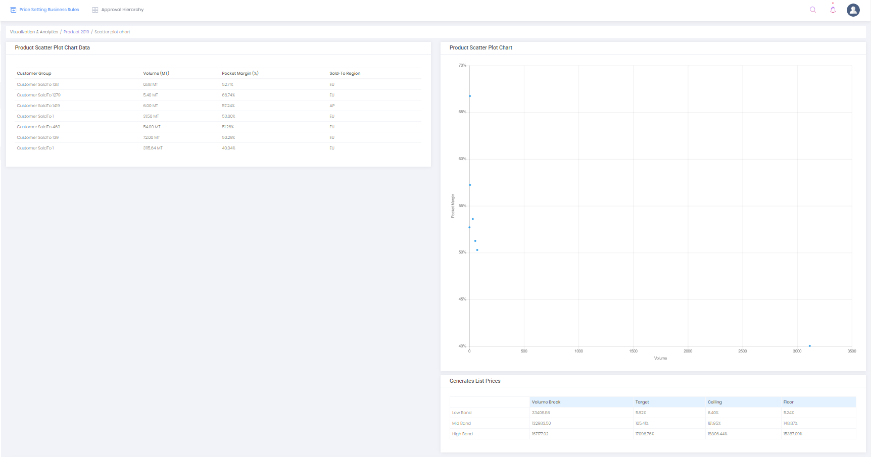
Product Scatterplot: UI/UX Issue
Browser resolution: 50%
Please Note: As I change the browser resolution, something strange happens. The graph becomes big in size, while the font and the other tables shrink. Please try this on your screens.
Browser resolution: 100%

Slide 10
Appendix
Following are sample slides from other tools for inspiration / ideas

Slide 11
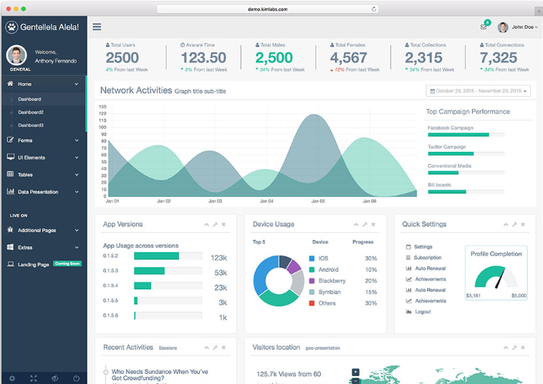
Sample Dashboard 1

Slide 12
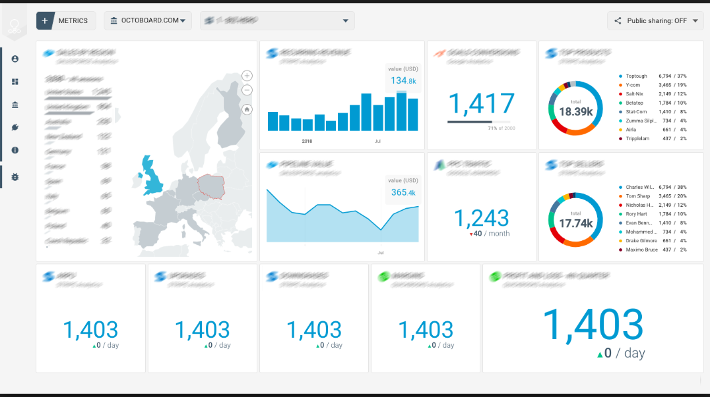
Sample Dashboard 2

Slide 13
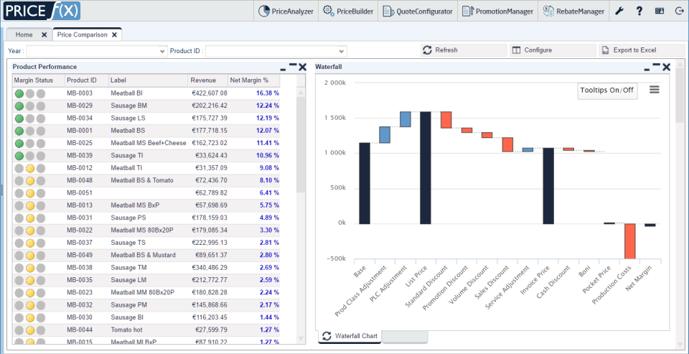
Pocket Price Waterfall

Slide 14
Sample Dashboard 2

Slide 15
Sample Dashboard 2

Slide 16
Sample Dashboard 2

