Slide 1
Game Theory
A mathematical approach to understand the outcomes of interactions between two or more individuals when benefits and costs of the interactions depend on the strategies of each individual.(+ definitions)
players I ( = {1, .., n} )
pure strategies for each player Si ( = {s1, ..., sm} )
mixed strategies x : A mixed strategy set can be defined as a vector x=(x1,...,xm), where m is the number of pure strategies and each component xh denotes the probability that player i chooses its hth pure strategy
utility function ui ( : S1 × ... × Sn → R ) : associates strategies to payoffs
Classical game theory VS Evolutionary game theory
Static strategies (CGT) VS Dynamic strategies (EGT)
Evolutionary game theory (EGT):
overcoming some limitations of traditional game theory
Evolutionary game theory differs from classical game theory in focusing more on the dynamics of strategy change (επανάληψη).
Nash equilibrium: set of strategy profiles in which each strategy is a best response to the strategy of the co-player and no player has the incentive to deviate from their decision (no player can increase his own expected payoff by changing his strategy ).
Payoff matrix: The value associated with a possible outcome of a game (set of strategies)

Slide 2
Proposed System
Our approach is defined in terms of evolutionary game theory.
(To the best of our knowledge,) our method is the first attempt to use a game theoretic framework in the specific NLP task of WSD
WSD task
sense-labeling task (sense assignment to word)
constraint satisfaction problem
WSD problem modelling in game theoretical terms
players → words
strategies → senses (evolving population)
payoff matrices → sense similarity
interactions → weighted graph
Nash equilibria correspond to consistent word-sense assignments
Word-level similarities: proportional to strength of co-occurrence between words
Sense-level similarities: computed using WordNet / BabelNet ontologies
It assumes that there is a population of individuals, represented by all the senses of the words to be disambiguated, and that there is a selection process, which selects the best candidates in the population. The selection process is defined as a sense similarity function, which gives a higher score to candidates with specific features, increasing their fitness to the detriment of the other population members. This process is repeated until the fitness level of the population regularizes and at the end the candidates with higher fitness are selected as solutions of the problem.

Slide 3
Proposed System
This approach ensures that the final labeling of the data is consistent and that the solution of the problem is always found. In fact, our system always converges to the nearest Nash equilibrium from which the dynamics have been started . TODO - always converges
This approach gives us the possibility not only to exploit the contextual information of a word but also to find the most appropriate sense association for the target word and the words in its context.
Within a game theoretic framework we are able to cast the WSD problem as a continuous optimization problem, exploiting contextual information in a dynamic way
Versatile approach: method is adaptive to different scenarios and to different tasks, and it is possible to use it as unsupervised or semi-supervised (new semi-supervised version of the approach, which can exploit the evidence from sense tagged corpora or the most frequent sense heuristic and does not require labeled nodes to propagate the labeling information.).

Slide 4
Data Modelling
Data Geometry
Strategy Space
Payoff
System Dynamics & Sense Classification

Slide 5
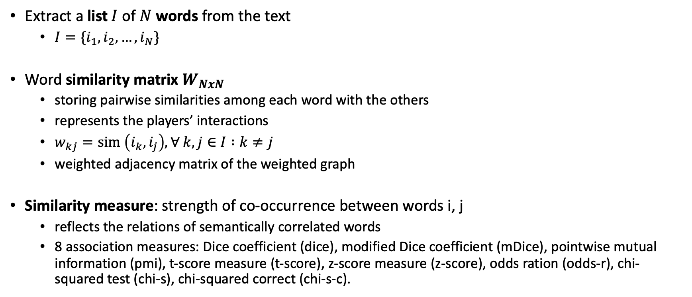
Data Geometry
Extract a list $I$ of $N$ words from the text
$I=\{i_{1}, i_{2}, …, i_{N}\}$
Word similarity matrix $W_{NxN}$
storing pairwise similarities among each word with the others
represents the players’ interactions
$w_{kj}=sim \left(i_{k},i_{j}\right), ∀ k,j∈I :k≠j$
weighted adjacency matrix of the weighted graph
Similarity measure: strength of co-occurrence between words i, j
reflects the relations of semantically correlated words
8 association measures: Dice coefficient (dice), modified Dice coefficient (mDice), pointwise mutual information (pmi), t-score measure (t-score), z-score measure (z-score), odds ration (odds-r), chi- squared test (chi-s), chi-squared correct (chi-s-c).

Slide 6
Data Geometry
Target words not in reference corpus
query expansion (alternative lexicalisations of lemma using WordNet )
Proximity relations with n-neighbours ( similarity augmentation - step 3 )
reflects the sentence structure
small n: fixed expressions
large n: semantic concepts
n-gram structure (graph representation Figure 4b)
similarity n-gram graph (Figure 4c)
No disconnected nodes
example-> m-dice (τύπος)

Slide 7
Data Geometry
Figure 4b
weighted adjacency matrix of the weighted graph

Slide 8
Strategy Space
collect sense inventories of each word M using a knowledge base (using WordNet and BabelNet as knowledge bases)
player (word) strategy space
Δp = { x Rn : i=1nxi=1, where xi 0 for i=1,2, ... ,n }, n-simplex, where n=m+1, m is the number of pure strategies and each component x_i denotes the probability that player p chooses its i-th pure strategy
represented as a regular polygon of radius 1, where the distance from the center to any vertex (mixed strategy) represents the probability associated with a particular word sense (pure strategy) (Figure 5)
(mixed strategy space of the game:Θ= Δi , iI (Cartesian Product)
create the list C = (1, . . . , c) of all the unique concepts in the sense inventories (space of game)
assign for each word in I a probability distribution over the senses in C (probability distribution over the possible strategies)

Slide 9
Strategy Space
System Strategy space S (matrix )
Each component sih denotes the probability that the player chooses to play its hth pure strategy among all the strategies in its strategy profile
Uniform distribution
equation 15
unsupervised learning: no prior knowledge
Geometric distribution
semi-supervised learning: exploits information from prior knowledge
equation 16: probability according to its rank, concentrating a higher probability on senses that have a high frequency
equation 17: cluster the senses & assign an equal probability to the senses belonging to a determined cluster

Slide 10
Payoff
compute the sense similarity matrix Z among each pair of senses in C, which is then used to compute the partial payoff matrices of each game
zij= ssim(ii , ij), i,jI:ij
partial payoff matrix: single games played between two players i and j, Z_ij -> dim mxn, m, n senses of words i, j.
semantic similarity
relations of likeness (“is-a”)
wup: only the path length among two concepts (τύπος?!)
ssim(si, sj)= 2 ∗ depth(msa)/(depth(s_i) + depth(s_j))
ssim(si, sj)= IC(s_i) + IC(s_j) − 2IC(msa), where IC(c) = “information content - surprisal - of concept c” - IC(c)= -log_2(p(c))- and msa= “most specific ancestor node”
jcn measure: corpus statistics and structural properties (τύπος!?)

Slide 11
Payoff
semantic relatedness
similarity among the definitions of two concepts
Wider range of relations (“is-a-part-of”, “is-the-opposite-of”)
definitions derived from glosses of the synsets in WordNet
co-occurrence vector vi = (w1,i,w2,i...wn,i) (for each concept i, where w represents the number of times word w occurs in the gloss - n total words)
cosine similarity
ssim(si, sj) = vi vj ||vi|| ||vj||, where ||vi|| = j=1nwji (cosine of the angle between the two co-occurrence vectors
4 variations (way the gloss vectors are constructed)
difference in co-occurrence calculation, the corpus use, and relation source
tf-idf, tf-idf_ext, vec, and vec_ext.

Slide 12
System Dynamics and Sense Classification
Apply the replicator dynamics equation in order to compute the Nash equilibria of the games
Equations 10(expected fitness of sense i),11(average fitness of population - senses),6(replicator equation)
A replicator equation is designed to model the change in frequency of a state—it increases the frequency of a better performing type(trait) and decreases the frequency of under-performing type (trait) . The performance is measured relative to the average fitness of population. The expected fitness of i-th type is (Πx)i and the average fitness of population is x^TΠx.
In each iteration of the system, each player plays a game with its neighbors Ni
the payoff of word i depends on the similarity that it has with word j, wij, the similarities among its senses and those of word j, Zij, and the sense preference of word j, (xj)
a process of selection allows strategies with higher payoff to emerge and at the end of the process each player chooses its sense according to these constraints.
( with Equation (5/6) it is always possible to find the Nash equilibria of the games + Theorem )

Slide 13
System Dynamics and Sense Classification
Classification: assign to each word i ∈ I a unique strategy s ∈ C unique -> argmax
the strategy(sense) with the highest probability is chosen
φi=argmax(xih), h=1,2, ... , c, (c -> senses, i -> word) - equation 7
This way, it is guaranteed that at the end of the process each word is mapped to exactly one sense. (Experimentally, we noticed that when a word is able to update its strategy space, it is not the case that two strategies in it have the same probability.)
A word is not disambiguated
not able to update its strategy space. This can happen when the player’s strategy space is initialized with a uniform distribution and either its payoff matrices have only zero entries (i.e., when its senses are not similar to the senses of the co-players), or it is not connected with other nodes in the graph

Slide 14
System Dynamics and Sense Classification
Figure 5
tokenize, lemmatize, and tag the sentence
extract the content words
calculation of pairwise similarity
m-dice association measure + proximity, n=1-> co-occurrence / similarity n-gram graph
collect sense inventories
pairwise semantic similarity (tf-idf)
strategy space -> uniform distribution (no prior info)
In each iteration of the dynamics each player plays a game with its neighbors, obtaining a payoff for each of its strategies according to Equation (10); once the players have played the games with their neighbors in W, the strategy space of each player is updated at time t + 1 according to Equation (6)
As we can see, at time step 1 the senses of each word are equiprobable, but as soon as the games are played some senses start to emerge
at time step 2 many senses are discarded
the words in the text push the senses of the other words toward a specific sense
the sense similarity values for certain senses are very low
Interesting behavior of the strategy space of the word bank
when it plays a game with the words financial and institution, it is directed toward its financial sense
when it plays a game with the word river, it is directed toward its naturalistic meaning
The balancing of these forces toward a specific meaning is given by the similarity value wij, which allows bank in this case to choose its naturalistic meaning

Slide 15
Parameter Tuning
Two data sets to evaluate our algorithm in different scenarios
From each data set
50 different data sets to simulate a situation in which the system must work on texts of different sizes and on different domains
The parameters that will be tuned:
Association and semantic measures to weight the similarity among word and senses
The n-gram graph to increase the weights of near words
The p of the geometric distribution used by their semi-supervised system

Slide 16
Parameter Tuning - Results
Association and Semantic Measures:
The relatedness measures perform significantly better than the semantic similarity measures
On average the best measures are dice and mdice
N-gram Graph:
Highest results on both data sets are tfidf -mdice, with n = 5
Geometric Distribution:
Parameter p = 0.4 (in a range from 0.4 to 0.7) in cases of semi-supervised learning→ the highest result

Slide 17
Evaluation set-up
Results are provided as F1 a measure that determines the weighted harmonic mean of precision and recall
Experiment with WordNet as Knowledge base:
The best performance on nouns on all the data sets
Low results on verbs on all data sets
The use of prior knowledge is beneficial in general domain data sets
Experiment with BabelNet as Knowledge base:
We used BabelNet to collect the sense inventories of each word to be disambiguated and NASARI to obtain the semantic representation of each sense
This data set contains highly ambiguous mentions

Slide 18
Comparison to state-of-the-art algorithms
WordNet:
Our unsupervised system performs better than any other unsupervised algorithm in all data sets
The performance of our system is more stable on the four data sets
The comparison with semi-supervised systems shows that our system always performs better than the most frequent sense heuristic when we use information from sense-labeled corpora
BabelNet:
The performance of our system is close to the results obtained with Babelfy on S13 and substantially higher on KORE50
It is also difficult to exploit distributional information on this data set because the sentences are short and, in many cases, cryptic. For these reasons, the recall on this data set is well below the precision: 55.5%

Slide 19
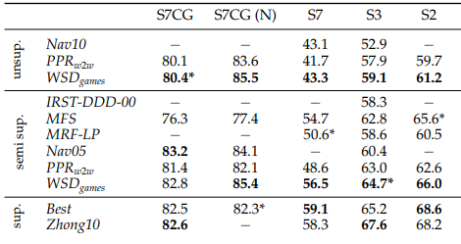
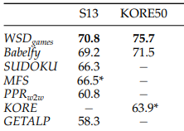
Comparison to state-of-the-art algorithms

