Slide 1
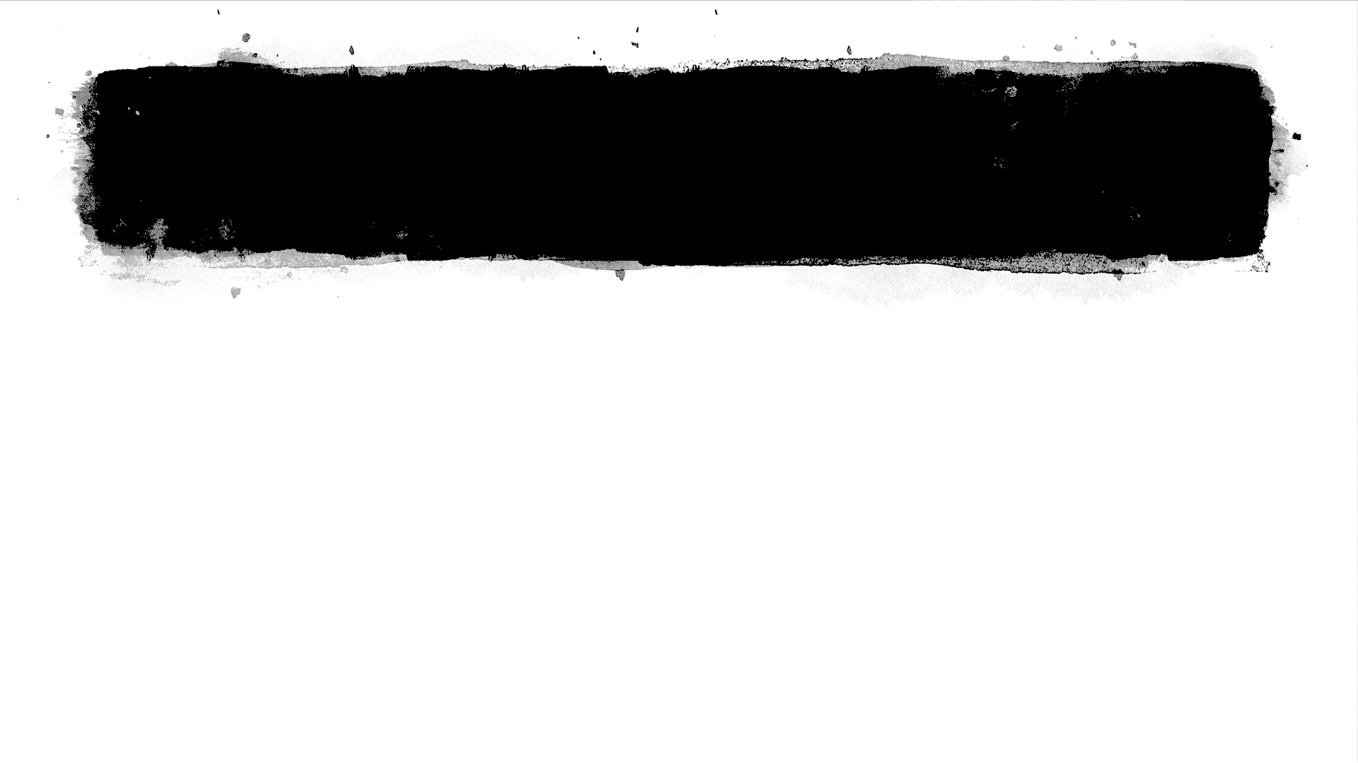

Game Theory
Mathematical approach to study the interaction between two or more individuals
Outcome → benefits and costs depend on the strategies of each other
Players $I=\left\{\text{1, .., }\text{n}\right\}$, where $N$ , the total number of players
Pure player strategy set $S_{i}=\{ s_{1}, s_{2}, … , s_{M }\}$, where
$M$ , the total number of strategies
Mixed player strategy set $x_{i}=\{ x_{11}, x_{12}, …, x_{1M} \}$
A mixed strategy set can be defined as a vector x=(x1,...,xm), where m is the number of pure strategies and each component xh denotes the probability that player i chooses its hth pure strategy
Utility function ui ( : S1 × ... × Sn → R ) : associates strategies to payoffs
Classical game theory VS Evolutionary game theory
Static strategies (CGT) VS Dynamic strategies (EGT)
Evolutionary game theory (EGT):
overcoming some limitations of traditional game theory
Evolutionary game theory differs from classical game theory in focusing more on the dynamics of strategy change (επανάληψη).
Nash equilibrium: set of strategy profiles in which each strategy is a best response to the strategy of the co-player and no player has the incentive to deviate from their decision (no player can increase his own expected payoff by changing his strategy ).
Payoff matrix: The value associated with a possible outcome of a game ( set of strategies )

Slide 2
Proposed System
Evolutionary game theory framework
First attempt in the specific NLP task of WSD
WSD
Sense - labeling task → sense assignment to words
Constraint satisfaction problem
WSD problem modelling in game theoretical terms
Players → words ( to be disambiguated )
Strategies → senses ( evolving population )
Payoff matrices → sense similarity
Interactions → weighted graph
Nash equilibrium → consistent word-sense assignment
Selection process
Iterative process of fitness increase ( candidates / senses with certain features )
best candidates ( senses with higher fitness ) in the population

Slide 3
Proposed System
The final labelling of the data is consistent
The solution of the problem is always found
System convergence to the nearest Nash equilibrium
(from dynamics’ starting point)
Target word
Words in its context
WSD problem
Continuous optimization problem
Exploitation of contextual information in a dynamic way
Versatile approach
Adaptive to different scenarios and tasks
Most appropriate sense association
(evolutionary game theoretic framework)
Unsupervised / Semi-supervised

Slide 4
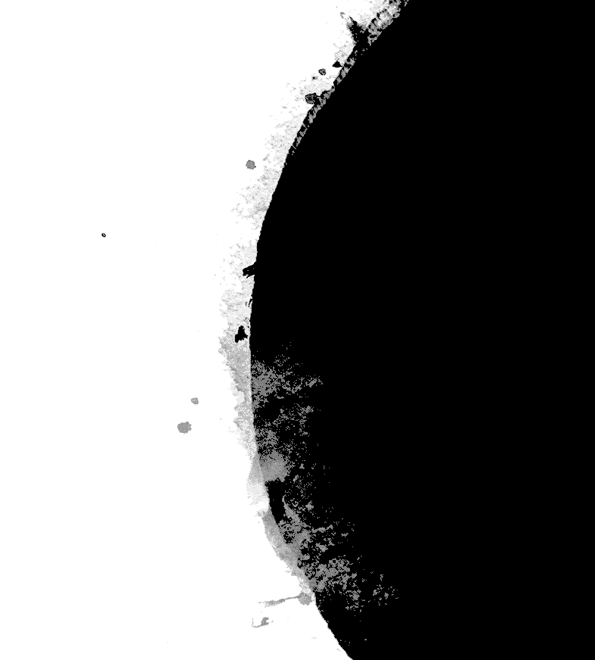
Data Modelling
Data Geometry
Strategy Space
Payoff
System Dynamics & Sense Classification

Slide 5

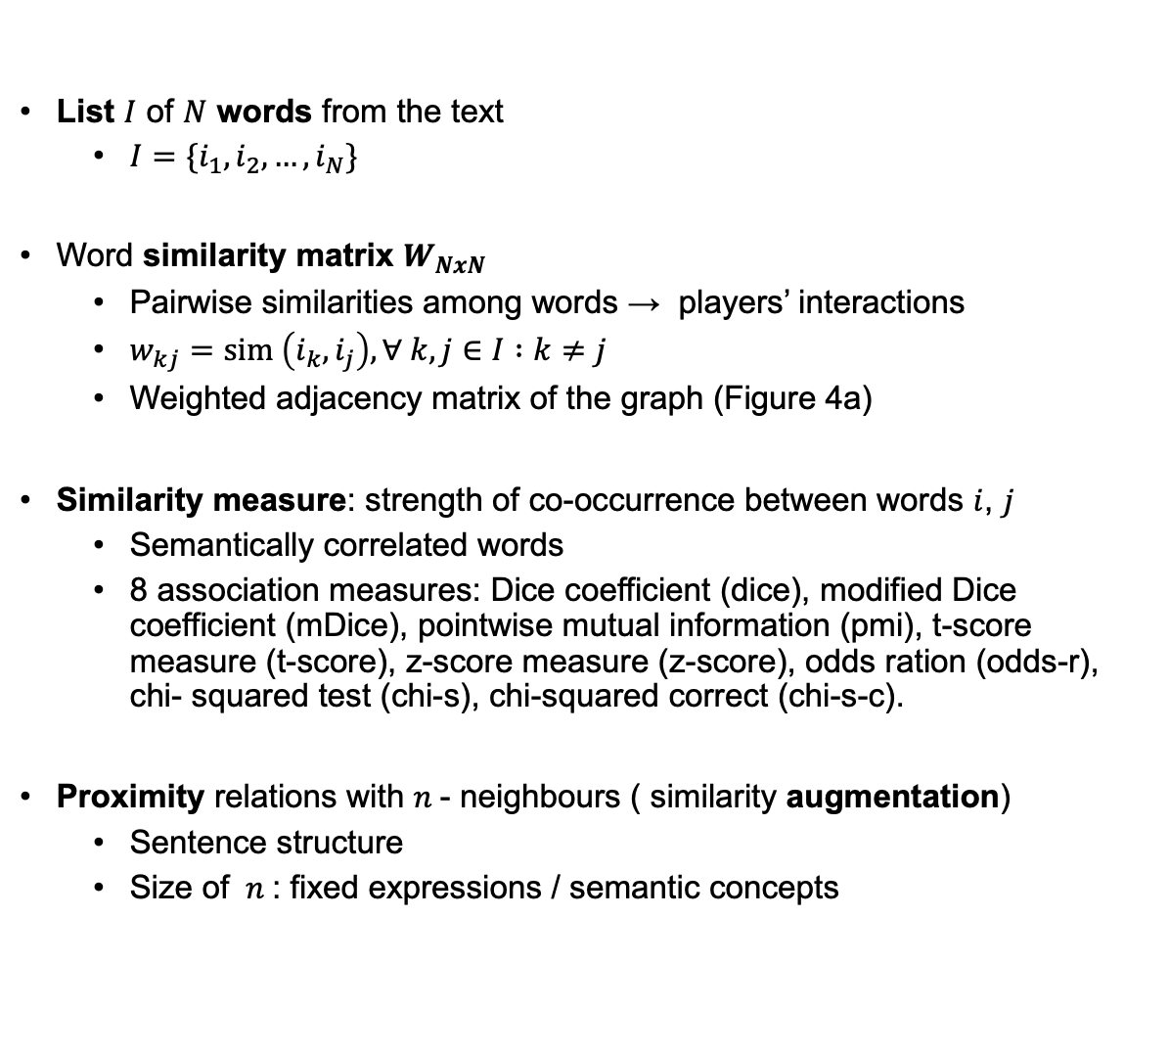
Data Geometry
List $I$ of $N$ words from the text
$I=\{i_{1}, i_{2}, …, i_{N}\}$
Word similarity matrix $W_{NxN}$
Pairwise similarities among words → players’ interactions
$w_{kj}=sim \left(i_{k},i_{j}\right), ∀ k,j∈I :k≠j$
Weighted adjacency matrix of the graph (Figure 4a)
Similarity measure: strength of co-occurrence between words $i$, $j$
Semantically correlated words
8 association measures: Dice coefficient (dice), modified Dice coefficient (mDice), pointwise mutual information (pmi), t-score measure (t-score), z-score measure (z-score), odds ration (odds-r), chi- squared test (chi-s), chi-squared correct (chi-s-c).
Proximity relations with $n$- neighbours ( similarity augmentation)
Sentence structure
Size of $n$: fixed expressions / semantic concepts

Slide 6
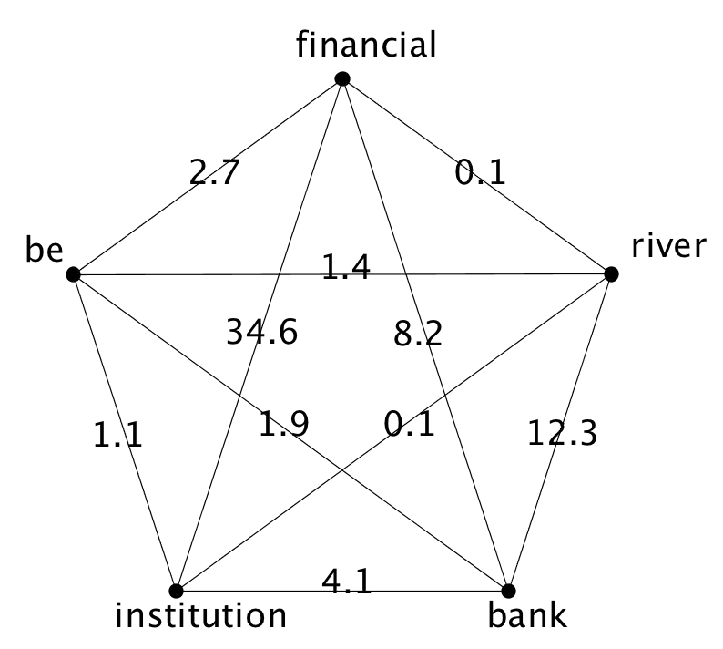
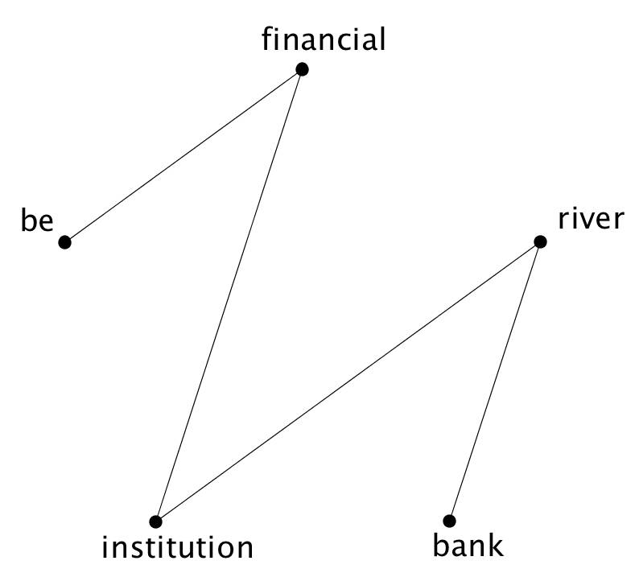
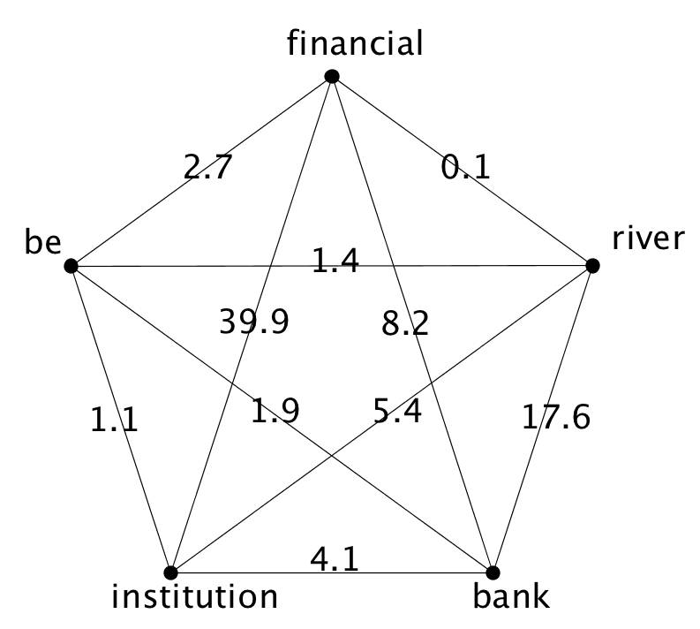
Data Geometry

Slide 7
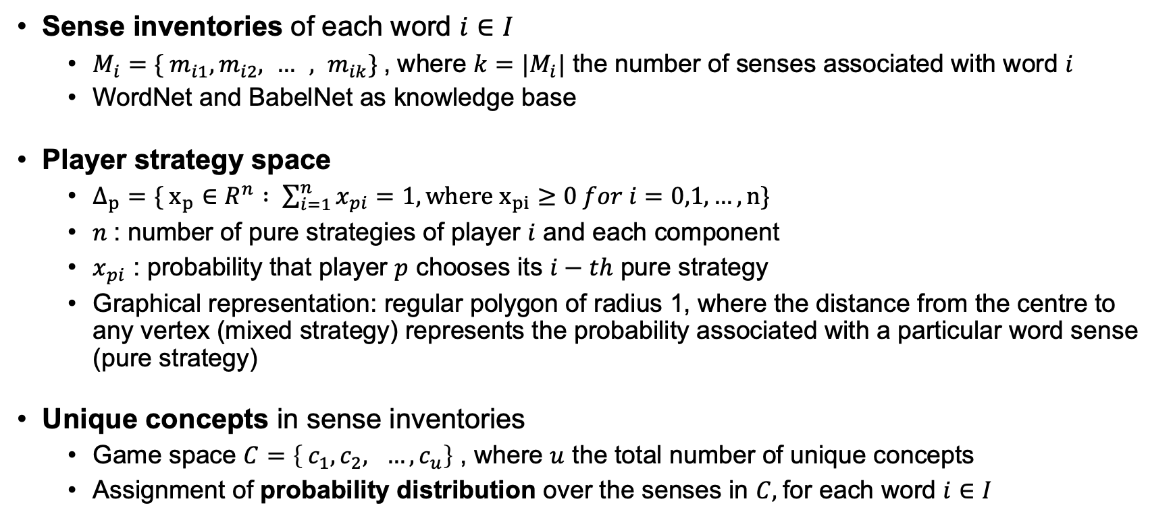
Strategy Space
Sense inventories of each word $i∈I$
$M_{i}=\{ m_{i1},m_{i2}, … , m_{ik}\}$, where $k=|M_{i}|$ the number of senses associated with word $i$
WordNet and BabelNet as knowledge base
Player strategy space
$Δ_{p}=\{ x_{p}∈R^{n} : \sum_{i=1}^{n}{x_{pi}}=1, where x_{pi}≥0 for i=0,1, …, n\}$
$n$: number of pure strategies of player $i$ and each component
$x_{pi}$ : probability that player $p$ chooses its $i−th$ pure strategy
Graphical representation: regular polygon of radius 1, where the distance from the centre to any vertex (mixed strategy) represents the probability associated with a particular word sense (pure strategy)
Unique concepts in sense inventories
Game space $C=\left\{ c_{1}, c_{2}, …, c_{u}\right\}$ , where $u$ the total number of unique concepts
Assignment of probability distribution over the senses in $C,$for each word $i∈I$

Slide 8
Strategy Space
Sense inventories of each word $i∈I$
$M_{i}=\{ m_{i1},m_{i2}, … , m_{ik}\}$, where $k=|M_{i}|$ the number of senses associated with word $i$
WordNet and BabelNet as knowledge base
Player strategy space
$Δ_{p}=\{ x_{p}∈R^{n} : \sum_{i=1}^{n}{x_{pi}}=1, where x_{pi}≥0 for i=0,1, …, n\}$
$n$: number of pure strategies of player $i$ and each component
$x_{pi}$ : probability that player $p$ chooses its $i−th$ pure strategy
Graphical representation: regular polygon of radius 1, where the distance from the centre to any vertex (mixed strategy) represents the probability associated with a particular word sense (pure strategy)
Unique concepts in sense inventories
Game space $C=\left\{ c_{1}, c_{2}, …, c_{u}\right\}$ , where $u$ the total number of unique concepts
Assignment of probability distribution over the senses in $C,$for each word $i∈I$

Slide 9
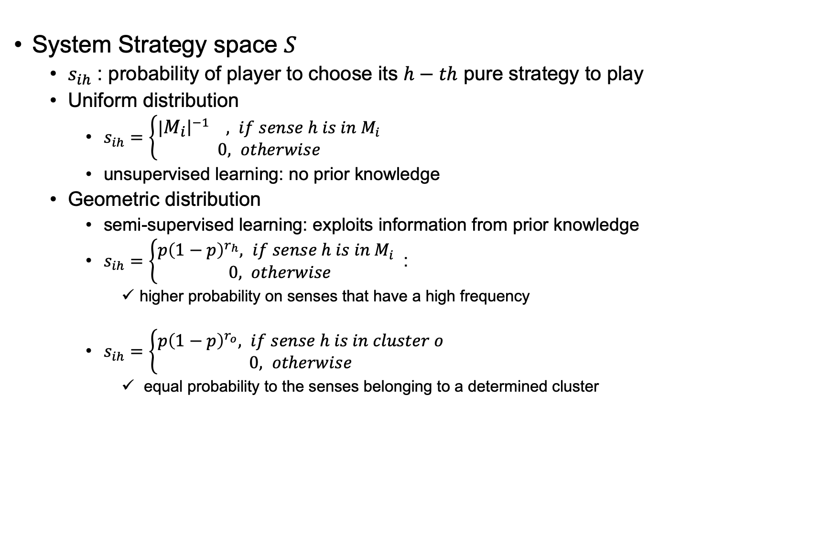
Strategy Space
System Strategy space $S$
$s_{ih}$ : probability of player to choose its $h−th$ pure strategy to play
Uniform distribution
$s_{ih}=\left\{\begin{aligned}|{\left.​M_{i}\right|}^{−1} , if sense h is in M_{i} \\ 0, otherwise\end{aligned}\right.$
unsupervised learning: no prior knowledge
Geometric distribution
semi-supervised learning: exploits information from prior knowledge
$s_{ih}=\left\{\begin{aligned}p{\left(1−p\right)}^{r_{h}}, if sense h is in M_{i} \\ 0, otherwise\end{aligned}\right.$ :
higher probability on senses that have a high frequency
$s_{ih}=\left\{\begin{aligned}p{\left(1−p\right)}^{r_{o}}, if sense h is in cluster o \\ 0, otherwise\end{aligned}\right.$
equal probability to the senses belonging to a determined cluster

Slide 10
Payoff
compute the sense similarity matrix Z among each pair of senses in C, which is then used to compute the partial payoff matrices of each game
zij= ssim(ii , ij), i,jI:ij
partial payoff matrix: single games played between two players i and j, Z_ij -> dim mxn, m, n senses of words i, j.
semantic similarity
relations of likeness (“is-a”)
wup: only the path length among two concepts (τύπος?!)
ssim(si, sj)= 2 ∗ depth(msa)/(depth(s_i) + depth(s_j))
ssim(si, sj)= IC(s_i) + IC(s_j) − 2IC(msa), where IC(c) = “information content - surprisal - of concept c” - IC(c)= -log_2(p(c))- and msa= “most specific ancestor node”
jcn measure: corpus statistics and structural properties (τύπος!?)

Slide 11
Payoff
semantic relatedness
similarity among the definitions of two concepts
Wider range of relations (“is-a-part-of”, “is-the-opposite-of”)
definitions derived from glosses of the synsets in WordNet
co-occurrence vector vi = (w1,i,w2,i...wn,i) (for each concept i, where w represents the number of times word w occurs in the gloss - n total words)
cosine similarity
ssim(si, sj) = vi vj ||vi|| ||vj||, where ||vi|| = j=1nwji (cosine of the angle between the two co-occurrence vectors
4 variations (way the gloss vectors are constructed)
difference in co-occurrence calculation, the corpus use, and relation source
tf-idf, tf-idf_ext, vec, and vec_ext.

Slide 12
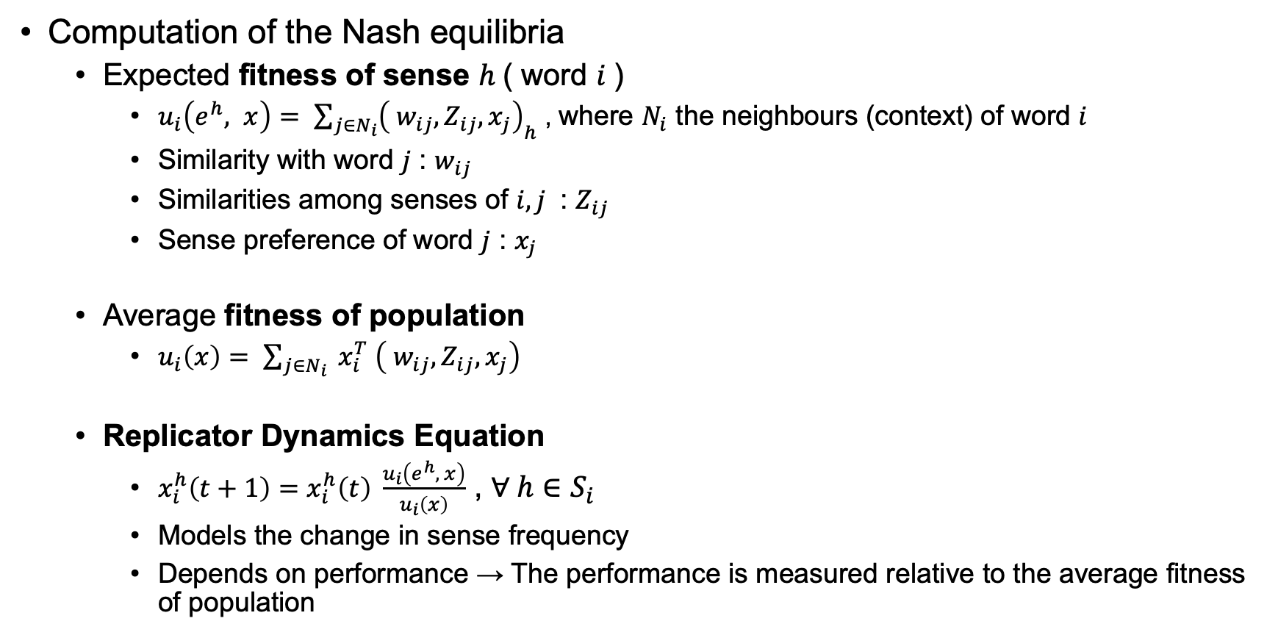
System Dynamics & Sense Classification
Computation of the Nash equilibria
Expected fitness of sense $h$( word $i$)
$u_{i}\left(e^{h}, x\right)= \sum_{j∈N_{i}}{{\left( w_{ij}, Z_{ij}, x_{j}\right)}_{h}}$ , where $N_{i}$ the neighbours (context) of word $i$
Similarity with word $j$ : $w_{ij}$
Similarities among senses of $i,j$ : $Z_{ij}$
Sense preference of word $j$ : $x_{j}$
Average fitness of population
$u_{i}\left(x\right)= \sum_{j∈N_{i}}{ x_{i}^{T} \left( w_{ij}, Z_{ij}, x_{j}\right)}$
Replicator Dynamics Equation
$x_{i}^{h}\left(t+1\right)=x_{i}^{h}\left(t\right) \frac{u_{i}\left(e^{h}, x\right)}{u_{i}\left(x\right)}$ , $∀ h∈S_{i}$
Models the change in sense frequency
Depends on performance → The performance is measured relative to the average fitness of population

Slide 13

System Dynamics & Sense Classification
Classification
Unique strategy $s∈S→$ each word $i∈I$
The strategy (sense) with the highest probability (payoff) is chosen
$φ_{i}=argmax\left( x_{ih} \right)$ , where $h=1, 2, …, \left|C\right|, \left|C\right|$ total number of senses
Each word $i∈I$ is mapped to exactly one sense $s∈S$
Word fails to be disambiguated
Unable to update its strategy space
Strategy space initialized with a uniform distribution
Zero entry payoff ( no similar senses with co-players)
Not connected with other nodes in the graph

Slide 14
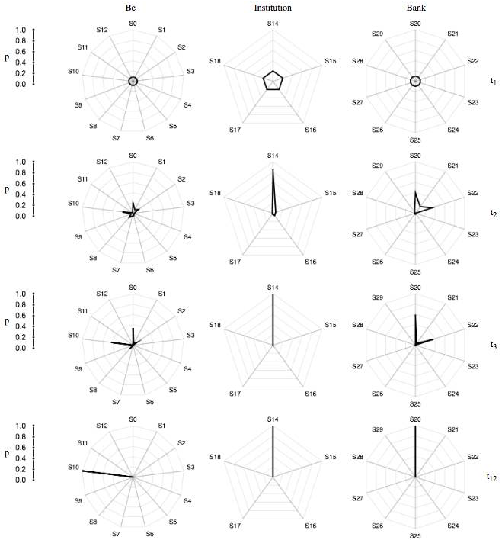
System Dynamics & Sense Classification

Slide 15
Parameter Tuning
Two data sets to evaluate our algorithm in different scenarios
From each data set
50 different data sets to simulate a situation in which the system must work on texts of different sizes and on different domains
The parameters that will be tuned:
Association and semantic measures to weight the similarity among word and senses
The n-gram graph to increase the weights of near words
The p of the geometric distribution used by their semi-supervised system

Slide 16
Parameter Tuning - Results
Association and Semantic Measures:
The relatedness measures perform significantly better than the semantic similarity measures
On average the best measures are dice and mdice
N-gram Graph:
Highest results on both data sets are tfidf -mdice, with n = 5
Geometric Distribution:
Parameter p = 0.4 (in a range from 0.4 to 0.7) in cases of semi-supervised learning→ the highest result

Slide 17
Evaluation set-up
Results are provided as F1 a measure that determines the weighted harmonic mean of precision and recall
Experiment with WordNet as Knowledge base:
The best performance on nouns on all the data sets
Low results on verbs on all data sets
The use of prior knowledge is beneficial in general domain data sets
Experiment with BabelNet as Knowledge base:
We used BabelNet to collect the sense inventories of each word to be disambiguated and NASARI to obtain the semantic representation of each sense
This data set contains highly ambiguous mentions

Slide 18
Comparison to state-of-the-art algorithms
WordNet:
Our unsupervised system performs better than any other unsupervised algorithm in all data sets
The performance of our system is more stable on the four data sets
The comparison with semi-supervised systems shows that our system always performs better than the most frequent sense heuristic when we use information from sense-labeled corpora
BabelNet:
The performance of our system is close to the results obtained with Babelfy on S13 and substantially higher on KORE50
It is also difficult to exploit distributional information on this data set because the sentences are short and, in many cases, cryptic. For these reasons, the recall on this data set is well below the precision: 55.5%

Slide 19
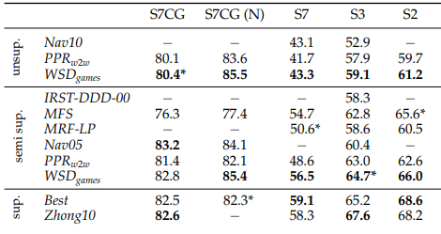
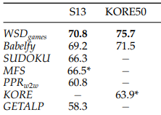
Comparison to state-of-the-art algorithms

