Slide 1
Marketplace Branching Strategy
Implementing a new branching strategy

Slide 2
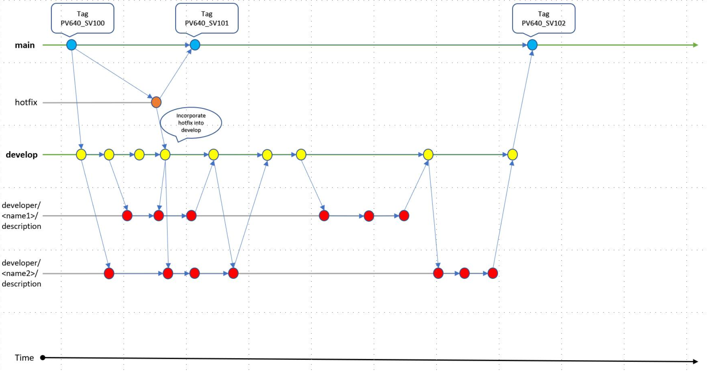

Slide 3
Why Branching Strategies Are Important
Branching and merging can be difficult with lots of developers and no standard for everyone to follow
Bad merges and late-stage integrations suck up developers' time, potentially delaying future work or releases
Optimize productivity
Enable parallel development
Provide a clear promotion path for software changes

Slide 4
Overview
1 long-lived branch; main
develop branch is created from main
developer branches are created from develop
main will always remain in a ready-to-deploy state
Tags are used in place of release branches
Tags are used on the main branch to identify releases and provide Release Notes
develop will contain the latest completed features
developer branches are short-lived branches and limited to a specific task

Slide 5
Rules
Anything in main is always deployable
Regularly pull and push your work to the developer branch
Using a pull request, discuss and review your code
After the list of approved reviewers has reviewed and signed off on the feature, it can be merged into develop
No direct commits on main
Perform code review before merges into main, not afterward
Commit messages to reflect the intent
All branches will follow the naming standards and be created in one of the following
main
develop
developer/
All branches outside of main will be short lived
When the developer branch is merged, the developer branch is immediately deleted.
When the develop branch is merged, the develop branch is immediately deleted.

Slide 6
Branch Naming
The 2 primary branches will be named main and develop
developer branches will start with developer/
Use personal identifier in developer branches
Use underscore or Slash as Separators
Avoid long descriptive names
By looking at the branch name, you can understand what this git branch is about and its purpose
EXAMPLE: developer/ocollazo/acm_pv630_sv102

Slide 7
Tags
Tags will be used on the main branch to mark release commits
Created after every feature and bug fix has been merged into main
Used as a point-in-time reference

Slide 8
Main Branch
This is a long-lived branch
The default branch
Named main
Main branch will always be in a production ready state
Stores official release history
All commits to main should be tagged with a version number
When a release is completed, this will be the only remaining branch

Slide 9
Develop Branch
This is a short-lived branch
Create from main
Named develop
Restricts developers from making any changes in the master branch directly
Developers will regularly push and pull from this branch
Serves as an integration branch for other branches
All supporting branches should be created from develop
Contains the complete history of the project
When a release is completed, a PR will be entered to merge into main

Slide 10
Developer Branch
This is a short-lived branch
Create from develop
Named developer/PersonalIdentifier/branch_name
When a release is completed, a PR will be entered to merge into main
When a topic is completed, a PR is submitted and merged into develop
This branch is manually deleted after each release

Slide 11
Advantages
Main branch remains in a clean deployable state
Short-lived branches keep branching clean
Ensures code quality and eliminates bugs early
Provides a close review of code
Opportunity for multiple testing cycles
Builds upon the current workflow strategy
It is a simple branching strategy

Slide 12
Disadvantages
Multiple branches and pull requests reduce development speed
Pull requests could lead to extensive micromanagement
A well documented and understood merge strategy is required to reduce commit history

