Slide 1
Static Application Security Testing:
SAST Best Practices
April 2021

Slide 2
What is Static Code Analysis?
The process of evaluating a system or component based on its form, structure, content, or documentation. From a software assurance perspective, static analysis finds weaknesses in program code that might lead to vulnerabilities. This type of analysis may be manual, as in code inspections, or automated through the use of one or more tools. Automated static code analyzers check source code for specific defects as well as for compliance with various coding standards.

Slide 3
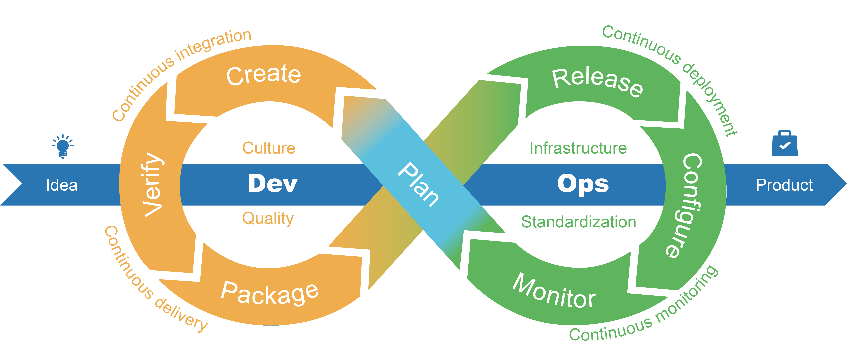
When to perform Static Code Analysis?
Static code analysis is performed early in development, before software testing begins.
Performed as part of a Code Review.
Static code analysis takes place during the “Create” phase.

Slide 4
How often to perform Static Code Analysis?
Client-side static code analysis should occur as code is written
As part of the daily build
Prior to any PR being approved

Slide 5
Identify our goals
GOALS | REQUIREMENTS
Increase efficiency in development process | Fix only most critical defects Improve software maintainability/reduce complexity Review code more frequently
Leverage tool to find and fix defects earlier for continuous integration | Run tools daily Address all defects before code check in
Document compliance for customers | Fix all defects reported Provide documentation of code compliance Tune the tools to specific coding standards
Improve security | Tune tools for vulnerabilities such as buffer overflows Use CERT compliance checks Ensure all security defects are documented and fixed
Increase quality | Review all results from tools Fix all critical defects
Increase reliability of software | Tune tools to find memory allocation issues Test all code paths

Slide 6
Limitations
False Positives
False Negatives
No Understanding of Developer Intent
Rules That Aren’t Statically Enforceable
Notes:
False Positives
The tool reports a possible vulnerability that in fact is not.
The tool cannot be sure of the integrity and security of data as it flows through the application from input to output
False Negatives
The tool cannot validate external integrations

Slide 7
Summary
Run scans as part of our daily build
Fix defects early in the process
Embed static analysis as part of the software development process
Integrate with source code management and build tools
Minimize time between code editing and defect reporting
Address problems as they are discovered
Development process should allocate enough time to address issues
Require a passing scan as prerequisite for a release
Avoid becoming the bottleneck
Developers should utilize sonarlint
Notes:
The longer the delay the higher chances are that developers will forget the details of the code they wrote.

Slide 8
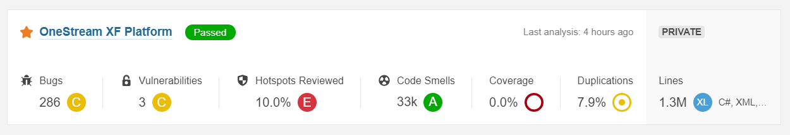
SonarQube Questions
Should we have more than a single SonarQube Project?

Slide 9
Links of interest
http://docs.media.bitpipe.com/io_12x/io_129893/item_1297562/WP7_Static_Analysis_ImplementationGuide.pdf
https://www.perforce.com/blog/sca/what-static-analysis
https://polcode.com/blog/best-practices-in-static-code-analysis/
https://owasp.org/www-community/controls/Static_Code_Analysis
https://www.sonarlint.org/

